Slide 1


AI Agents in the Data Pipeline
Craig West
https://craig-west.netlify.app/
https://evaluating-ai-agents.com/
Talk Slides and Repo:
https://github.com/Python-Test-Engineer/earl2025
This also contains links to a video of the BrighonPy talk/workshop on
‘AI as API’ and the repo for the PyData Southampton Meetup ‘AI Agents in
The Data Pipeline’ as well as additional resources.

Slide 2
Desired Outcomes
To better understand the Agent Landscape, its terminology, basis and uses.
To see the uses of AI Agents in the Data Pipeline and the likely future of Data Pipeline applications.
This is a ‘fly by’ rather than ‘deep dive’. The repo has more detailed examples and links to help you go further and deeper.

Slide 3


Raw code implementation of an Agent
No more difficult than what we do currently – just 180 degrees different
“It doesn’t get any easier – just different” - Anon

Slide 4
Agenda (1)
With code examples where appropriate:
AI Agents from scratch
Tool/Function calling
Agentic Patterns
Demos

Slide 5
Agenda (2)
With code examples where appropriate:
Image Analysis
Agents that write code to carry out ETL, Data Analysis
MCP – Model Context Protocol
A2A – Agent to Agent protocol
Full demo using Cline in VSCode to create full app

Slide 6


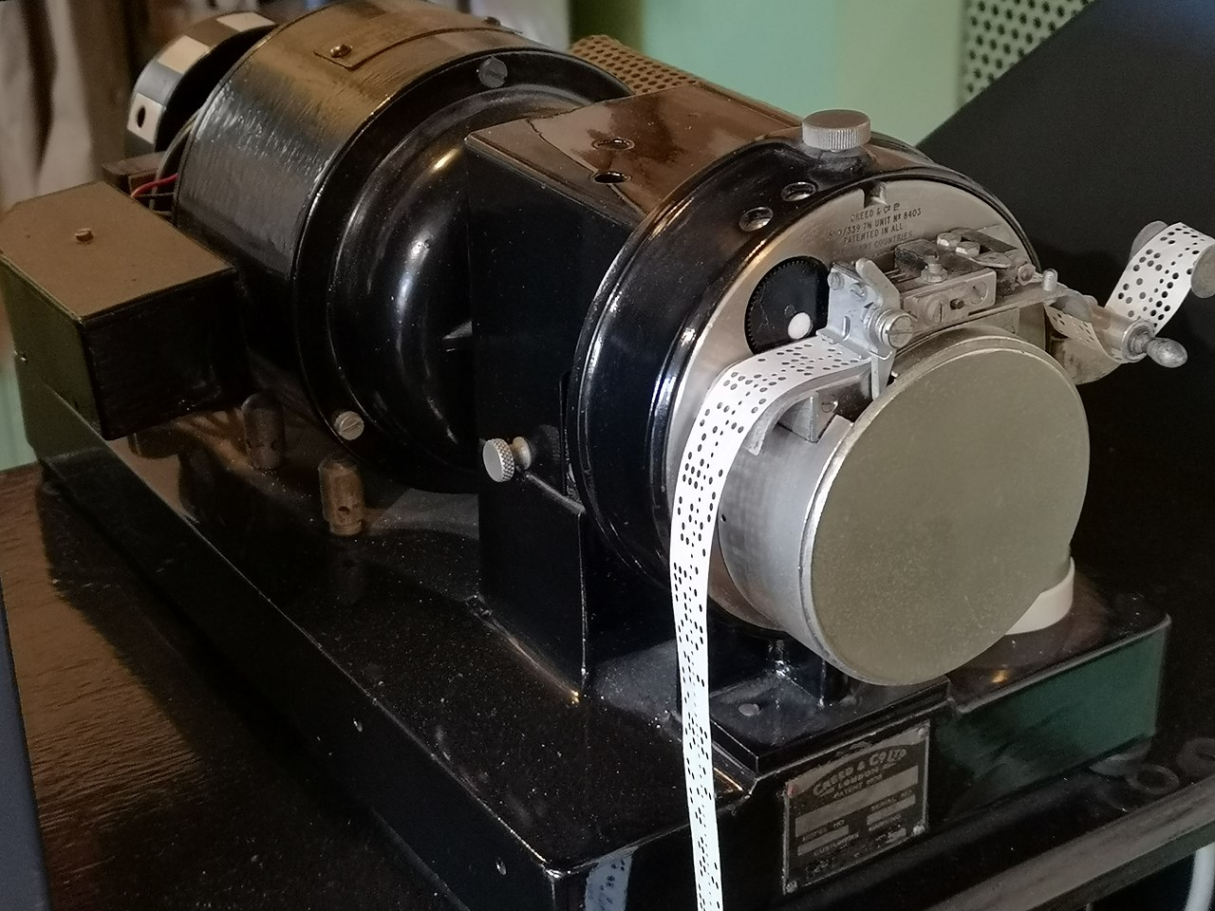

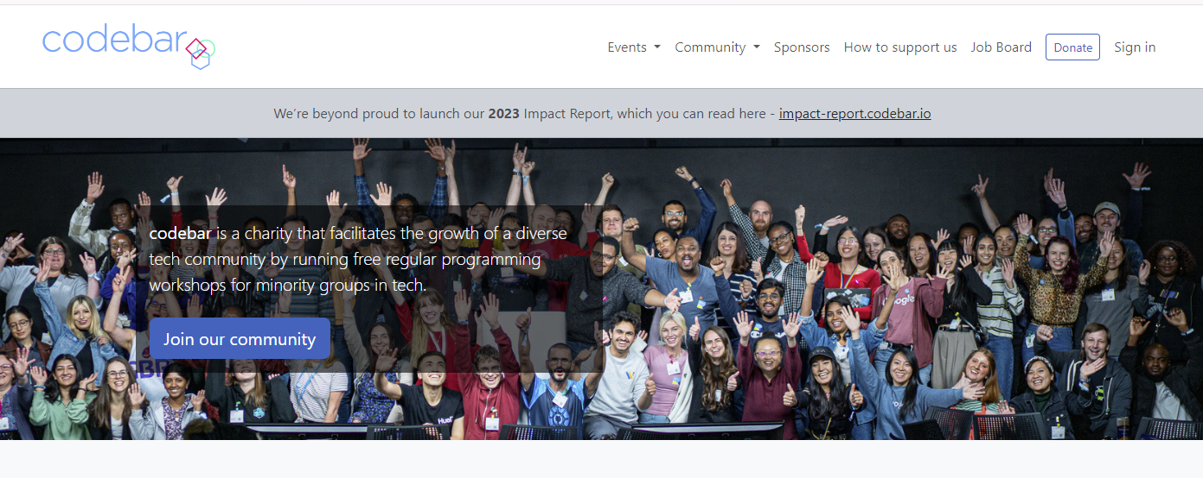
About me
codebar.io/brighton – basis
for some of the examples in
this talk…

Slide 7
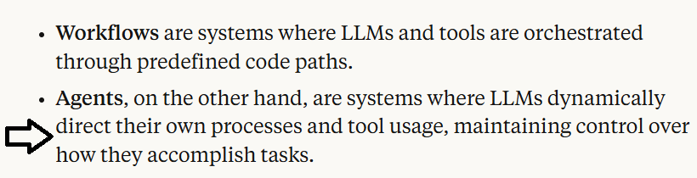
What is an AI Agent?
Many definitions and people opt for ‘Agentic Apps’
Anthropic

Slide 8
What is a Agentic?
It is like…an email
One endpoint
Payload of instructions and context (info)

Slide 9
What is Agentic?
Tell me about Data Analytics…
Tell me about Data Analytics and how it can help me with sales analysis for the last quarter…
“I need more info…”

Slide 10
What is Agentic?
Tell me about Data Analytics and here is some data…
This is context engineering where we supply appropriate context for the Agent.

Slide 11
What is Agentic?
Tool/Function Calling – adding more context/info
Tell me about Data Analytics and here is some data…
Also compare our share price with {company X}…
We don’t know this information at time of request as it will vary with each query.
We need a tool/function the Agent can use to get the share price… “tool/function calling”

Slide 12

What is Agentic?
INITIAL PROMPT: Tell me about Data Analytics and here is some data…Also compare our share price with {company X}…
Here is a tool you might need “get_share_price”
If you need it, return: {“tool”:“get_share_price”, “args”: “X”}
I will then run this function and give you the value…
Whole thread is sent…as if for the first time…like an email thread.

Slide 13
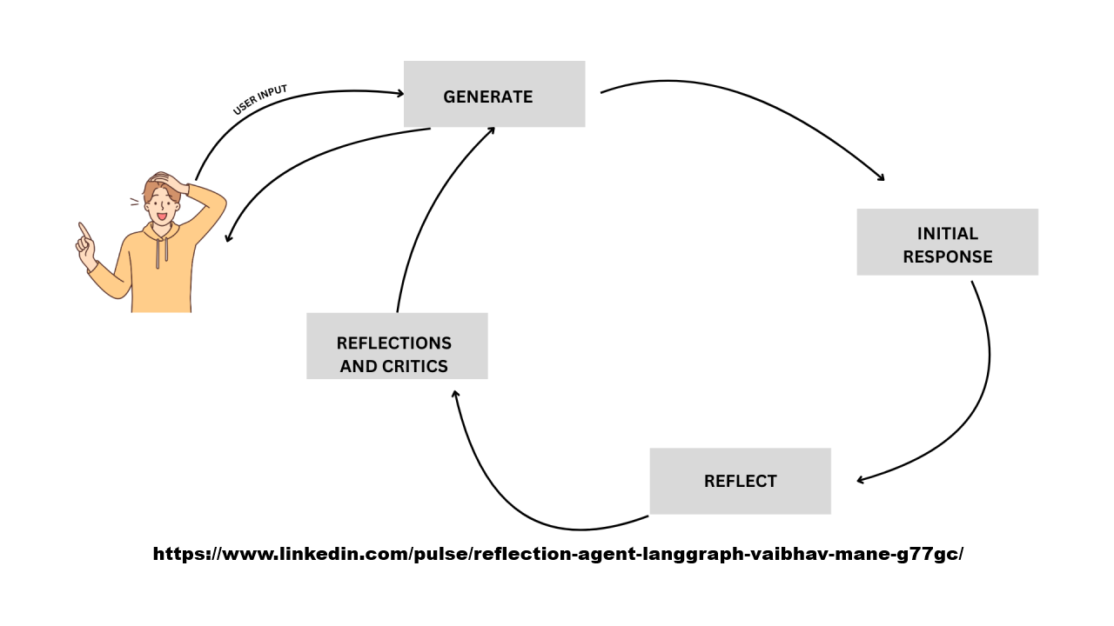
What is Agentic?
This is the REFLECTION pattern (looping):

Slide 14
Raw code implementation of an Agent
Post a set of instructions and additional information (context) to an API
Single API
We send instructions in Natural Language
There is not official way to write instructions but clear, complete and with examples are key as we would give to an ‘intern’
Pro-tip: save understanding to offline
Let’s look at 01_demo_api.ipynb in the repo…

Slide 15
What is Tool/Function calling?
In our INSTRUCTIONS we can add:
Here are some useful tools/functions that may be of help at run time.
Let me know which you want to run and with what arguments.
I will run them on my machine and then send this extra CONTEXT back to you (reflection which we see later)
03_demo_tools_calulate_gross_price.ipynb
But first next slide has a diagram…

Slide 16
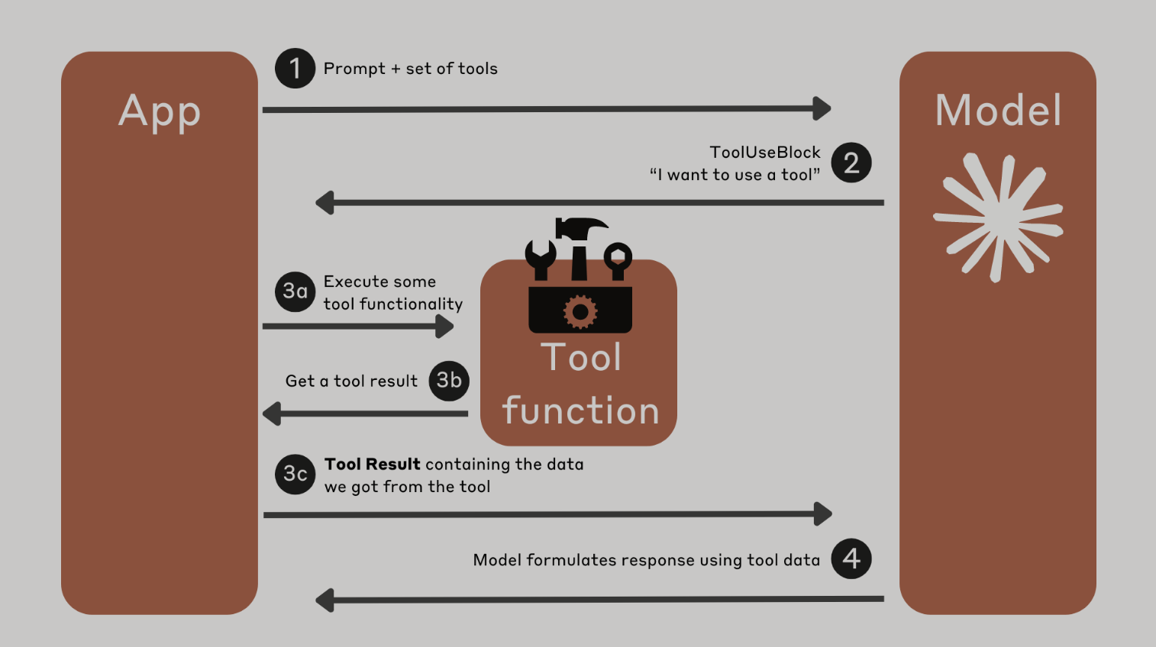
What is Tool/Function calling?

Slide 17
What is the Model Context Protocol (MCP)?
We have seen how we can write tools for the Agent to discover and call as needed.
What about tools others have created?
How can an Agent discover what tools are available, how to use them with what ever arguments are needed and how to execute them?
This is Model Context Protocol.
In essence, an Agent can find a list of tools we have given it, with these tools able to inform Agent how to use them.
The Agent runs the pipx to download and run them in a separate process.

Slide 18
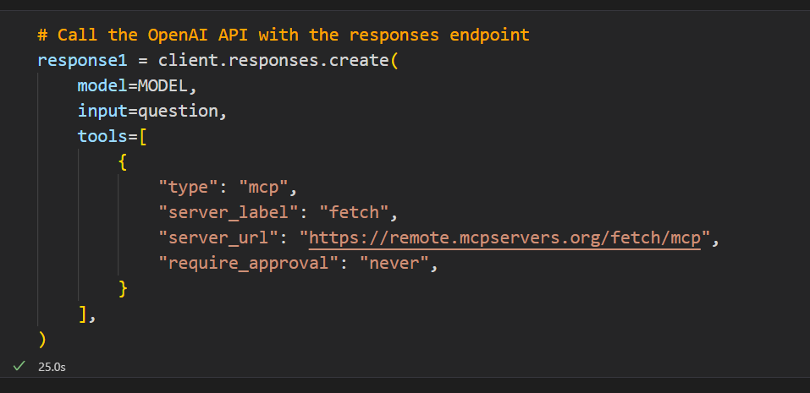
What is the Model Context Protocol (MCP)?
https://mcpservers.org/servers/modelcontextprotocol/fetch

Slide 19
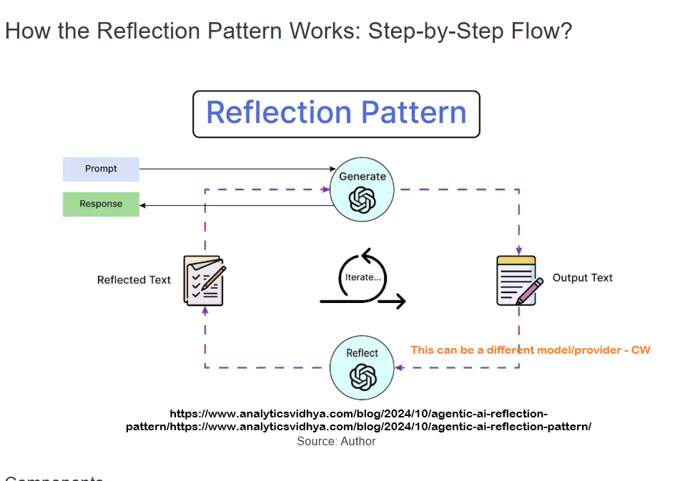
Agentic Patterns (1)
04_demo_reflection.ipynb

Slide 20
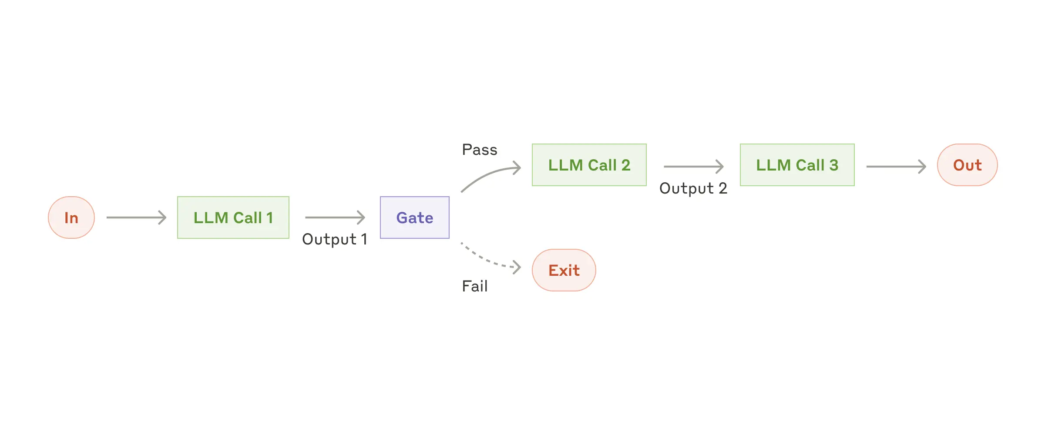
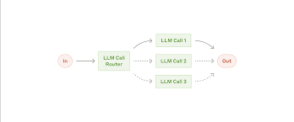
Agentic Patterns (2)
https://www.anthropic.com/engineering/building-effective-agents

Slide 21
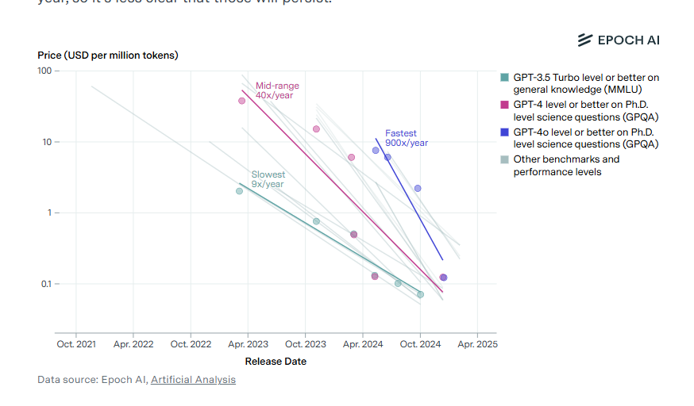
Model costs

Slide 22
What is the Agent2Agent Protocol (A2A)?
A complimentary protocol to allow one Agent to discover and understand what another Agent does.
It can then hand off work to the other Agent to get a desired response.
It might seem that tools, MCP, A2A are all similar!
At the end of the day Python is variables and code…all objects and essentially variations on functions.
Protocols, like HTTP for example, are implementations to enable communication between bits of code.
Next…an example from Google…

Slide 23
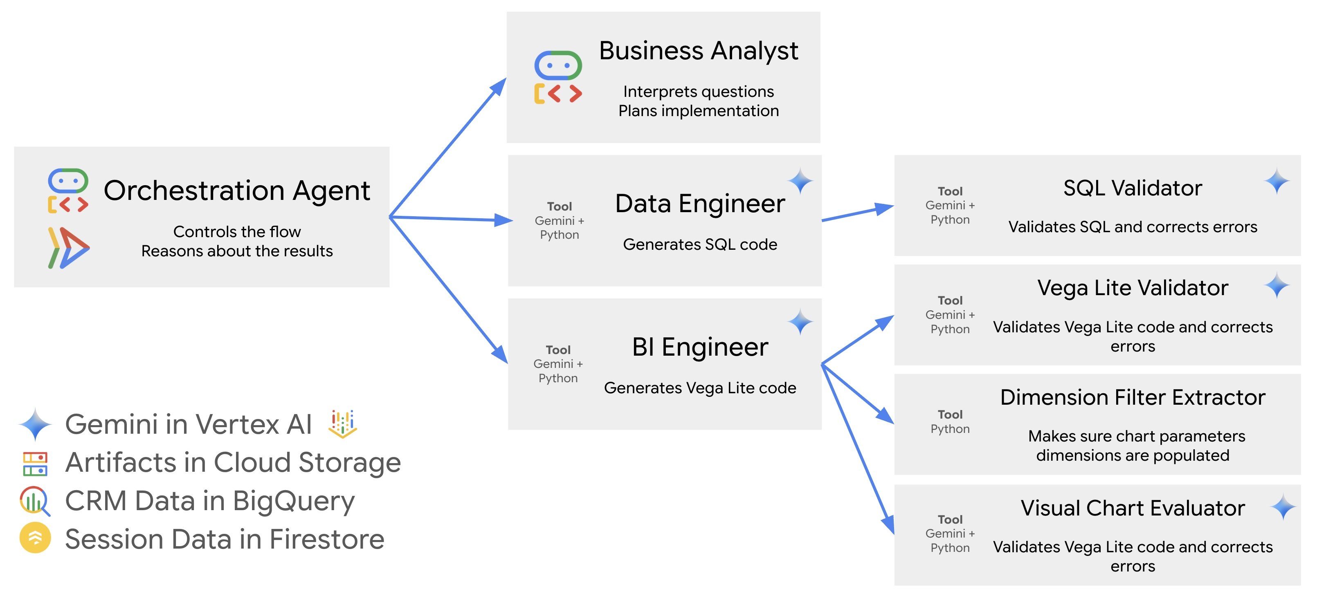
Google CRM Agent (1)

Slide 24
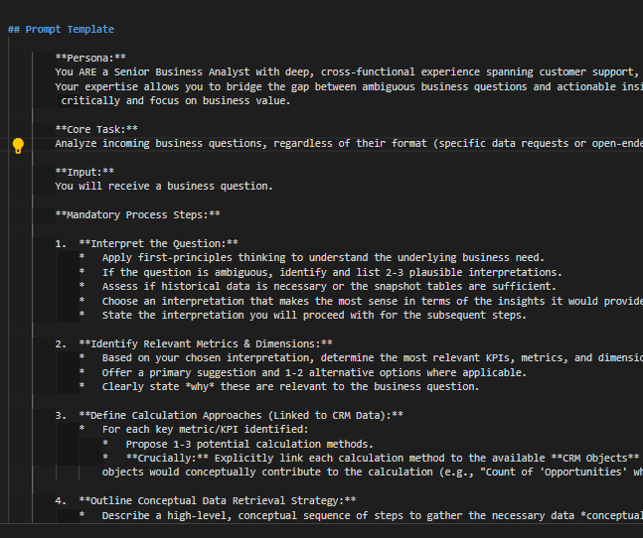
Google CRM Agent (2)
https://github.com/vladkol/crm-data-agent/blob/main/src/agents/data_agent/prompts/crm_business_analyst.py
06_demo_prompt_google_crm.md
We can learn a lot about best
practices for Context Engineering by
looking at big tech repos.

Slide 25
A complete demo (1)
Using Cline to create a complete pipeline…in practice devs do it bit by bit.
Let’s look at an example…

Slide 26
A complete demo (2)
CLAUDE:
create a simple sales csv with just 5 rows
sales_data = [
['Date', 'Product', 'Quantity', 'Unit_Price', 'Total'],
['2024-01-15', 'Laptop', 2, 999.99, 1999.98],
['2024-01-16', 'Mouse', 5, 29.99, 149.95],
['2024-01-17', 'Keyboard', 3, 79.99, 239.97],
['2024-01-18', 'Monitor', 1, 299.99, 299.99],
['2024-01-19', 'Headphones', 4, 149.99, 599.96]
]
CLINE:
“I have a CSV for some sales data. Make a simple ETL and data analysis programme for it to show plots and graphs.”
IN DEMO: I will add…
[“There is a folder already called `sales_etl_analysis` - please ignore and start afresh”]

Slide 27
Summary
It has been 3 years since ChatGPT was released.
The 6 months from arranging this talk to doing it is a very long time in AI with great changes in that time.
The next 6 months/1 year/2 years?
Craig West
https://craig-west.netlify.app/
https://evaluating-ai-agents.com/
https://github.com/Python-Test-Engineer/earl2025

