Slide 1

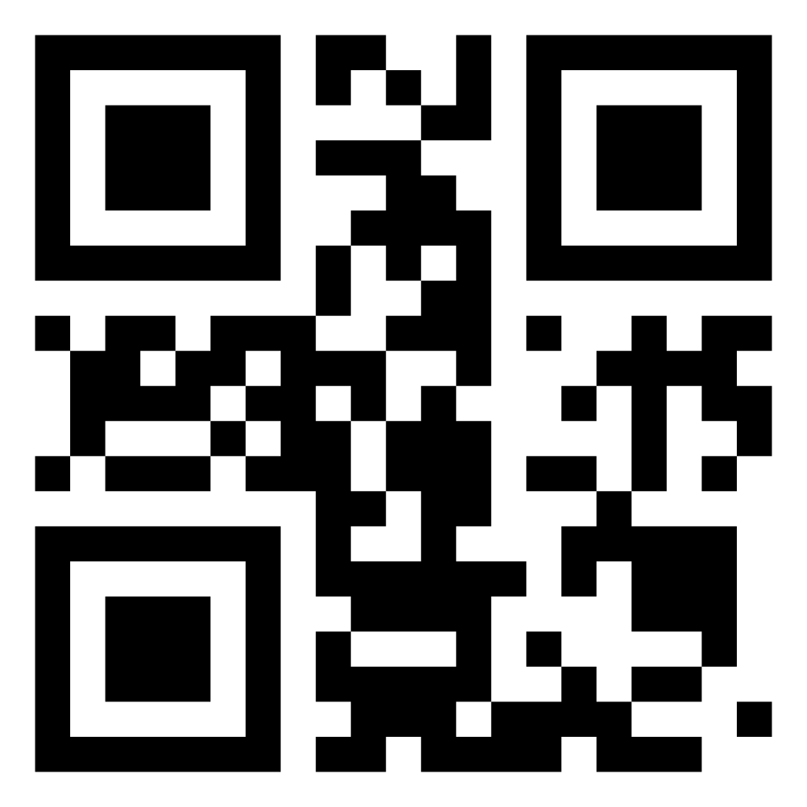
AI Agents in the Data Pipeline
Craig West
https://craig-west.netlify.app/
https://evaluating-ai-agents.com/
Talk Slides and Repo:
https://github.com/Python-Test-Engineer/earl2025

Slide 2
Desired Outcomes
To better understand the Agent Landscape, its terminology, basis and uses.
To see the uses of AI Agents in the Data Pipeline and the likely future of Data Pipeline applications.
This is a ‘fly by’ rather than ‘deep dive’. The repo has more detailed examples and links to help you go further and deeper.

Slide 3
Agenda (1)
With code examples where appropriate:
AI Agents from scratch
Tool/Function calling
Agentic Patterns
Reporting

Slide 4
Agenda (2)
With code examples where appropriate:
Text2SQL
Image Analysis
Agents that write code to carry out ETL, Data Analysis
MCP – Model Context Protocol
A2A – Agent to Agent protocol

Slide 5
About me
First computer…
Live in Brighton with Leo…
Evaluating AI Agents
Codebar.io/brighton – basis for some of the examples…

