Slide 1


AI Agents in the Data Pipeline
Craig West
https://craig-west.netlify.app/
https://evaluating-ai-agents.com/
Talk Slides and Repo:
https://github.com/Python-Test-Engineer/earl2025
This also contains links to a video of the BrighonPy talk/workshop on
‘AI as API’ and the repo for the PyData Southampton Meetup ‘AI Agents in
The Data Pipeline’ as well as additional resources.

Slide 2
Desired Outcomes
To better understand the Agent Landscape, its terminology, basis and uses.
To see the uses of AI Agents in the Data Pipeline and the likely future of Data Pipeline applications.
This is a ‘fly by’ rather than ‘deep dive’. The repo has more detailed examples and links to help you go further and deeper.

Slide 3
Agenda (1)
With code examples where appropriate:
AI Agents from scratch
Tool/Function calling
Agentic Patterns
Text2SQL

Slide 4
Agenda (2)
With code examples where appropriate:
Image Analysis
Agents that write code to carry out ETL, Data Analysis
MCP – Model Context Protocol
A2A – Agent to Agent protocol
Full demo using Cline in VSCode to create full app

Slide 5


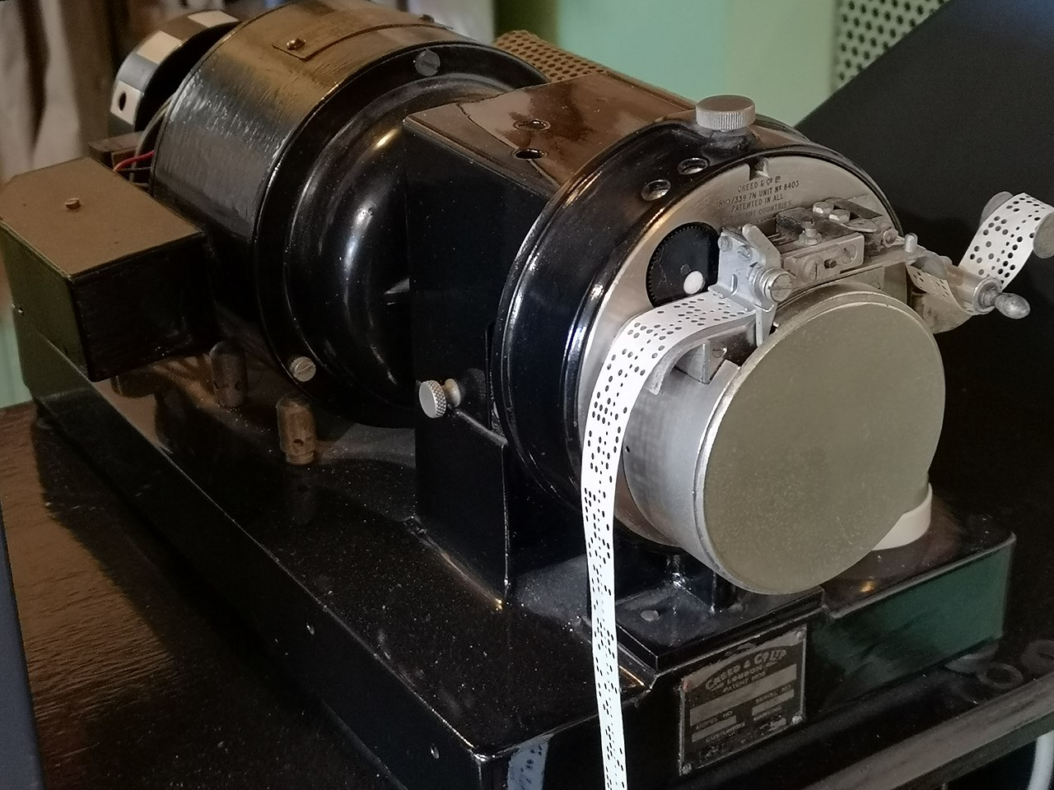

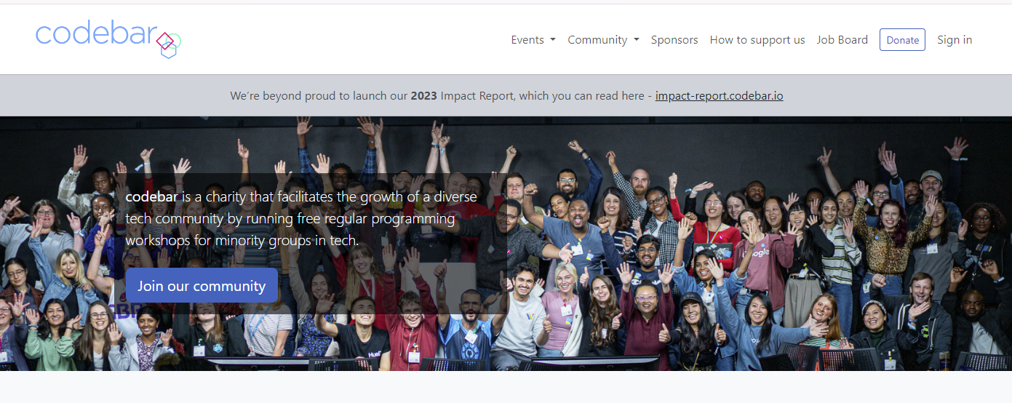
About me
codebar.io/brighton – basis
for some of the examples in
this talk…

Slide 6
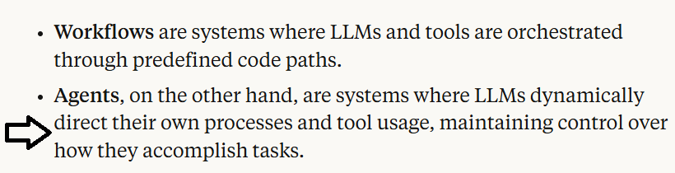
What is an AI Agent?
Many definitions and people opt for ‘Agentic Apps’
Anthropic

Slide 7
What is Prompt/Context Engineering?
Prompt Engineering is going out of fashion and people opt for Context Engineering and In Context Learning.
We create a set of instructions and add additional information to a request we send to the LLM.
Just one API – our programming code is on our side and in Natural Language.

Slide 8


Raw code implementation of an Agent
No more difficult than what we do currently – just 180 degrees different
“It doesn’t get any easier – just different” - Anon

Slide 9
Raw code implementation of an Agent
Post a set of instructions and additional information (context) to an API
Single API
We send instructions in Natural Language
There is not official way to write instructions but clear, complete and with examples are key as we would give to an ‘intern’
Pro-tip: save understanding to offline
Let’s look at 01_demo_api.ipynb in the repo…

Slide 10
What is Tool/Function calling?
In our INSTRUCTIONS we can add:
Here are some useful tools/functions that may be of help at run time.
Let me know which you want to run and with what arguments.
I will run them on my machine and then send this extra CONTEXT back to you (reflection which we see later)
03_demo_tools_calulate_gross_price.ipynb
But first next slide has a diagram…

Slide 11
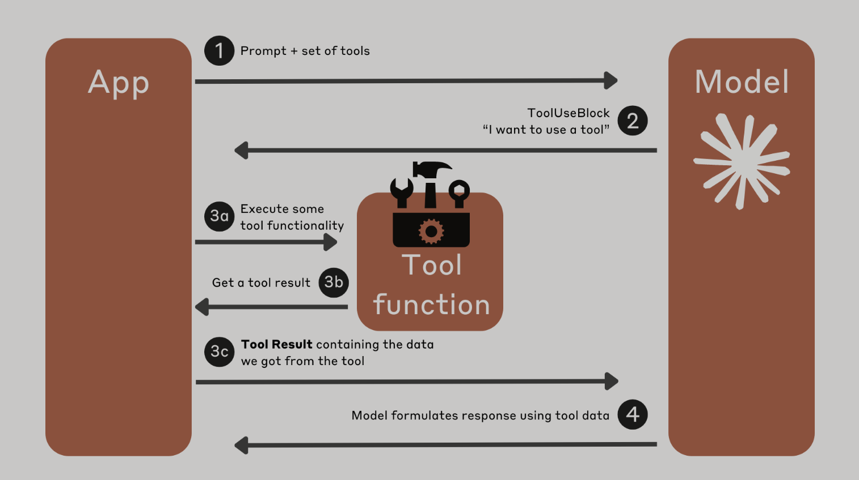
What is Tool/Function calling?

Slide 12
What is the Model Context Protocol (MCP)?
We have seen how we can write tools for the Agent to discover and call as needed.
What about tools others have created?
How can an Agent discover what tools are available, how to use them with what ever arguments are needed and how to execute them?
This is Model Context Protocol.
In essence, an Agent can find a list of tools we have given it, with these tools able to inform Agent how to use them.
The Agent runs the pipx to download and run them in a separate process.

Slide 13
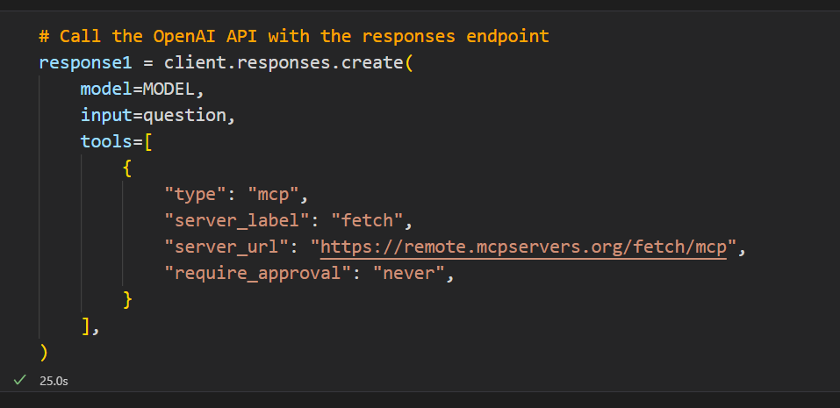
What is the Model Context Protocol (MCP)?
https://mcpservers.org/servers/modelcontextprotocol/fetch

Slide 14
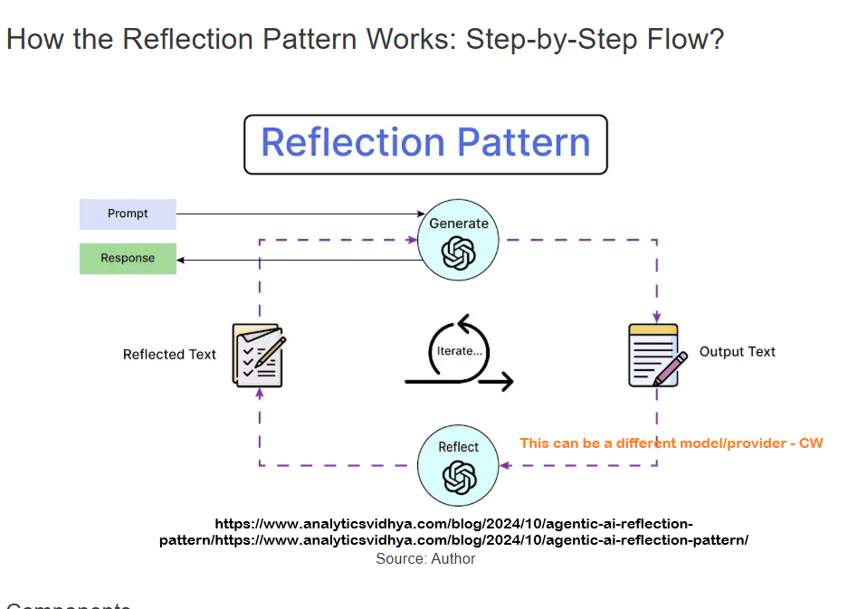
Agentic Patterns (1)
04_demo_reflection.ipynb

Slide 15
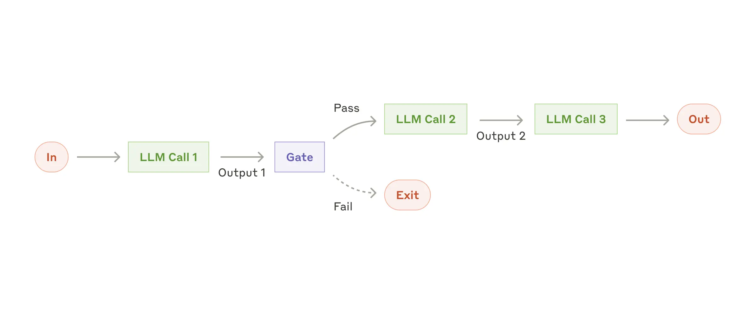
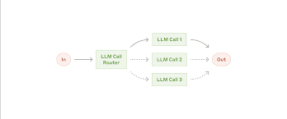
Agentic Patterns (2)
https://www.anthropic.com/engineering/building-effective-agents

Slide 16
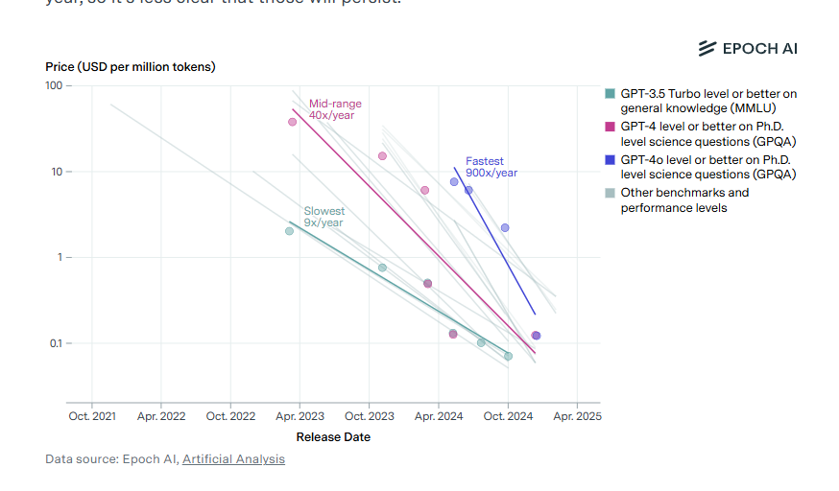
Model costs

Slide 17
What is the Agent2Agent Protocol (A2A)?
A complimentary protocol to allow one Agent to discover and understand what another Agent does.
It can then hand off work to the other Agent to get a desired response.
It might seem that tools, MCP, A2A are all similar!
At the end of the day Python is variables and code…all objects and essentially variations on functions.
Protocols, like HTTP for example, are implementations to enable communication between bits of code.
Next…an example from Google…

Slide 18
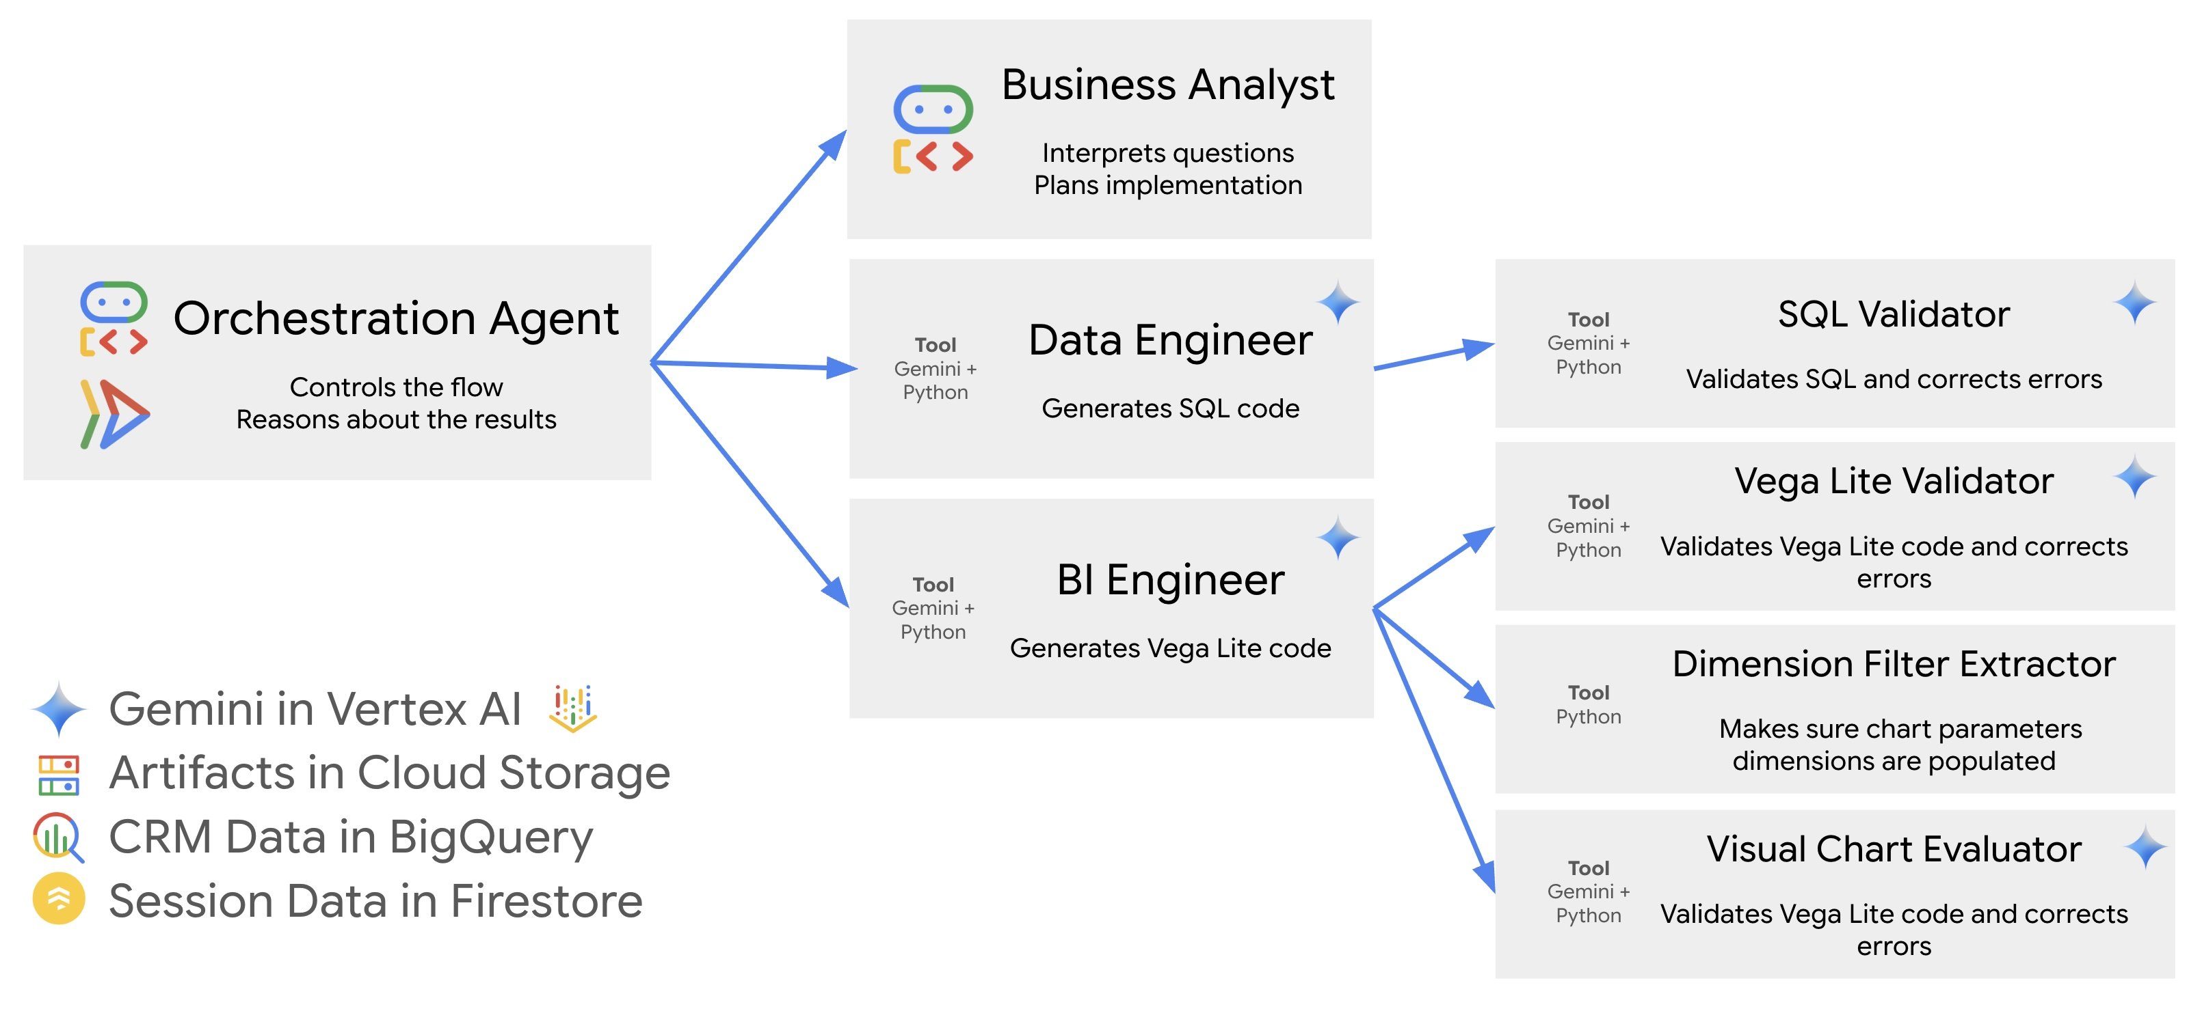
Google CRM Agent (1)

Slide 19
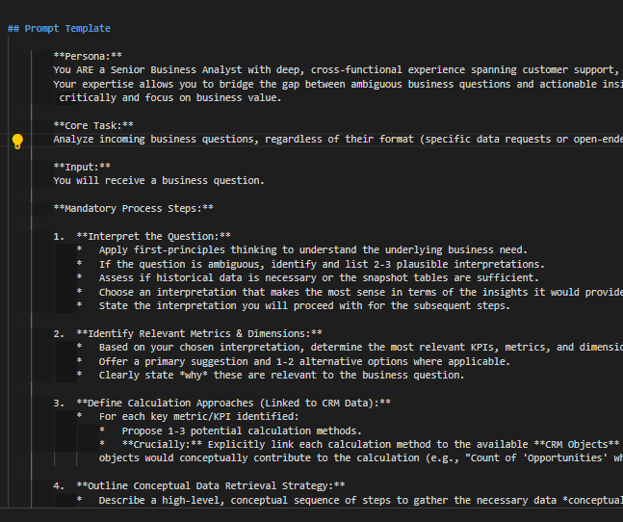
Google CRM Agent (2)
https://github.com/vladkol/crm-data-agent/blob/main/src/agents/data_agent/prompts/crm_business_analyst.py
06_demo_prompt_google_crm.md
We can learn a lot about best
practices for Context Engineering by
looking at big tech repos.

Slide 20
A complete demo (1)
Using Cline to create a complete pipeline…in practice devs do it bit by bit.
Let’s look at an example…

Slide 21
A complete demo (2)
CLAUDE:
create a simple sales csv with just 5 rows
sales_data = [
['Date', 'Product', 'Quantity', 'Unit_Price', 'Total'],
['2024-01-15', 'Laptop', 2, 999.99, 1999.98],
['2024-01-16', 'Mouse', 5, 29.99, 149.95],
['2024-01-17', 'Keyboard', 3, 79.99, 239.97],
['2024-01-18', 'Monitor', 1, 299.99, 299.99],
['2024-01-19', 'Headphones', 4, 149.99, 599.96]
]
CLINE:
“I have a CSV for some sales data. Make a simple ETL and data analysis programme for it to show plots and graphs.”
IN DEMO: I will add…
[“There is a folder already called `sales_etl_analysis` - please ignore and start afresh”]

Slide 22
Summary
It has been 3 years since ChatGPT was released.
The 6 months from arranging this talk to doing it is a very long time in AI with great changes in that time.
The next 6 months/1 year/2 years?
Craig West
https://craig-west.netlify.app/
https://evaluating-ai-agents.com/
https://github.com/Python-Test-Engineer/earl2025

