Slide 1


Breaking the Black Box - Evals
Craig West
https://craig-west.netlify.app/
https://evaluating-ai-agents.com/
Contains links for slides and eval-framework
Everything in this talk is included

Slide 2



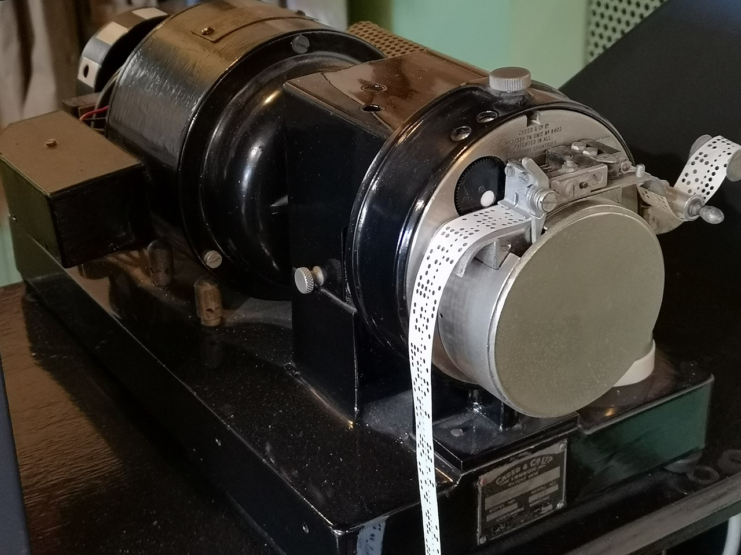
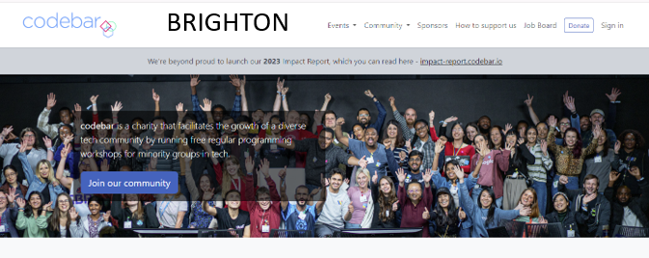
About me

Slide 3
My desired outcome
Not for you to fully understand Evals
But…
That Evals are doable
There are useful resources available for you
Demystify and simplify what an Agent is
There will be some slides and then we will dive into the code and manual (website).

Slide 4


180-degree shift
No more difficult than what we do currently – just 180 degrees different
“It doesn’t get any easier – just different” - Anon

Slide 5
But I don’t use Agents!
Perhaps not now, but it might be that your app is required to use Natural Language, (text, voice) from the user as the front end.
You might use or incorporate ready made 3rd party software that is Agentic as in the next two slides…
or use Model Context Protocol/Agent2Agent in your ‘app’.
Or need to make an MCP Server
It may be helpful to understand what Agents are as they seem to crop up everywhere.

Slide 6
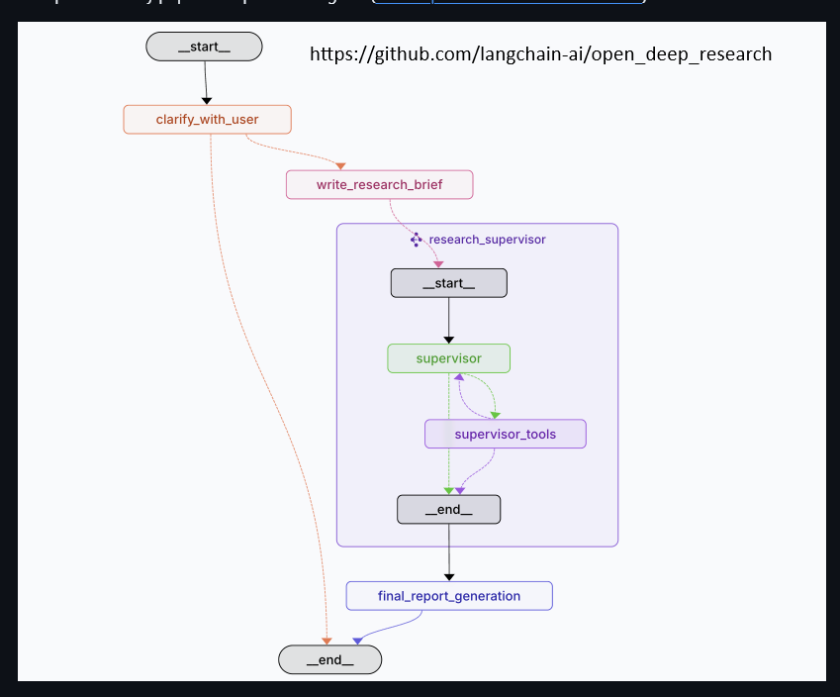
Langchain Deep Research Agent
A top performing Deep Research Agent based on certain open benchmarks.
https://github.com/langchain-ai/open_deep_research

Slide 7
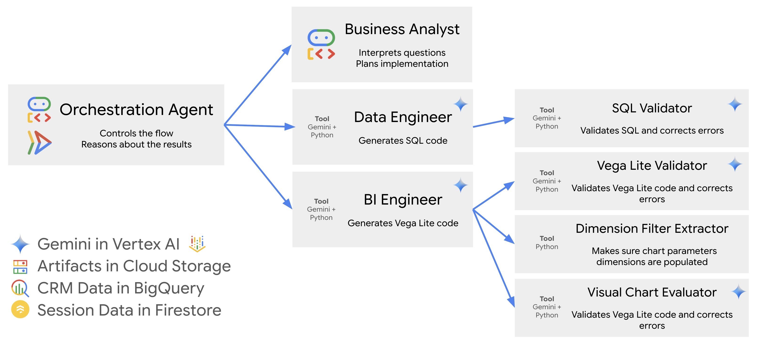
Google CRM Agent
https://github.com/vladkol/crm-data-agent/blob/main/src/agents/data_agent/prompts/crm_business_analyst.py
https://www.youtube.com/watch?v=2-AJszogj7Y

Slide 8
Why Evals?
Ensure TRUST and CAPABILITIES of our AGENTS so that somebody will pay for them.
Would you pay for a substandard product?
Excellence in an evaluator will rub off on developer prompt code.
Can we save £ if we use a different LLM?

Slide 9
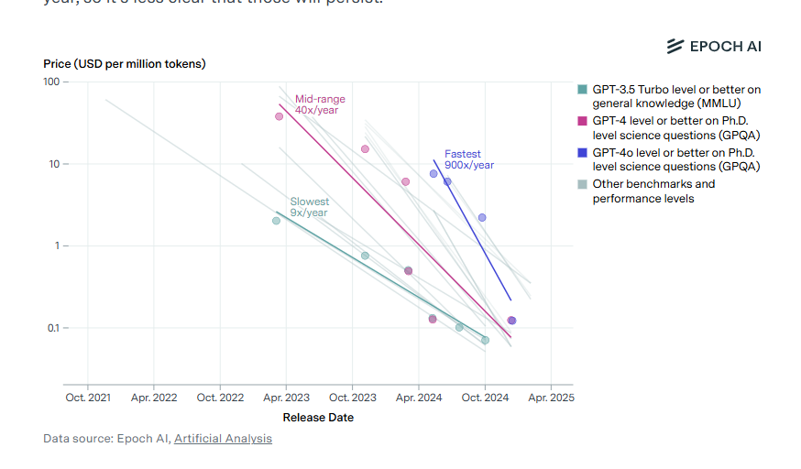
Model costs
Cost of a unit of ‘intelligence has dropped ~ 99% in last two years and is 10x a year (anecdotal)

Slide 10

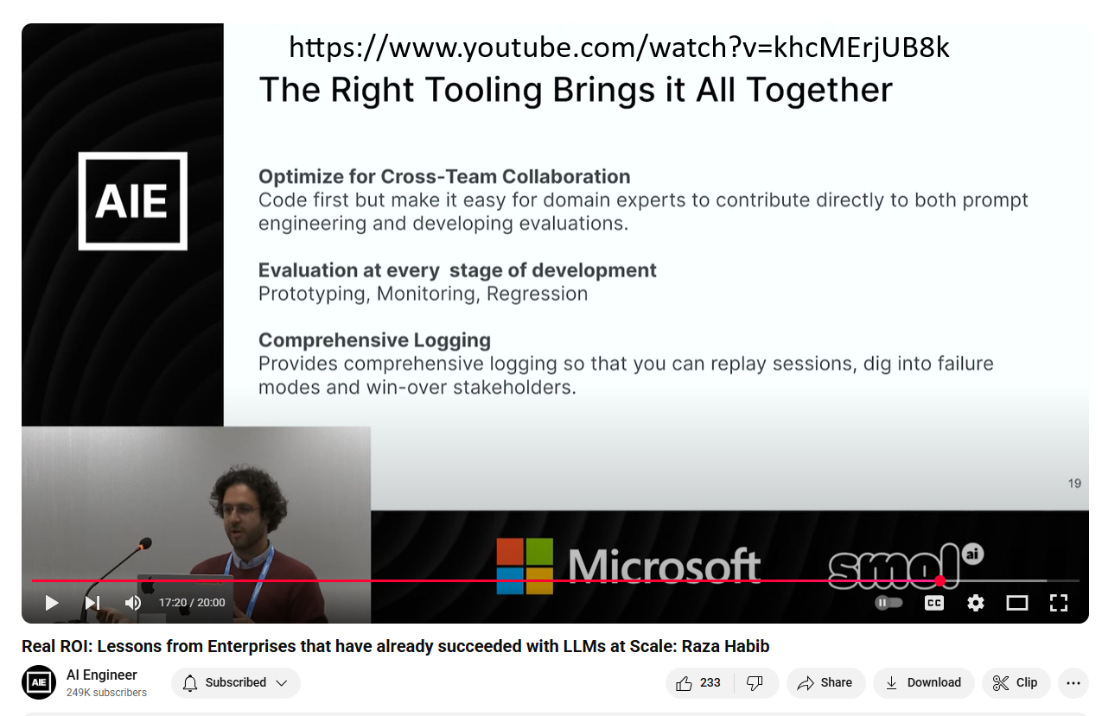
When to use Evals?
.
If we are to design and build an F1 race car, we might need a set of specs to develop, test and monitor against.
Raza Habib is the CEO and Cofounder of Humanloop
Acquired by Anthropic

Slide 11
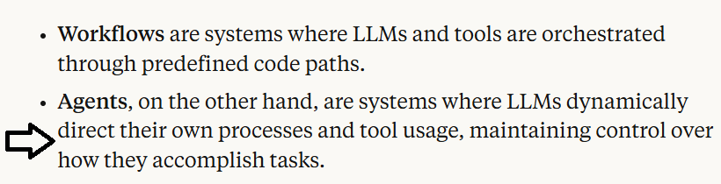
What is an AI Agent?
Many definitions and people opt for ‘Agentic Apps’
Anthropic

Slide 12
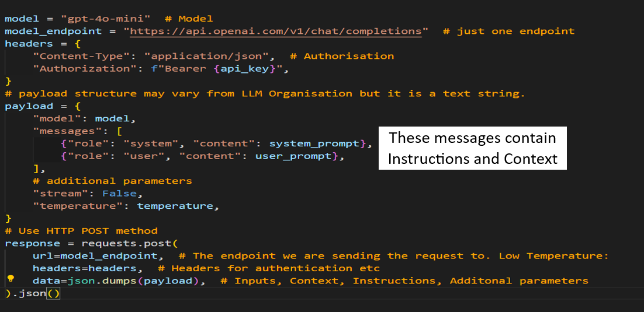

API

Slide 13
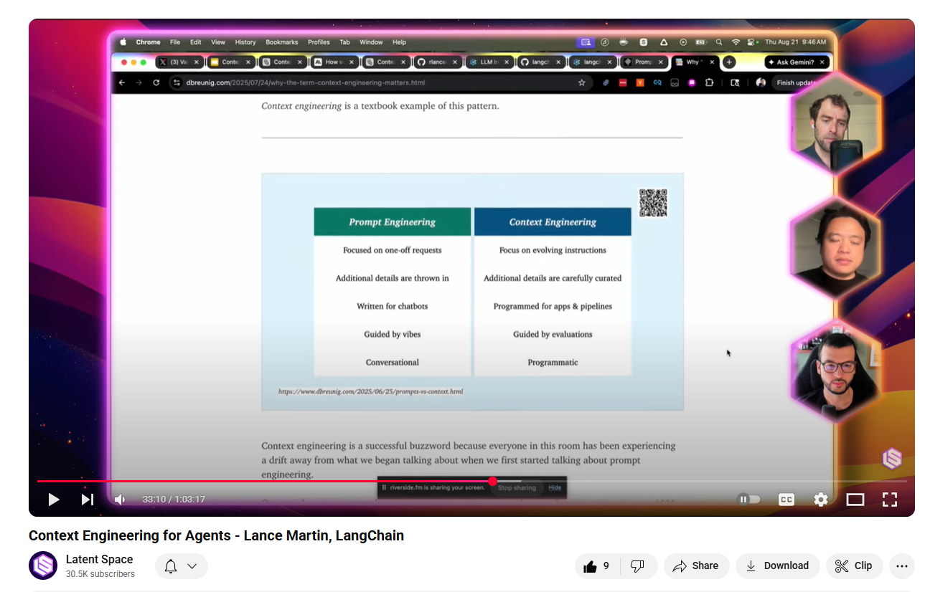
What is Prompt/Context Engineering?

Slide 14
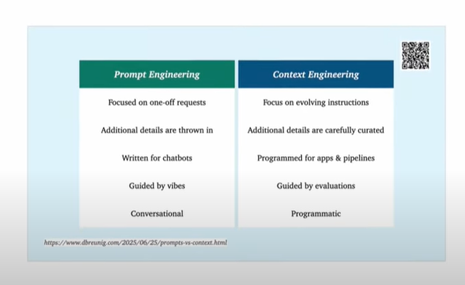
What is Prompt/Context Engineering?

Slide 15
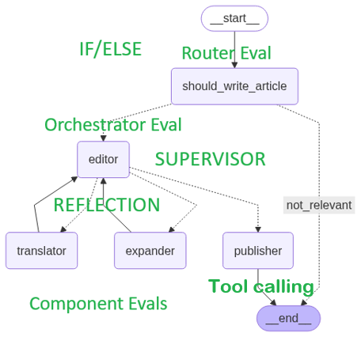
Where to start? What to do?
We will look at Case Study 1 in the manual and framework.
Given an article title, determine if it is about AI.
Take title and create article of N words (EXPANDER)
In a specified language (TRANSLATOR)
Ensure article is not sensational (EDITOR)
Publisher determines prices with dependent tools (TOOL CALLING) – calculate price and then categorise this price.
GOTO PUBLISH = YES only if 1,2 and 3 are YES
This app could be a leaf of a larger app.

Slide 16
A possible workflow
We build our app with a basic prompt “Write an article on {TOPIC} of around {N} words in language {LANGUAGE}.”
We test manually during dev.
It all works mechanistically.
Now lets progress…

Slide 17
A possible workflow
We decide to add a simple to see what cusomers like.
We notice that users like:
Bullet points – Abstract - Conclusion

Slide 18
A possible workflow
We change our prompt to include these features.
However, only 2% of users give feedback so we decide to use Human Evaluators to give feedback as well as label articles as ‘good article’ etc.

Slide 19
A possible workflow
We need to draft up guidelines on what an article should contain, its structure and other ways an article is ‘good’.
This exercise further helps our LLM app prompt, and we refine it.

Slide 20
A possible workflow
We can only handle/afford a small percentage, so we decide to use an LLM as Judge.
Seems illogical but is actually very effective. An uncalibrated bitof code calibrating another
With our original prompt and our human evaluator guidelines we write a prompt for this LLM Judge. We can now process a much greater percentage online and offline.
It is better than our app! We refine our app prompt…

Slide 21
A possible workflow
Now that we are looking at our data, we see that sometimes the app offers financial advice.
We must prevent this (guardrails) so we create an LLM as Judge that detects if this article had financial advice.
It saves many problems…

Slide 22
A possible workflow
Now that we have a robust way of evaluating our app, we can start to tinker:
Different models in different places for cost reduction yet same performance?
Does one part of the app give greater benefit for unit of change than another?
Can we reduce latency without breaking anything (regression testing)
Offer a client dashboard of filtered metrics to our clients in real time? They have entrusted us with their business.
Process not tools.

Slide 23
Demo – our app from earlier
We will look at Case Study 1 in the manual and framework.
Given an article title, determine if it is about AI.
Take title and create article of N words (EXPANDER)
In a specified language (TRANSLATOR)
Ensure article is not sensational (EDITOR)
Publisher determines prices with dependent tools (TOOL CALLING) – calculate price and then categorise this price.
GOTO PUBLISH = YES only if 1,2 and 3 are YES
This app could be a leaf of a larger app.

Slide 24
Summary Key Points
Evals are tests we carry out in the same way we would in tradional software development.
We need to look at the data to determine what are EVAL criteria are
We need to determine what success will look like
We will need humans at certain points
We need a Domain Expert
LLM Judges are primarily for scaling
We need to do EVALS on these LLM Judges
Process more important than tools

Slide 25
Craig West
https://craig-west.netlify.app/
https://evaluating-ai-agents.com/
Catching 915 train to Brighton so I can’t stay
Afterwards but you can contact me whilst
on train and we can text/call.
Contact links on the sites
Always have 10 mins to answer questions…

