Slide 1


Breaking Black Box - Evals
Craig West
https://craig-west.netlify.app/
https://evaluating-ai-agents.com/
Contains links for slides and eval-framework
Everything in this talk is included

Slide 2
My desired outcome
Not for you to fully understand Evals
But…
That Evals are doable
There are useful resources available for you
Demystify and simplify what an Agent is
There will be some slides and then we will dive into the code and manual (website).

Slide 3



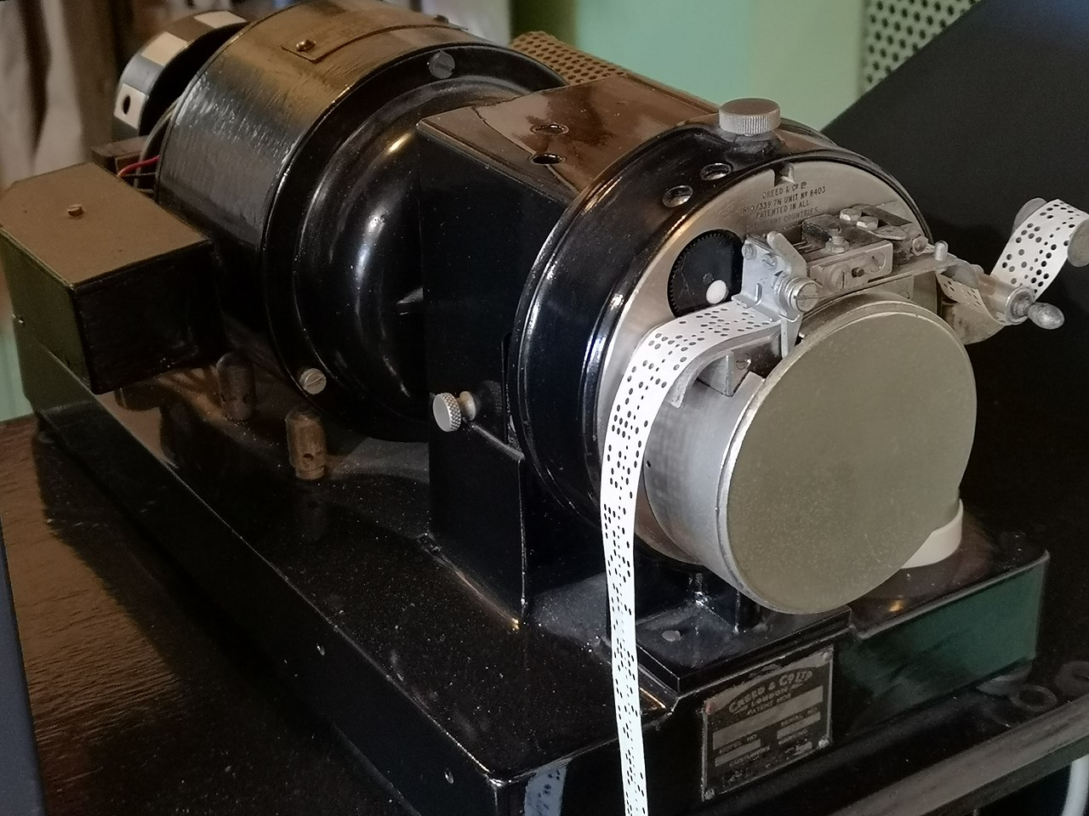
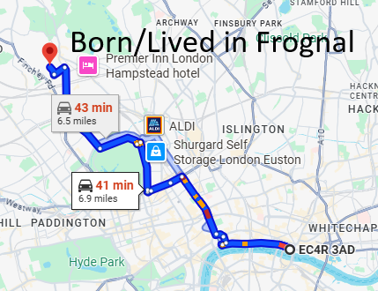
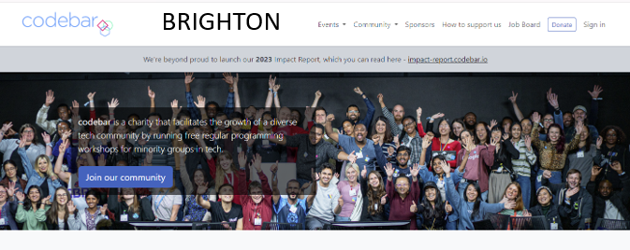
About me

Slide 4
Why Evals?
Ensure TRUST and CAPABILITIES of our AGENTS so that somebody will pay for them.
Would you pay for a substandard product?
Excellence in an evaluator will rub off on developer prompt code.
Can we save £ if we use a different LLM?

Slide 5
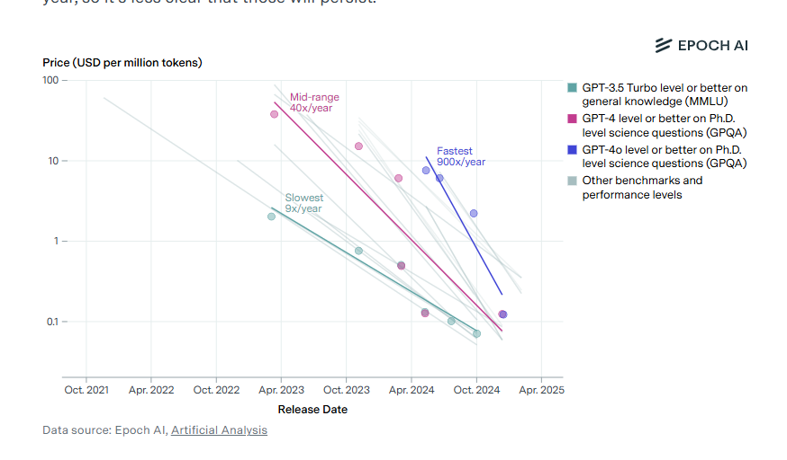
Model costs
Cost of a unit of ‘intelligence has dropped ~ 99% in last two years and is 10x a year (anecdotal)

Slide 6
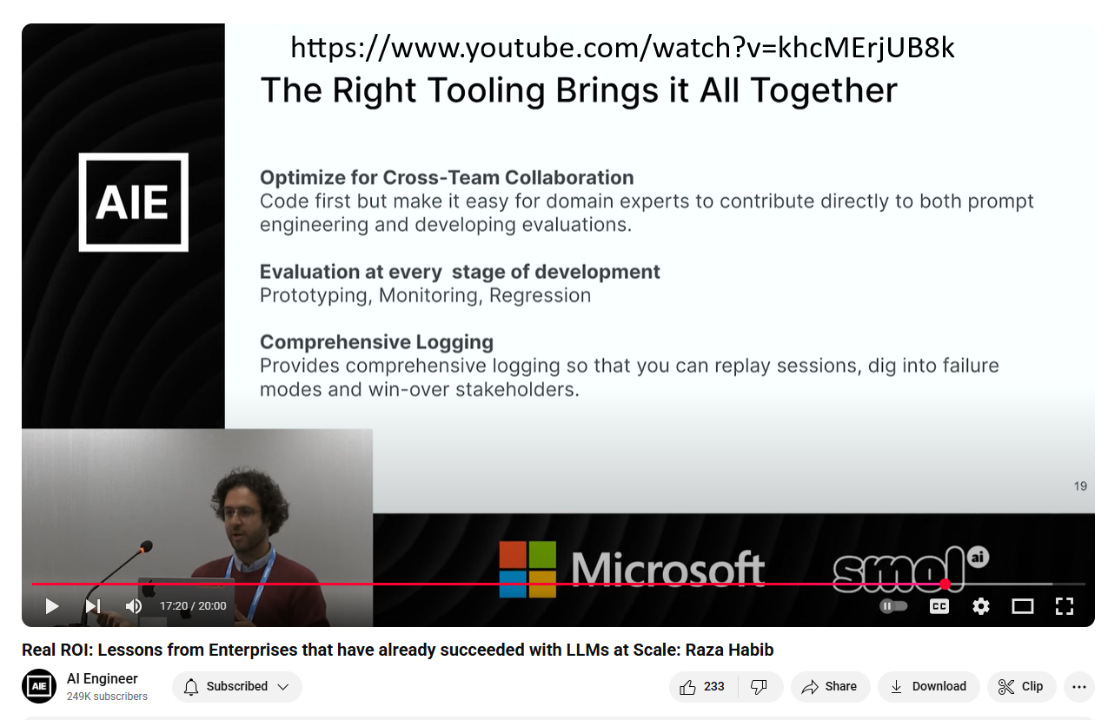
When to use Evals?
.
Raza Habib is the CEO and Cofounder of Humanloop
Acquired by Anthropic

Slide 7
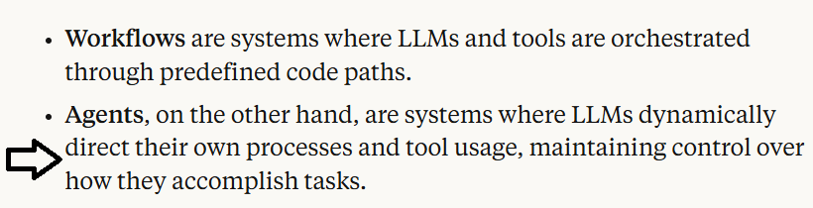
What is an AI Agent?
Many definitions and people opt for ‘Agentic Apps’
Anthropic

Slide 8
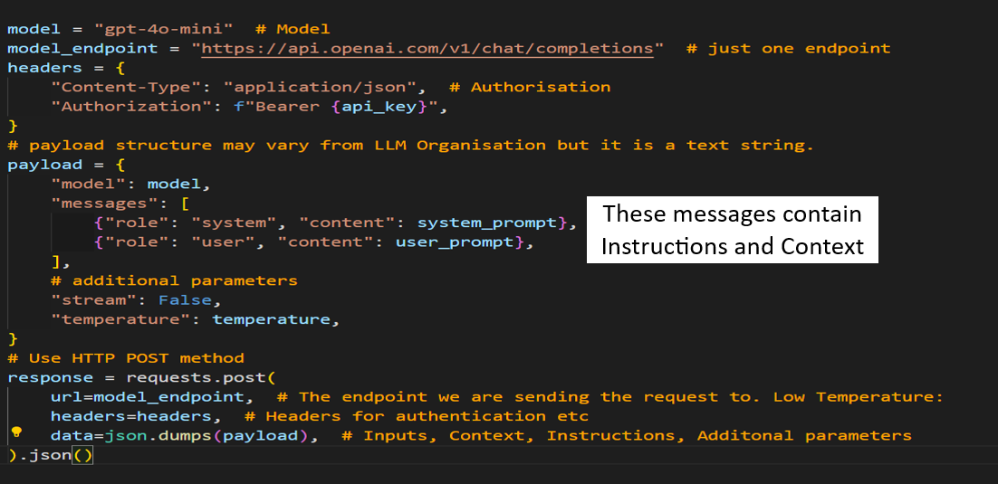
API

Slide 9
But I don’t use Agents!
Perhaps not now, but it might be that your app is required to use Natural Language, (text, voice) from the user.
You might use or incorporate ready made 3rd party software that is Agentic as in the next slide…Google’s CRM Agent…
or use Model Context Protocol/Agent2Agent in your ‘app’
It may be helpful to understand what Agents are

Slide 10
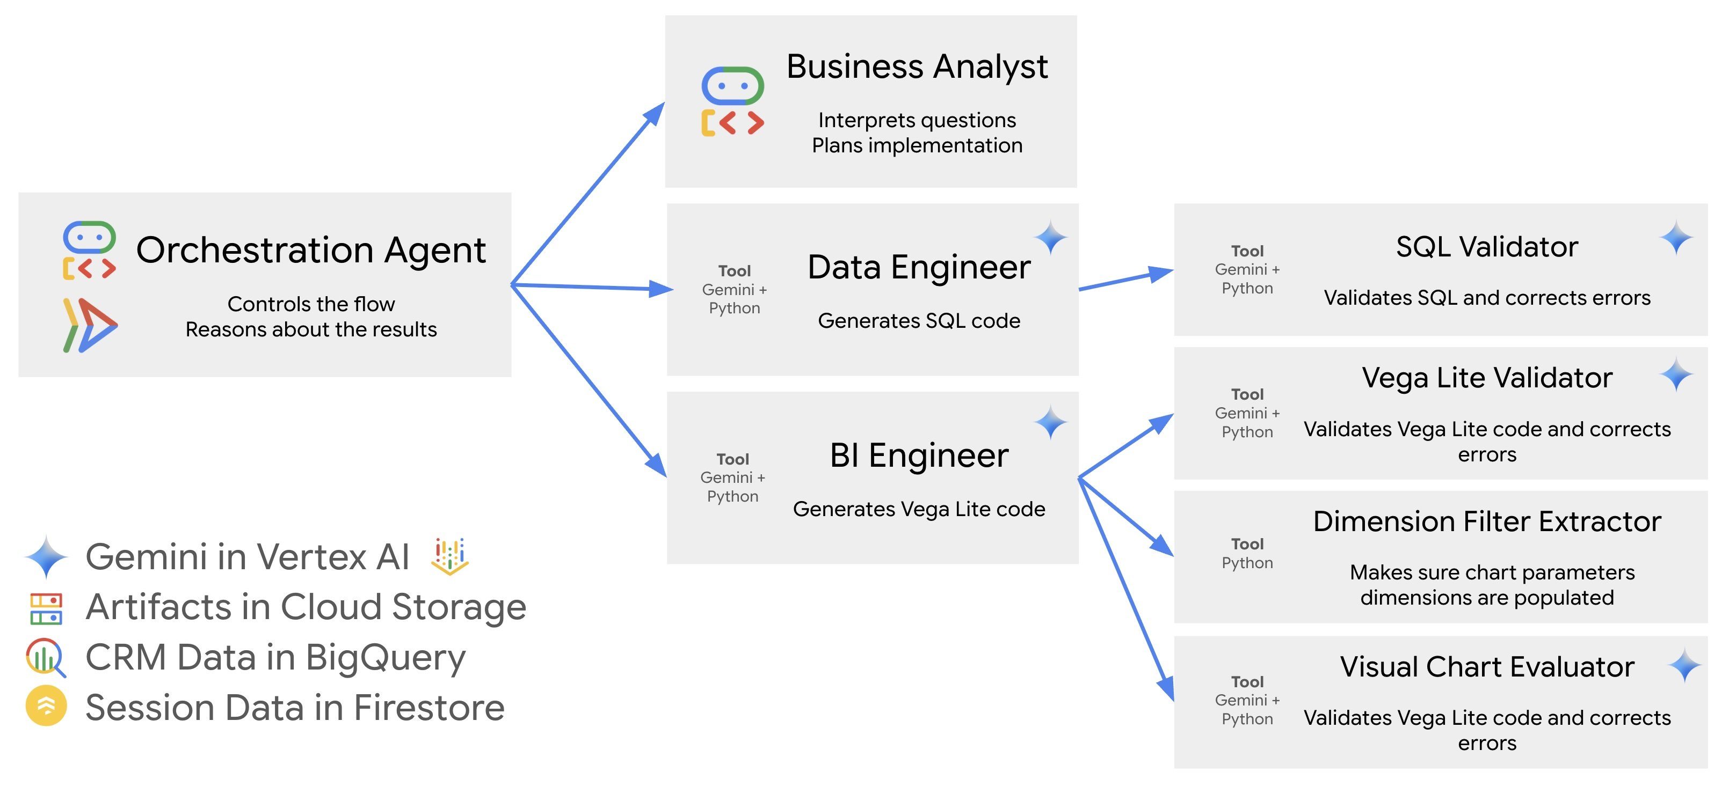
Google CRM Agent
https://github.com/vladkol/crm-data-agent/blob/main/src/agents/data_agent/prompts/crm_business_analyst.py
https://www.youtube.com/watch?v=2-AJszogj7Y

Slide 11
What is Prompt/Context Engineering?
Prompt Engineering is going out of fashion and people opt for Context Engineering and In Context Learning.
We create a set of instructions and add additional information to a request we send to the LLM.
We can let LLM know that more context is available if it tells us which of the tools/functions we have told it about it wants us to call with arguments it has provided – we will run it on our box and send the extra context/information.
The API is STATELESS – we must pass all the information it needs every time as if it was the first time.

Slide 12


180-degree shift
No more difficult than what we do currently – just 180 degrees different
“It doesn’t get any easier – just different” - Anon

Slide 13
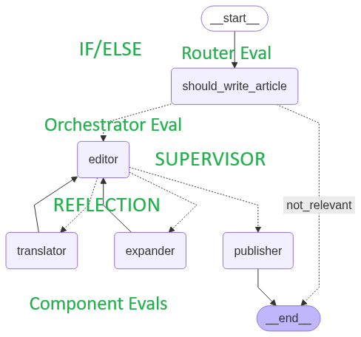
Where to start? What to do?
We will look at Case Study 1 in the manual and framework.
Given an article title, determine if it is about AI.
Take title and create article of N words (EXPANDER)
In a specified language (TRANSLATOR)
Ensure article is not sensational (EDITOR)
PUBLISH = YES only if all three are YES
This app could be a leaf of a larger app.

Slide 14
A possible workflow
We build our app with a basic prompt “Write an article on {topic} of around {N} words.”
It all works mechanistically.
Now lets progress…

Slide 15
A possible workflow
We decide to add a simple
We notice that users like:
Bullet points – Abstract - Conclusion

Slide 16
A possible workflow
We change our prompt to include these features.
However, only 2% of users give feedback so we decide to use Human Evaluators to give feedback as well as label articles ‘good’ etc

Slide 17
A possible workflow
We need to draft up guidelines on what an article should contain, its structure and other ways an article is ‘good’.
This exercise further helps our LLM app prompt, and we refine it.

Slide 18
A possible workflow
We can only handle/afford a small percentage, so we decide to use LLM as Judge.
Seems illogical but is actually very effective.
With our original prompt and our human evaluator guidelines we write a prompt for this LLM Judge. We can now process a much greater percentage online and offline.
It is better than our app! We refine our app prompt…

Slide 19
A possible workflow
Now that we are looking at our data, we see that sometimes the app offers financial advice.
We must prevent this (guardrails) so we create an LLM as Judge that detects if this article had financial advice.
It saves many problems…

Slide 20
A possible workflow
Now that we have a robust way of evaluating our app, we can start to tinker:
Different models in different places for cost reduction yet same performance?
Does one part of the app give greater benefit for unit of change than another?
Can we reduce latency without breaking anything (regression testing)
Offer a client dashboard of filtered metrics to our clients in real time? They have entrusted us with their business.
Process not tools.

Slide 21
Demo – our app from earlier
We will look at Case Study 1 in the manual and framework.
Given an article title, determine if it is about AI (ROUTER)
Take title and create article of N words (EXPANDER)
In a specified language (TRANSLATOR)
Ensure article is not sensational (EDITOR)
A ‘good article’ – OMITTED IN DEMO
PUBLISH = YES only if last three are YES in EDITOR
Let’s go to the guide and code…

Slide 22
Summary Key Points
We need to look at the data to determine what are EVAL criteria are
We need to determine what success will look like
We will need humans at certain points
We need a Domain Expert
LLM Judges are primarily for scaling
We need to do EVALS on these LLM Judges
Process more important than tools

Slide 23
Future
Craig West
https://craig-west.netlify.app/
https://evaluating-ai-agents.com/
Contact links on the sites
Always have 10 mins to answer questions…

