Slide 1
Web Components and CSS
CSS can be tricky with all its rules. We will have many focussed templates to see the rules.
Rule of thumb:
The Shadow DOM gets flattened and is part of the overall DOM so general CSS inheritance applies.
Page CSS can target overall selector <my-component> but not inside (except new ::part)
CSS in component have higher priority in accordance with CSS inheritance rules.

Slide 2
Web Components and CSS
How to style inside component? <style></style>
How to allow customisation from outside? CSS Variables and ::part.
Use :host, ::slotted, slot for specific uses (next slide).
How to use enterprise wide styling?
JS import as <link> an anti-pattern due to FOUC.
We can use CSS imported in via a js file.

Slide 3
Web Components and CSS
How to style component based on props in Light DOM and context where component is?
:host() and :host(context) enable a component to see what CSS props it has in its tag in the Light DOM.
::slotted() and slot[name=first] can be used to detect props at page level.
Diagram on next slide will help…

Slide 4
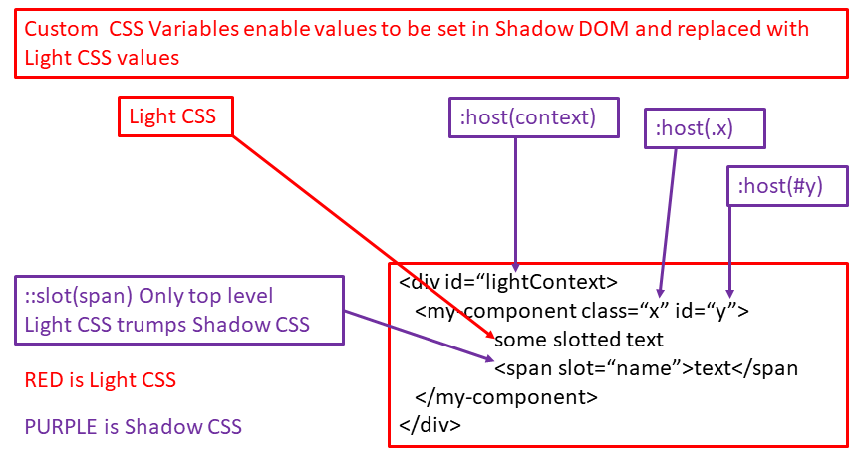
Web Components and CSS
There is also ::part from Light CSS to part=first in component HTML.
A design choice if you want colleagues/clients to access methods and properties directly or whether you restrict to props only.

