Slide 1
Web Components as Micro Apps
Craig West
All talk resources, apps and slides provided.
Everything scaffolded out – break and repair approach!
Feel free to raise your hand, ask questions in chat or interject as we go along…let’s make it an interactive and connected workshop.

Slide 2
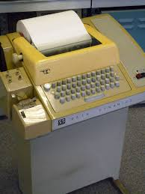

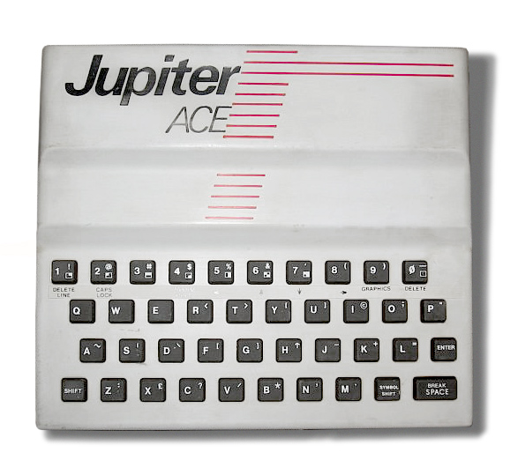
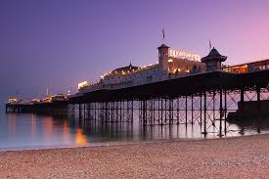
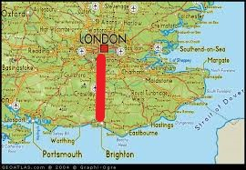
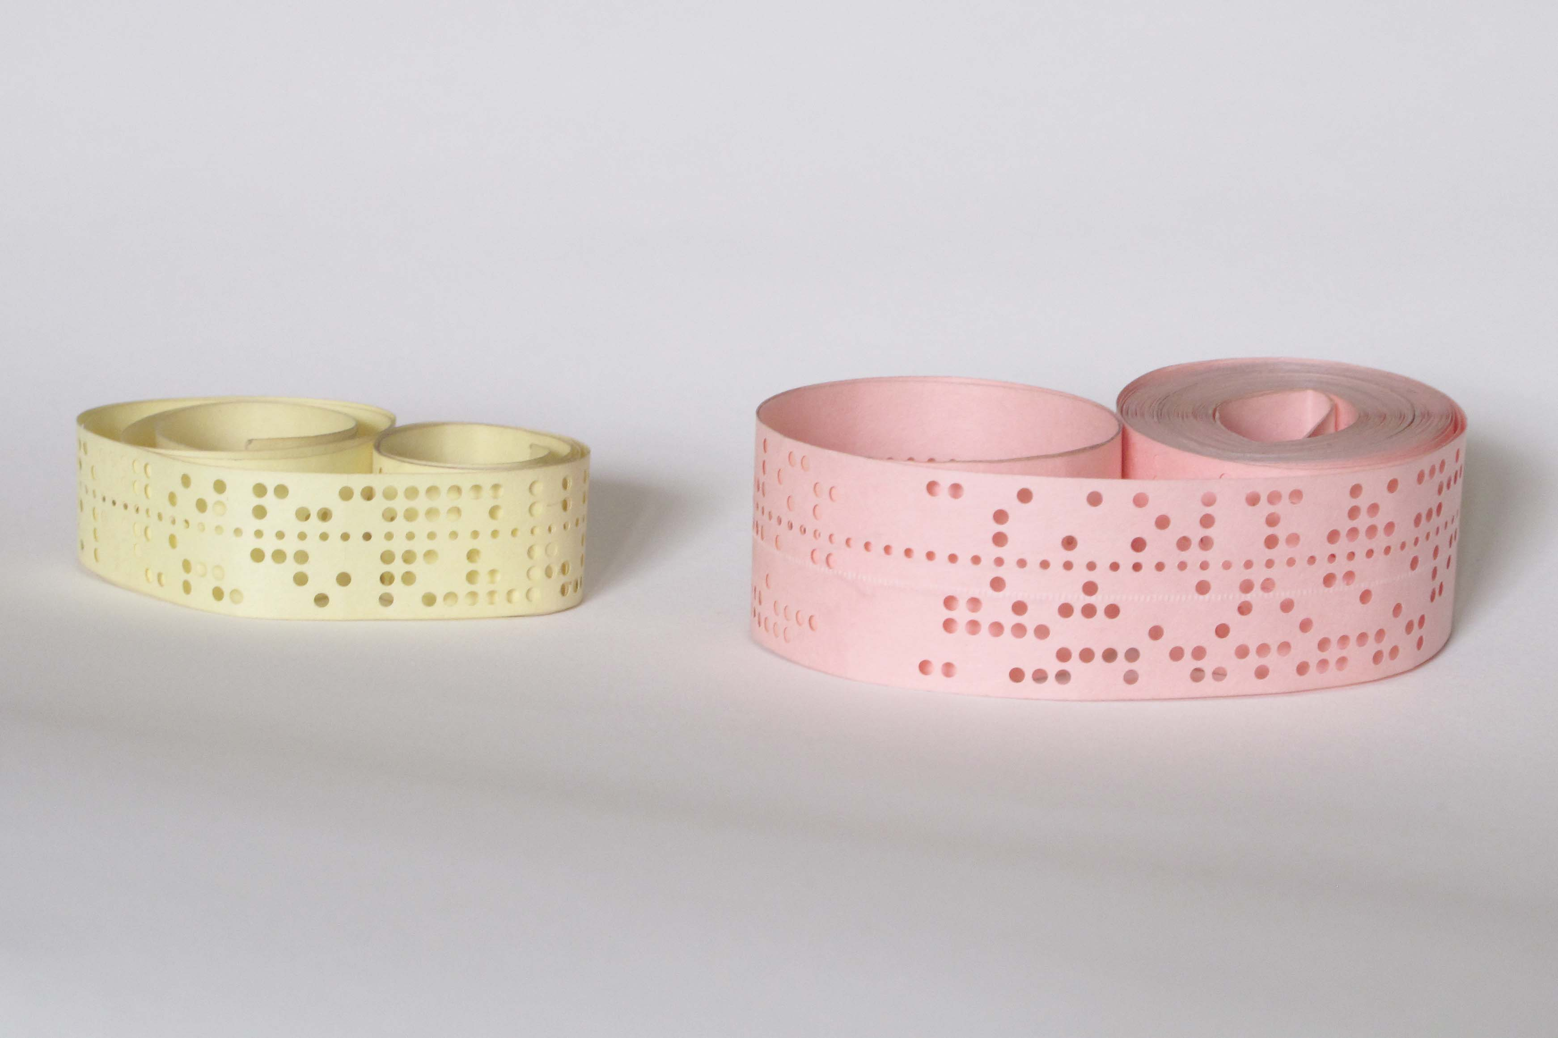
PWAs, Web Components, RxJS & Async JS
Just a developer like all of you.
Tech is still challenging.
“It doesn’t get any easier…just different”
- anon.
Source:Wikimedia Commons
Brighton, UK
Source:Wikimedia Commons
1980: At University, I studied Chemistry and used MS-DOS, client/server main frame systems, ZX-Spectrum computer and Jupiter Ace recreationally.
Former careers as accountant, SQL Server DBA and Business Information Architect.
Volounteer tutor at codeyourfuture.io
http://www.map-of-uk.co.uk/
80 km
Source:Wikimedia Commons
Source:Wikimedia Commons

Slide 3
Introductions
Name.
Where you live.
Your tech stack.
Why you are interested in Web Components.
I will honour completing course in 4 hours but will be available if needed after. Ends: 12pm GMT.
50ish minutes lesson and a 10 min break but the group will determine what works best.

Slide 4
Web Components as Micro Apps
Web Components as MicroApps
Or HTML5

Slide 5
Already built in to HTML5
Re-render on prop change.
Emit Custom Events and data.
Listen to Custom Events.
Expose methods.
Cache API to preload/store pages.
Store data with Local Storage (sync) and IndexedDB (async).

Slide 6
Web Components as Micro Apps
TALK: Decoupled/Headless WP and WP Components for non-WP sites - WordCamp Brighton, August 2019.
TALK - WP-HTML: The marriage of WP and JS Frameworks for expansion, ubiquity and profit - WordCamp Vienna February 2020.
WORKSHOP: Web Components Workshop (2hrs) - NDC Oslo June 2020.
TALK: Unifying frameworks with Web Components - Brighton AsyncJS, Nov 2020.
TALK: Web Components as Micro Apps - NDC London, Jan 2021
TALK: Web Components in WP, Gutenberg and as HTML plugins - WordCamp Northeast Ohio May 2021…some more scheduled on:
WP REST API + WEB COMPONENTS => 100% INTERNET

Slide 7
I do a lot of courses…what I like is…
Easy set up!
Code that works out the box.
Break and repair rather than coding exercises.
Links and references to use after course.
Spaced repetition.
Tutor to use same code/setup as me.

Slide 8
I don’t like exercises!
Prefer ready made examples to break and rebuild.
I am using enough brain power to just handle the whole workshop.
If I can’t solve the exercise I get stuck there until I resolve it in my head.
I make negative judgements about myself.

Slide 9

Roadmap for the day
Introduction and overview of Web Components
Work through scaffolded lessons
A factory for you to start producing COMPONENTS straight away with all the templates and eco system resources you will need after the course so that today you can focus on a global understanding.
Create highly functional components/Micro Apps
Build tools, NPM and libraries
Deploying components between frameworks
Wrap up

Slide 10
Why do I like Web Components?
Code modularity.
Declarative style – like writing sentences.
Focus on what the app does rather than how.
Universal use – JS, NPM, UNPKG.
A return to the simplicity of HTML/CSS/JS.
JS is always backward compatible – code from 20 years ago works today.

Slide 11
In this talk…creating a context for the workshop
This talk not meant to be learning!
What is a Web Component?
How do we use them?
How do we make them:
- Vanilla JS
- with build tools (not frameworks).
- using frameworks to export app as a Web Component.
How to import them into any framework.
Using Web Components as interconnected Micro Apps/Micro Services.
Use them as business widgets for not-tech users.
.
Useful links at end of slides…

Slide 12
Web Components and SEO
https://www.youtube.com/watch?v=3B7gBVTsEaE Martin Splitt - Technical SEO 101 for React Developers | React Next 2019
https://search.google.com/test/mobile-friendly can test if app is mobile friendly but also the HTML that the Search Bot sees. It will show that SEO bots see the rendered HTML from the Web Component.
Linking pages, use links not buttons as Bot does not do ‘clicks’. No # but use history. Only submit quality pages and a site map of important links.

Slide 13
SEO
Give good description about your lists.
React helmet, use canonical links for legacy routes. OK to say do not crawl.
Structured data application/ld+json
g.co/searchconsole.

Slide 14
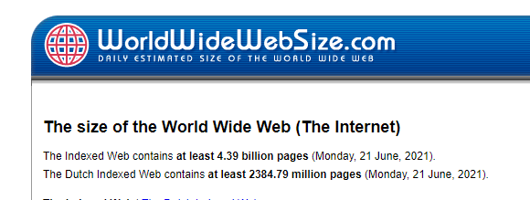
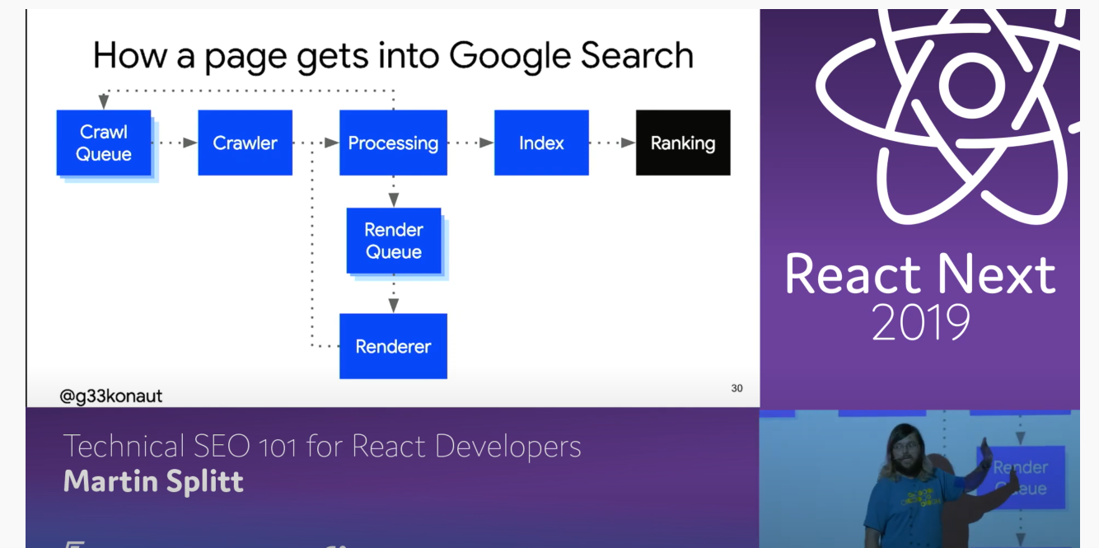
Web Components and SEO
4.39 Billion pages…
https://www.youtube.com/watch?v=3B7gBVTsEaE
Regular HTML get processed first and sent to Index
JS generated content gets placed in render queue to be processed later.

Slide 15
Web Components and SSR
Google is working on a proposal for SSR Web Components.
https://github.com/mfreed7/declarative-shadow-dom/blob/master/README.md
It would allow two versions on page – the SSR one using HTML and the current client-side Web Component.
It is OK for Web Components to be just client-side with static HTML served initially.

Slide 16
Two Business Applications ( 1 )
Case One:
Disassemble a very monolithic PHP/MySQL into a set of HTML/JS/CSS Web Components that can be used in the app or as a Micro App in any HTML site.
This will be WordPress as it is very monolithic, PHP and very popular.

Slide 17

1
WordPress
HTML
WEB COMPONENTS
Web Components
WP PHP PAGES
Gutenberg Blocks
Framework 1
Framework 2
Framework ...n

Slide 18
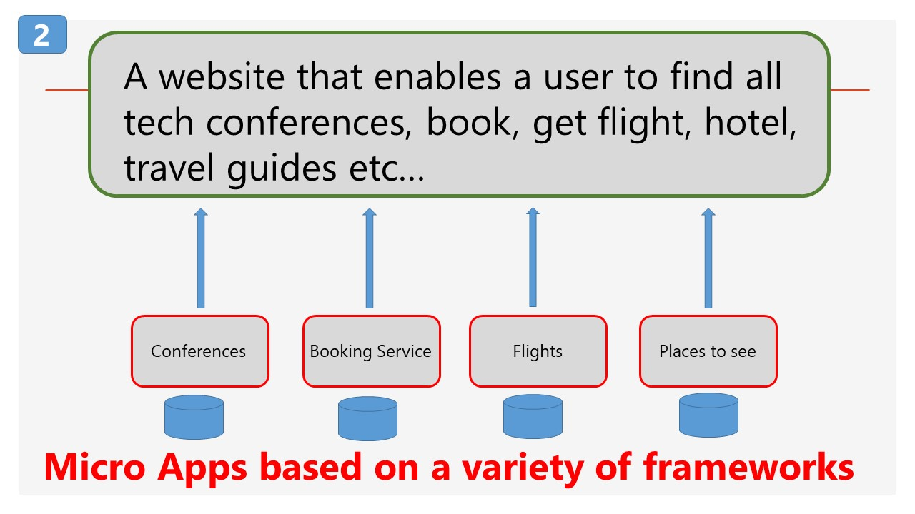
Two Business Applications ( 2 )
Case Two:
Entrepreneur wants to create a ONE-STOP tech conference site that uses several other businesses to provide information on tech events, booking, flights, hotels and tour guides.
Each Micro App is a separate concern, and all needed to be orchestrated together with minimal coding.
Enlarged on next slide…

Slide 19
2
A website that enables a user to find all tech conferences, book, get flight, hotel, travel guides etc…
Conferences
Booking Service
Flights
Places to see
Micro Apps based on a variety of frameworks

Slide 20
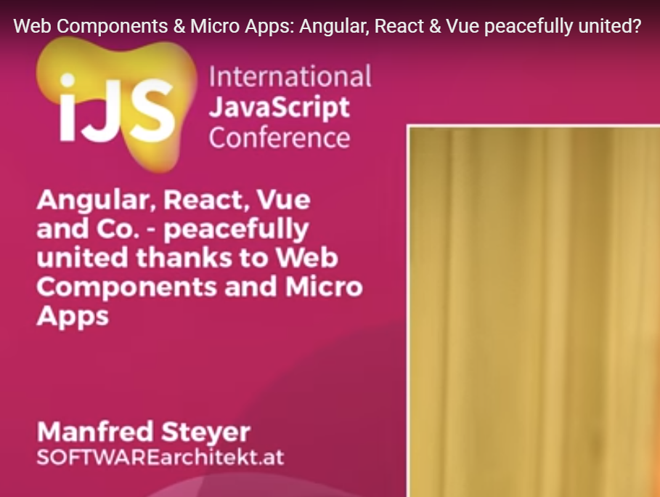
International JS Conference London 2018 – Key Note Speech
https://www.youtube.com/watch?v=1KJQurclLdw

Slide 21
Two Business Applications ( 2 )
<div id=“react-app”/>
<div id=“vue-app” />
<div id =“angular-app” />
<div id=“wordpress-app” />
Communicate events and data between all of them.

Slide 22
Pseudo code
<list-conferences tech=“JS” workshops=“yes”>
<book-an-event event=“22” use=“invoice” />
<show-flights city=“LON” when=“…”/>
<list-hotels min-stars=“3” meals=“yes” />
Declarative rather than Imperative

Slide 23
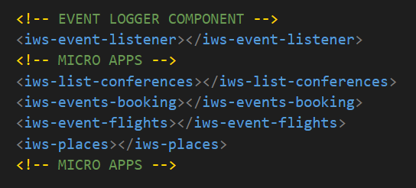
Two Business Applications ( 2 )

Slide 24
Definitions
Micro App:
A micro app is an interactive software module designed to perform like a full coded application or website. (Wikipedia)
Micro Service:
A self-contained piece of business functionality with clear interfaces - "Do one thing and do it well". (Paraphrased from Wikipedia) or…

Slide 25
Which begs the question…
When is an app an app?
When is an app a micro app?
On own it is an app, with others a micro app?
Context…?

Slide 26
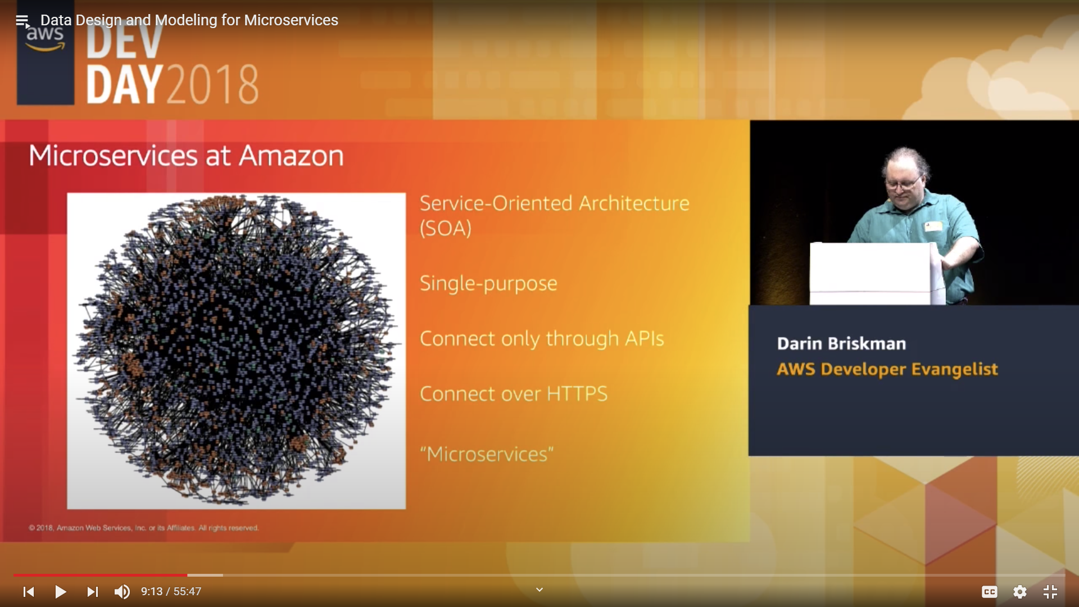
Definitions
Single-Purpose, connecting through APIs over HTTPS = MICRO SERVICE

Slide 27
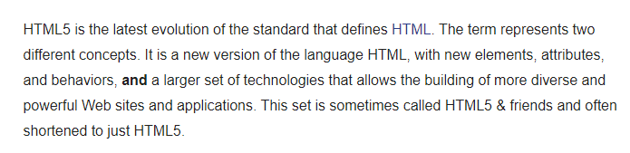
What is HTML5?
https://developer.mozilla.org/en-US/docs/Web/Guide/HTML/HTML5
Create our own HTML tags.
Re-render tags on state change.
Preload/save web pages with the Cache API.
Save data to Local Storage (synchronously).
Store large date in an asynchronous, transactional database with IndexedDB.
We can create a device level web and DB server.

Slide 28
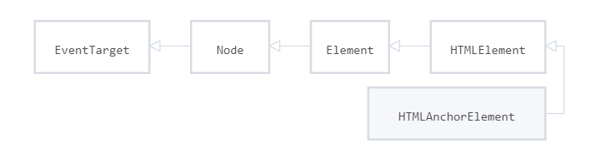
What is an anchor tag?
<a href=“#” target=“_blank>CLICK EVENT</a>
props built-in click method slot api
Anchor tag extends the HTMLElement class
https://developer.mozilla.org/en-US/docs/Web/API/HTMLAnchorElement

Slide 29
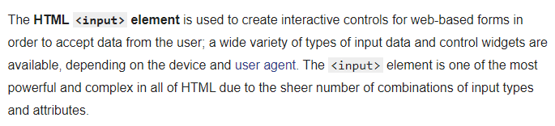
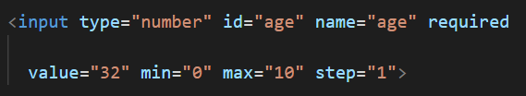
What is an input element?
https://developer.mozilla.org/en-US/docs/Web/HTML/Element/input
And pop-over UI!

Slide 30
What is a Custom HTML Tag?
<my-component></my-component>
<script src=“file.js”></script>
Must contain at least one hyphen.
Use just like any HTML tag.
They extend the HTMLElement class.

Slide 31
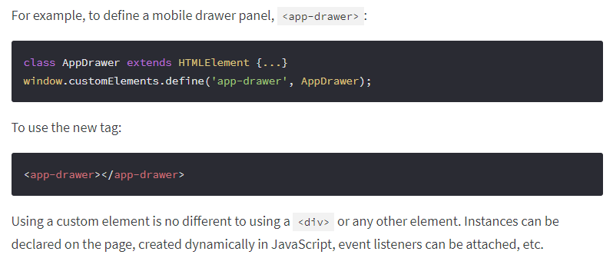
How to use
We can create elements as part of HTML5 spec.
https://www.webcomponents.org/introduction

Slide 32
Useful references
https://www.webcomponents.org/
- main reference site
https://custom-elements-everywhere.com/
(Making sure frameworks and custom elements can be BFFs )

Slide 33
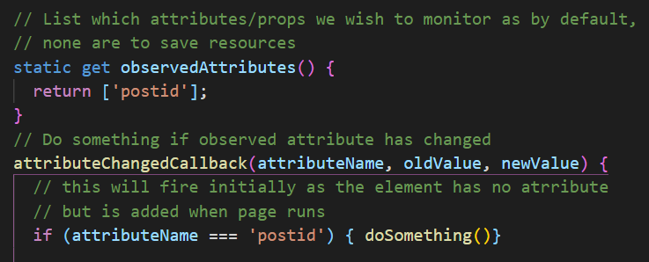
How to use – Props Down
PROPS DOWN <show-post postid=“34” />
Demo: 05-events/05-showPost.html

Slide 34
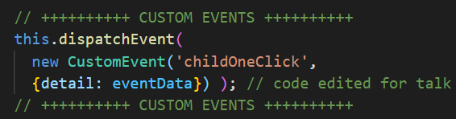
How to use – Events Up
EVENTS UP
Demo: 05-events/15-child-to-parent
We use JS Custom Events to send event and data.
In page, listen for the ‘childOneClick’ event…

Slide 35
How to use
NB Methods and properties on components can be directly accessed.
This would be a design choice as components tend to use props down events up, rather than sibling to sibling.

Slide 36
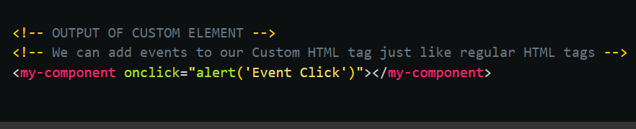
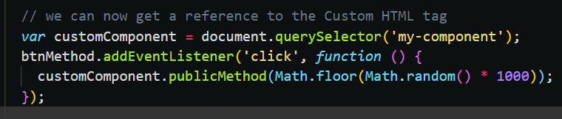
How to use
A function in class
05: 01-light-events.html

Slide 37

Framework: <div id=“app”></div>
<web-component id=“app” custom=“{}” …></web-component>
HTML attributes (props)
Attribute can be string, number, array, object – usually JSON.stringify.
Props down – Events up are the two normal design patterns.
Props down
Emit custom event with payload
Listen to custom event with payload
Events Up
= primary use cases
A
Public Methods/Properties called by COMPONENT C etc…
1. Public method/property on component B
2. Set attributes on component B
Slot API (Children)

Slide 38
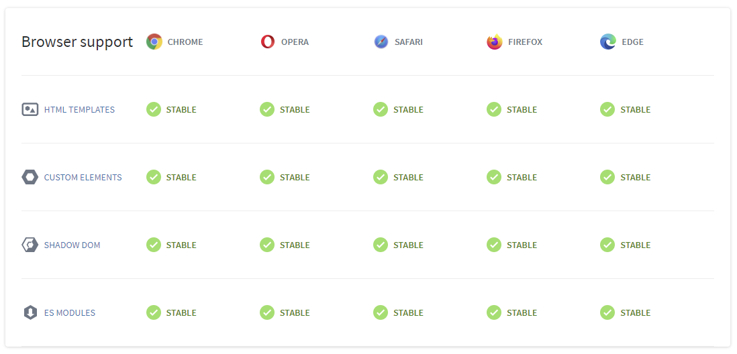
Browser Support - Polyfills available
https://www.webcomponents.org/

Slide 39
Useful links
https://coryrylan.com/blog/using-web-components-in-react-video-tutorial
https://coryrylan.com/blog/using-web-components-in-angular-video-tutorial
https://coryrylan.com/blog/using-web-components-in-vue
https://stenciljs.com/docs/overview
https://webcomponents.dev/
https://custom-elements-everywhere.com/
https://developers.google.com/web/fundamentals/web-components

Slide 40
Encapsulation!
Very important.
Stumbling block in past.
Now fully implemented with the Shadow DOM.
We will see it in action in the demos but CSS is fully scoped with no bleeding between Light and Shadow DOM.
Rules to allow crossing of boundary for CSS and JS…

Slide 41
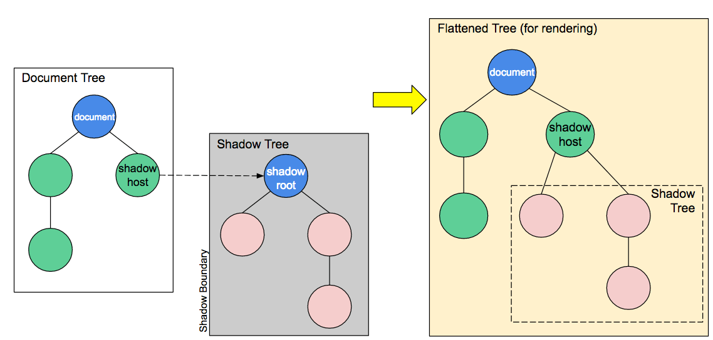
Shadow DOM – explained more fully later…

Slide 42
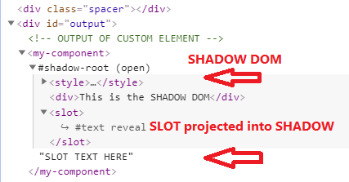
Shadow DOM – explained more fully later…
FRAGEMENT

Slide 43
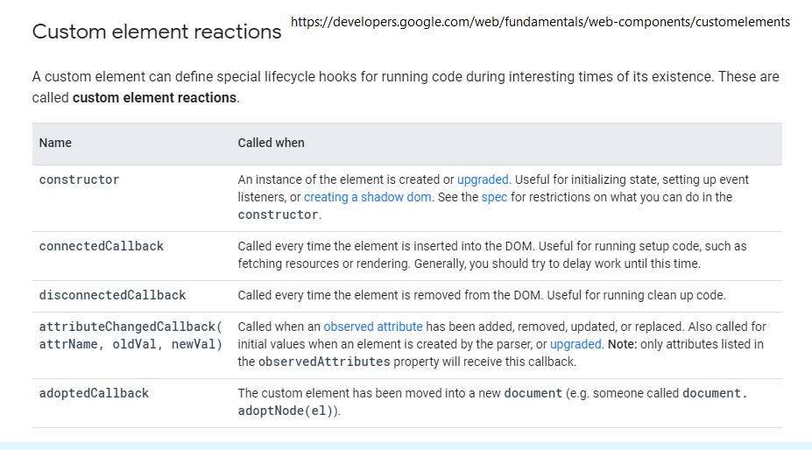
Lifecycles – explored later in lessons
Render on state change
Seldom used…

Slide 44
Who uses Web Components?
https://github.blog/2021-05-04-how-we-use-web-components-at-github/
Google 20,000+, GitHub
Google Accelerated Mobile Pages.
Ionic and Ionic/ReactJS/Angular (Ionic Apps with Capacitor can run on IOS, Android, Web and Electron). ‘Write once, run anywhere…’
Salesforce – Lightning Web Components
Salesforce has purchased Slack
Google video about Web Components and Salesforce: https://www.youtube.com/watch?v=YBwgkr_Sbx0

Slide 45
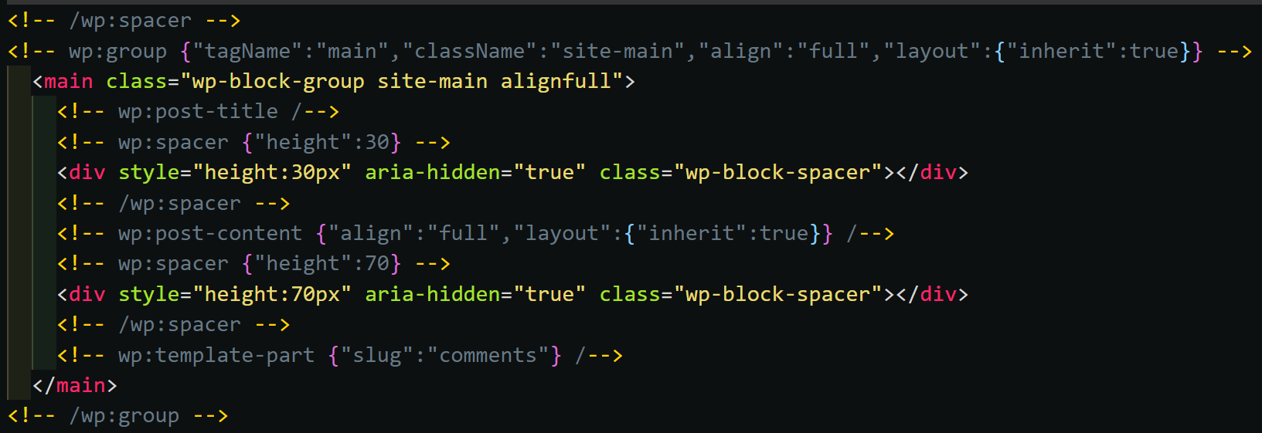
WordPress Full Site Editing
Comments used as component identifiers.

Slide 46
Types of Web Components
These are only limited by our use of JS as they are regular JS components.
We will look at couple of UI components and many more highly functional components that have built in functionality…

Slide 47
Types of Web Components
Fetch requests.
Lazy loading and dynamic loading (scripts/components).
Storing JSON in IndexedDB and rendering it via templates.
Authentication and storage of JSON Web Tokens.
Added offline capability and ‘instant’ pages.

Slide 48
Useful references
https://www.webcomponents.org/
- main reference site
https://custom-elements-everywhere.com/
(Making sure frameworks and custom elements can be BFFs )
https://webcomponents.dev/
over 40 libraries and compilers
let’s see these libraries and compilers…

Slide 49
Demo time
This will help give context to the workshop:
1. Business case (1) site: WordPress converted to Micro Apps.
https://wpjs.co.uk/demo1 (in repo)
2. Conference app: MVP of many frameworks working together as separate and independent Micro Apps.

Slide 50
Converting Frameworks to Web Components
Node – JS placed in usual public/js folder.
Angular: https://angular.io/guide/elements
Vue: https://www.npmjs.com/package/vue-custom-element
Vue: https://github.com/karol-f/vue-custom-element#demo
React: https://github.com/LukasBombach/react-web-component
Many others: https://webcomponents.dev/

Slide 51
Deployment
How to deploy Web Components as a third party:
In HTML pages as we have seen.
Via NPM we can import into builds.
For Angular, Vue, React etc, there are well documented procedures, (e.g. https://stenciljs.com/docs/framework-bindings)

Slide 52
Summary
Craig West
wpjs.co.uk
craig@wpjs.co.uk

