Slide 1
Web Components are HTML
<my-component onclick="alert('Event Click’)”>
</my-component>
All regular HTML ‘things’ work on Web Components.

Slide 2
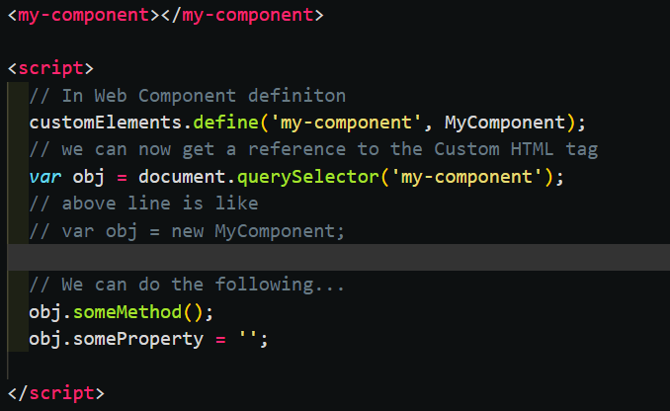
Web Components as a Class Instance
A design choice if you want colleagues/clients to access methods and properties directly or whether you restrict to props only.
General rule is ‘PROPS DOWN – EVENTS UP’

Slide 3
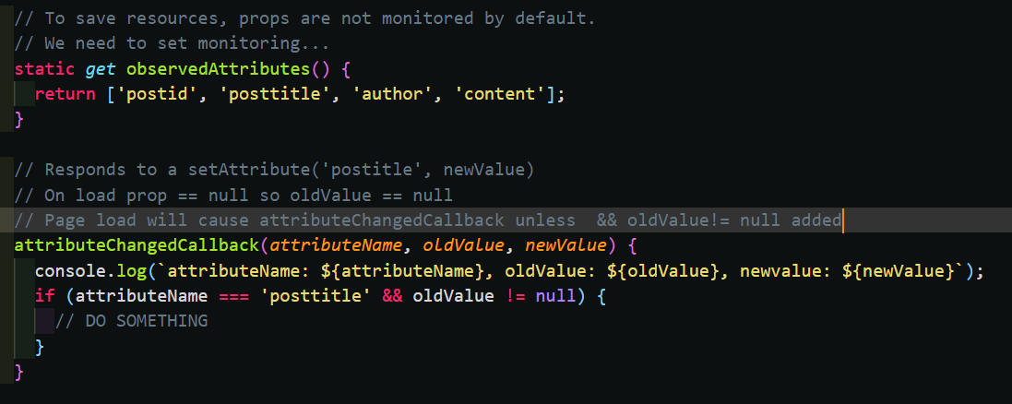
attributeChangedCallback()
<
A design choice if you want colleagues/clients to access methods and properties directly or whether you restrict to props only.

Slide 4
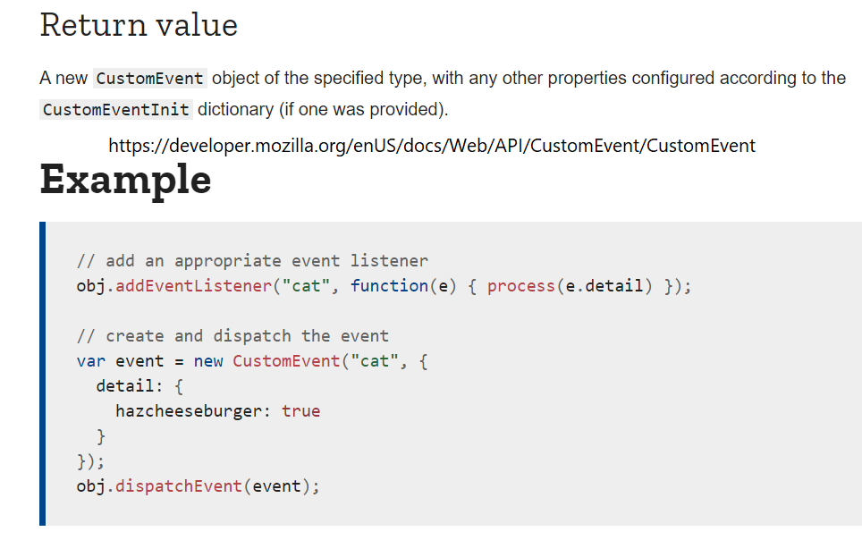
Custom Events in JS

Slide 5
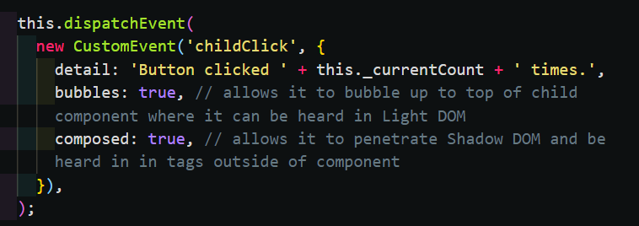

Custom Events in Web Components
Detail is payload
See 15-child-to-parent.html – seems to work with no composed: true

Slide 6

CHILD TO PARENT COMMUNICATION
PARENT
Custom Event: <name>
Payload: {data}
Does something…
CHILD ONE

Slide 7
CHILD TO CHILD COMMUNICATION
PARENT
setAtrribute(‘prop’: Y)
Custom Event: <name>
Payload: {data}
CHILD ONE
CHILD TWO prop=X
CHILD TWO prop=Y
rerender – on attributeChangeCallback

