Slide 1
Web Components and CSS
How to style inside component? <style></style>
How to allow customisation from outside? CSS Variables and ::part. Remember too that Light CSS trumps Component CSS.
How to use enterprise wide styling? JS import as <link> an anti-pattern due to FOUC.
How to style component based on props in Light DOM and context where component is? :host and :host context. SLOT styling possible too…

Slide 2
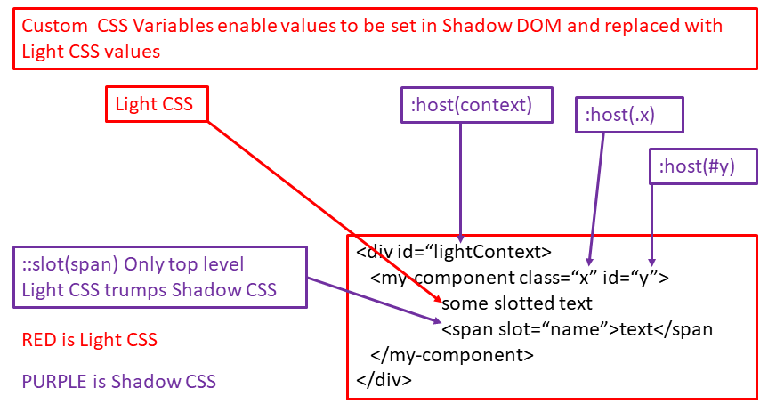
Web Components and CSS
A design choice if you want colleagues/clients to access methods and properties directly or whether you restrict to props only.

