Slide 1
Web Components and CSS
CSS can be tricky with all its rules. We will have many focussed templates to see the rules.
Rule of thumb:
The Shadow DOM gets flattened and is part of the overall DOM so general CSS inheritance applies.
Page CSS can target overall selector <my-component> but not inside (except new ::part)
CSS in component have higher priority in accordance with CSS inheritance rules.
When it comes to the tag and slot in the page, the user has the final say if we are using :host and ::slotted.

Slide 2
Web Components and CSS
How to style inside component? <style></style>
How to allow customisation from outside? CSS Variables and ::part.
Use :host, ::slotted, slot for specific uses (next slide).
How to use enterprise wide styling?
JS import as <link> an anti-pattern due to FOUC.
We can use CSS imported in via a js file.

Slide 3
Web Components and CSS
How to style component based on props in Light DOM and context where component is?
:host() and :host(context) enable a component to see what CSS props it has in its tag in the Light DOM.
::slotted() and slot[name=first] can be used to detect props at page level.
Diagram on next slide will help…

Slide 4
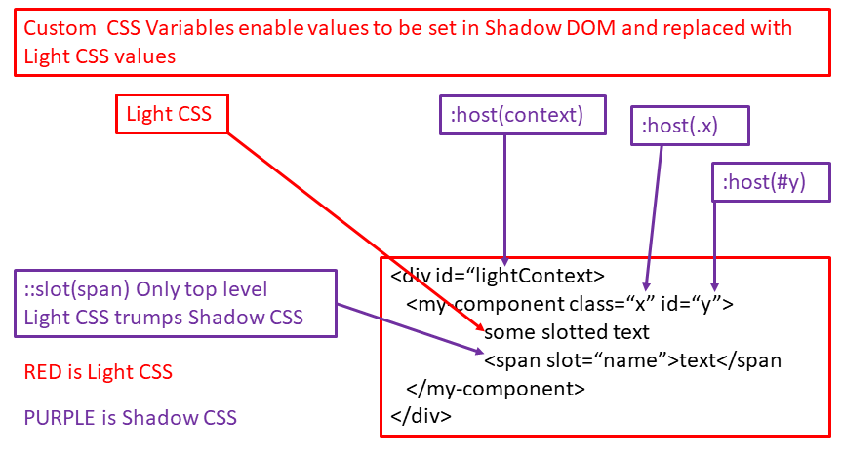
Web Components and CSS
There is also ::part from Light CSS to part=first in component HTML.
A design choice if you want colleagues/clients to access methods and properties directly or whether you restrict to props only.

