Slide 1
Python for Data Science Bootcamp (PDSB)
Fall 2020
Prof. Luis E. Morales
Aug 10, 2020
PDSB

Slide 2

Lecture #1 Agenda
Lecture #1
Course Objectives, Learning Objectives, Where, When
Setting the Context
Game plan:
Our Approach, Content, Weekly Topics
Class Structure, Activities
Text Books
Course Grading
Wrap up and look ahead
PDSB
Notes:
Here is our agenda for today:
Objectives
My background
TA’s background
Class structure
Text books
Grading, HomeWorks, Office hours
Approach
We’ll hear from you
Team
Lecture 1

Slide 3
Python for Data Science Bootcamp (PDSB)
Course Objectives
Lecture #1
WHAT: Prepare students with knowledge essential for data analysis, information sharing and information extraction using Python
HOW: Introduce students to foundational data science concepts and provide hands on experience with critical skills including loading, cleaning, manipulating, visualizing, analyzing and interpreting data
WHY: Build proficiency in the use of Python for Data Science
PDSB

Slide 4
Python for Data Science Bootcamp (PDSB) Learning Objectives
Lecture #1
Manage fundamental python programming techniques
Employ frequently used libraries, such as numpy, pandas, matplotlib in your own codes
Apply data analysis methods on real data including loading, cleaning, manipulating, visualizing and running basic statistical analyses
Evaluate whether the selected methods and experimental results are reasonable
Conduct simulations of chance experiments with discrete or continuous outcomes
PDSB

Slide 5
Python for Data Science Bootcamp (PDSB) Where, When, How
Lecture #1
Where:
Lecture Sessions: Notes and videos available online
Checkpoint Sessions: Live via Zoom (and recorded)
When:
Lectures
4 Lectures per week (posted in advance)
1 Checkpoint per week Thursday 8:00 PM - 8:30 PM
How:
Two entry points for students based on incoming Python proficiency
First Entry Point: Week 1 – For students with little or no Python experience
Second Entry Point: Week 3 – For students that meet minimum proficiency standards
No pre-requisites open to everyone
PDSB

Slide 6

Python for Data Science Bootcamp (PDSB) My Background
Lecture #1
~3 years as faculty in the Master of Engineering Management (MEM) program at Duke University’s Main Campus in Durham, North Carolina
Created and teach two courses to MEM/ECE master students:
Software Quality Management (EGRMGMT-575)
Improving Customer Experience (EGRMGMT-579)
Taught “Introduction to Data Science” (STATS 102) as visiting faculty at Duke Kunshan University in the Spring 2020
Prior to Duke served 28 years in various engineering leadership roles in technology industry:
13 years at Cisco Systems in North Carolina
15 years at AT&T Labs in New Jersey
In 2018, started consulting practice (Calu Consulting LLC) that helps clients use data to improve customer experience

Slide 7
Python for Data Science Bootcamp (PDSB) My Background (cont.)
Lecture #1
Publications:
Co-author, "Achieving Customer Experience Excellence Through a Quality Management System." Book published by ASQ Quality Press in June 2016
Co-author, ”Quality Experience Telemetry." Book published by ASQ Quality Press in April 2018
Inventor: Six patents (one for Lucent, and five for AT&T) in the area of IP networking and security
Winner of Cisco’s highest technical recognition, Cisco Pioneer Award 2011
PDSB

Slide 8
Python for Data Science Bootcamp (PDSB) What is Data Science?
Lecture #1
Math
Statistics
Computer Science
Data Science
What Makes You Unique???
My domain - Customer Experience and Quality
Interdisciplinary domain knowledge
PDSB
Notes:
Data science sits are the intersection of three fields:
Math (statistics)
Computer science
Interdisciplinary domain knowledge
In the context of our class, we are approaching data science from the customer experience domain

Slide 9

Python for Data Science Bootcamp (PDSB) Why Study Data Science?
Lecture #1
Living in a data rich world… Data is everywhere, and it is created/captured as we interact with digital world.
PDSB

Slide 10

Python for Data Science Bootcamp (PDSB) Why Study Data Science? (cont.)
Lecture #1
…and there is more to come!
Technology trends that are providing “wind beneath the sails” of increased data generation and capture
These include:
Digitization
Internet of Things
Cloud Computing
IPV6
Machine Learning and AI
What do we do with all this data????
PDSB
Notes:
Let’s look at technological forces driving or benefiting from increased use of telemetry data
When would you say a technology is benefiting?
When would you say a technology is driving?
Many of the technologies mentioned in this section can increase agility, enhance productivity and substantially improve processes. The considerations provided with each technology are just a partial list of many others you must give attention to if you were to adopt it.
Even though executives understand the benefits, the path to adopting the technologies can be daunting. To be successful and remain ahead of the race, most companies need to execute and innovate quickly. Complete transition to digital cannot happen overnight and hybrid models are more likely to emerge and become popular until the time the company is ready to embrace the next-generation IT solutions fully, to get to the customers first and create new growth. The hybrid solution is the infrastructure which will provide speed, security, agility and flexibility. It will promote new applications that will provide ability to face future challenges.

Slide 11
Python for Data Science Bootcamp (PDSB) Data Scientist Responsibilities
Lecture #1
Include:
Collecting large amounts of raw data and transforming it into a more usable format
Solving business-related problems using data-driven techniques
Build mathematical models using the data
Blend data sources
Having a solid grasp of statistics, including statistical tests and distributions
Staying on top of analytical techniques such as machine learning, deep learning and text analytics
Communicating and collaborating with both IT and business
Looking for order and patterns in data, as well as spotting trends that can help a business’s bottom line
PDSB
Notes:
Responsibilities tend to include:
Data source identification and management
Developing Algorithms or analysis
Presenting and communicate insights

Slide 12

Python for Data Science Bootcamp (PDSB) Our Approach
David Donoho, “50 Years of Data Science”
1. Data Exploration and Preparation
2. Data Representation and Transformation
3. Computing with Data
4. Data Modeling
5. Data Visualization and Presentation
6. Science about Data Science
Introduce students to foundational data science concepts and provide hands on experience with critical skills including loading, cleaning, manipulating, visualizing, analyzing and interpreting data -- learn by doing
PDSB
Notes:
Our approach is influenced by David Donoho’s definition of Data Science

Slide 13
Python for Data Science Bootcamp (PDSB) Course Content
Lecture #1
Learn Basic Python programming
Use Numerical Python Library (Numpy)
Load and manipulate data using the Panda's library
Plot, chart & visualize data using the Matplotlib library
Learn Basic probability & statistics concepts and simulation techniques
PDSB

Slide 14
Python for Data Science Bootcamp (PDSB) Weekly Topics – First Three Weeks
Lecture #1
First entry point
Date | Class topic/unit name | Pre-class work for students | Planned in- class activities | Assessments Released
Week 1 | Course introduction, Basic Python programming I | Donoho D. 50 Years of Data Science. Journal of Computational & Graphical Statistics, 2017, 26(4): 745- 766 https://www.py4e.com/Chapters 1-6 | lectures, checkpoint | Assignment 1
Week 2 | Basic Python programming II, | https://www.py4e.com/Chapters 7-11 | lectures, checkpoint | Assignment 2 Mini-project 1
Week 3 | Numpy, Load and manipulate data using the panda's library | PDSH reading chapters 2 and 3 (up to section 3.04) | lectures, checkpoint | Assignment 3
1
Second entry point
2
PDSB

Slide 15
Python for Data Science Bootcamp (PDSB) Weekly Topics (cont.)
Lecture #1
Date | Class topic | Pre-class work for students | Planned in-class activities | Assessments Released
Week 4 | Load and manipulate data using the panda's library (cont.) | PDSH reading chapters 3 (sections 3.05, 3.06, 3.07, 3.08 and 3.10) | lectures, checkpoint | Assignment 4 Mini-project 2
Week 5 | Plotting, charting & data visualization using the matplotlib library; Probability and statistics | PDSH reading chapter 4 (sections 4.01, 4.02, 4.05, 4.14); Introduction to Probability, chapter 1 | lectures, checkpoint | Assignment 5
Week 6 | Probability and statistics | Introduction to Probability, chapters 2-5 | lectures, checkpoint | Assignment 6 Mini-project 3
PDSB

Slide 16
Python for Data Science Bootcamp (PDSB) Class Activities
Lecture #1
Lecture Sessions:
Delivery: Asynchronous online
Jupyter notes and lecture video will be posted a week ahead
Total: 23; 4 per week (3 on week 6)
Each video lecture is on average 35 minutes long (shortest 16 minutes, longest 65 minutes)
Checkpoint Sessions:
Delivery: Synchronous, recorded
Total: 6; 1 per week (Thu)
Each session is 30 mins long
PDSB

Slide 17

Python for Data Science Bootcamp (PDSB) Text Books
Lecture #1
Python Data Science Handbook: Essential Tools for Working with Data, by Jake VanderPlas, O'Reilly Media; 1 edition (December 10, 2016), ISBN-13: 978-1491912058, full text and code freely available at: https://jakevdp.github.io/PythonDataScienceHandbook/
Python for everybody, Exploring Data Using Python 3, Charles R. Severance, free open book at https://www.py4e.com/
Introduction to Probability by Charles M. Grinstead and J. Laurie Snell, free open book at www.dartmouth.edu/~chance/teaching_aids/books_articles/probability_book/book.html
PDSB

Slide 18
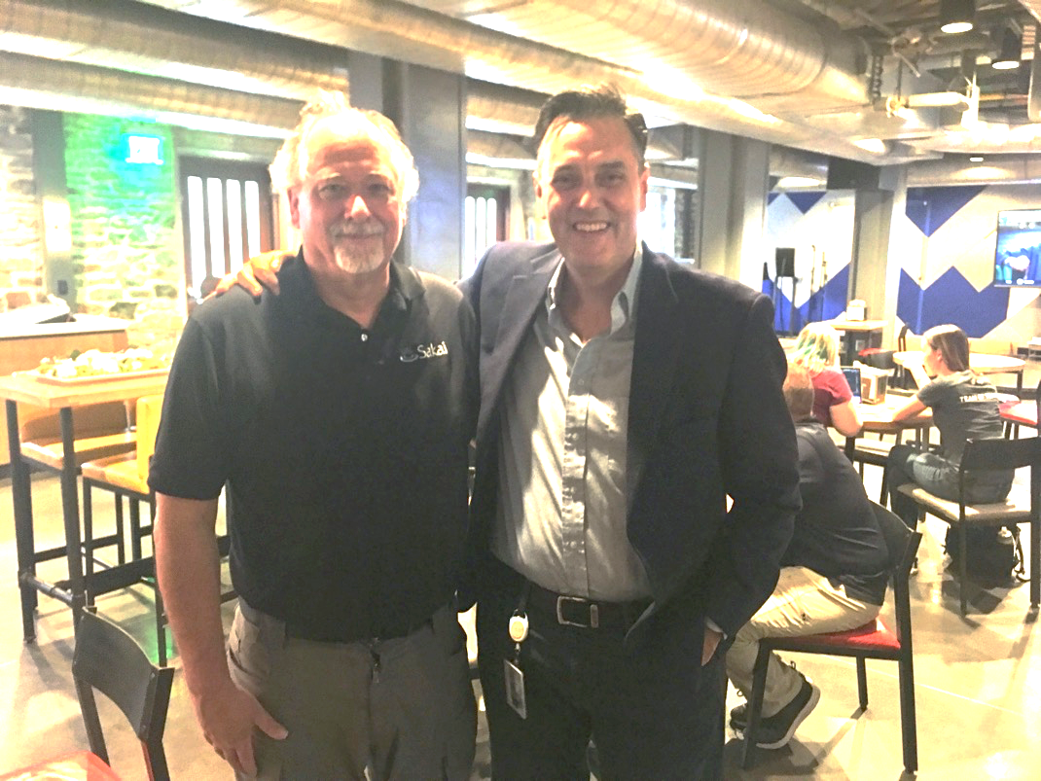
Greetings from Chuck Severance Author PY4E!!! October 7, 2019 Duke’s campus
Lecture #1
PDSB

Slide 19

Python for Data Science Bootcamp (PDSB) Course Grading
Lecture #1
Pass/Fail: To pass, the student must pass each assessment. If an assessment fails (assignment or mini-project) student must resubmit.
PDSB
Notes:
Talk about attendance, excuses

Slide 20

Python for Data Science Bootcamp (PDSB) Assessments
Lecture #1
Assignments
Total: 6; 1 per week
Released and collected: Released Monday due Friday
Time to complete and submit: 5 days
Mini-Projects
Total: 3; 1 every other week
Released and collected: Released Monday due following Monday
Time to complete and submit: 1 week
To be released and collected using GitHub and graded using Nbgrader application built on Jupyter notebooks
PDSB
Notes:
Talk about attendance, excuses

Slide 21
Python for Data Science Bootcamp (PDSB) Setting up Your Coding Environment
Lecture #1
Download Anaconda: https://www.anaconda.com/download/
Including Python 3.7, Jupyter Notebook 6.0.1
Install Anaconda Navigator on your desktop
Open Jupyter notebook
Create, then go to PDSB folder
Download and open “test” notebook
Close notebook and logout
Nbgrader documentation available at: http://nbgrader.readthedocs.io/en/stable/user_guide/highlights.html
* Additional instructions for GitHub account to be provided later
PDSB

Slide 22

In summary….
Lecture #1
Course Objectives, Learning Objectives, Where, When, How
Setting the Context
Reviewing our Game plan
PDSB

Slide 23

Look Ahead
Lecture #1
Before lecture #2:
Do: Install anaconda, Python, Jupyter notebook, GitHub
Read: https://py4e.com/ Chapter 2
PDSB

Slide 24

Lecture #1

