Slide 1
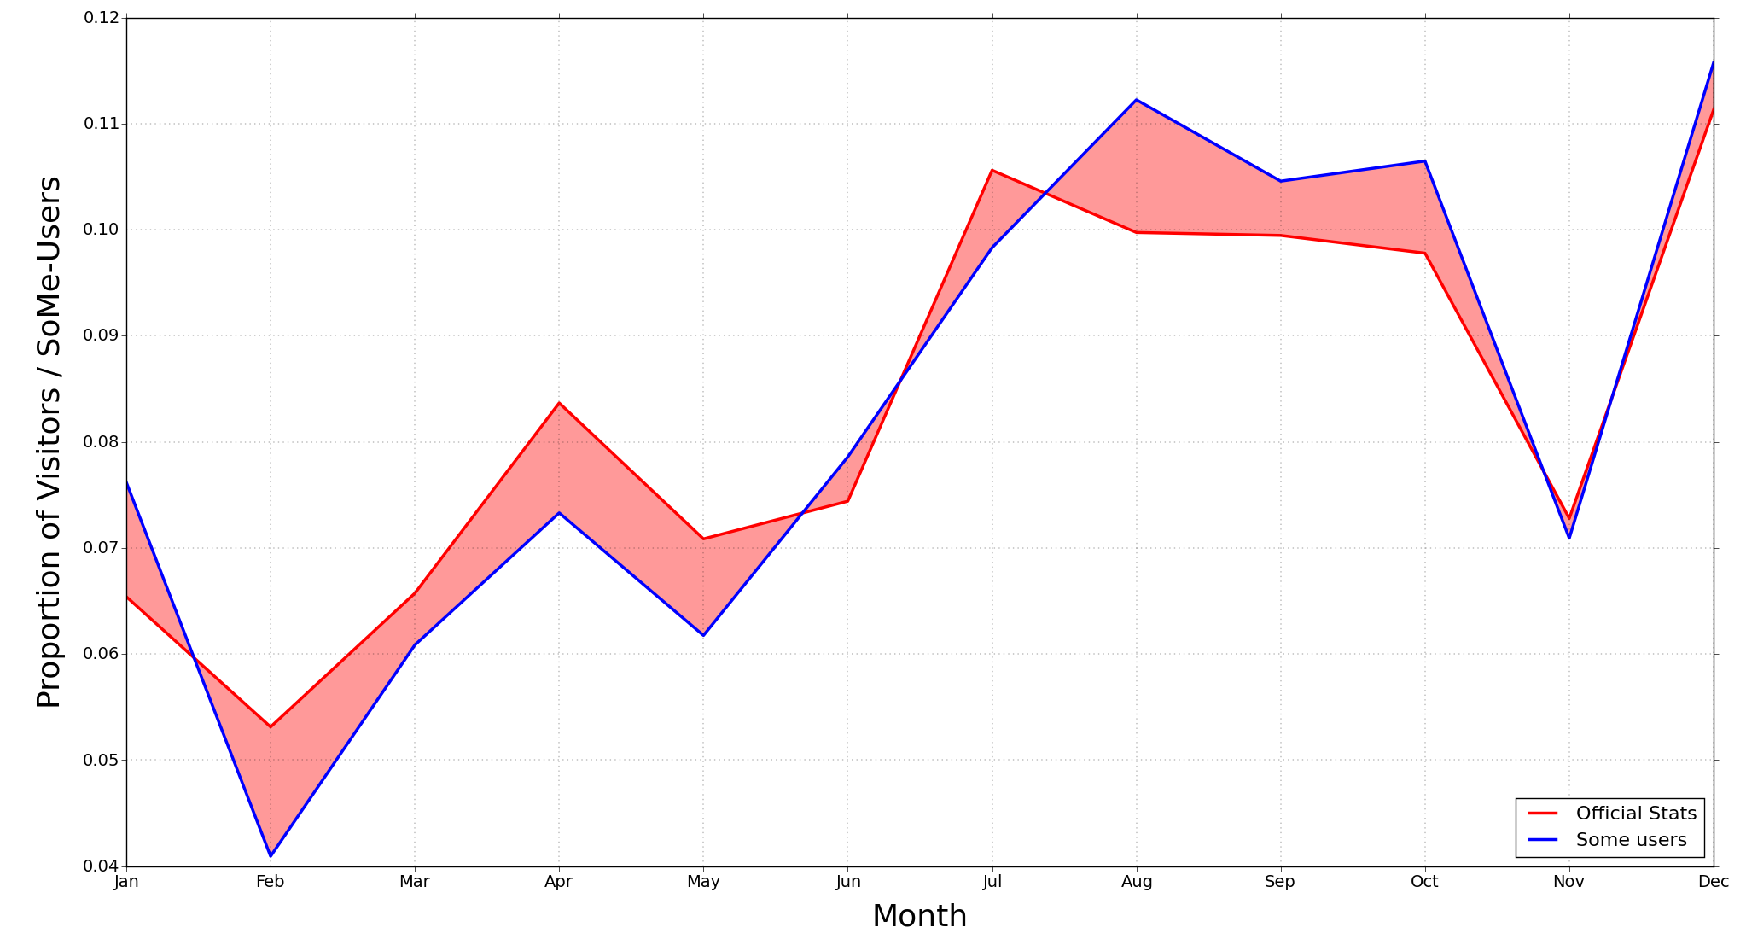
Social media vs Official statistics
tick –label (y)
Highest peak
annotation
y -label
Title
line
y –axis
grid lines
filling
ticks
Legend
tick –label (x)
x –label
padding
(i.e the distance between label and the axis)
y –axis

