Slide 1

Introduction to SAGA and BigJob

Slide 2
SAGA

Slide 3
BigJob: A SAGA-based Pilot Job System
BigJob utilizes SAGA as the resource access layer for the resource provisioning component (can talk to PBS, SGE, Globus, Condor, Amazon EC2)
Uses SAGA/JSDL-based workload description
Based on lightweight Python scripts

Slide 4
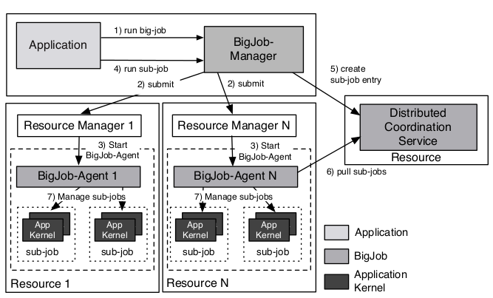
More on BigJob
SAGA BigJob is comprised of 3 components
BigJob Manager that provides the pilot job abstraction and manages the orchestration and scheduling of BigJobs (which in turn allows the management of both bigjob objects and subjobs)
BigJob Agent that represents the pilot job and thus, the application-level resource manager running on the respective resource, and
Advert Service that is used for communication between the BigJob Manager and Agent.
BigJob supports MPI and distributed (multiple-machine) workflows

Slide 5
BigJob Terminology
BigJob has a centralized database called the Distributed Coordination Service from where tasks are pulled once the BigJob becomes active.
A single task is called as a subjob in a Bigjob. Each subjob has a job description which specifies the directory the job executes, input, output files, number of processes required by subjob etc.

Slide 6
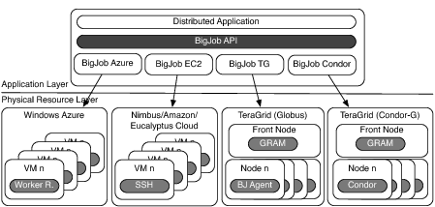
Distributed, High Throughput & High Performance

Slide 7
BigJob Deployments
BigJob is available in CSA space on both XSEDE and FutureGrid resources
Wiki contains user guide and many example scripts for each individual machine
https://github.com/saga-project/BigJob
Can use BigJob to...
Specify the database of tasks
Define the resources needed (SAGA does the queue translation)
Detail the computational task
Note: Need python programming experience.
Can be used to develop sophisticated workflows like Replica Exchange.
Suitable to run huge number of simulations across different machines

Slide 8
Sample BigJob Workflow Development
Note: Sample scripts are just basic building blocks written in python, which can be edited & used to build complex workflows.
Edit the sample scripts to
Provide distributed coordination database hostname & port number
Provide resource information like SAGA host URL on which you want to execute jobs, wall time, ppn, number of nodes, working directory ( where bigjob executes and bigjob log & error files are created ).
Provide subjob details like ( executable, location of input files ( arguments), environment variables, spmd_variation ( single / mpi ), subjob working directory ( where subjob executable is exected and its log & error files are created )
Extend the script for workflows.( its just python programming )

Slide 9
Applications of BigJob
Actually any workflow-based applications!
Examples:
Plant Pathology and Crop Physiology
Biomedical Engineering
Pharmacy
Petroleum Engineering
Computational Chemistry: AMBER, IMPACT, NAMD
Replica Exchange, Ensemble Workflows (w/ or w/o restart conditions), QM/MM

Slide 10
Questions
Please visit our wiki:
https://github.com/saga-project/BigJob/wiki/

