Slide 1
Connor

Slide 2
Rationale
Notes:
Background
Researchers are increasingly searching for lower allele frequency variants in diverse genomic populations using deep coverage next-generation sequencing data(refs). Errors in (1) PCR duplication and (2) instrument base calling confound attempts to assign true biological alternate allele frequency for rare variants; in response, a number of researchers have introduced custom DNA barcoding methods to differentiate true variants from false-positive artifacts (refs). By adding a molecule-specific barcode sequence, these methods enable downstream data transformations that can meaningfully aggregate sequences of PCR duplicates into sequence of the original biological molecules and disambiguate PCR and sequencing errors from low-frequency variants.
Connor de-duplicates a barcoded BAM and emits a BAM of consensus alignment pairs that represent the sequences of original biological molecules. In terms of data workflow, Connor is similar to position-based deduplication (e.g. Picard MarkDuplicates (ref)). However, deduplication based solely on position disproportionally discards original molecules that fall in small target regions with ultra-deep coverage (where positional overlap is more frequent) and typically chooses a consensus sequences that match the reference over sequences containing variants. In contrast, Connor combines sequences where the alignment structure and molecular barcodes match, creating a consensus sequences that more faithful model the population of original molecules.
Workflow
Sequencing [FASTQ ½] -> Aligner [BAM] -> Connor [BAM] -> Variant Detection [VCF]
Connor assumes the input BAM files barcoded using the Rubicon ThruPLEX R044 Preparation Kit. In particular Connor assumes each query sequence begins with a Universal Molecular Identifier (UMI) in-line barcode sequence (6 nt), followed by a non-random stem sequence (8-11 nt), followed by the target region.
[barcode | [stem] | target sequence]
ACTGTT-GTAGCTCA-GTTGAGACACAT…
[ soft clipped ] [ match ...
Because a correct UMI and consistent alignment structure are integral to Connor’s ability to accurately deduplicate, we encourage analysts to avoid any manipulations between sequencing and alignment. For example, given a set of PCR replicates from a single molecule:
end trimming can shave base calls off the front of the sequence (the UMI) which would prevent affected reads from being correctly grouped
pre-alignment quality trimming may shave reads off the end of the sequence which would proliferate the distinct CIGAR values obscuring the common alignment structure
Connor has been tested with BWA, Bowtie2 (-local mode), DNASTAR (disable clipping and deduplication), Hisat2, and Novoalign (PARAMETERS TBD) using default parameters except where noted. In a valid input BAM, the barcode and stem regions are assumed to be soft-clipped by the aligner (i.e. the sequence and qualities of the bases are retained in the alignment record but that region is marked as clipped in the BAM CIGAR field; soft clipped regions will not be processed by downstream variant detection methods).
Overview of UMI barcode deduplication method
Discard alignments which could not be mapped, are not properly paired, have low mapping quality (<1), or are missing CIGAR value.
Discard alignments whose pair partner is missing
Group together alignment pairs which share the same stem-template edge coordinates into a “position family”
Based on left and right UMI, subdivide “position families” into “UMI families”.
Extract left + right (combined 12-mer) UMI barcodes and sort by frequency into candidate families
For each alignment pair, loop over candidate family (in descending popularity) comparing the alignment UMI with the candidate family
Exact match across 12-mers is considered a match
Exact match of left or right UMI (6-mer) is considered a match
Inexact match (within Hamming distance 1) of left or right UMI is considered a match
Each alignment pair will either match an existing family, or found its own family
Within each UMI family, establish the majority CIGAR across alignments; discard alignment pairs with non-majority CIGARs
Discard UMI families with fewer than 3 original pairs
For each UMI family, collapse the set of original alignment pairs into a single consensus alignment pair.
Consensus sequence is determined by majority vote at each position in the base call sequence
Any position with less than 60% majority results in an N at that position
Consensus quality is determined by majority vote at each position in the quality sequence
Consensus CIGAR is the majority cigar for that UMI family
Example
Consensus + Annotated Alignments (Tags)

Slide 3
Position Family Grouping
GTTACA-GTAGCTA-NNNNNN…
…NNNNNN-ATCGATG-AATGCA
UMI
stem
target
target
stem
UMI
a
b
Position family
1
2
3
(discard)
Notes:
Figure 1. Position families
Alignments are grouped into position families based on their alignment to the reference. Each bar represents a paired alignment positioned on the reference.
The stem-target boundaries of the target sequences define the groups (beginning of left target, end of the right target) [a,b]
Unmapped, unpaired, or low-quality reads are removed.

Slide 4
UMI Family Grouping
GTTACA-GTAGCTA-NNNNNN…
…NNNNNN-ATCGATG-AATGCA
UMI 1
stem
target
target
stem
UMI 2
Position family
3 UMT families
1
2
1
2
a
3
4
b
1
2
1
2
1
5
1
5
3
4
3
4
3
4
6
4’
c
7
8
6
4’
7
8
d
Notes:
Figure 2. UMI families
Position families are further divided into UMI families by UMI barcode. Each bar represents a paired alignment; distinct UMI barcodes are numbered and shaded. The collection of the left is the alignments from the position family; on the right those same alignments are partitioned into three UMI families.
Alignment will be admitted to a UMI family if it either left or right UMI barcode is similar (within one hamming distance); several match types are noted: [a] are exact left-right matches, [b] is exact one-side match, [c] is inexact one-side match.
Small families (<3 alignment pairs) are discarded [d].

Slide 5
Building consensus alignment
GTTACA-GTAGCTA-NNNNNN…
…NNNNNN-ATCGATG-AATGCA
UMI 1
stem
target
target
stem
UMI 2
1
2
1
2
UMT
family
1
3
1
2
1
2
a
1
2
1
2
b
c
d
Consensus
alignment
1
2
Notes:
Figure 3. Building consensus alignment
The set of alignment pairs in a UMI family (top) are combined into a single consensus pair (bottom) by majority vote. Each bar represents a paired alignment; distinct UMI barcodes are numbered and shaded; mismatches (candidate variants) in the target sequence region are highlighted.
Within a UMI family, only structurally identical alignments (i.e. matching CIGAR values) as can be combined; alignment pairs with minority CIGAR values are discarded [a].
Consensus alignment preserves the majority UMI left and right barcodes and stem. In the target sequence region, the base calls are tallied for each position and the majority base call becomes the consensus base call [b,c]. If the majority base call is less than 60%, the base call is replaced by “N” indicating ambiguity [d].

Slide 6
Connor Data Workflow A
Raw Reads
(FASTQ)
Aligner
Original Alignments (BAM)
Connor
Consensus Alignments
(BAM)
Notes:
Alignment guidelines – the most important factors in generating a file useful for Connor is to not trim read and to not force a global alignment. Any manipulations done to a bam file post-sequencing may reduce the fidelity of the UMI sequence and may detract from Connor’s ability to remove duplicates. Connor has been tested with BWA, Bowtie2, Novoalign and DNASTAR aligners. BWA will work fine in default mode; Bowtie2 must be run in ‘-local’ mode; Novoalign ...; DNASTAR should not have “clipping” or “deduplication” turned on. Subsequent diagrams are generated with BWA.
Connor takes as input alignment files (BAM) that have been barcoded using the Rubicon xxx kit. It assumes the reads have a specific structure: that the reads begin with six bases of UMI barcode sequence followed by variable length (in most cases 10-12 bp) stem sequence, followed by target sequence. Connor will output a new alignment file (BAM) containing consensus reads, each representing the set of original reads with identical locations, barcodes, and alignment structure that theoretically originate from a single original molecule of DNA in the biological sample.
[barcode] [stem] [target sequence]
UUUUUU-SSSSSSSSSSSS-NNNNNNNNNNNN...
[ soft clipped ] [ match ...
The barcode and stem are assumed to be soft-clipped by the aligner, i.e. the sequence and qualities of the bases are retained in the alignment record but that region is marked as clipped in the BAM CIGAR field. (Soft clipped regions will not be processed by downstream variant detection methods.) Any processing steps prior to and including alignment that impact the UMI region will degrade or prohibit Connor’s ability to deduplicate; for example, quality trimming can shave off bases from the UMI which will prevent affected reads from being correctly grouped.

Slide 7
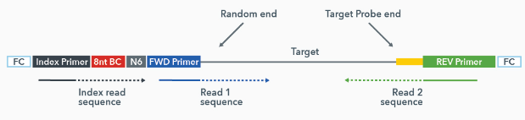
Connor Data Workflow B
@HWI-D00143:749:HM5YFBCXX:2:1101:1004:2029 1:N:0:ATTCAGAA
NCCATCGTAGCTCATTTCAAAACTGCTCTATCAAAAGAAAGCTTCAACACTGTTAGTTGAGGGCGCACATCACAAATAAGATTCTGAGAATGCTTCTGTC
@HWI-D00143:749:HM5YFBCXX:2:1101:1004:2029 1:N:0:ATTCAGAA
NCCATCGTAGCTCATTTCAAAACTGCTCTATCAAAAGAAAGCTTCAACACTGTTAGTTGAGGGCGCACATCACAAATAAGATTCTGAGAATGCTTCTGTC
Notes:
Reads processed by Connor are assumed to have the indicated structure. In addition to the standard sequence adapter stuff the UMI barcode is included (adjacent to sequencing primers), followed by stem sequence, followed by target query sequence.

Slide 8
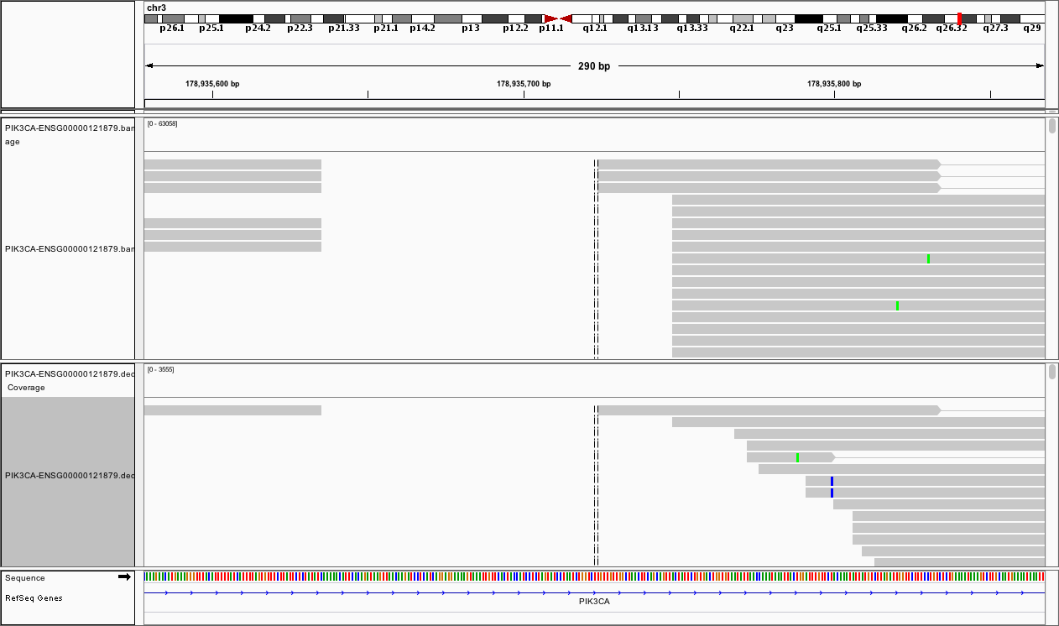
Connor Data Workflow C
Raw reads
Deduped reads

Slide 9
Dedup Consensus Details A
Original Alignments
(BAM)
Filtering
Group by position
Build UMI Family
Create Consensus
Family Size Filter
Consensus Alignments
(BAM)
Notes:
Overview of UMI barcode deduplication
Discard alignments which could not be mapped, are not properly paired, have low mapping quality (<1), or are missing CIGAR value.
Discard alignments whose pair partner is missing
Group together alignment pairs which share the same stem-template edge coordinates into a “position family”
Based on left and right UMI, subdivide “position families” into “UMI families”.
Extract left + right (combined 12-mer) UMI barcodes and sort by frequency into candidate families
For each alignment pair, loop over candidate family (in descending popularity) comparing the alignment UMI with the candidate family
Exact match across 12-mers is considered a match
Exact match of left or right UMI (6-mer) is considered a match
Inexact match (within hamming distance 1) of left or right UMI is considered a match
Each alignment pair will either match an existing family, or found its own family
Within each UMI family, establish the majority CIGAR across alignments; discard alignment pairs with non-majority CIGARs
Discard UMI families with fewer than 3 original pairs
For each UMI family, collapse the set of original alignment pairs into a single consensus alignment pair.
Consensus sequence is determined by majority vote at each position in the base call sequence
Any position with less than 60% majority results in an N at that position
Consensus quality is determined by majority vote at each position in the quality sequence
Consensus CIGAR is the majority cigar for that UMI family
Example

Slide 10
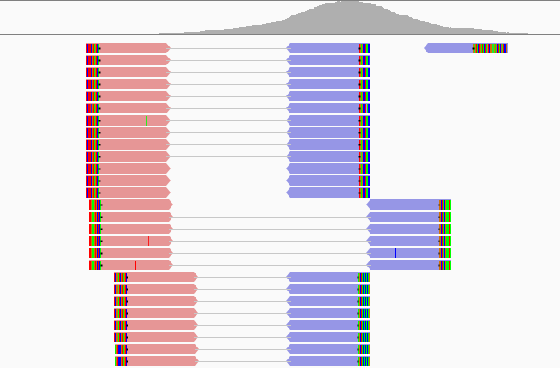
Position Family Grouping
a
b
c
d
Notes:
Figure 1. Position families
Alignments are grouped into position families based on their alignment to the reference.
In the schematic each bar represents an alignment where the barcode [a], stem [b], and target sequence [c] are shaded.
Unpaired and low-quality alignments are discarded [d].
The stem-target boundaries of the target sequences define the groups (beginning of left target, end of the right target) [c]

Slide 11
UMI Family Grouping (no mismatches)
GTTACA-AGCCAGTTTAGG-NNNNNN
NNNNNN-GAGCCTAACTAACG-AATGCA
TACCTC-AGCCAGTTTAGG-NNNNNN
NNNNNN-GAGCCTAACTAACG-ATAGGC
Notes:
Then, all reads in a position family are further grouped based on their UMI barcodes into “UMI families”. A UMI family consists of all reads at each position that have matching UMI barcodes. Only one side of a barcode pair is required to match, and Inexact matching is permitted when creating a UMI family based on a user-defined Hamming distance. One UMI barcode is chosen to represent the entire family based on frequency: the most frequently occurring UMI tag is nominated to represent the generated consensus read.

Slide 12
UMI Family Grouping
Notes:
A UMI family consists of all reads at each position that have matching UMI barcodes. Only one side of a barcode pair is required to match, and Inexact matching is permitted when creating a UMI family based on a user-defined Hamming distance. One UMI barcode is chosen to represent the entire family based on frequency: the most frequently occurring UMI tag is nominated to represent the generated consensus read.

Slide 13
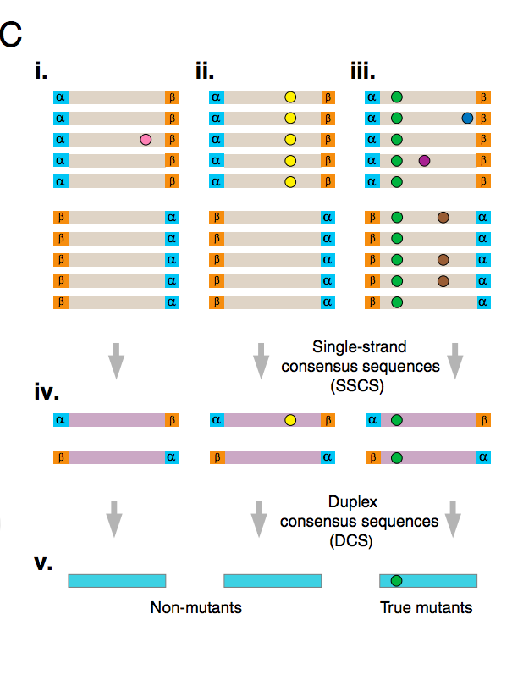
Dedup Consensus Details D

Slide 14
Sort UMI barcodes by frequency, generate candidate
Loop over UMI families
Loop over UMIs, (inexact)match to most popular UMI?
Yes
Join family
No
Choose next most popular UMI barcode
Join family

