Slide 1



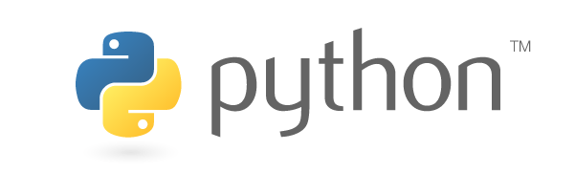
The Language

Slide 2



A bit of history
Python was conceived in 1980 and started being implemented in 1989 by Guido van Rossum at CWI (Netherlands), entitled BDFL (Benevolent Dictator For Life) by the community
Focus on code readability, providing a syntax that allows more concepts in fewer lines of code
Fully open-source with a extremely active and wide community

Slide 3
A bit of history – Versions
The first main community backed version:
Python 2.0, October 16, 2000
    Cycle-detecting garbage collector for memory management
    Unicode support

Slide 4
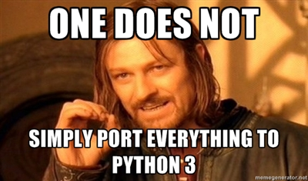
A bit of history – Versions
The first main community backed version:
Python 2.0, October 16, 2000
    Cycle-detecting garbage collector for memory management
    Unicode support
Python 3.0, December 3, 2008
    Backwards-incompatible
    Major features backported to
    python 2.6 & 2.7
(In 2005)
DISCLAIMER: This workshop will be using python 3.0

Slide 5
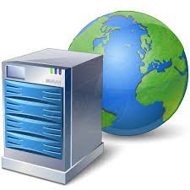

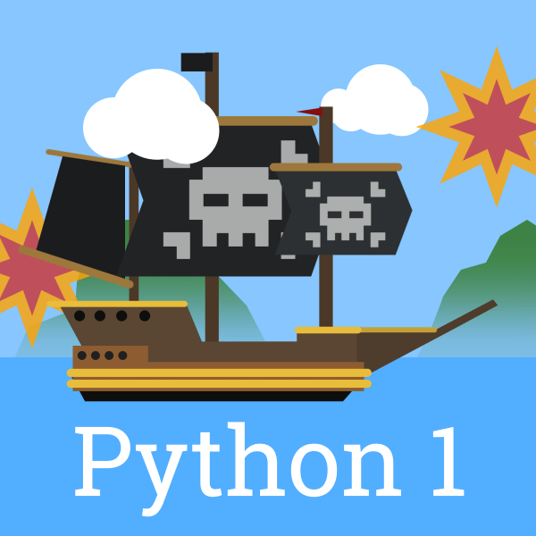


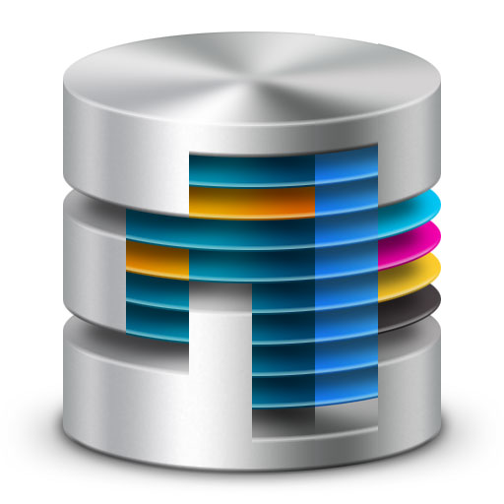
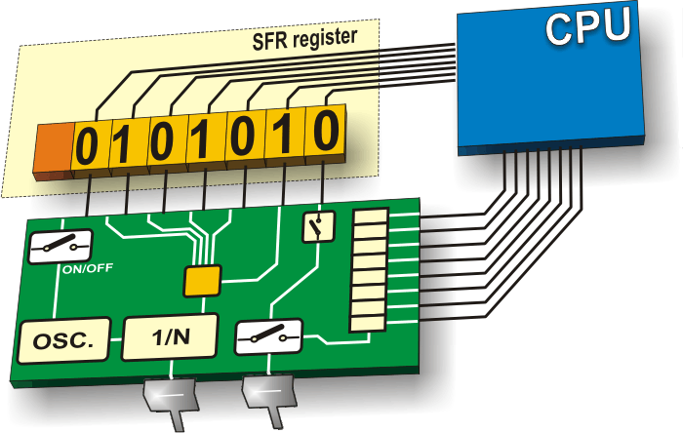
A bit of history – Use of python
Python is currently being used for “everything”
Large-scale servers
working 24/7
Astronomy
Teaching Kids
Throw-away
scripts
Machine
learning
Databases
Microcontrollers

Slide 6

A bit of history – Use of python
(Some) Companies currently massively using python

Slide 7
A bit of history – Python 3
Python 3 was designed to correct some fundamental design flaws
(see https://en.wikipedia.org/wiki/History_of_Python#Features)
    Not possible to retain full backwards compatibility
What does this mean?
    If you start now with python 3, you will learn the “good way”
    Some packages may still be not fully functional in python 3 (give them some time!)
    You can check the version of python you are using simply by:
    import sys; print(sys.version)
DISCLAIMER: This workshop will be using python 3.0

Slide 8
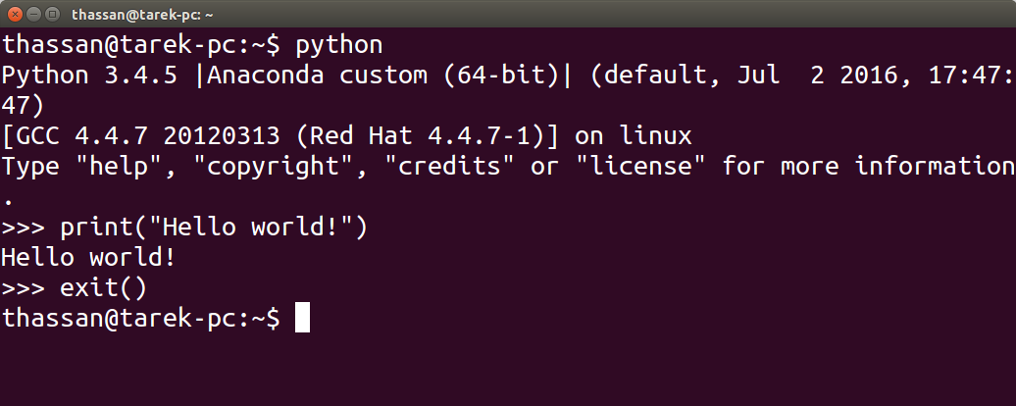
Getting started with python
Open a terminal and type “python”

Slide 9
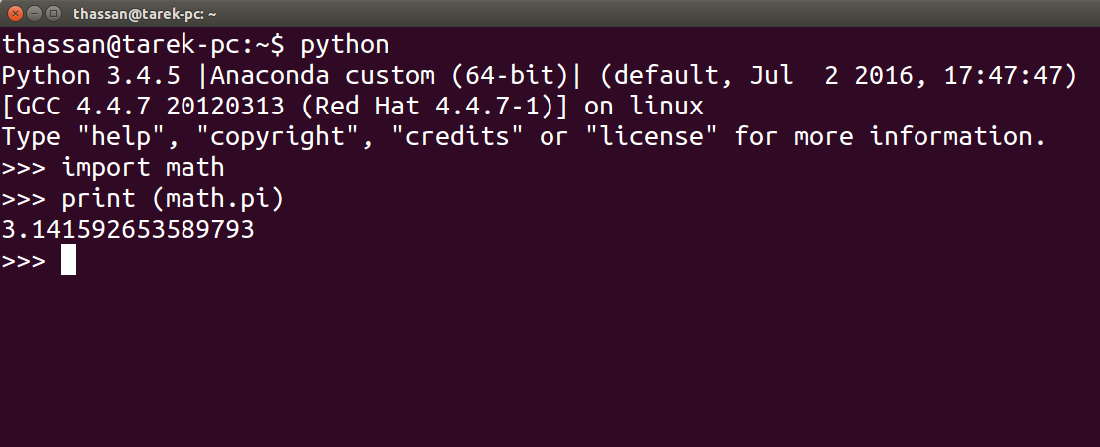
Getting started with python
To use an external library, you need to “import” it:
Python standard library: https://docs.python.org/3/library/index.html

Slide 10
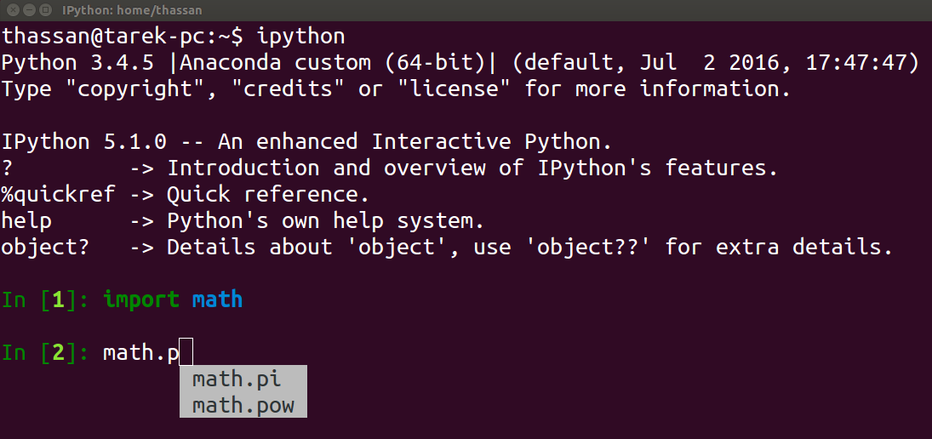


Getting started with python
You have more interactive options, like “ipython”:

Slide 11
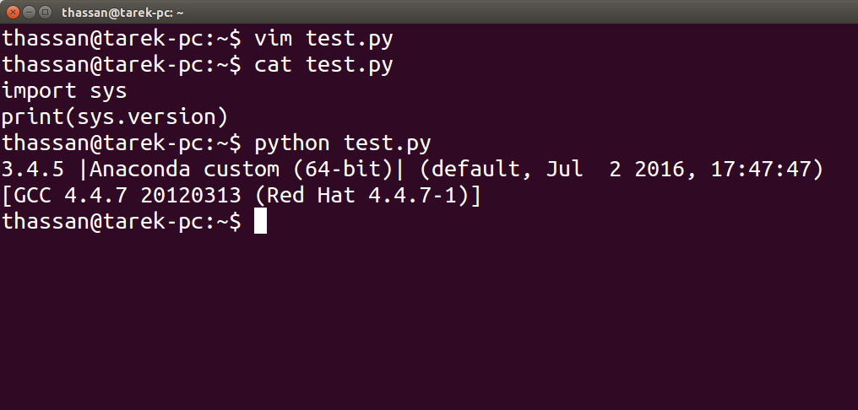
Getting started with python
For writing scripts, you can use any “plain” text editor:

Slide 12
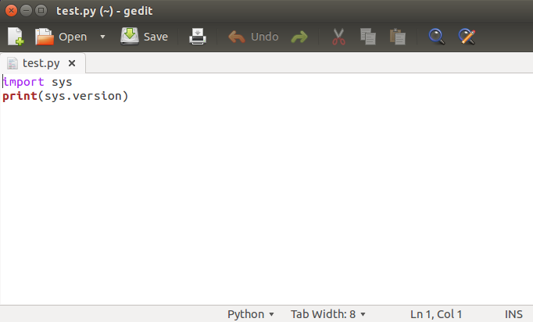
Getting started with python
For writing scripts, you can use any “plain” text editor:

Slide 13
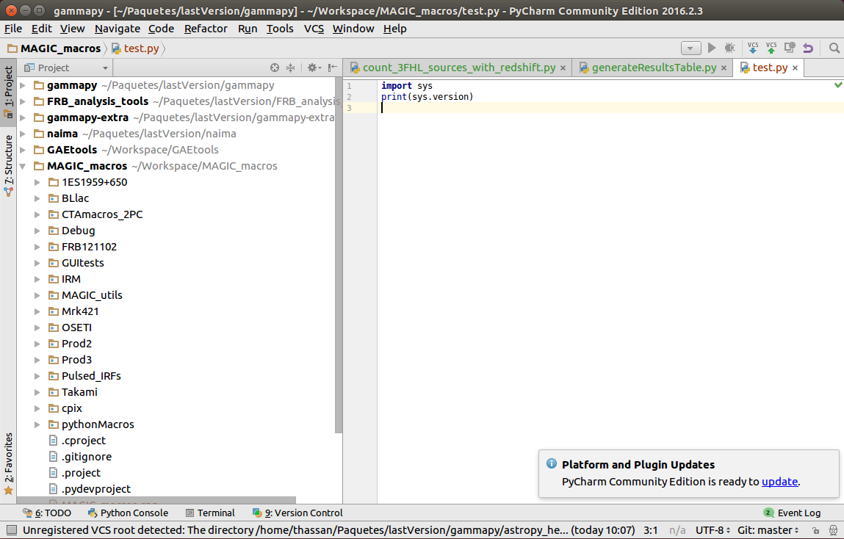
Getting started with python
Or use an IDE: (e. g. pyCharm, eclipse, vim, wing, spyder...)

Slide 14
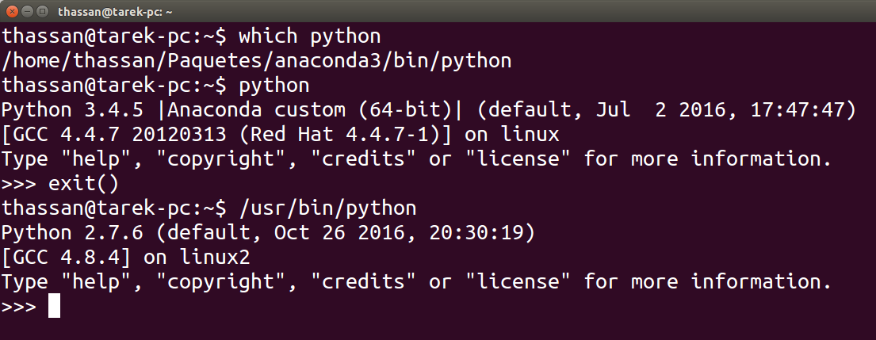
How python works: binaries
As it is possible (and usual) to have several “pythons” installed, some clarifications are useful
      When you enter the python console, you execute a python binary (you may have several installed!)

Slide 15
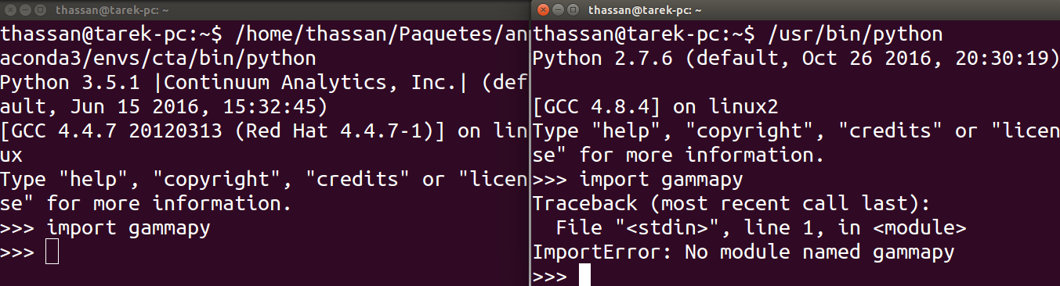
How python works: binaries & libraries
Certain libraries may be installed only in some python environments:

Slide 16
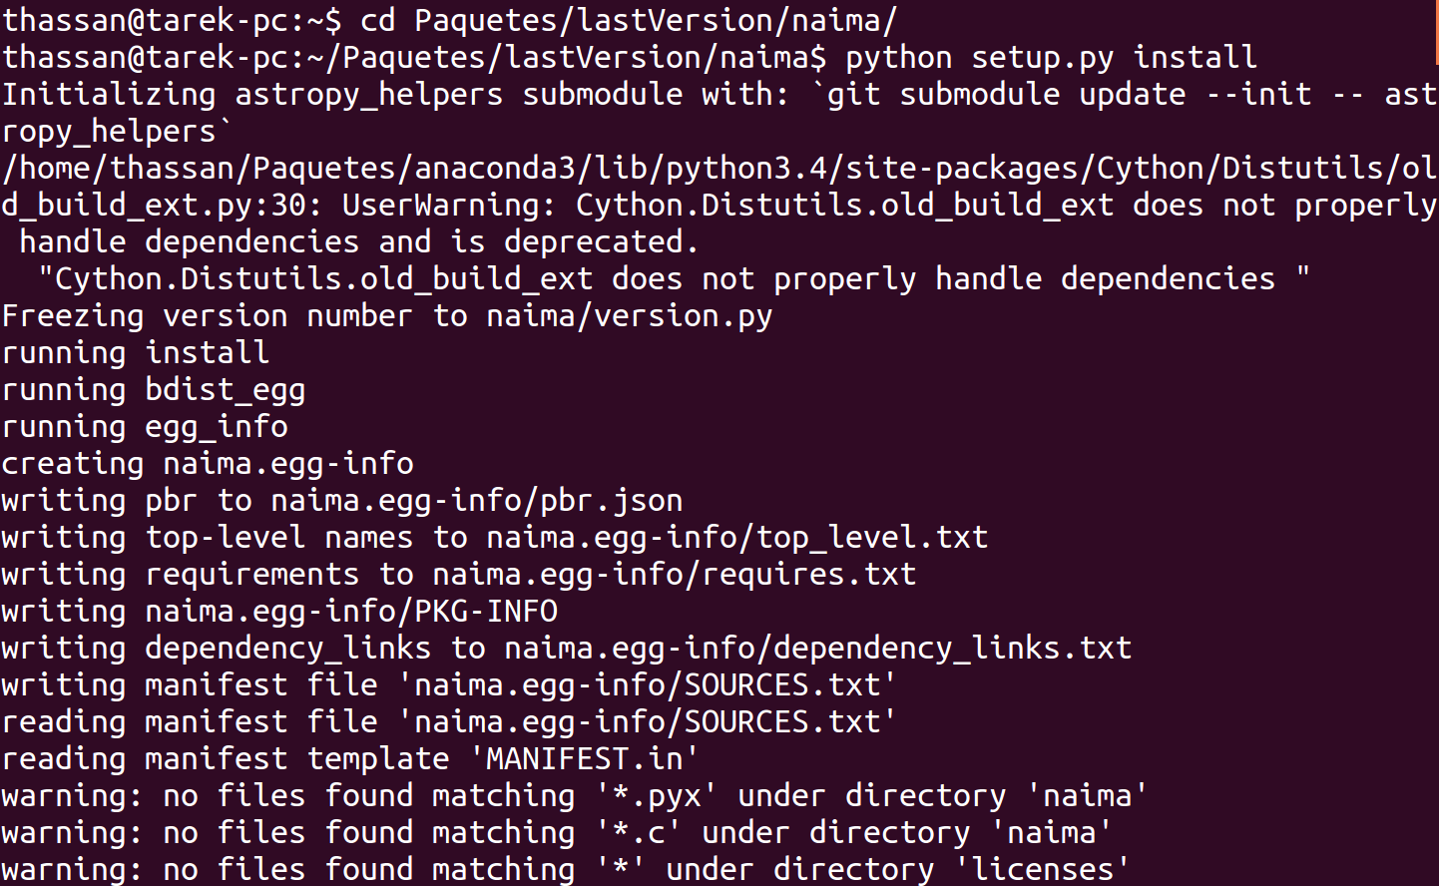
How python works: binaries & libraries
To install a library:
    You may do it manually (usually not encouraged):
        Download package, “compile” and install

Slide 17
How python works: binaries & libraries
To install a library:
    You may do it manually (usually not encouraged):
        Download package, “compile” and install
    You may use a package manager such as “pip”:
        E. g. “pip install ipython-sql”
        This will install all dependencies, in the version required by the package
        Unless if you are a developer of a specific package, you will probably always use this method (or analog ones)

Slide 18

How python works: binaries & libraries
Working with environments:
    If you followed the tutorial we sent to install python, you installed anaconda and created an environment named “py36”
    These virtual environments allow to have a clean installation of python where all third-party packages are in the required version
        Different python project may (and probably will) require different dependencies (either different libraries, or same libraries with different versions)
        Usually, you will just need to activate the desired environments: “source activate py36”
https://conda.io/docs/user-guide/tasks/manage-environments.html

Slide 19
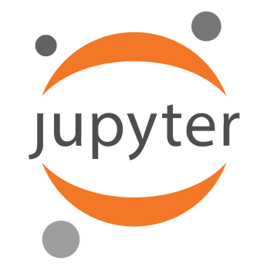
Using Jupyter notebooks
For simplicity, to follow the tutorials of this course we will be using Jupyter notebooks
    Open-source web application that allows to edit
    and execute code
    All code is executed locally within your python
    environment (even if it is shown within your browser)
To begin the course, clone the gitHub repository of the course and execute the jupyter notebook “02_01_TheLanguage.ipynb”

Slide 20
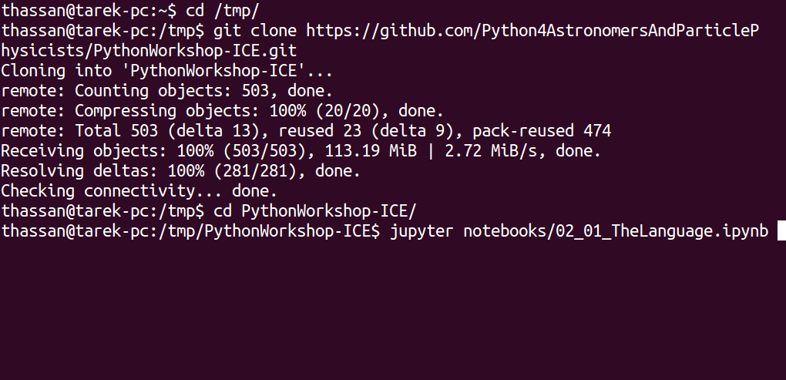
Using Jupyter notebooks
To begin the course (if you did not do it already), clone the gitHub repository of the course and execute the jupyter notebook “02_01_TheLanguage.ipynb”

Slide 21
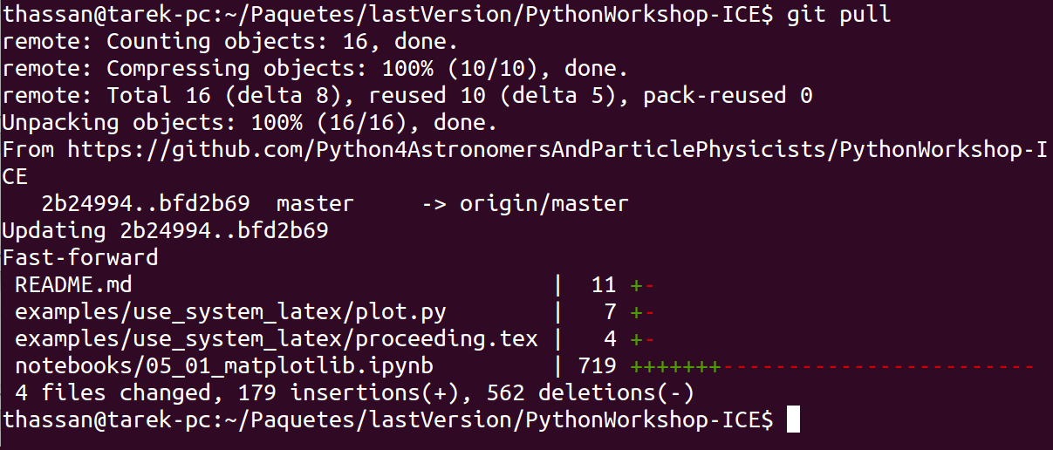
Using Jupyter notebooks
To begin the course (if you did not do it already), clone the gitHub repository of the course and execute the jupyter notebook “02_01_TheLanguage.ipynb”
If you already cloned it, make sure that you have the latest version by typing within your project “git pull”:

Slide 22
Using Jupyter notebooks
To begin the course (if you did not do it already), clone the gitHub repository of the course and execute the jupyter notebook “02_01_TheLanguage.ipynb”
If you already cloned it, make sure that you have the latest version by typing within your project “git pull”:
If conflicts appear while updating (probably caused by local modifications you did to the notebooks), you may “stash” your changes and try to update again:
> git stash
> git pull

Slide 23
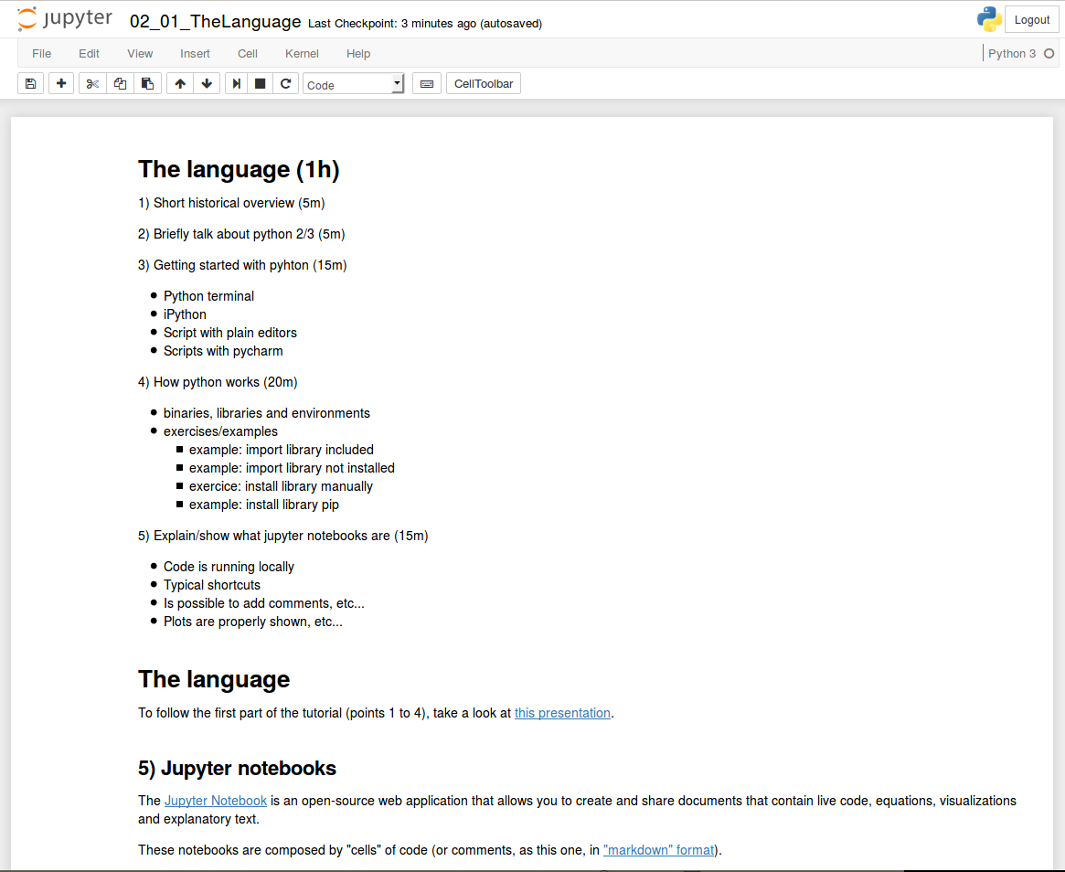
Using Jupyter notebooks
From now on, the tutorial (and whole workshop) continues through notebooks (in your browser, similar to this):

