Slide 1
Learning visual Features
How Neural network Extract hierarchical features in the image Domain? And Most Importantly
How Neural network allows us to learn those visual features from visual Data if cleverly constructed!!!

Slide 2
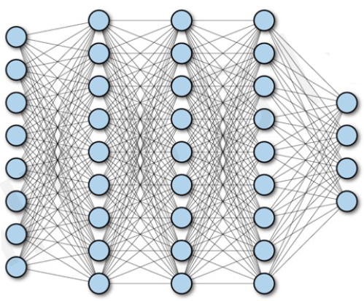
Fully Connected Neural Network

Slide 3
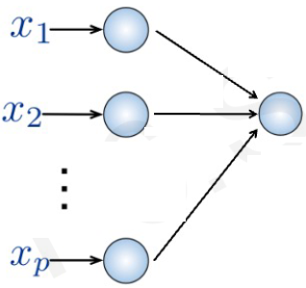
Fully Connected Neural Network
Fully Connected:
Connect Neuron in hidden layer to all neurons in input layer
No spatial Information (3-D or 4-D)
Large no. of parameters, as the system is fully connected
Input:
2-D Image
Collapsing into 1-D sequence of number (Vector of pixel values)
Remember that our image is just 2-D array
Fully connected NN can’t process 2-D Matrix

Slide 4
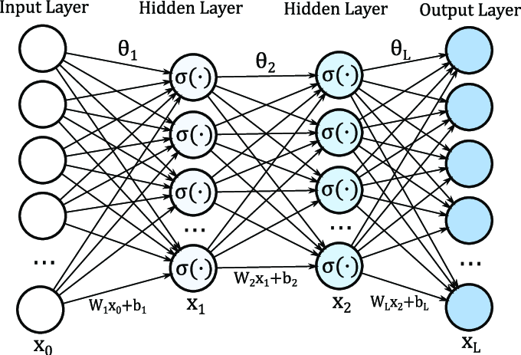
Fully Connected Neural Network

Slide 5
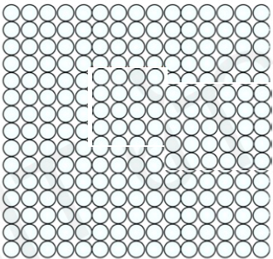
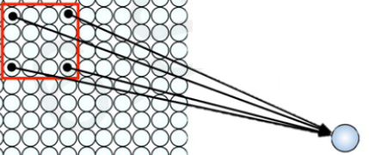
Using Spatial Structure
Input:
2-D Image
Collapsing into 1-D sequence of number (Vector of pixel values)
Idea: connect patches of input to neuron in hidden layer
Neuron connected to region of input, only sees the values

Slide 6
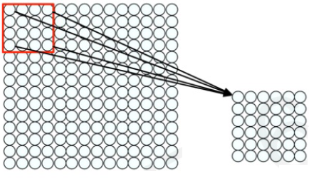
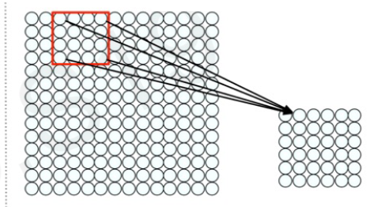
Using Spatial Structure
Connect patch in input layer to a single neuron in subsequent layer by using a sliding window to define connections, and thus preserving very rich spatial information.
How we can weight the patch to detect particular patch?

Slide 7
Applying Filters to Extract Features
Apply a set of weight - a filter – to extract local features
1
Use Multiple filters to extract different features.
2
Spatially share parameters of each filter
3

Slide 8
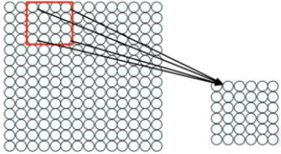
Features Extraction with Convolution: An Example
Filter of size 4*4= 16 different weights
Apply this same filter to 4*4 patches in input and use the result of that operation to update the state of the neuron in the next layer
Shift by 2 pixel for next patch to define the next neuron in the adjacent location in the future layer
Concept of Convolution at high level

Slide 9
Feature Extraction and Convolution: A Case Study
How convolution allows us to learn these features/patterns in the data which is our ultimate goal

Slide 10
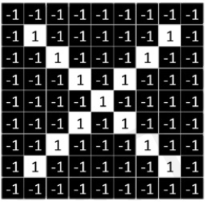
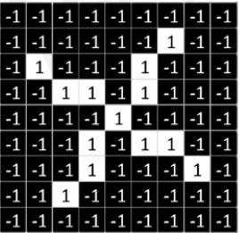

Designing a Convolutional Algorithm to Detect or Classify X as X in a Black & White Image
No Grayscale image, black and white (1-white and -1 for black)
Detect x in both of these images slightly rotated
Cleverly we have to detect those feature that define an X: So let see how to use Convolution to do that

Slide 11
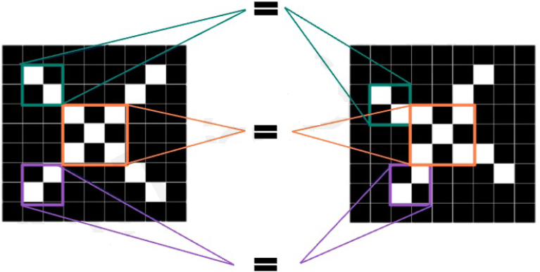
Identifying Features of X using Convolution
We need our model to compare images of this X, piece by piece or patch by patch and the important patches that we look for are exactly these features that will define our X:
If our model can find these rough features roughly in the same position in our input than we can infer that these two images or of the same type

Slide 12

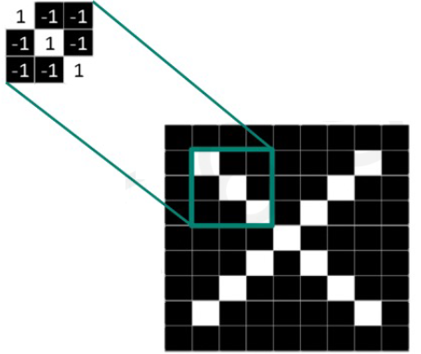


Identifying Features of X using Filters
These smaller matrices are Filter of weights or jus numerical values of each pixel in these mini patches
Probably we will capture these features in the arms and the centers of our letter in any image of X regardless of its position

Slide 13
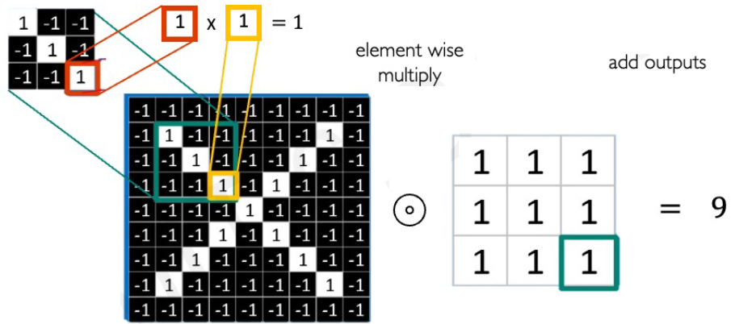
The Convolution Operation: Another Example:
Element wise Multiplication between the Filter Matrix those mini patches as well as the patch of our input image

Slide 14
The Convolution Operation: Another Example:

Slide 15
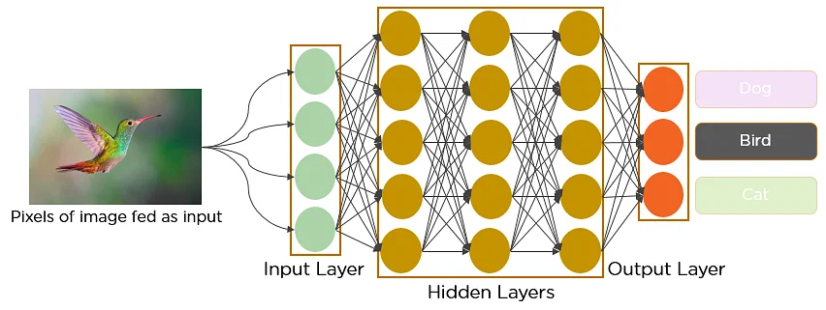
Lets see how NN and CNN Process an Image
Feed the pixels of the image in the form of arrays to the input layer of the NN
Multi-layer networks used to classify things.
The hidden layers carry out feature extraction by performing different calculations and manipulations.
There are multiple hidden layers like the convolution layer, the ReLU layer, and pooling layer, that perform feature extraction from the image.
Finally, there’s a fully connected layer that identifies the object in the image.

Slide 16
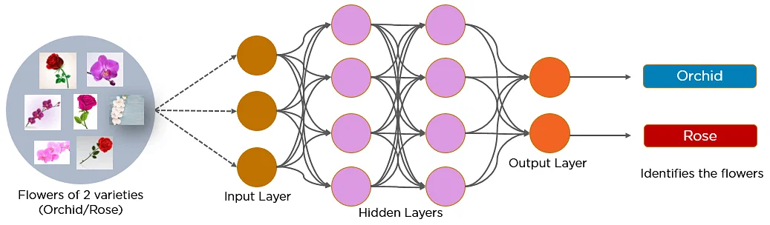
Lets see how NN and CNN Process an Image

Slide 17
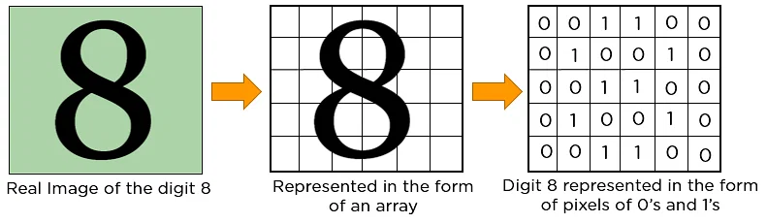
Lets see how NN and CNN Process an Image
In CNN, every image is represented in the form of an array of pixel values.
Let’s understand the convolution operation using two matrices, a and b, of 1 dimension.
a = [5,3,2,5,9,7]
b = [1,2,3]

Slide 18
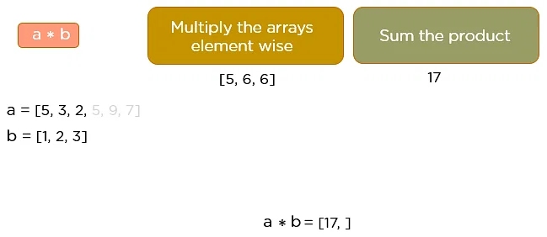
Lets see how NN and CNN Process an Image
a = [5,3,2,5,9,7]
b = [1,2,3]

Slide 19
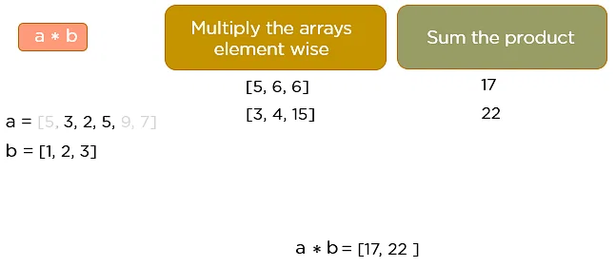
Lets see how NN and CNN Process an Image

Slide 20
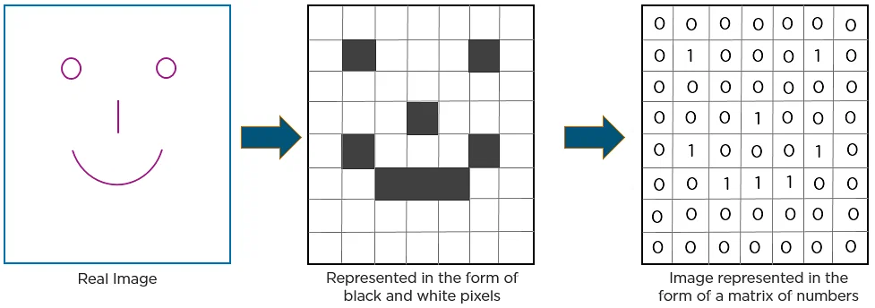
How CNN Recognized Image

