Slide 1
Tyrone Bracker
Automatize Plugging Test Program

Slide 2
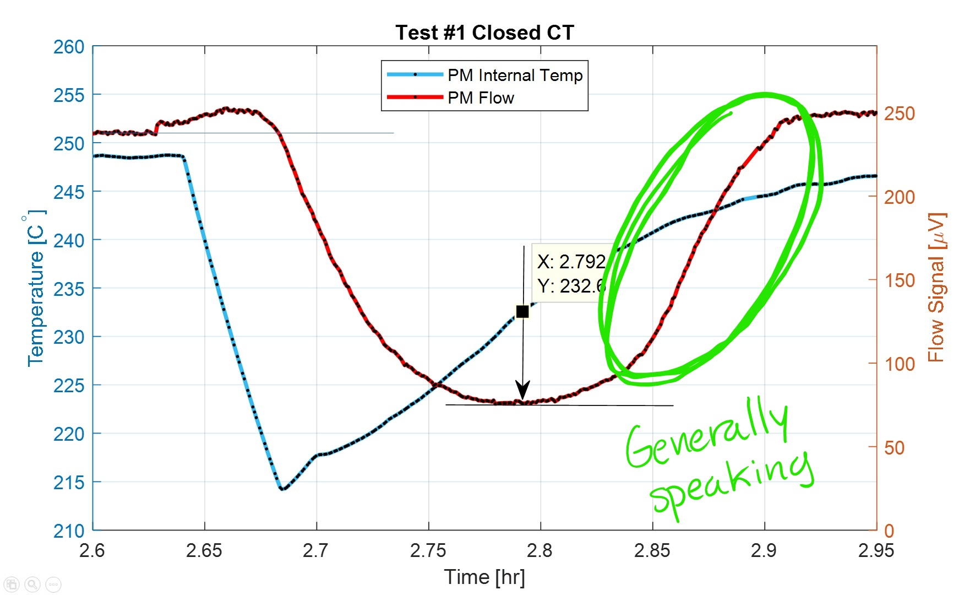
The Goal
Run the raw data through a filter and compare the two data types visually on a chart.
Record the two data types and find about three points of interest:
The minimum voltage value
The correlating temperature
The oxygen concentration
Have the program stop recording data when the flow “recovers” to steady-state or any percentage defined by the user.
Notes:
Last bulletin: Refer to picture

Slide 3
The process so far… in words
Let the data “build up” inside the for loop
The program finds the points of interest
Displays each element on one graph and individual indicators
Input the number of data points you want to record and press run

Slide 4
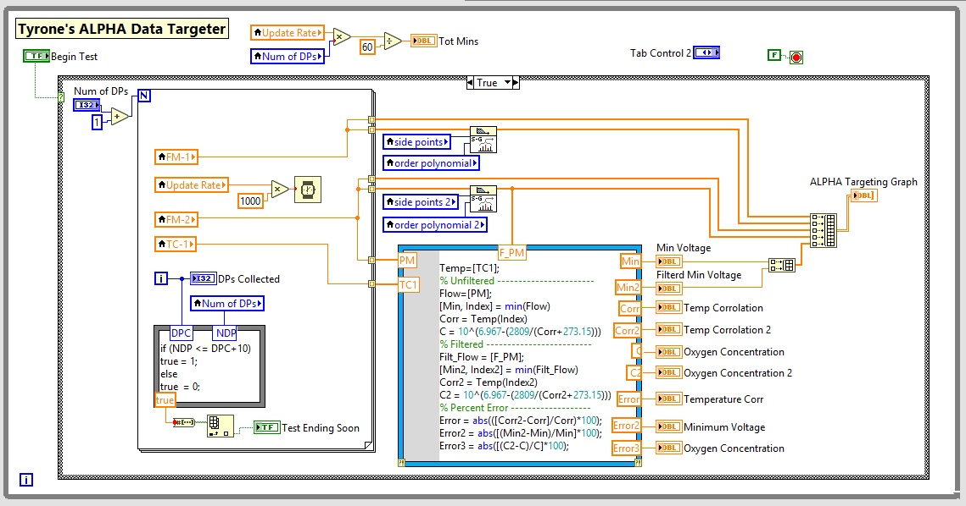
The process so far… visually (block diagram v1)
Notes:
V1 standing for “Version 1”. Working on V2.

Slide 5
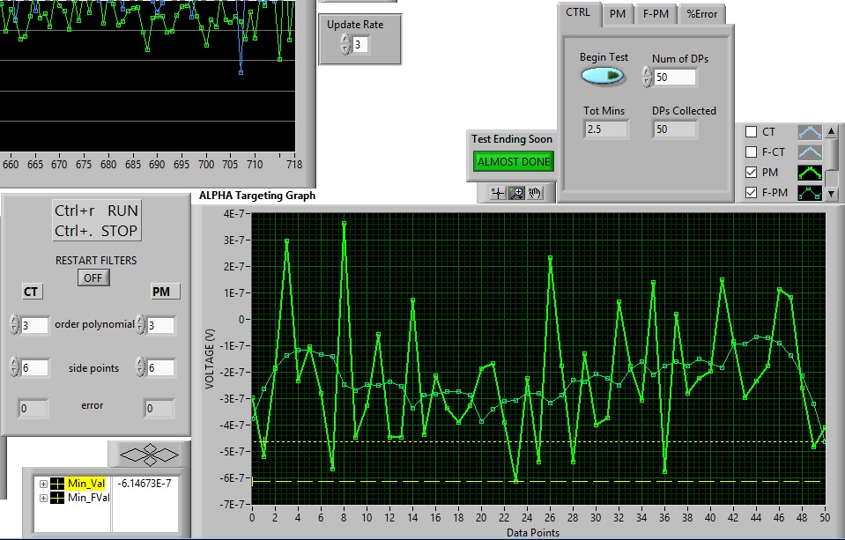
Front panel v1
Notes:
I wasn’t able to get a picture of an actual test but the basic function of the program works as displayed here.
The function being that the raw and filtered data is displayed together. Those two yellow lines represent the minimum voltage value found; the long-dashed line is for the raw data and the smaller-dashed line is for the filtered data.

Slide 6
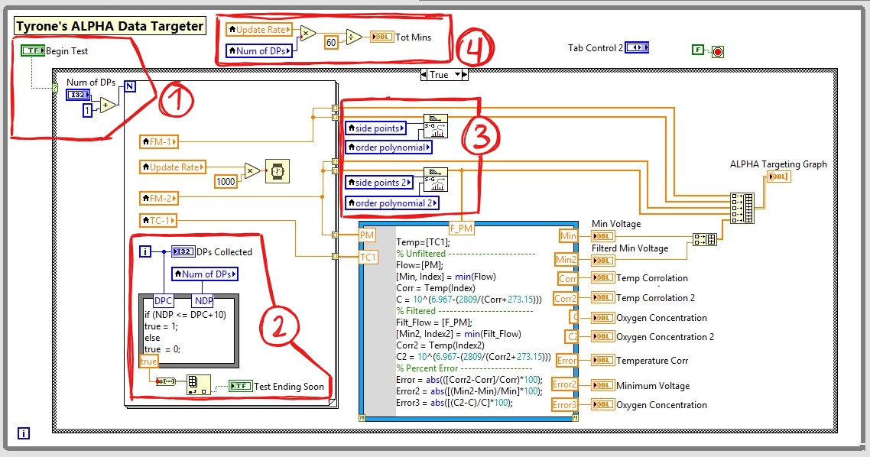
Highlights (Block diagram)
Notes:
You can flip back and forth between this slide and the next to see the corresponding controls and indicators that are highlighted.

Slide 7
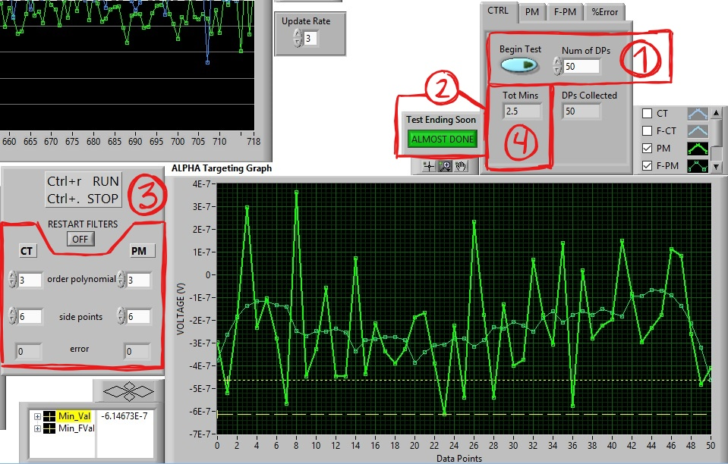
Highlights (front panel)
Setting the parameters of the test and begin
Additional indicators for the user
Savitzky-Golay filter controls
Estimated time value corresponding to “Num of DPs”
Notes:
DPs = Data Points
An indicator for both inside and outside the tab
Side points specifies the number of data points to each side of the current data point to use for the least squares minimization. This number determines the amount of data being used to fit the curve. Default poly-nom is 3.
Sometimes keeping track of how long a plugging test runs for is easier than determining how many data points you want to record, so there’s an indicator for that.

Slide 8
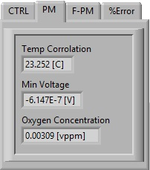
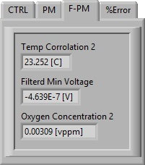
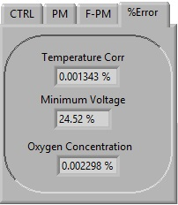
Tab information
Temp is recorded, used for both raw and filtered data
Minimum value and index is found within the data array(s)
Index is used to find corresponding temp
Noden Correlation equation uses corresponding temp to find oxygen concentration
Each data type receives a percent error
Notes:
Temp and EM-FM values (both raw and filtered) are stored in an array 1st, then the code runs protocols/equations on them.

Slide 9
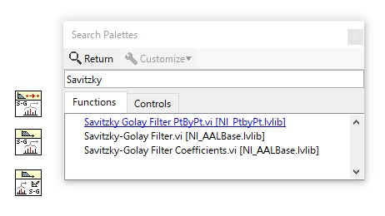
Different Savitzky-golay (s.g.) vi(s)
Point by point
LabVIEW: Performs fitting based on a polynomial of a given order and then smooths the curve instead of returning raw data.
Tyrone: Filters continuous data in real-time.
Normal
LabVIEW: Filters the input data sequences X using S.G. FIR smoothing filter.
Tyrone: Filters data that’s already been generated. Like an array of data.
Coefficients
LabVIEW: Designs a S.G. FIR smoothing filter. This VI returns the designed S.G. filter coefficients and the differentiation filter coefficients.
Tyrone: A more advanced
Notes:
“Tyrone” definition is just from testing, trial-and-error, and what I saw, in LabVIEW.
That being said, I never used the coefficients-version of the filter.

