Slide 1




Python and Wikidata: a match made in heaven?
Ian Watt, Code The City
Wikidata logo By Planemad - Own work, Public Domain, https://commons.wikimedia.org/w/index.php?curid=20650833
Python Logo: Dnu72, CC BY-SA 4.0, via Wikimedia Commons
Original content of this presentation – Ian Watt, Own Work CC-BY-SA 4

Slide 2
Introduction
What is Wikidata?
Python Libraries we can use to interact with Wikidata
Querying Wikidata with SPARQL
Examples using one simple library
How to get involved
Useful resources

Slide 3
Wikidata …..
is a free and open knowledge base that can be read and edited by both humans and machines.
acts as central storage for the structured data of its Wikimedia sister projects.
provides support to many other sites and services beyond just Wikimedia projects.
Has a free licence (CC0),
Contents can be exported using standard formats, and can be interlinked to other open data sets on the linked data web.
Notes:
is a free and open knowledge base that can be read and edited by both humans and machines.
acts as central storage for the structured data of its Wikimedia sister projects including Wikipedia, Wiki Commons etc.
also provides support to many other sites and services beyond just Wikimedia projects! The content of Wikidata is available under a free license, exported using standard formats, and can be interlinked to other open data sets on the linked data web.

Slide 4
Wikidata
97 Million items
https://Wikidata.org
Wikidata logo By Planemad - Own work, Public Domain, https://commons.wikimedia.org/w/index.php?curid=20650833

Slide 5
Graph Databases vs Relational Databases
RDBMS
Tables
Schema
Linking of tables
Normalisation
(Primary) keys
Table Joins
SQL
Graph DB
Nodes (items)
Edges (relationships)
Schema-less
Nodes and edges have properties
Ad hoc additions
SPARQL / CYPHER

Slide 6
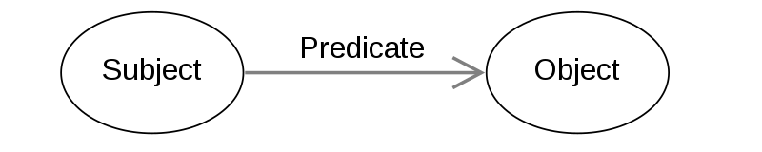
The RDF triple
In Linked Data we express the relationships as follows.
This Photo by Unknown Author is licensed under CC BY-SA
Applying this to our graph data we can say that Node A (subject) has a relation (predicate) of / to Node B (object)
RGU
Is an instance of
University
Is located at
Garthdee
RGU

Slide 7
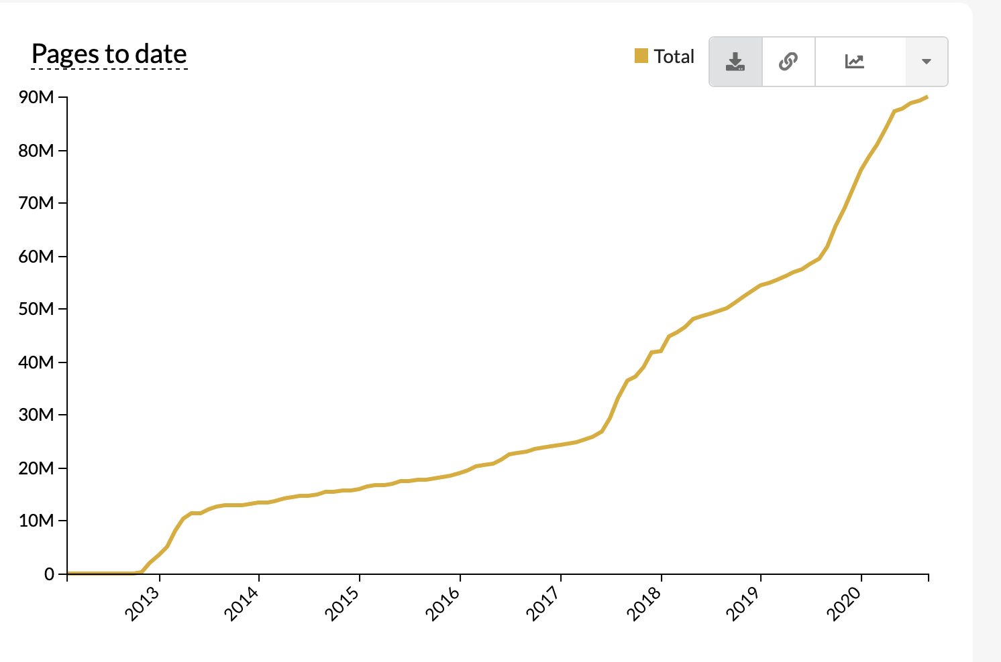
What is Wikidata?
Wikidata is a
collaboratively edited knowledge base
hosted by the Wikimedia Foundation.
common source of Linked Open Data
anyone can use, under a CC0 public domain license.
powered by the software Wikibase.
Main features:
Items (QID)
Properties (P number)
Statements (key-val pair)
https://www.wikidata.org/

Slide 8
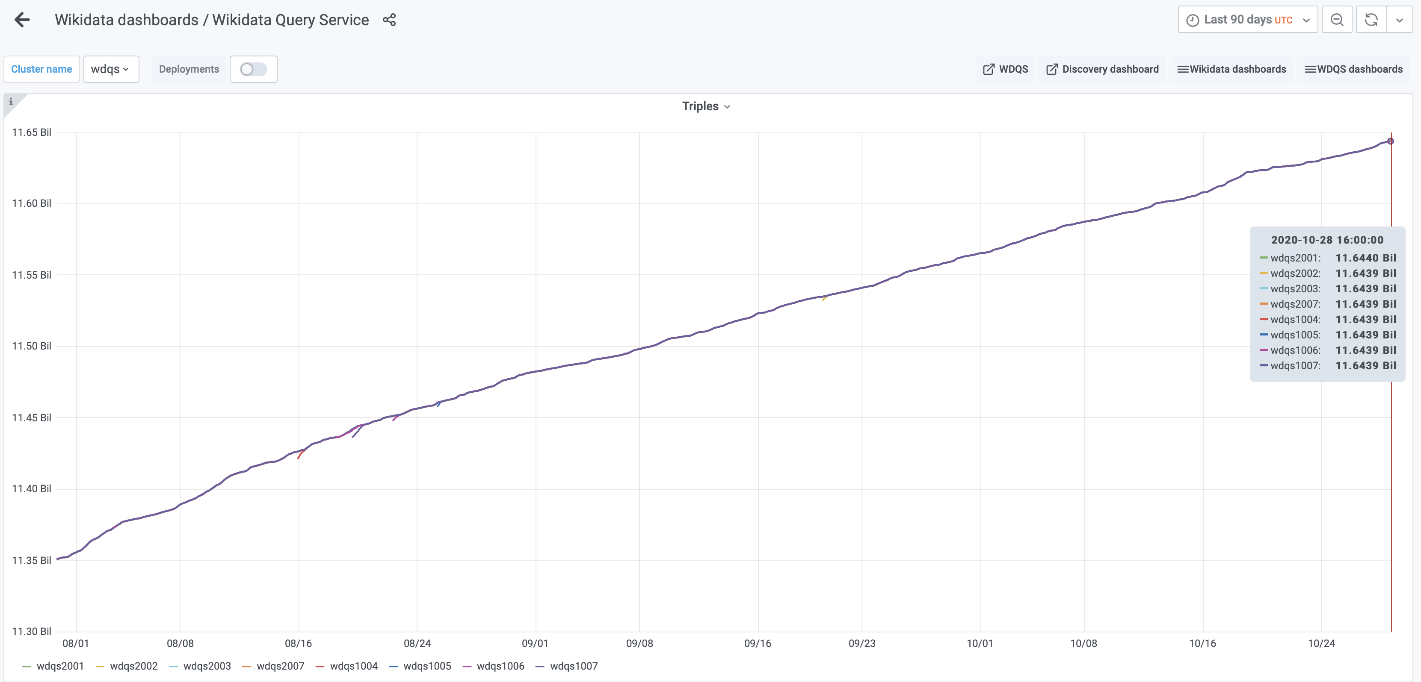
Wiki Data triples
Notes:
And on 4 March 2020 Wikidata reached 10 billion triples
Currently at 11.64 billion.

Slide 9
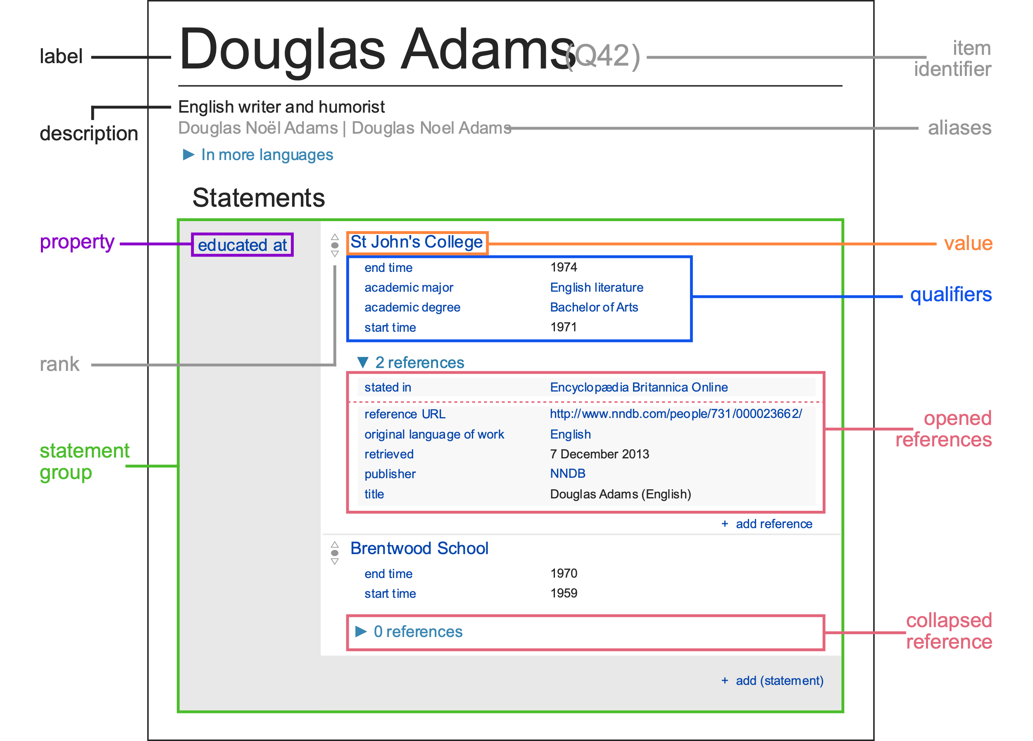
Example data
Wikidata items identified by QIDs
https://www.wikidata.org/wiki/Q42
Graphic by Charlie Kritschmar (WMDE) - Own work, CC0, https://commons.wikimedia.org/w/index.php?curid=49616867

Slide 10
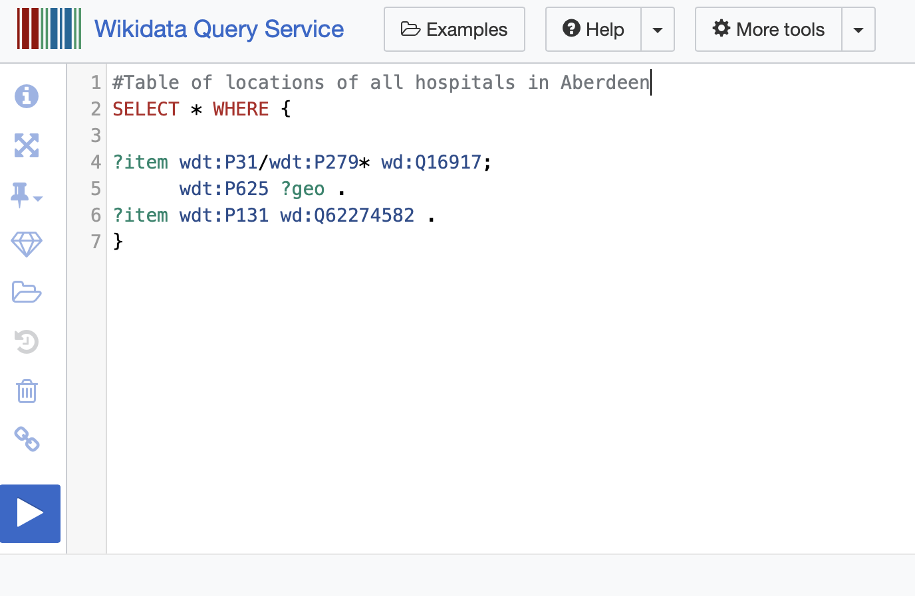
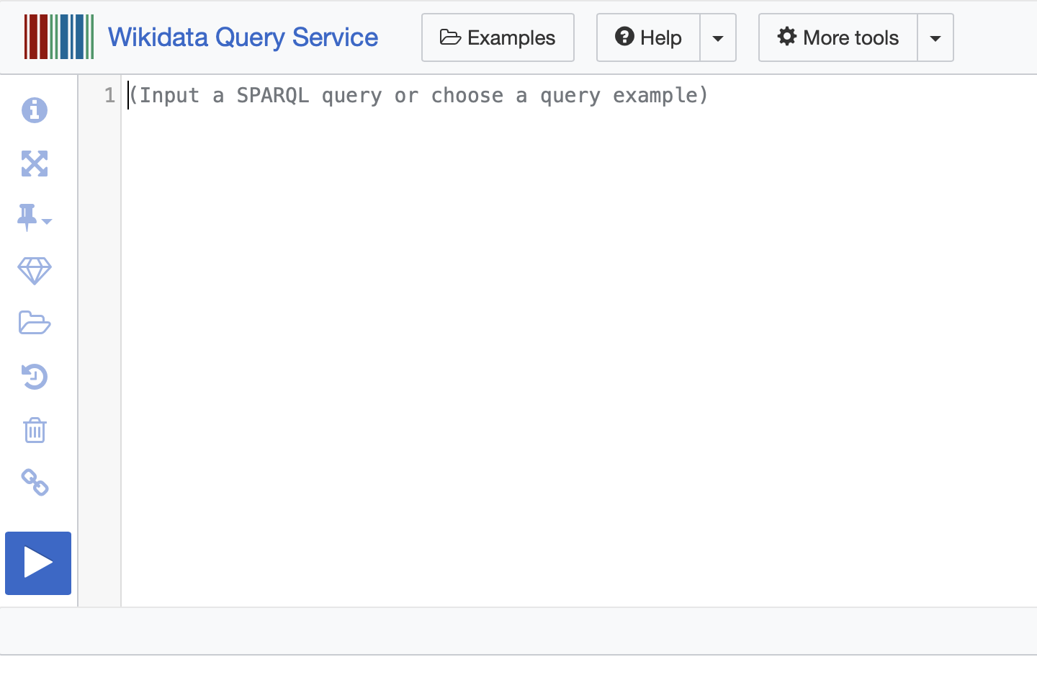
Querying Wikidata
https://query.wikidata.org
Useful example queries
Where we write our query
How we run our query

Slide 11
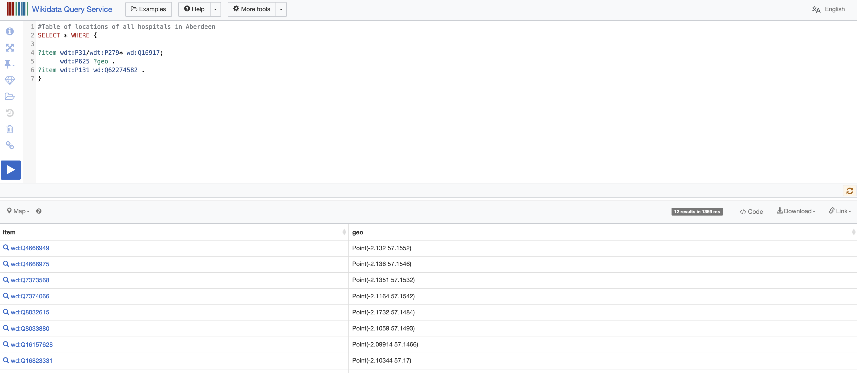
Results

Slide 12
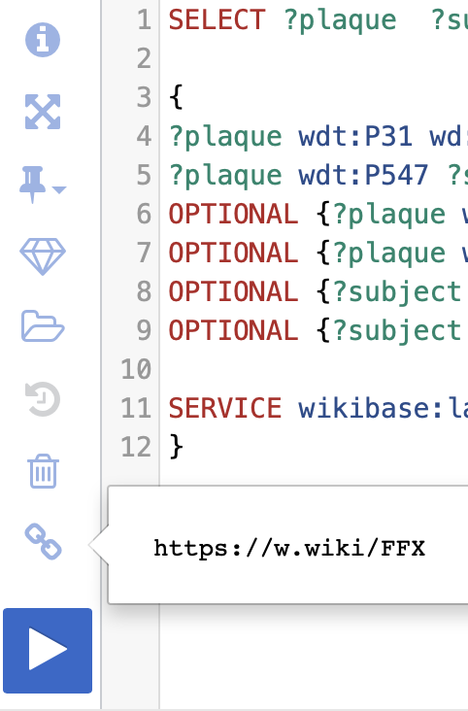
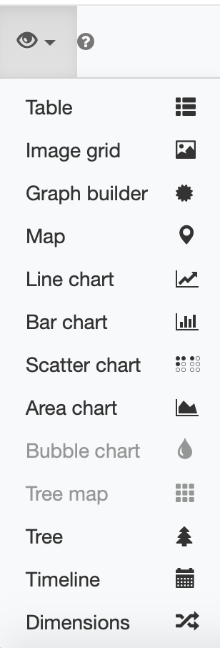
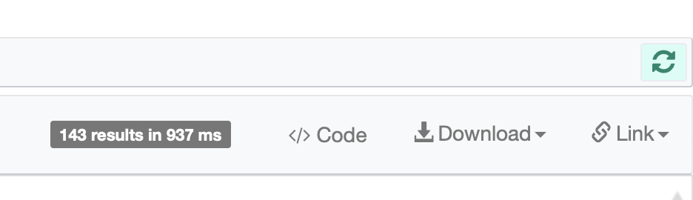
Results

Slide 13
Python / Wikidata Libraries
PyWikiBot
WikiDataDL
WikiRepo
WikiData2DF
WikiData Integrator
SPARQLWrapper
MKWikiData
…… and 40+ more

Slide 14
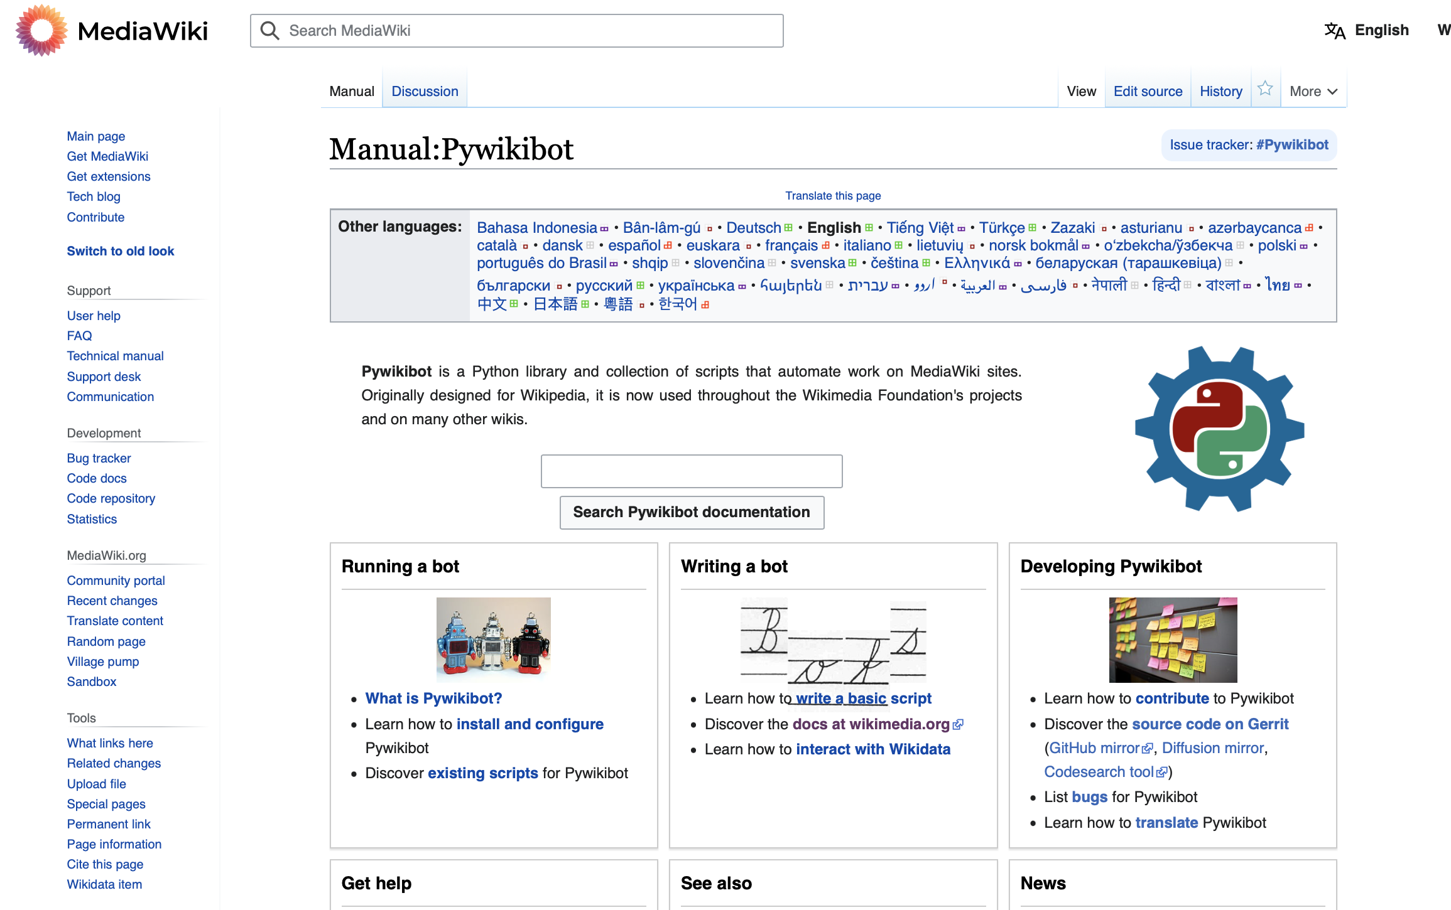
PyWikiBot

Slide 15
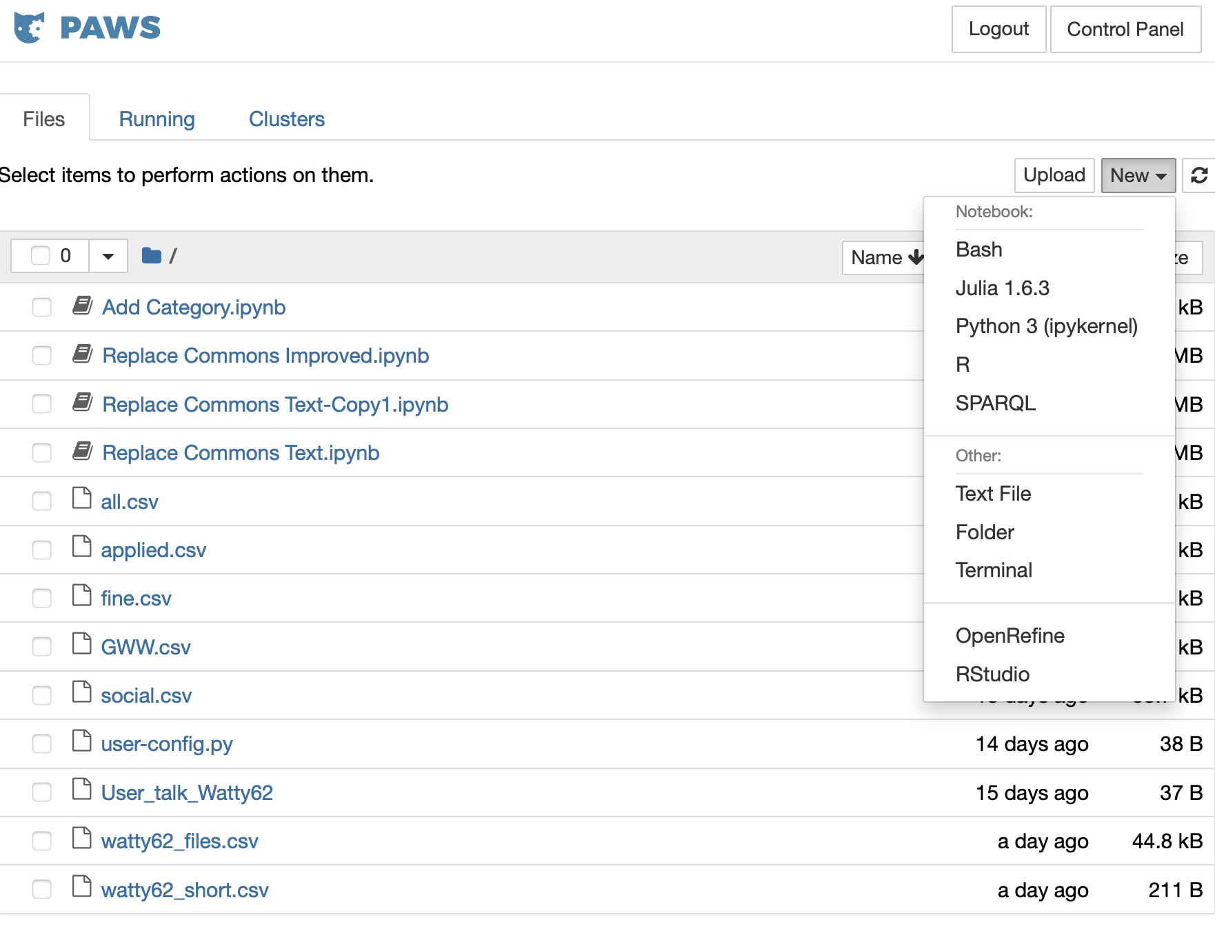
PAWS
https://hub.paws.wmcloud.org/

Slide 16
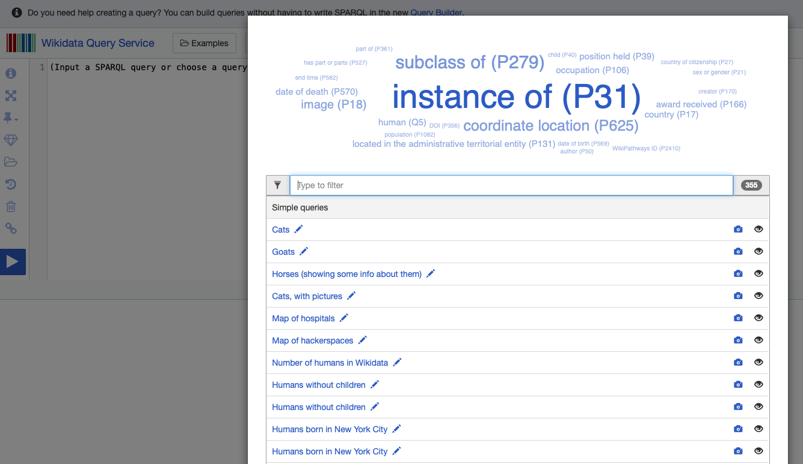
Some Wikidata queries
https://query.wikidata.org
Notes:
Break out to run some queries from samples

Slide 17
MKwikidata
A simple Wikidata query-wrapper for Python
Uses requests library
>> Pip install mkwikidata
Allows us to create a query, pass that to Wikidata and have a dictionary of results returned

Slide 18
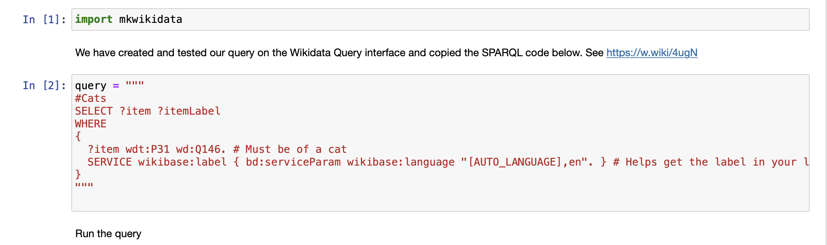
Running our query from Python
Notes:
Run examples

Slide 19
Useful resources
Introduction to Graphs
NEW – Interactive WIKIDATA Query Service Tutorial
16-min SPARQL tutorial
Building SPARQL Queries (41 min tutorial)
Querying WIKIDATA with Python
Wikidata Integrator (Python library)
Lucas Werkmeister – Querying Wikidata with SPARQL
PAWS (PAWS A Web Shell) – About PAWS
Aberdeen-related Wikidata
Timeline of Aberdeen Uni Graduates
Aberdeen Plaques – Part 1
Aberdeen Plaques – Part 2
Aberdeen Provosts
Mapping Memorials to Women in Aberdeen
Shipwrecks

Slide 20
Getting involved
Sign up for a Wikidata account http://Wikidata.org
Come to Code The City events: https://codethecity.org
Sign up for the Code The City newsletter: http://eepurl.com/dNW2RA
Email: ian@codethecity.org
Twitter: @watty62

