Slide 1
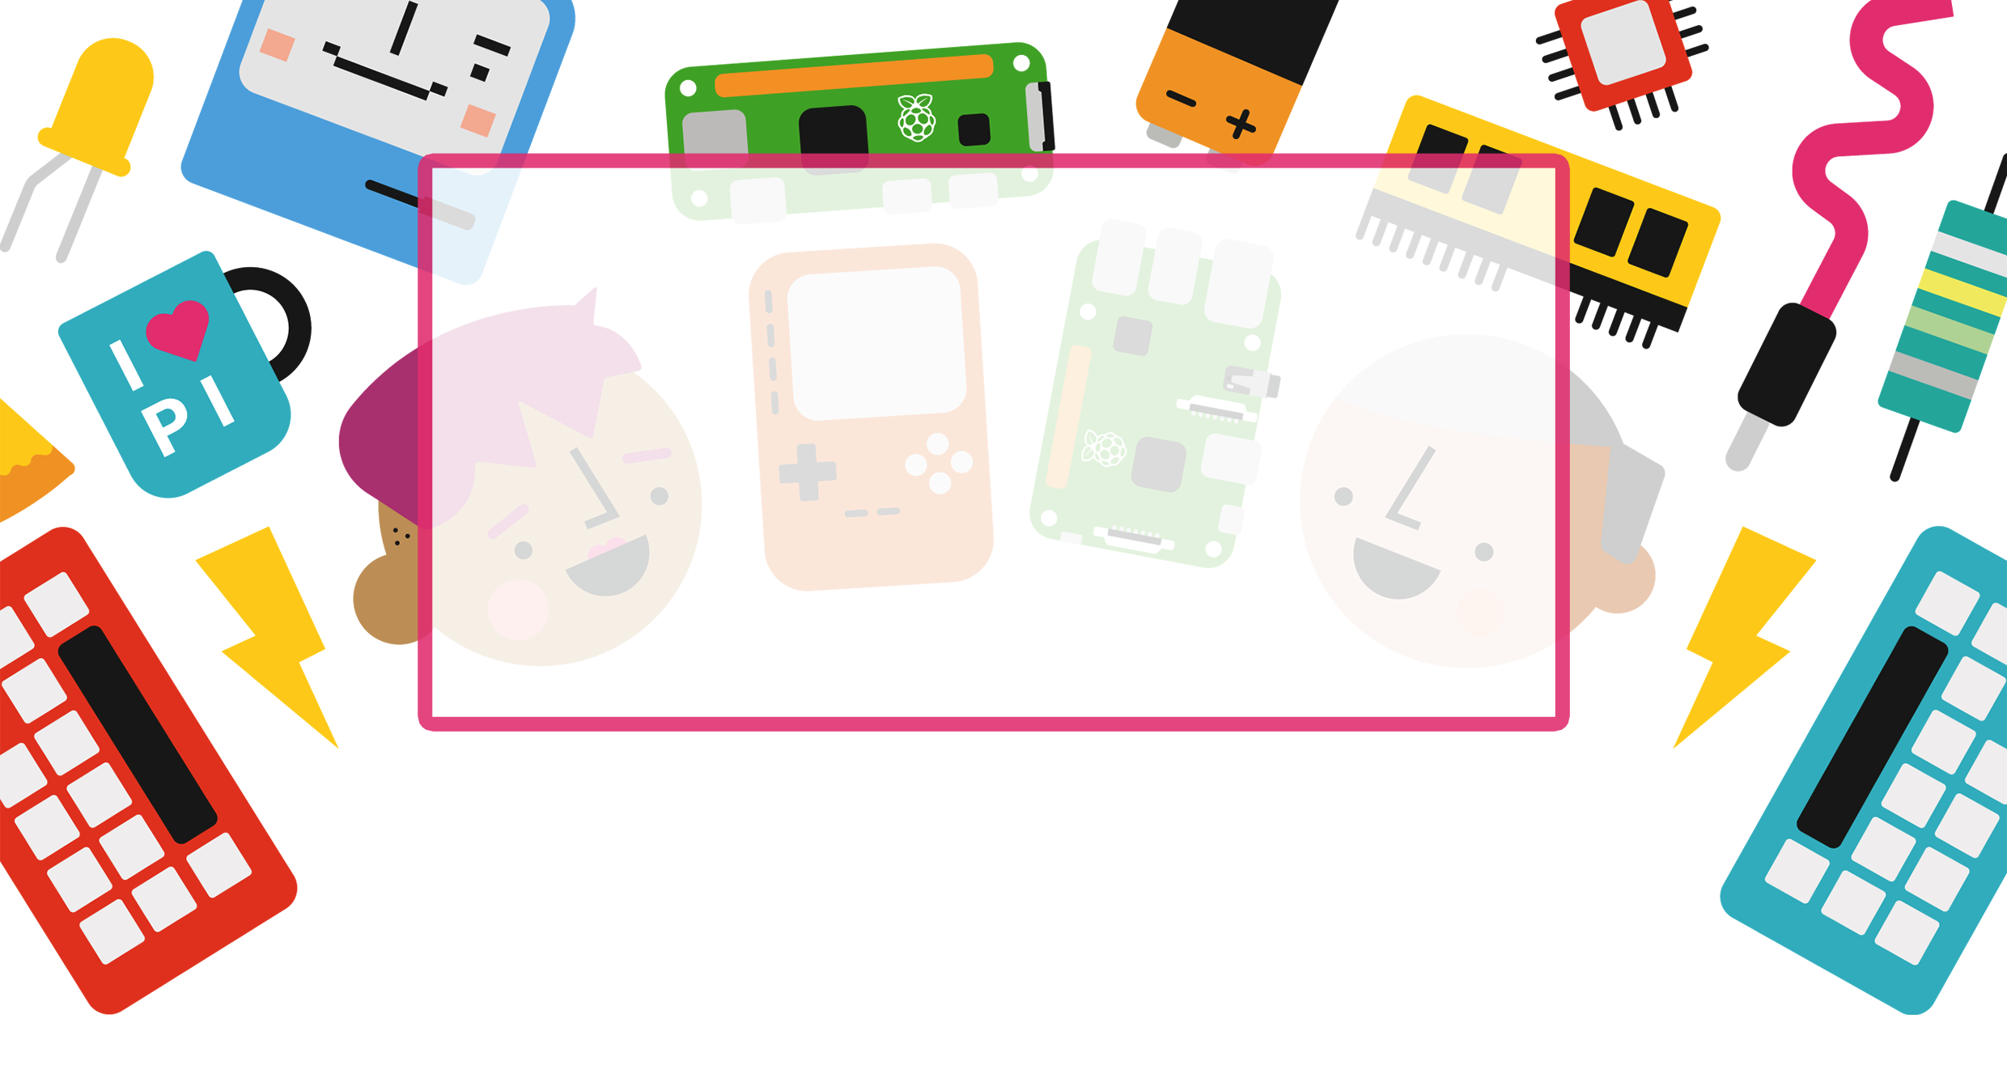

GETTING STARTED
WITH PYGAME ZERO
ON THE RASPBERRY PI
Mark Vanstone
Technical Director
TechnoVisual education

Slide 2
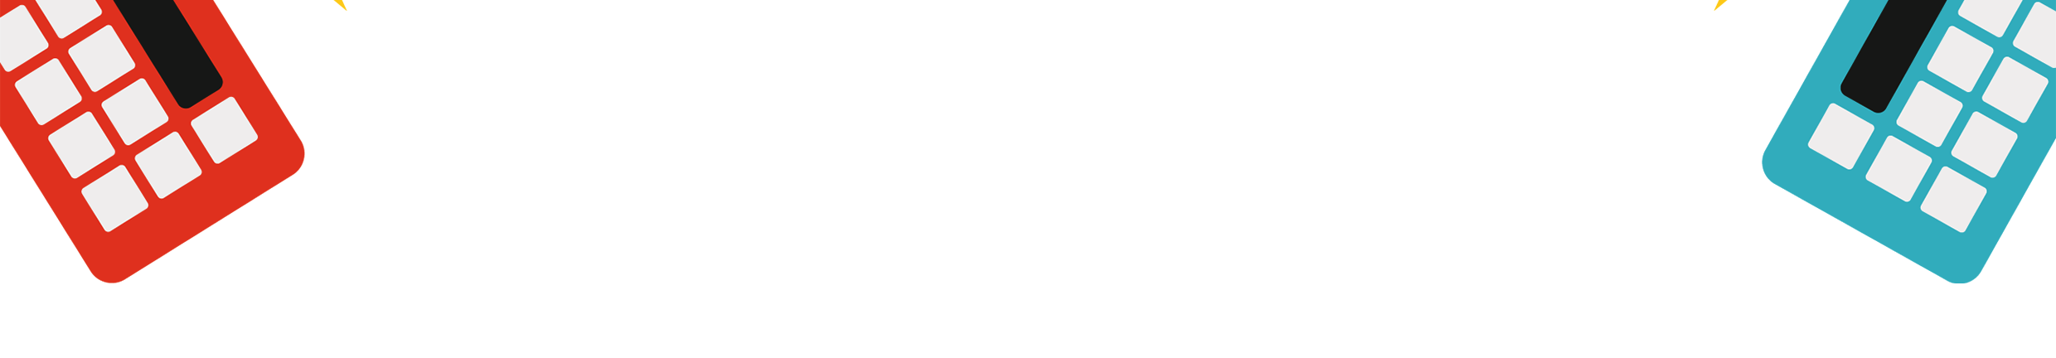
IN THIS WORKSHOP
Running a Pygame Zero Programme
Using Built in Pygame Zero Functions
Working with Sprites and Actors
Getting User Input
Collision Detection
Generating Random Numbers
Using Boolean and Integer Game States
Using Arrays (lists)

Slide 3

THINGS TO LOOK OUT FOR
SPEED = 4
screen.fill((128, 128, 128))
trackDirection = False
screen.blit('rflag', (318, 268))
trackLeft.append(Actor("barrier", pos = (trackPosition-trackWidth,0)))

Slide 4

THANK YOU

