Slide 1
IAG Python Boot Camp
LmFit – Least-Squares minimization and curve fitting

Slide 2
Features
Powerful tool for fitting data
High control over parameters
Model different profiles over data
Built-in models

Slide 3
A practical start
LmFit deals with models as objects, and they can be defined pretty easily
Model() automatically builds the object with parameters
Let’s import the data
We’re going to call the fitting into an object, so it can store the fit data
Here’s what were made
>>> from lmfit import Model
>>> def gaussian(x, amp, cen, wid):
... return (amp/(np.sqrt(2*np.pi)*wid)) * np.exp(-(x-cen)**2 /(2*wid**2))
>>> gmod = Model(gaussian)
>>> data = np.genfromtxt(‘1d_gauss.dat’, comments=“#”)
>>> result = gmod.fit(y, x=x, amp=5, cen=5, wid=1)
>>> print(result.fit_report())
[[Model]]
gaussian
[[Fit Statistics]]
# function evals = 33
# data points = 101
# variables = 3
chi-square = 3.409
reduced chi-square = 0.035
[[Variables]]
amp: 8.88021829 +/- 0.113594 (1.28%) (init= 5)
cen: 5.65866102 +/- 0.010304 (0.18%) (init= 5)
wid: 0.69765468 +/- 0.010304 (1.48%) (init= 1)
[[Correlations]] (unreported correlations are < 0.100)
C(amp, wid) = 0.577

Slide 4
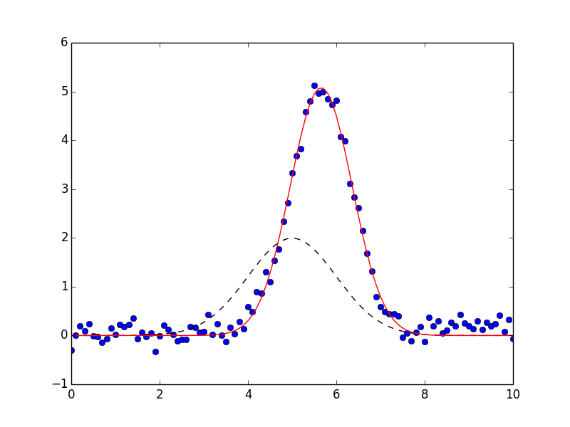
A practical start
LmFit deals with models as objects, and they can be defined pretty easily
Model() automatically builds the object with parameters
Let’s import the data
We’re going to call the fitting into an object, so it can store the fit data
Here’s what were made
To see the results in a more graphical way, here’s the plot
>>> plt.plot(x, y, 'bo')
>>> plt.plot(x, result.init_fit, 'k--')
>>> plt.plot(x, result.best_fit, 'r-')
>>> plt.show()

Slide 5
The Parameters class
Isn’t just a fancy dictionary
To use it, we need first to initialize it by guessing from a model.
To set the parameter properties, this is the syntax
Where cant it be useful?
>>> const = ConstantModel(prefix = 'constant_')
>>> pars = const.guess(x, x=x)
>>> pars['constant_c'].set(1., min = 0.01, max = 10.)

Slide 6
Combining models
We can abridge the process of calling and defining parameters in a def()
When we use call_constant, it will give a tuple with the model and the parameters
Let’s define another one
>>> from lmfit.models import GaussianModel, ConstantModel
>>> def call_constant(x, y):
... const = ConstantModel(prefix = 'constant_')
... pars = const.guess(y, x=x)
... pars['constant_c'].set(1., min=0.8, max=1.2)
... return const, pars
>>> def call_gauss(x, y, cen, count, pars):
... label='g‘ + str(count) + '_'
... gauss = GaussianModel(prefix = label)
... pars.update(gauss.make_params())
... pars[label + 'center'].set(cen, min = cen - 0.02, max = cen + 0.02)
... pars[label + 'amplitude'].set(0, min = -10., max=1.2)
... pars[label + 'sigma'].set(0.2, min = 0.005, max = 0.3)
... return gauss

Slide 7
Combining models
We can abridge the process of calling and defining parameters in a def()
When we use call_constant, it will give a tuple with the model and the parameters
Let’s define another one
(whew!) Now, reading a file containing a spectral line blend
We need a first guess on where are our line centers, so they are passed as arguments from the previous functions
>>> blend = np.genfromtxt(‘blend.dat’, unpack=True)
>>> X = blend[0]
>>> Y = blend[1]
>>> modsum, pars = call_constant(X,Y)
>>> modsum = modsum + call_gauss(X, Y, 5709.38, 1, pars)
>>> modsum = modsum + call_gauss(X, Y, 5709.44, 2, pars)

Slide 8
Combining models
Now, fitting the composed model as an object
Attributing the fitted parameters for a dictionary object
>>> blend = np.genfromtxt(‘blend.dat’, unpack=True)
>>> X = blend[0]
>>> Y = blend[1]
>>> modsum, pars = call_constant(X,Y)
>>> modsum = modsum + call_gauss(X, Y, 5709.38, 1, pars)
>>> modsum = modsum + call_gauss(X, Y, 5709.44, 2, pars)
>>> out = modsum.fit(blend[1], pars, x = )
>>> bvals = out.best_values

Slide 9
Combining models
Now, fitting the composed model as an object
Attributing the fitted parameters for a dictionary object
Getting our parameters
>>> bvals
{'constant_c': 0.49397897495513765,
'g1_amplitude': 0.060487229982086888,
'g1_center': 5709.3999999991884,
'g1_sigma': 0.17871403025631516,
'g2_amplitude': -0.14775858864141611,
'g2_center': 5709.4393240686413,
'g2_sigma': 0.1379790055019624}

Slide 10
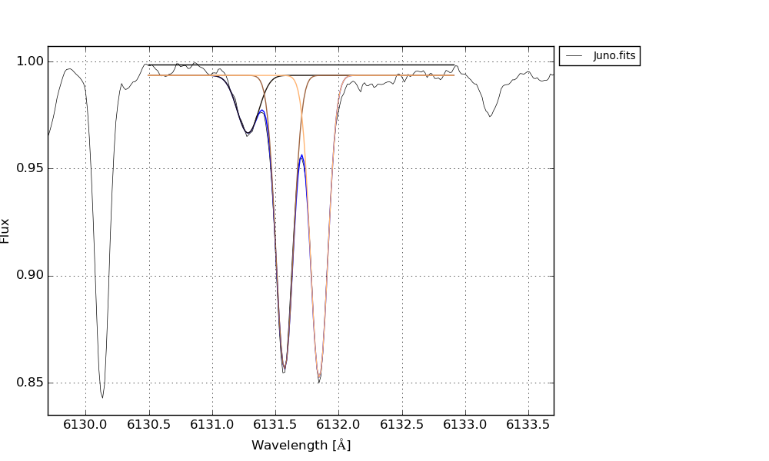
Combining models
A working example

