Slide 1
IAG Python Boot Camp
Matplotlib – plotting and visualizing your data

Slide 2
Features
Matlab-based interface
Easy to implement simple plots and visual elements
Tons of configs an styling options
Highly versatile, can do almost everything you can imagine with interactive, dynamic data plotting
You can real-time manipulate the plot show
In this lecture, we'll deal more with examples than explaining code

Slide 3
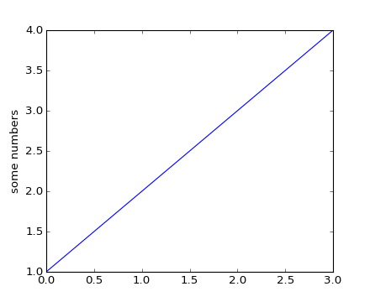
The basics: matplotlib.pyplot
Let's import it:
Matplotlib deals with figure windows as objects. If you call any function from plt, it will refer to the last plotting figure you made.
Let's plot the simpler graphic we can, and name the y axis.
What happened here?
If you pass only one argument (a list or an array), pyplot assumes that x values are integer indexes starting with 0
>>> import matplotlib.pyplot as plt
>>> plt.plot([1,2,3,4])
>>> plt.ylabel('some numbers')
>>> plt.show()

Slide 4
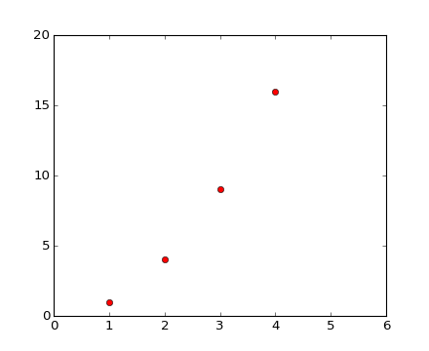
The basics: matplotlib.pyplot
plot() is a versatile command; takes an arbitrary number of arguments.
Okay, now a better example.
For every x, y pair of arguments, there is an optional third argument, a string that formats the style of the plot.
The format string 'ro' represents the color (first character) and the marker style (last character). When plotting lines, the style is the last 2 characters.
axis() can receive a list containing the axes limits
>>> import matplotlib.pyplot as plt
>>> plt.plot([1,2,3,4], [1,4,9,16], 'ro')
>>> plt.axis([0, 6, 0, 20])
>>> plt.show()

Slide 5
The basics: matplotlib.pyplot
What about overplots?
2 options:
Pass all lists and styles as arguments once
Pass each plot as a separate command
>>> t = np.arange(0., 5., 0.2)
>>> plt.plot(t, t, 'r--', t, t**2, 'bs', t, t**3, 'g^')
>>> plt.plot(t, t, 'r-')
>>> plt.plot(t, t**2, 'bs')
>>> plt.plot(t, t**3, 'g^')

Slide 6
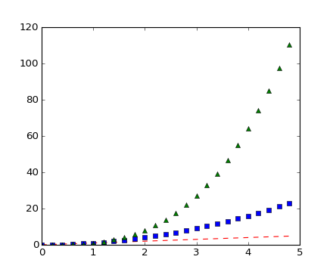
The basics: matplotlib.pyplot
What about overplots?
2 options:
Pass all lists and styles as arguments once
Pass each plot as a separate command
The result is the same
>>> plt.show()

Slide 7
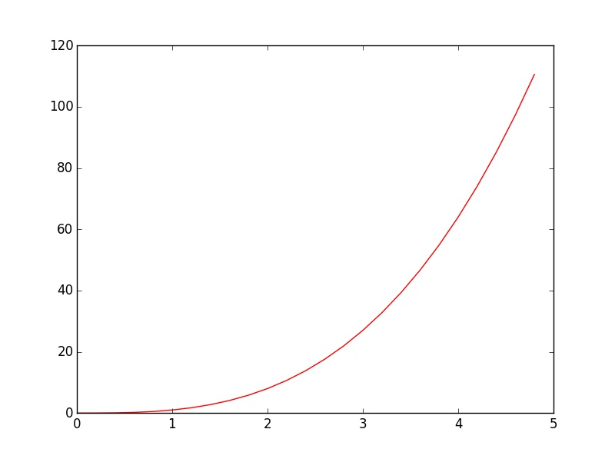
The basics: matplotlib.pyplot
What about overplots?
2 options:
Pass all lists and styles as arguments once
Pass each plot as a separate command
The result is the same
You can also control the line width when plotting lines:
>>> plt.plot(t, t**3, 'r-', linewidth=1)
>>> plt.show()

Slide 8
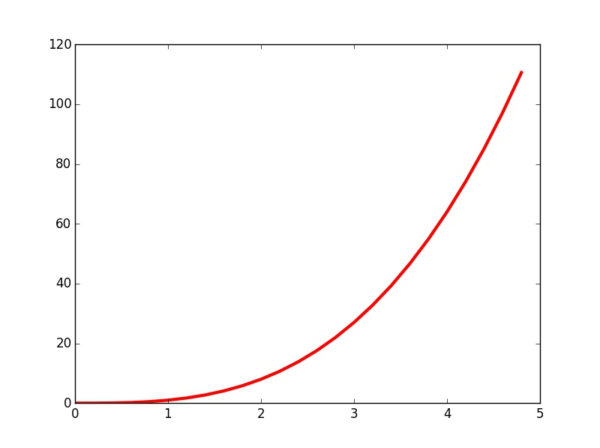
The basics: matplotlib.pyplot
What about overplots?
2 options:
Pass all lists and styles as arguments once
Pass each plot as a separate command
The result is the same
You can also control the line width when plotting lines:
To see more about markers and line styles, take a look at:
http://matplotlib.org/api/markers_api.html
http://matplotlib.org/examples/lines_bars_and_markers/line_styles_reference.html
>>> plt.plot(t, t**3, 'r-', linewidth=3)
>>> plt.show()

Slide 9
Multiple plots
Let's define a function and some arrays
To draw a figure with multiple subplots, you must first call a figure object
Then add subplots
The subplot() command specifies (numrows, numcols, fignum). Pyplot automatically arranges the space to fit it.
Every command you call before other subplot will refer to the last.
Calling the other plots
>>> def f(t):
return np.exp(-t) * np.cos(2*np.pi*t)
>>> t1 = np.arange(0.0, 5.0, 0.1)
>>> t2 = np.arange(0.0, 5.0, 0.02)
>>> plt.figure()
>>> plt.subplot(211)
>>> plt.plot(t1, f(t1), 'bo', t2, f(t2), 'k')
>>> plt.subplot(212)
>>> plt.plot(t2, np.cos(2*np.pi*t2), 'r--')

Slide 10
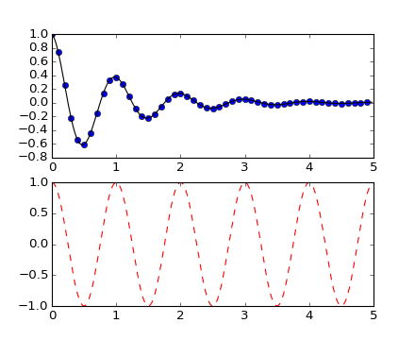
Multiple plots
Let's define a functions and some arrays
To draw a figure with multiple subplots, you must first call a figure object
Then add subplots
The subplot() command specifies (numrows, numcols, fignum). Pyplot automatically arranges the space to fit it.
Every command you call before other subplot will refer to the last.
Calling the other plots
There you are
>>> plt.show()

Slide 11
Adding text
Let's add annotations to the plot. For this, here's an example of an histogram
These commands plot the axis titles , the graph title and annotate text on a specific position. The title() function takes x, y position as first arguments, then a string as the annotation text
>>> mu, sigma = 100, 15
>>> x = mu + sigma * np.random.randn(10000)
>>> n, bins, patches = plt.hist(x, 50, normed=1, facecolor='g', alpha=0.75)
>>> plt.xlabel('Smarts')
>>> plt.ylabel('Probability')
>>> plt.title('Histogram of IQ')
>>> plt.text(60, .025, r'$\mu=100,\ \sigma=15$')
>>> plt.axis([40, 160, 0, 0.03])
>>> plt.grid(True)

Slide 12
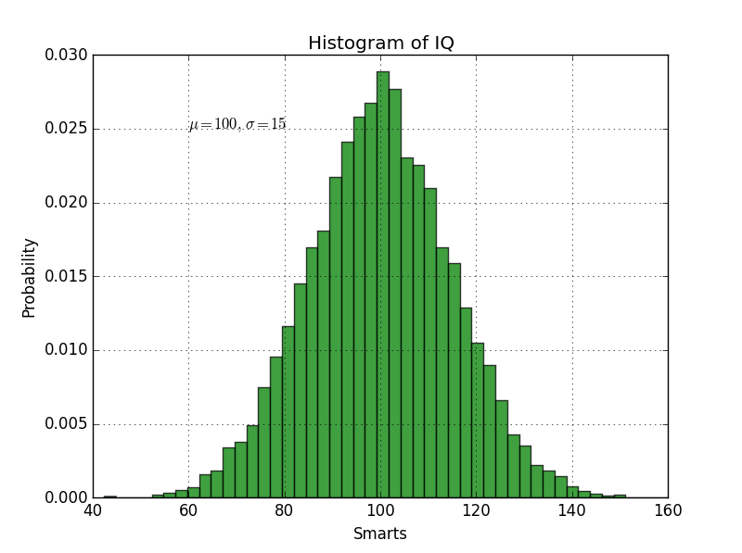
Adding text
Let's add annotations to the plot. For this, here's an example of an histogram
These commands plot the axis titles , the graph title and annotate text on a specific position. The title() function takes x, y position as first arguments, then a string as the annotation text
And here's the plot
>>> plt.show()

Slide 13
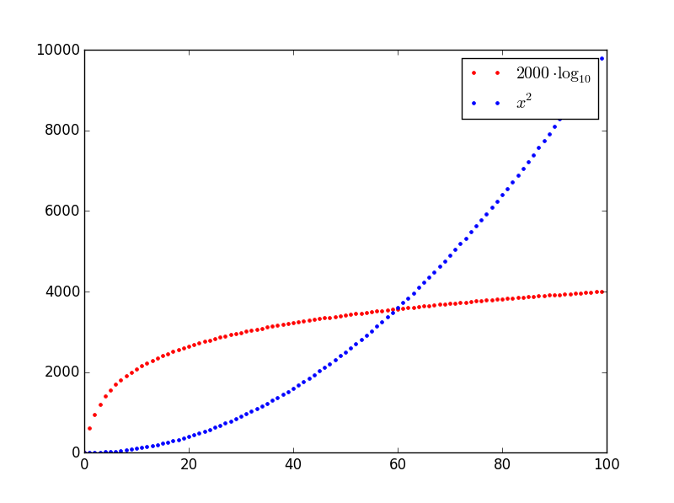
Legends
Now, about legends to the plot. For each data series, we can add a separate legend entry. For this, we must specify a label to each plot and the legend() command does the rest
Let's see what we get
To take a look on the syntax of math text, visit http://matplotlib.org/users/mathtext.html
>>> x = np.arange(100)
>>> log_10 = plt.plot(x, 2000*np.log10(x), 'r.', label=r'$2000\cdot\log_{10}$')
>>> x_2 = plt.plot(x, x**2, 'b.', label=r'$x^2$')
>>> plt.legend()
>>> plt.show()

Slide 14
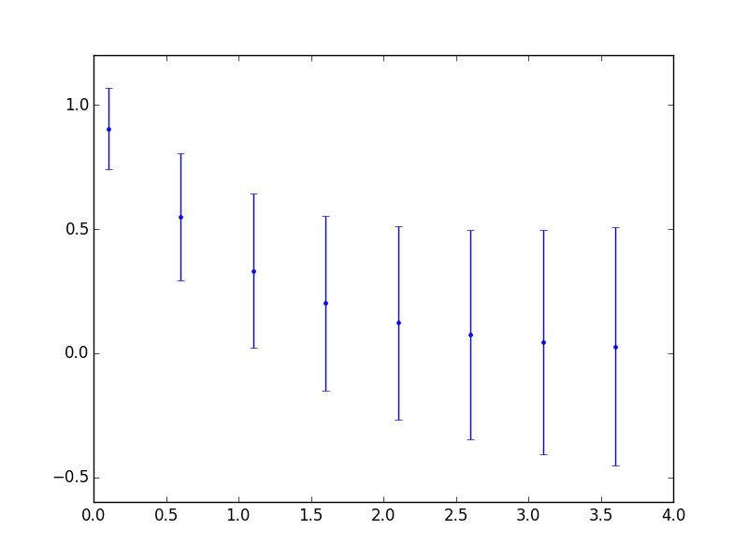
Error bars
Let's take a simple function to establish our points and another one to the errorbars
To draw error bars, we use the errorbar() function
>>> x = np.arange(0.1, 4, 0.5)
>>> y = np.exp(-x)
>>> err = 0.1 + 0.2*np.sqrt(x)
>>> plt.errorbar(x, y, yerr=err, fmt='b.')
>>> plt.show()

Slide 15
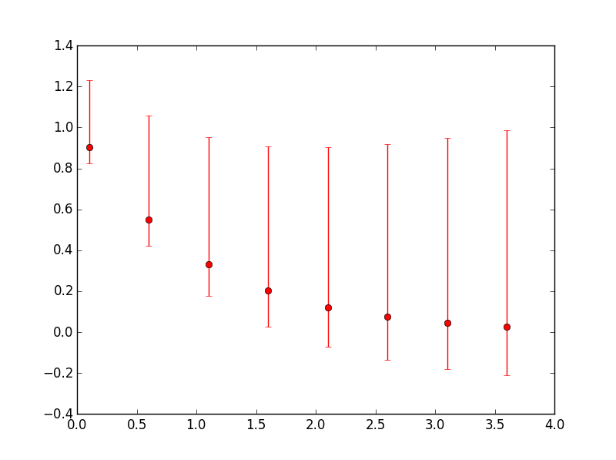
Error bars
Let's take a simple function to establish our points and another one to the errorbars
To draw error bars, we use the errorbar() function
For asymmetric errors, specify a list of 2 elements to the error argument
>>> x = np.arange(0.1, 4, 0.5)
>>> y = np.exp(-x)
>>> err = 0.1 + 0.2*np.sqrt(x)
>>> plt.errorbar(x, y, yerr=[0.5*err, 2*err], fmt='ro')
>>> plt.show()

Slide 16
HANDS-ON!!
Read the spectra-halpha.dat that contains a region from a stellar spectrum
Plot the spectrum with a solid thin red line and overplot it with the same points now in black with error bars
Name the axes with Wavelength and Flux

Slide 17
HANDS-ON!!
Reading the file with ‘unpack’
Plot the line spectrum
Plot the errorbars
Name the axes
>>> spec = np.genfromtxt('spec.dat', skip_header=True, unpack=True)
>>> plt.plot(spec[0], spec[1], 'r-', lineweight=0.5)
>>> plt.errorbar(spec[0], spec[1], yerr=spec[2], 'k.')
>>> plt.ylabel('Flux')
>>> plt.xlabel('Wavelength')
>>> plt.show()

Slide 18
Contour plots
Ok, now some fancy examples
For a contour plot, we need a x, y grid containing scalar values. For that, we'll use the numpy's meshgrid function with 256 points on each axis
Now, specifying a 3D function
The contour function gets the x, y coordinates, the z values, the number of contours and optional formatting commands
Let's remove the ticks by specifying empty lists to them
>>> n = 256
>>> x = np.linspace(-3,3,n)
>>> y = np.linspace(-3,3,n)
>>> X,Y = np.meshgrid(x,y)
>>> def f(x,y):
return (1-x/2+x**5+y**3)*np.exp(-x**2-y**2)
>>> plt.contour(X, Y, f(X,Y), 8, colors='black', linewidth=.5)
>>> plt.xticks([]), plt.yticks([])

Slide 19
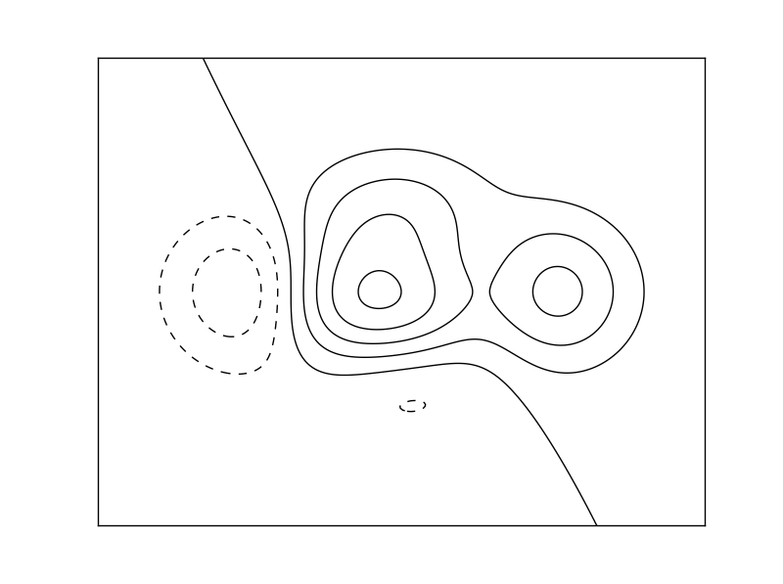
Contour plots
Ok, now some fancy examples
For a contour plot, we need a x, y grid containing scalar values. For that, we'll use the numpy's meshgrid function with 256 points on each axis
Now, specifying a 3D function
The contour function gets the x, y coordinates, the z values, the number of contours and optional formatting commands
Let's remove the ticks by specifying empty lists to them
Here's what we get
>>> plt.show()
On the lecture directory, there's a .py file with an example involving colored contours and annotated values

Slide 20
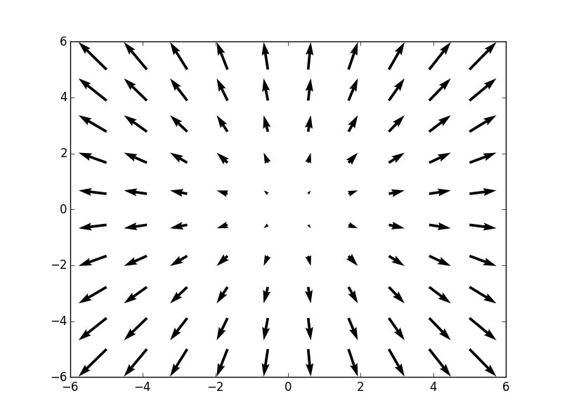
Quiver
We can plot a vectorial field using the quiver() function
We'll use meshgrids
And since it's about vectors, we have their u, v components too
The quiver() function takes the x, y coordinates and the u, v vector components
And we get this
On the lecture directory, there's a .py file with 2 more examples on drawing quiver-type graphs
>>> x = np.linspace(-5, 5, 10)
>>> y = np.linspace(-5, 5, 10)
>>> X, Y = np.meshgrid(x, y)
>>> U, V = np.cos((X - 10) / (2*np.pi)), np.sin((Y) / (2*np.pi))
>>> plt.quiver(X, Y, U, V)
>>> plt.show()

Slide 21
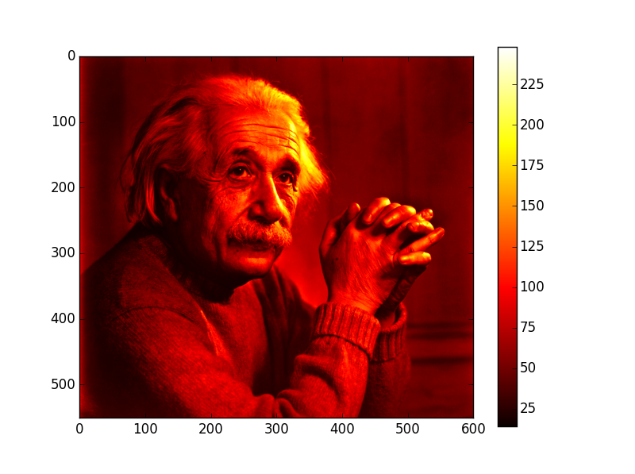
Dealing with image data
Since an image is a matrix of values, we can deal with them using arrays.
Scipy has a module for reading images and turning them into arrays
Let's use Einstein's face
We'll visualize it with imshow(), but let's associate an object to the plot
We can set its properties
And also add the colorbar reference with values
Let’s see
>>> from scipy.misc import imread
>>> img = imread('einstein.jpg')
>>> fig = plt.imshow(img)
>>> fig.set_cmap('hot')
>>> plt.colorbar()
>>> plt.show()

Slide 22
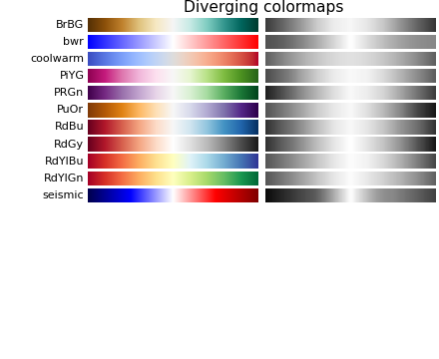
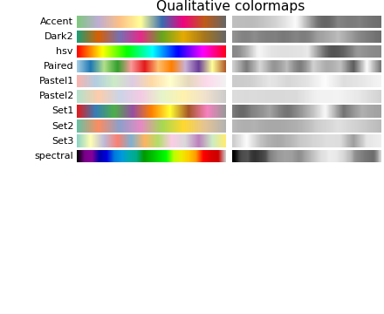
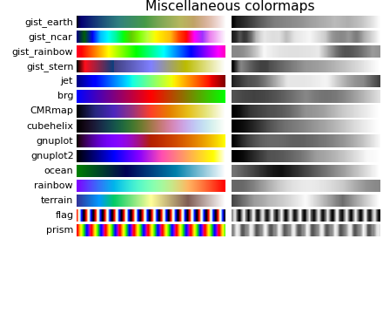
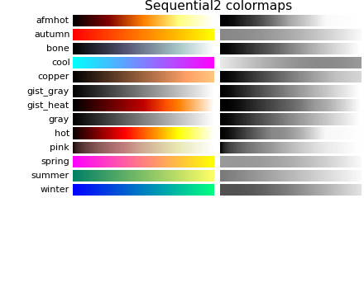
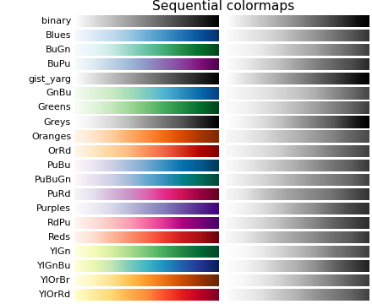
Color maps
Matplotlib has built-in color maps

Slide 23
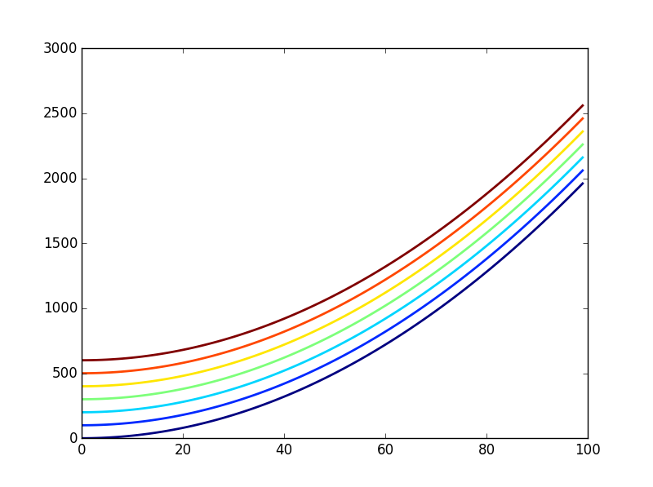
Color maps
Matplotlib has built-in color maps
Here’s an example on how to use them
We can extract the colors from the colormaps using the get_cmap() function combined with a numpy array
Let’s plot one graph with each color
>>> c = plt.get_cmap('jet')(np.linspace(0, 1, 7))
>>> x = np.arange(100)
>>> for i in range(7):
plt.plot(x, 0.2*y**2 + 100*i, color = c[i], linewidth=2)
>>> plt.show()

Slide 24
HANDS-ON!!
Read the ASCII file messier_12.dat that contains a matrix, into an array
Visualize the grayscale image with a colorbar
Tip#1: use a log scale for the intensities
Tip#2: add a very small number to the values to avoid math errors on taking the log

Slide 25
HANDS-ON!!
Read the file and don’t forget the delimiters
Plot the image using the log scale
Set the colormap
Add the colorbar
>>> messier = np.genfromtxt('messier.dat', delimiter=',')
>>> image = plt.imshow(np.log10(messier + 0.01))
>>> image.set_cmap('gray')
>>> plt.colorbar()
>>> plt.show()

