Slide 1
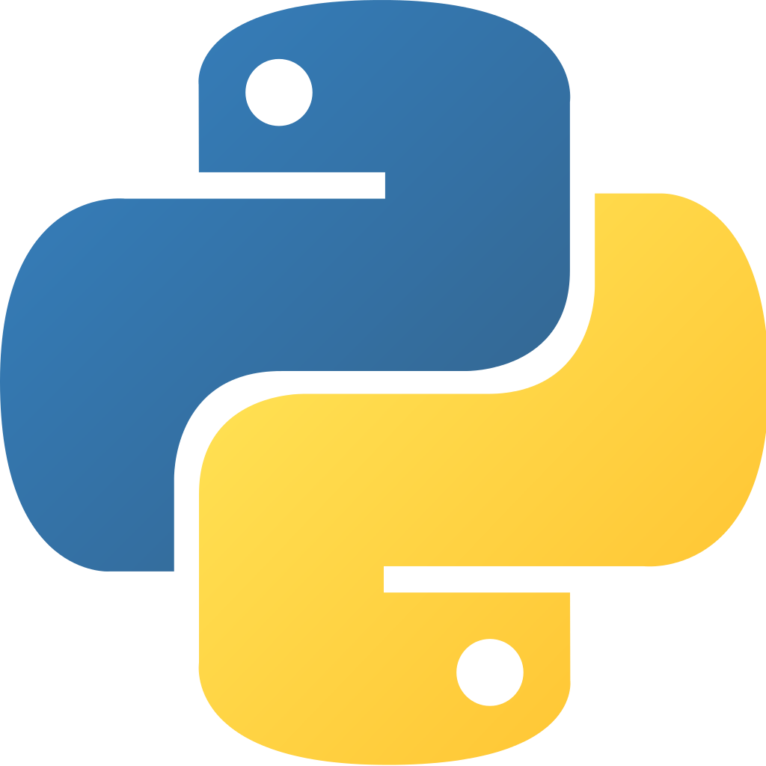
IAG Python Boot Camp
PyRAF - a better interface wrapping IRAF into python
Elvis Cantelli

Slide 2
Features
Iraf command prompt becomes much more simpler and “pythonic”
Epar uses a friendly window with buttons and fields
Use iraf tasks on your python scripts
You must have IRAF or Ureka

Slide 3
IRAF-Python interface
You can just type “pyraf” on terminal to launch
Remember to run mkiraf on the directory you are working or on the directory from which you call pyraf
Now the classical iraf cl becomes the python interpreter, still taking the package commands and tasks the same usual way
You can silence the shell by typing _doprint = False
$ mkiraf
$ pyraf
--> _doprint = False

Slide 4
IRAF-Python interface
From the PyRAF command line, you can call the IRAF commands, for example the noao package and its subpackages and commands.
The epar has now a pretty interface with embedded help, buttons, fields and drop menus
Of course you can import python modules here too
To exit, we use another syntax too
$ mkiraf
$ pyraf
--> _doprint = False
--> noao
--> onedspec
--> splot Juno.fits
--> rv
--> epar fxcor
--> import numpy as np
--> import matplotlib.pyplot as plt
--> .exit

Slide 5
Scripting with PyRAF
From the python command line we can import pyraf
Now we can call all iraf commands into python using its proper syntax
The task arguments are passed as function arguments in python as well. Like IRAF, the main arguments can be passed as strings, but configs must be used as kwargs
>>> from pyraf import iraf
>>> iraf.noao()
>>> iraf.rv()
>>> iraf.fxcor(‘inputspec.fits’, templ = ‘sun_temp.fits’, outp = ‘rv_out.dat’, obser=‘paranal’)

