Slide 1

IAG Python Boot Camp
SymPy – Symbolic mathematical systems
Elvis Cantelli

Slide 2
Ok, what’s symbolic computation?
Math entities become symbols
Objects are represented exactly
Can represent expressions and functions
Easily readable expressions in a console
Solve equations, integrate and differentiate
Simplify expressions

Slide 3
Keep in mind
SymPy does not add anything to Python
You must declare the symbol objects
Symbols and object names doesn’t need to be the same
Like any object, symbols can be redefined into other objects
Sympy automatically simplifies some expressions when typed, e.g.: sqrt(8) becomes 2*sqrt(2)
Let’s see some “gotchas”:

Slide 4
Not so obvious things
Don’t use implicit operations, like 3x. Use instead 3*x
Power is **, not ^
Equal signs peculiarities
SymPy doesn’t use =
== evaluates as True only expressions that are exacly alike
In SymPy outputs, equality is represented by ==
Fractions must be constructed explicitly, otherwise, it will use python comprehension
Sympy expressions are immutable.
>>> (x + 1)**2 == x**2 + 2*x + 1
False
>>> Eq(x + 1, 4)
x + 1 == 4
>>> x + sympy.Integer(1)/sympy.Integer(3)
X + 1/3
>>> x + 1./2
X + 0.5
>>> x + 1/2
X (integer division returns integers, 0 in the case)
>>> expr = cos(x)
>>> expr.subs(x, 0)
1
>>> expr
cos(x)
>>> x
x

Slide 5
The operations
Importing and conventions
Substitutions
Evaluate by replacing variable by a number
Replace symbol for expression
>>> from sympy import *
>>> x, y, z = symbols("x y z")
>>> expr = cos(x) + 1
>>> expr.subs(x, y)
cos(y) + 1
>>> expr.subs(x, 0)
2
>>> expr = x**y
>>> expr
x**y
>>> expr = expr.subs(y, x**y)
>>> expr
x**(x**y)
>>> expr = expr.subs(y, x**x)
>>> expr
x**(x**(x**x))

Slide 6
The operations
Importing and conventions
Substitutions
Evaluate by replacing variable by a number
Replace symbol for expression
Multiple substitutions; list of tuples
Converting strings: simpyfi
Evaluate at a point: evalf
>>> expr = x**3 + 4*x*y - z
>>> expr.subs([(x, 2), (y, 4), (z, 0)])
40
>>> str_expr = "x**2 + 3*x - 1/2"
>>> expr = sympify(str_expr)
>>> expr
x**2 + 3*x - 1/2
>>> expr.subs(x, 2)
19/2
>>> expr = sqrt(8)
>>> expr.evalf()
2.82842712474619
numerical (doesn’t need args)
expr = cos(2*x)
>>> expr.evalf(subs={x: 2.4})
0.0874989834394464
Algebraic (pass variables argument via dictionary)

Slide 7
The operations
Importing and conventions
Substitutions
Evaluate at a point
Evaluate by replacing variable by a number
Multiple substitutions; list of tuples
Converting strings: simpyfi
Evaluate at a point: evalf
Evaluate at multiple points: lambdify
Multiple variables
>>> a = np.arange(10)
>>> expr = sin(x)
>>> f = lambdify(x, expr, "numpy")
>>> f(a)
array([ 0., 0.8414, 0.9092, 0.1411, -0.7568, -0.9589, -0.2794 0.6569, 0.9893 0.4121])
>>> a = np.reshape(np.arange(12), (3, 4))
>>> a
array([[ 0, 1, 2, 3],
[ 4, 5, 6, 7],
[ 8, 9, 10, 11]])
>>> expr = x + y + z
>>> f = lambdify((x, y, z), expr, “numpy”)
>>> f(a[0], a[1], a[2])
array([12, 15, 18, 21])
Note that each “matrix” line correspond to the variable and each line element corresponds to a evaluating point for that variable.

Slide 8
Printing clean, readable expressions
SymPy has various printers, like ASCII, Unicode, LaTeX. Depends on your environment.
init_session automatically uses the best one and do various setups
You can also write your expression into LaTeX code
>>> from sympy import init_session
>>> init_session()
Python console for SymPy 0.7.3 (Python 2.7.5-64-bit) (ground types: gmpy)
These commands were executed:
>>> from __future__ import division
>>> from sympy import *
>>> x, y, z, t = symbols('x y z t')
>>> k, m, n = symbols('k m n', integer=True)
>>> f, g, h = symbols('f g h', cls=Function)
>>> init_printing()
Documentation can be found at http://www.sympy.org
>>> x = Symbol("x")
>>> a = 1/( (x+2)*(x+1) )
>>> latex(a)
\frac{1}{\left(x + 1\right) \left(x + 2\right)}

Slide 9
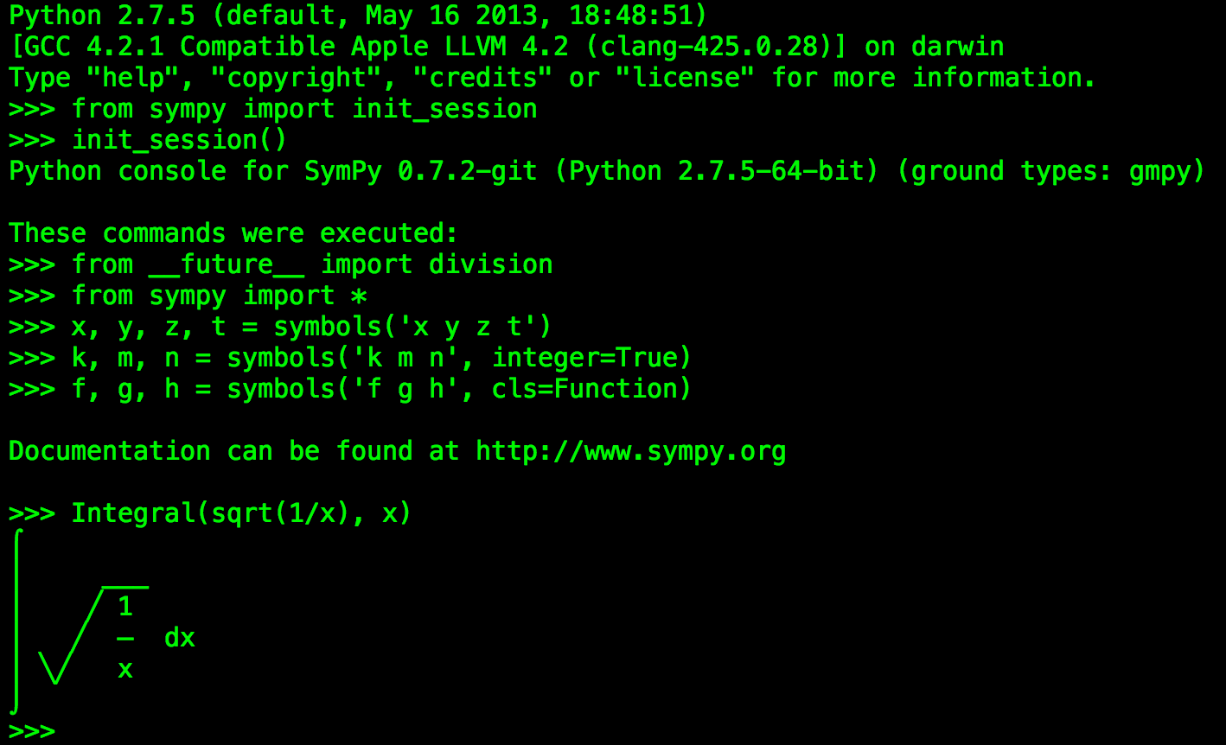
Printing clean, readable expressions
SymPy has various printers, like ASCII, Unicode, LaTeX. Depends on your environment.
init_session automatically uses the best one and do various setups
You can also write your expression into LaTeX code
An Unicode example in a terminal that supports it

Slide 10
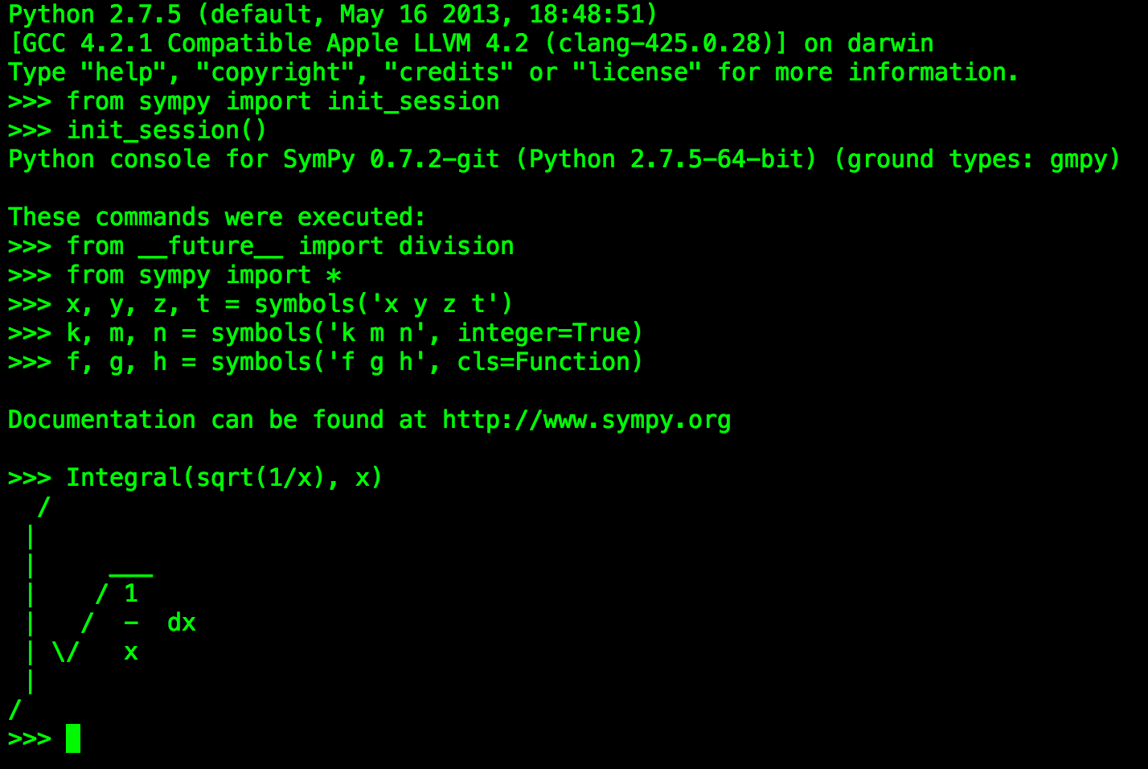
Printing clean, readable expressions
SymPy has various printers, like ASCII, Unicode, LaTeX. Depends on your environment.
init_session automatically uses the best one and do various setups
You can also write your expression into LaTeX code
An Unicode example in a terminal that supports it
An ASCII Pretty Printer example in the terminal

Slide 11
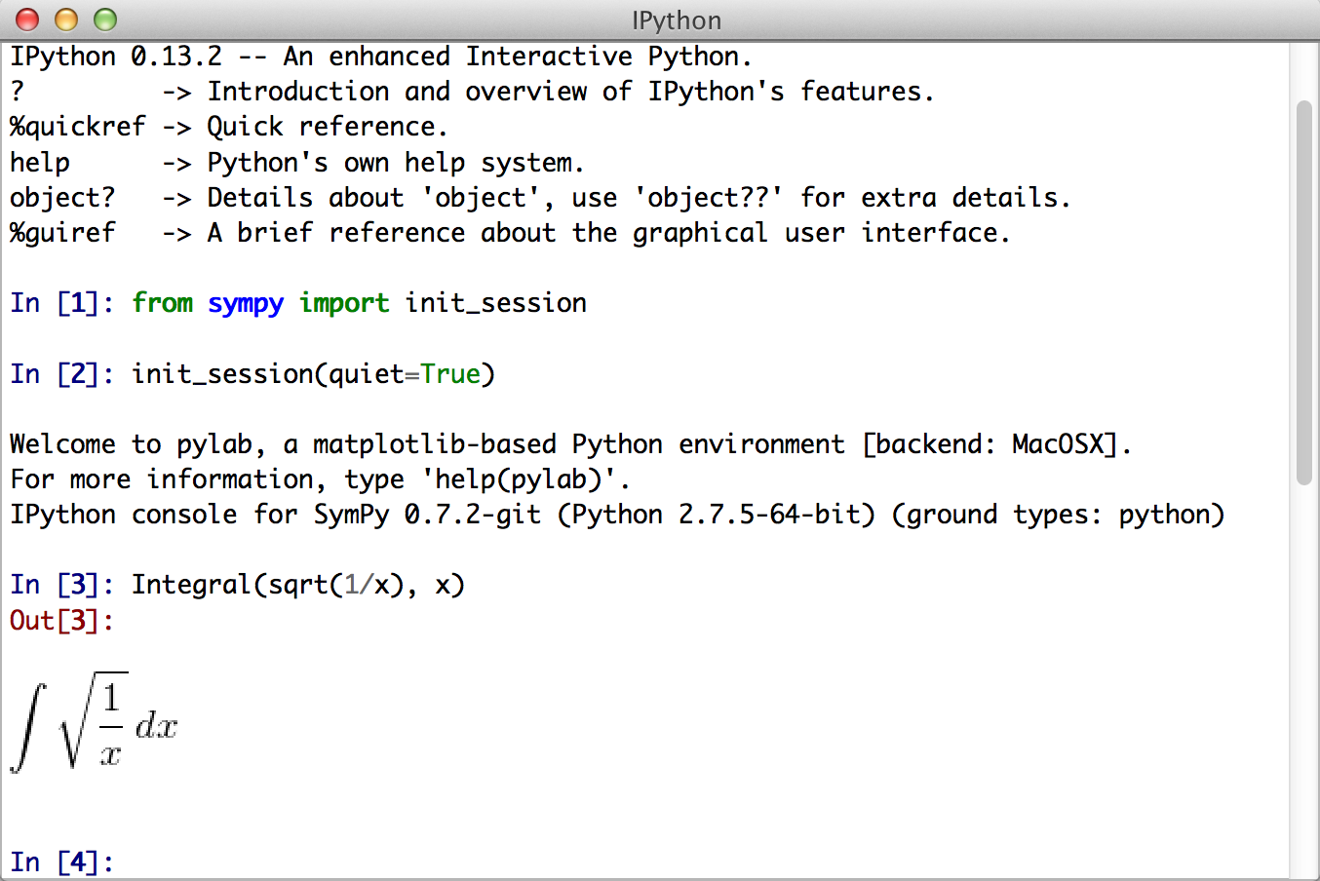
Printing clean, readable expressions
SymPy has various printers, like ASCII, Unicode, LaTeX. Depends on your environment.
init_session automatically uses the best one and do various setups
You can also write your expression into LaTeX code
An Unicode example in a terminal that supports it
An ASCII Pretty Printer example in the terminal
QtConsole have LaTeX installed, so it will enable the LaTeX printer

Slide 12
Simplification
Convention:
Simplifying
Expanding
>>> from sympy import *
>>> x, y, z = symbols('x y z')
>>> init_printing(use_unicode=True)
>>> simplify(sin(x)**2 + cos(x)**2)
1
>>> simplify((x**3 + x**2 - x - 1)/(x**2 + 2*x + 1))
x - 1
>>> simplify(gamma(x)/gamma(x - 2))
(x - 2)⋅(x - 1)
>>> expand((x + 1)**2)
2
x + 2⋅x + 1
>>> expand((x + 2)*(x - 3))
2
x - x - 6

Slide 13

Simplification
Convention
Simplifying
Expanding
Factorating
Cancelling (puts in canonical form $\frac{a}{b}$ )
>>> factor(x**3 - x**2 + x - 1)
/ 2 \
(x - 1)*\x + 1/ cool, isn’t it? isn’t it?!
>>> factor(x**2*z + 4*x*y*z + 4*y**2*z)
2
z⋅(x + 2⋅y)
>>> expr = 1/x + (3*x/2 - 2)/(x - 4)
>>> expr
3⋅x
─── - 2
2 1
─────── + ─
x - 4 x
>>> cancel(expr)
2
3⋅x - 2⋅x - 8
──────────────
2
2⋅x - 8⋅x

Slide 14
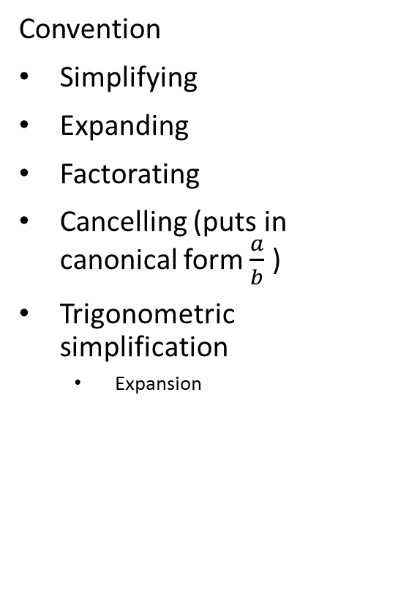
Simplification
Convention
Simplifying
Expanding
Factorating
Cancelling (puts in canonical form $\frac{a}{b}$ )
Trigonometric simplification
Expansion
>>> trigsimp(sin(x)**4 - 2*cos(x)**2*sin(x)**2 + cos(x)**4)
cos(4⋅x) 1
──────── + ─
2 2
>>> trigsimp(sin(x)*tan(x)/sec(x))
2
sin (x)
>>> trigsimp(cosh(x)**2 + sinh(x)**2)
cosh(2⋅x)
>>> expand_trig(sin(x + y))
sin(x)⋅cos(y) + sin(y)⋅cos(x)
>>> expand_trig(tan(2*x))
2⋅tan(x)
─────────────
2
- tan (x) + 1

Slide 15
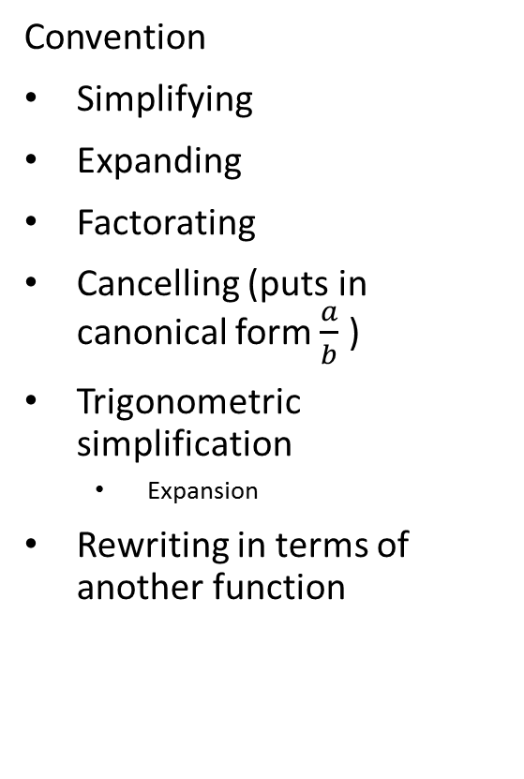
Simplification
Convention
Simplifying
Expanding
Factorating
Cancelling (puts in canonical form $\frac{a}{b}$ )
Trigonometric simplification
Expansion
Rewriting in terms of another function
>>> tan(x).rewrite(sin)
2
2⋅sin (x)
─────────
sin(2⋅x)
>>> factorial(x).rewrite(gamma)
Γ(x + 1)
There’s a lot of other types of simplification that you con explore at the documentation of SymPy

Slide 16
Calculus
Derivatives
Diff() function
Multiple derivatives
>>> diff(cos(x), x)
-sin(x)
>>> diff(exp(x**2), x)
/ 2\
\x /
2⋅x⋅ℯ
>>> diff(x**4, x, x, x)
24⋅x
>>> diff(x**4, x, 3)
24⋅x

Slide 17
Calculus
Derivatives
Diff() function
Multiple derivatives
Multiple variables
>>> expr = exp(x*y*z)
>>> diff(expr, x, y, y, z, z, z, z)
3 2/ 3 3 3 2 2 2 \ x⋅y⋅z
x ⋅y ⋅\x ⋅y ⋅z + 14⋅x ⋅y ⋅z + 52⋅x⋅y⋅z + 48/⋅ℯ
>>> diff(expr, x, y, 2, z, 4)
3 2/ 3 3 3 2 2 2 \ x⋅y⋅z
x ⋅y ⋅\x ⋅y ⋅z + 14⋅x ⋅y ⋅z + 52⋅x⋅y⋅z + 48/⋅ℯ
>>> expr.diff(x, y, y, z, 4) also does the same

Slide 18
Calculus
Derivatives
Diff() function
Multiple derivatives
Multiple variables
Leave at the differential form (same syntax)
Evaluate it (method doit())
>>> deriv = Derivative(expr, x, y, y, z, 4)
>>> deriv
7
∂ / x⋅y⋅z\
──────────\ℯ /
4 2
∂z ∂y ∂x
>>> deriv.doit()
3 2/ 3 3 3 2 2 2 \ x⋅y⋅z
x ⋅y ⋅\x ⋅y ⋅z + 14⋅x ⋅y ⋅z + 52⋅x⋅y⋅z + 48/⋅ℯ

Slide 19
Calculus
Integrals
Indefinite
Definite (pass variable and limits as a tuple. Infinite is oo; double ‘o’)
Multiple integrals
Leave unevaluated
>>> integrate(cos(x), x)
sin(x)
>>> integrate(exp(-x), (x, 0, oo))
1
>>> integrate(exp(-x**2 - y**2), (x, -oo, oo), (y, -oo, oo))
Π
>>> expr = Integral(log(x)**2, x)
>>> expr
⌠
| 2
| log (x) dx
⌡
>>> expr.doit()
2
x⋅log (x) - 2⋅x⋅log(x) + 2⋅x

Slide 20
Calculus
Integrals
Indefinite
Definite (pass variable and limits as a tuple. Infinite is oo; double ‘o’)
Multiple integrals
Leave unevaluated
Series expansions
Use series() as a method
>>> expr = exp(sin(x))
>>> expr.series(x, 0, 4)
2
x / 4\
1 + x + ── + O\x / <- Landau order term
2
>>> expr.series(x, 0, 4).removeO()
2
x
── + x + 1
2

Slide 21
Solving equations
Equations in SymPy don’t use equal signs. It works with Eq(a, b)where a is the first member and b the second.
Solving an equation: solve()
Multiple variables
Polynomial roots
>>> Eq(x, y)
x = y
>>> solve(Eq(x**2, 1), x)
[-1, 1]
>>> solve(Eq(x**2 - 1, 0), x)
[-1, 1]
>>> solve(x**2 - 1, x)
[-1, 1]
If you pass an equation argument that is not an Eq object, it is supposed that the expression equals 0
>>> a = Eq(3*x + 4*y – 2)
>>> b = Eq(0.5*x – 2*y - 6)
>>> solve([a, b], [x, y])
{x: 3.5, y: -2.125}
>>> roots(x**3 - 6*x**2 + 9*x, x)
{0: 1, 3: 2}

Slide 22
Solving equations
Equations in SymPy don’t use equal signs. It works with Eq(a, b)where a is the first member and b the second.
Solving an equation: solve()
Multiple variables
Polynomial roots
Differential equations: use Function objects
Define it by applying diff
>>> f, g = symbols('f g', cls=Function)
>>> f(x)
f(x)
If you use only f, it is undefined. If you type f(x), it’s now an unknown function
>>> f(x).diff(x)
d
──(f(x))
dx

Slide 23
Solving equations
Equations in SymPy don’t use equal signs. It works with Eq(a, b)where a is the first member and b the second.
Solving an equation: solve()
Multiple variables
Polynomial roots
Differential equations: use Function objects
Define it by applying diff
Solve it with dsolve()
>>> diffeq = Eq(f(x).diff(x, 2) - 2*f(x).diff(x) + f(x), sin(x))
>>> diffeq
2
d d
f(x) - 2⋅──(f(x)) + ───(f(x)) = sin(x)
dx 2
dx
>>> dsolve(diffeq, f(x))
x cos(x)
f(x) = (C₁ + C₂⋅x)⋅ℯ + ──────
2

Slide 24
HANDS-ON!!
Read from the file “eq_example.dat” both equations into an array specifying dtype=“str”
Convert both to a SymPy equation
expand them
Integrate them
Differentiate to check (maybe you’ll have to simplify them after that)
Do it in the printing mode

Slide 25
HANDS-ON!!
Start the printing mode
Reading the file
Converting the strings into equations
Expanding them
Integrating (just one here) in x
Differentiating
Simplifying
>>> init_session()
>>> eqs = np.genfromtxt(‘eq.example.dat’, dtype=“str”)
>>> e1 = simplify(eqs[0])
>>> e2 = simplify(eqs[1])
>>> e1x, e2x = expand(e1), expand(e2)
>>> int_e1 = integrate(e1x, x)
>>> e1_new = diff(int_e1, x)
>>> simplify(e1_new)

