Slide 1
IAG Python Boot Camp
Matplotlib – plotting and visualizing your data

Slide 2
Features
Matlab-based interface
Easy to implement simple plots and visual elements
Tons of configs an styling options
Highly versatile, can do almost everything you can imagine with interactive, dynamic data plotting
You can real-time manipulate the plot show
In this lecture, we’ll deal more with examples than explaining code

Slide 3
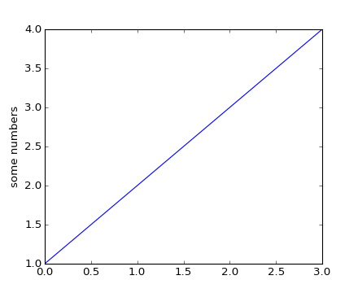
The basics: matplotlib.pyplot
Let’s import it:
Matplotlib deals with figure windows as objects. If you call any function from plt, it will refer to the last plotting figure you made.
Let’s plot the simpler graphic we can and name the y axis.
What happened here?
If you pass only one argument (a list or an array), pyplot assumes that x values are integer indexes starting with 0
>>> import matplotlib.pyplot as plt
>>> plt.plot([1,2,3,4])
>>> plt.ylabel('some numbers')
>>> plt.show()

Slide 4
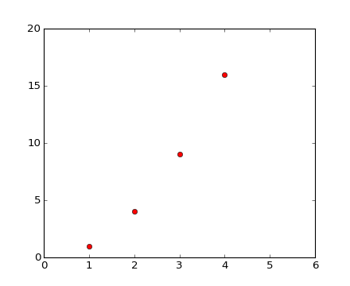
The basics: matplotlib.pyplot
plot() is a versatile command; takes an arbitrary number of arguments.
Okay, now a better example.
For every x, y pair of arguments, there is an optional third argument, a string that formats the style of the plot.
The format string ‘ro’ represents the color (first character) and the marker style (last character). When plotting lines, the style is the last 2 characters.
axis() can receive a list containing the axes limits
>>> import matplotlib.pyplot as plt
>>> plt.plot([1,2,3,4], [1,4,9,16], 'ro')
>>> plt.axis([0, 6, 0, 20])
>>> plt.show()

Slide 5
The basics: matplotlib.pyplot
What about overplots?
2 options:
Pass all lists and styles as arguments once
Pass each plot as a separate command
>>> t = np.arange(0., 5., 0.2)
>>> plt.plot(t, t, 'r--', t, t**2, 'bs', t, t**3, 'g^')
>>> plt.plot(t, t, 'r-’)
>>> plt.plot(t, t**2, 'bs‘)
>>> plt.plot(t, t**3, 'g^‘)

Slide 6
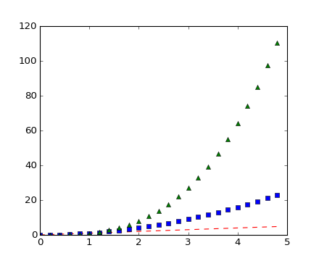
The basics: matplotlib.pyplot
What about overplots?
2 options:
Pass all lists and styles as arguments once
Pass each plot as a separate command
The result is the same
>>> plt.show()

Slide 7
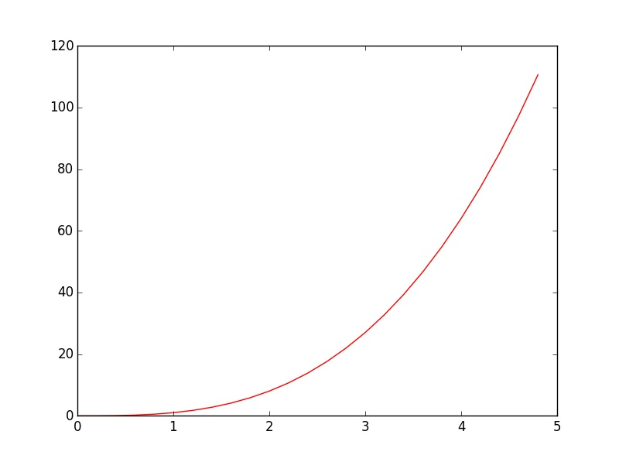
The basics: matplotlib.pyplot
What about overplots?
2 options:
Pass all lists and styles as arguments once
Pass each plot as a separate command
The result is the same
You can also control the line width when plotting lines:
>>> plt.plot(t, t**3, ‘r-’, linewidth=1)
>>> plt.show()

Slide 8
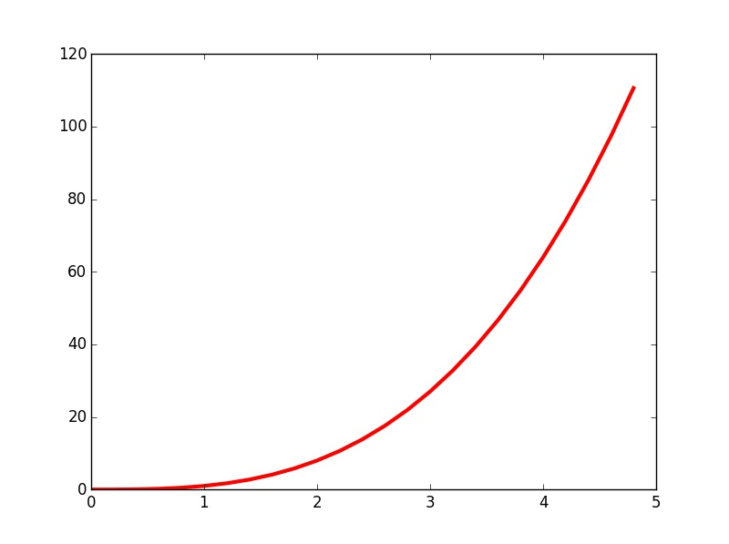
The basics: matplotlib.pyplot
What about overplots?
2 options:
Pass all lists and styles as arguments once
Pass each plot as a separate command
The result is the same
You can also control the line width when plotting lines:
To see more about markers and line styles, take a look at:
http://matplotlib.org/api/markers_api.html
http://matplotlib.org/examples/lines_bars_and_markers/line_styles_reference.html
>>> plt.plot(t, t**3, ‘r-’, linewidth=3)
>>> plt.show()

Slide 9
Multiple plots
Let’s define a function and some arrays
To draw a figure with multiple subplots, you must first call a figure object
Then add subplots
The subplot() command specifies (numrows, numcols, fignum). Pyplot automatically arranges the space to fit it.
Every command you call before other subplot will refer to the last.
Calling the other plots
>>> def f(t):
return np.exp(-t) * np.cos(2*np.pi*t)
>>> t1 = np.arange(0.0, 5.0, 0.1)
>>> t2 = np.arange(0.0, 5.0, 0.02)
>>> plt.figure()
>>> plt.subplot(211)
>>> plt.plot(t1, f(t1), 'bo', t2, f(t2), 'k')
>>> plt.subplot(212)
>>> plt.plot(t2, np.cos(2*np.pi*t2), 'r--')

Slide 10
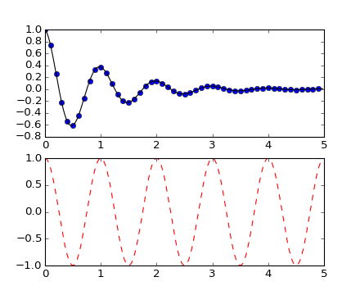
Multiple plots
Let’s define a functions and some arrays
To draw a figure with multiple subplots, you must first call a figure object
Then add subplots
The subplot() command specifies (numrows, numcols, fignum). Pyplot automatically arranges the space to fit it.
Every command you call before other subplot will refer to the last.
Calling the other plots
There you are
>>> plt.show()

Slide 11
Adding text
Let’s add annotations to the plot. For this, here’s an example of an histogram
These commands plot the axis titles , the graph title and annotate text on a specific position
>>> mu, sigma = 100, 15
>>> x = mu + sigma * np.random.randn(10000)
>>> n, bins, patches = plt.hist(x, 50, normed=1, facecolor='g', alpha=0.75)
>>> plt.xlabel('Smarts')
>>> plt.ylabel('Probability')
>>> plt.title('Histogram of IQ')
>>> plt.text(60, .025, r'$\mu=100,\ \sigma=15$')
>>> plt.axis([40, 160, 0, 0.03])
>>> plt.grid(True)

Slide 12
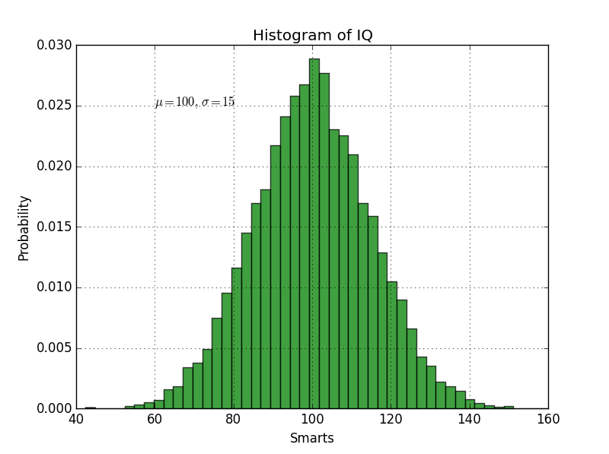
Adding text
Let’s add annotations to the plot. For this, here’s an example of an histogram
These commands plot the axis titles , the graph title and annotate text on a specific position
And here’s the plot
>>> plt.show()

Slide 13
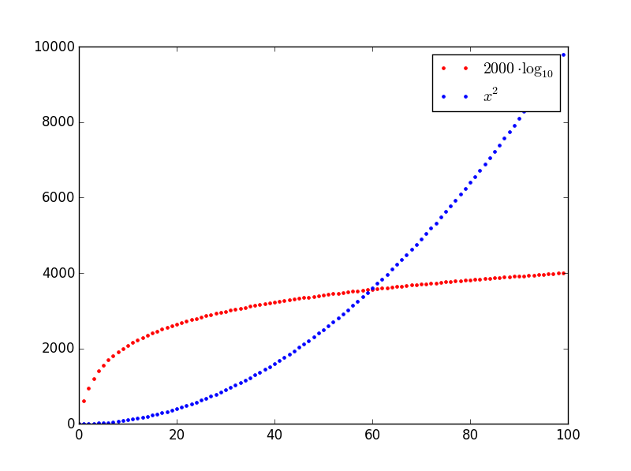
Legends
Now, about legends to the plot. For each data series, we can add a separate legend entry. For this, we must specify a label to each plot and the legends() command does the rest
Let’s see what we get
To take a look on the syntax of math text, visit http://matplotlib.org/users/mathtext.html
>>> x = np.arange(100)
>>> log_10 = plt.plot(x, 2000*np.log10(x), 'r.', label=r'$2000\cdot\log_{10}$')
>>> x_2 = plt.plot(x, x**2, 'b.', label=r'$x^2$')
>>> plt.legend()
>>> plt.show()

