Slide 1



Paralelization and other languages
Henrique Gubolin
hgubolin@gmail.com
Master student at IAG

Slide 2
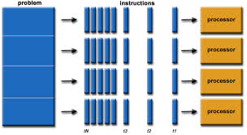
Beware!!!
The Sea of Paralization!!

Slide 3
Table of Contents
Concept of paralelization
Paralelization in python
Integration with other languages
Both together!

Slide 4
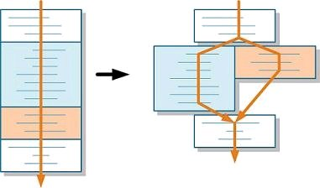
Paralelization – The Idea
http://m.eet.com/media/1110347/analyze_c_code_for_parallelization_fig1.jpg

Slide 5
Multiprocessing module
Pool → Interable paralelization
Process → More complex

Slide 6
Multiprocessing module
Pool → Interable paralelization
Process → More complex

Slide 7
Pool
Use of map function
Class Pool
Pool.map
Test for x**2 → Hands on!! =D

Slide 8
Process
Class Process
p.start()
p.join()
Test for x**2 → Hands on!! =D

Slide 9
Other Languages (=/) with Python (=D)
In C → Ctypes
In FORTRAN → f2py
IDE and python → pyIDL, i2py

Slide 10
Ctypes
gcc -shared -o testlib.so -fPIC testlib.c
cdll('Path_to_file')

Slide 11
Ctypes
gcc -shared -o testlib.so -fPIC testlib.c
cdll('Path_to_file')

Slide 12
f2py
F2py arq.f -c -m fatF fatorial.90

