Slide 1
Exceptions in Python
Júlio Trevisan

Slide 2
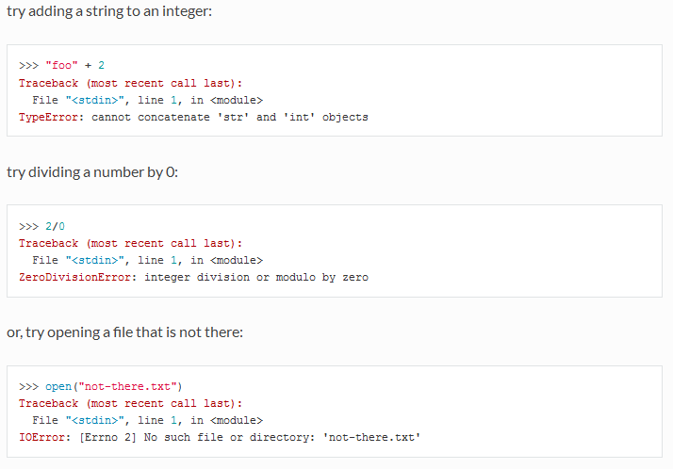
Way to express that there is something wrong
http://anandology.com/python-practice-book/object_oriented_programming.html

Slide 3


“Ask forgiveness, not permission”
forgiveness
permission

Slide 4
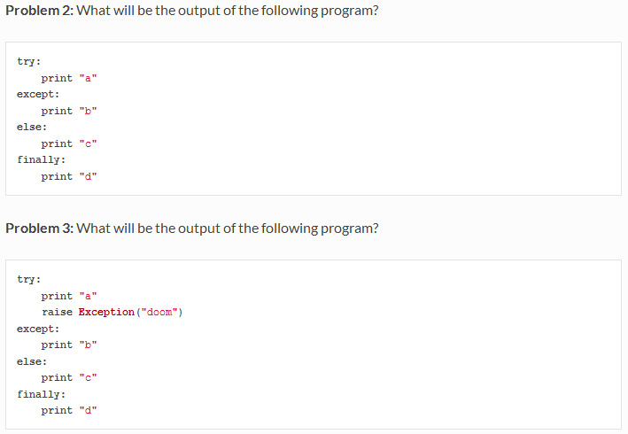
Exercises
http://anandology.com/python-practice-book/object_oriented_programming.html

Slide 5
Exercises
Put the following in a “try” block:
s = raw_input(“Enter lamda (angstrom): ”)
lambda_ = float(s)

Slide 6
Conclusion
Other important topics:
  When building your own library, you should also raise exceptions when the user tries to use it in a wrong way
  assertions
Diving deeper keywords:
raise, assert

