Slide 1
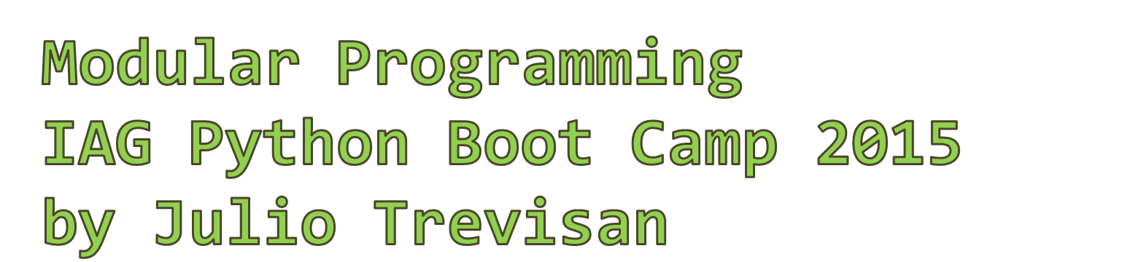

Slide 2
Introduction
Modular programming is about designing a structure to the code
Motivation:
  Organization or even feasibility
  Documentation
  Re-using parts of the code in other projects
  Sharing

Slide 3

Aim:
  To create a Python package
Objectives:
  To structure a working script using def’s, classes and modules
  The code will load a spectrum and perform two math operations on it

Slide 4
Methodology of this lecture
We will build the code in 10 steps
steps[0:3] will be to develop the logic
steps[3:10] will be to modularize the code

Slide 5
# First stage: loads spectrum from file
import matplotlib.pyplot as plt
import numpy as np
FILENAME = 'exemplo_espectro.txt'
# Loads spectrum into two separate vectors
X = np.loadtxt(FILENAME)
lamb = X[:, 0]
flux = X[:, 1]
# Visualizes the results
plt.plot(lamb, flux)
plt.show()

Slide 6
# 2nd stage: cuts spectrum
import matplotlib.pyplot as plt
import numpy as np
FILENAME = 'exemplo_espectro.txt'
LAMBDA_CUT_LEFT = 5000
LAMBDA_CUT_RIGHT = 9000
# Loads spectrum into two separate vectors
X = np.loadtxt(FILENAME)
lamb = X[:, 0]
flux = X[:, 1]
# --- Step 0 --- Cuts spectrum to region of interest
# converts lambdas to vector indexes
idx_cut_left = np.argmin(np.abs(lamb-LAMBDA_CUT_LEFT))
idx_cut_right = np.argmin(np.abs(lamb-LAMBDA_CUT_RIGHT))
# cuts lambdas and fluxes
lamb_1 = lamb[idx_cut_left:idx_cut_right+1]
flux_1 = flux[idx_cut_left:idx_cut_right+1]
# Visualizes the results
ax0 = plt.subplot(2, 1, 1)
plt.plot(lamb, flux)
ax = plt.gca()
plt.subplot(2, 1, 2, sharex=ax0)
plt.plot(lamb_1, flux_1)
plt.show()

Slide 7
# 3rd stage: converts flux to magnitude
import matplotlib.pyplot as plt
import numpy as np
FILENAME = 'exemplo_espectro.txt'
LAMBDA_CUT_LEFT = 5000
LAMBDA_CUT_RIGHT = 9000
MAGNITUDE_OFFSET = -48.60
# Loads spectrum into two separate vectors
X = np.loadtxt(FILENAME)
lamb = X[:, 0]
flux = X[:, 1]
# --- Step 0 --- Cuts spectrum to region of interest
# converts lambdas to vector indexes
idx_cut_left = np.argmin(np.abs(lamb-LAMBDA_CUT_LEFT))
idx_cut_right = np.argmin(np.abs(lamb-LAMBDA_CUT_RIGHT))
# cuts lambdas and fluxes
lamb_1 = lamb[idx_cut_left:idx_cut_right+1]
flux_1 = flux[idx_cut_left:idx_cut_right+1]
# --- Step 1 --- Converts flux to magnitude
lamb_2 = np.copy(lamb_1) # lambda vector is copied
flux_2 = -2.5 * np.log10(flux_1) + MAGNITUDE_OFFSET
# Visualizes the results
ax0 = plt.subplot(3, 1, 1)
plt.plot(lamb, flux)
ax = plt.gca()
plt.subplot(3, 1, 2, sharex=ax0)
plt.plot(lamb_1, flux_1)
plt.subplot(3, 1, 3, sharex=ax0)
plt.plot(lamb_2, flux_2)
plt.show()

Slide 8
# 4th stage: def's
#
# Advantage: a library is born!
import matplotlib.pyplot as plt
import numpy as np
FILENAME = 'exemplo_espectro.txt'
LAMBDA_CUT_LEFT = 5000
LAMBDA_CUT_RIGHT = 9000
MAGNITUDE_OFFSET = -48.60
def load_spectrum(filename):
# Loads spectrum into two separate vectors
X = np.loadtxt(filename)
lamb = X[:, 0]
flux = X[:, 1]
return lamb, flux
def cut(lamb, flux, lambda_left, lambda_right):
# Cuts spectrum to region of interest
# converts lambdas to vector indexes
idx_cut_left = np.argmin(np.abs(lamb-lambda_left))
idx_cut_right = np.argmin(np.abs(lamb-lambda_right))
# cuts lambdas and fluxes
lamb_1 = lamb[idx_cut_left:idx_cut_right+1]
flux_1 = flux[idx_cut_left:idx_cut_right+1]
return lamb_1, flux_1
def to_magnitude(lamb, flux, offset):
# Converts flux to magnitude
lamb_2 = np.copy(lamb) # lambda vector is copied
flux_2 = -2.5 * np.log10(flux) + offset
return lamb_2, flux_2
# Applies the sequence
lamb, flux = load_spectrum(FILENAME)
lamb_1, flux_1 = cut(lamb, flux, LAMBDA_CUT_LEFT, LAMBDA_CUT_RIGHT)
lamb_2, flux_2 = to_magnitude(lamb_1, flux_1, MAGNITUDE_OFFSET)
# Visualizes the results
ax0 = plt.subplot(3, 1, 1)
plt.plot(lamb, flux)
ax = plt.gca()
plt.subplot(3, 1, 2, sharex=ax0)
plt.plot(lamb_1, flux_1)
plt.subplot(3, 1, 3, sharex=ax0)
plt.plot(lamb_2, flux_2)
plt.show()

Slide 9
# 5th stage: spectrum becomes an object
#
# Advantage: now the spectrum can be represented by a single variable.
import matplotlib.pyplot as plt
import numpy as np
from copy import deepcopy
FILENAME = 'exemplo_espectro.txt'
LAMBDA_CUT_LEFT = 5000
LAMBDA_CUT_RIGHT = 9000
MAGNITUDE_OFFSET = -48.60
class Spectrum(object):
def __init__(self):
self.lamb = None
self.flux = None
def load_spectrum(filename):
# Loads spectrum into two separate vectors
X = np.loadtxt(filename)
output = Spectrum()
output.lamb = X[:, 0]
output.flux = X[:, 1]
return output
def cut(input, lambda_left, lambda_right):
# Cuts spectrum to region of interest
# converts lambdas to vector indexes
idx_cut_left = np.argmin(np.abs(input.lamb-lambda_left))
idx_cut_right = np.argmin(np.abs(input.lamb-lambda_right))
# cuts lambdas and fluxes
output = Spectrum()
output.lamb = input.lamb[idx_cut_left:idx_cut_right+1]
output.flux = input.flux[idx_cut_left:idx_cut_right+1]
return output
def to_magnitude(input, offset):
# Converts flux to magnitude
output = Spectrum()
output.lamb = np.copy(input.lamb) # lambda vector is copied
output.flux = -2.5 * np.log10(input.flux) + offset
return output
# Applies the sequence
spectrum0 = load_spectrum(FILENAME)
spectrum1 = cut(spectrum0, LAMBDA_CUT_LEFT, LAMBDA_CUT_RIGHT)
spectrum2 = to_magnitude(spectrum1, MAGNITUDE_OFFSET)
# Visualizes the results
ax0 = plt.subplot(3, 1, 1)
plt.plot(spectrum0.lamb, spectrum0.flux)
ax = plt.gca()
plt.subplot(3, 1, 2, sharex=ax0)
plt.plot(spectrum1.lamb, spectrum1.flux)
plt.subplot(3, 1, 3, sharex=ax0)
plt.plot(spectrum2.lamb, spectrum2.flux)
plt.show()

Slide 10
#!/usr/bin/python
#
# 6th stage: all operations become classes
#
# Advantage: all operations now have the same "interface", i.e.,
# an operation is applied by calling: output = operation.apply(input)
# regardless of the class of the operation.
import matplotlib.pyplot as plt
import numpy as np
FILENAME = 'exemplo_espectro.txt'
LAMBDA_CUT_LEFT = 5000
LAMBDA_CUT_RIGHT = 9000
MAGNITUDE_OFFSET = -48.60
class Spectrum(object):
def __init__(self):
self.lamb = None
self.flux = None
def load_spectrum(filename):
# Loads spectrum into two separate vectors
X = np.loadtxt(filename)
output = Spectrum()
output.lamb = X[:, 0]
output.flux = X[:, 1]
return output
class Cutter(object):
def __init__(self, lambda_left, lambda_right):
self.lambda_left = lambda_left
self.lambda_right = lambda_right
def apply(self, input):
# converts lambdas to vector indexes
idx_cut_left = np.argmin(np.abs(input.lamb - self.lambda_left))
idx_cut_right = np.argmin(np.abs(input.lamb - self.lambda_right))
# cuts lambdas and fluxes
output = Spectrum()
output.lamb = input.lamb[idx_cut_left:idx_cut_right+1]
output.flux = input.flux[idx_cut_left:idx_cut_right+1]
return output
class ToMagnitude(object):
def __init__(self, offset):
self.offset = offset
def apply(self, input):
# Converts flux to magnitude
output = Spectrum()
output.lamb = np.copy(input.lamb) # lambda vector is copied
output.flux = -2.5 * np.log10(input.flux) + self.offset
return output
# creates objects
operation_0 = Cutter(LAMBDA_CUT_LEFT, LAMBDA_CUT_RIGHT)
operation_1 = ToMagnitude(MAGNITUDE_OFFSET)
# acts
spectrum0 = load_spectrum(FILENAME)
spectrum1 = operation_0.apply(spectrum0)
spectrum2 = operation_1.apply(spectrum1)
# Visualizes the results
ax0 = plt.subplot(3, 1, 1)
plt.plot(spectrum0.lamb, spectrum0.flux)
ax = plt.gca()
plt.subplot(3, 1, 2, sharex=ax0)
plt.plot(spectrum1.lamb, spectrum1.flux)
plt.subplot(3, 1, 3, sharex=ax0)
plt.plot(spectrum2.lamb, spectrum2.flux)
plt.show()

Slide 11
# 7th stage: vectorizes the operations
#
# Advantage: code is now prepared for arbitrary number of operations
. . .
# creates objects
sequence = [Cutter(LAMBDA_CUT_LEFT, LAMBDA_CUT_RIGHT),
ToMagnitude(MAGNITUDE_OFFSET)
]
# applies operations
spectra = [load_spectrum(FILENAME)] # loads spectrum
for operation in sequence:
output = operation.apply(input)
spectra.append(output)
input = output
# Visualizes the results
num_plots = len(spectra)
for i in range(num_plots):
if i == 0:
ax = plt.subplot(num_plots, 1, i+1)
reference_axis = ax # if first plot, saves reference axis
# to link to it later (below)
else:
ax = plt.subplot(num_plots, 1, i+1, sharex=ax)
spectrum = spectra[i]
plt.plot(spectrum.lamb, spectrum.flux)
plt.show()

Slide 12
# 8th stage: docstrings
. . .
class Spectrum(object):
"""Class to represent a spectrum.""“
. . .
def load_spectrum(filename):
# No need to document what is obvious; here I am not mentioning the
# filename argument.
"""Loads spectrum file into two separate vectors.""“
. . .
class Cutter(object):
# Description of the arguments passed to __init__() go at the
# class docstring
"""Cuts spectrum to region specified by a wavelength interval.
Arguments:
lambda_left -- initial wavelength
lambda_right -- final wavelength
"""
. . .
class ToMagnitude(object):
"""Converts flux to magnitude.
Arguments:
offset -- see formula
Formula: magniture = -2.5 * log10(flux) + offset
The formula is applied to all elements in flux vector.
"""
. . .

Slide 13
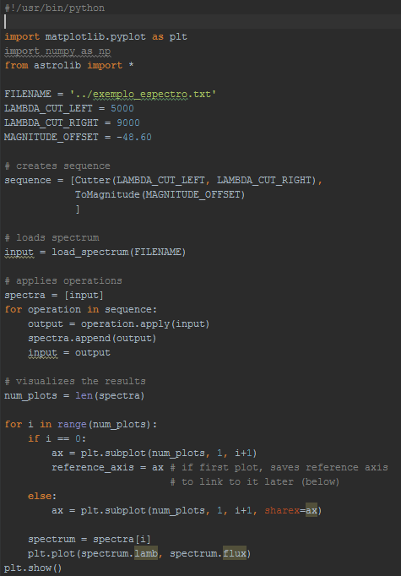

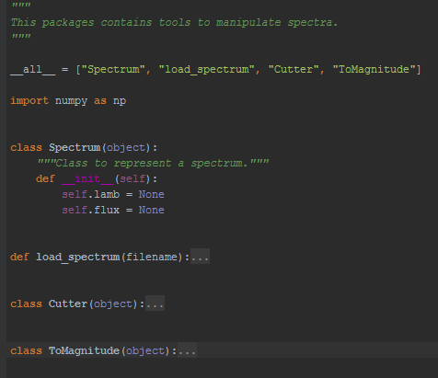
9th stage

Slide 14
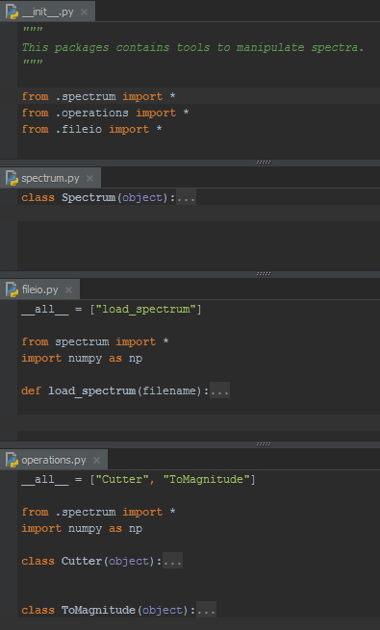

10th stage

Slide 15
Summary
Keywords:
module, package, __all__
class, __init__, self

Slide 16
Conclusion
Keywords for diving deeper into object-oriented programming:
    polymorphism
    inheritance
    composition

