Slide 1
Showing Cause,
Introduction to Study Design
Principles of Epidemiology
Lecture 4
Dona Schneider, PhD, MPH, FACE

Slide 2
Theories of Disease Causation
Supernatural Theories
Hippocratic Theory
Miasma
Theory of Contagion
Germ Theory (cause shown via Henle-Koch postulates)
Classic Epidemiologic Theory
Multicausality and Webs of Causation (cause shown via Hill’s postulates)

Slide 3
Henle-Koch Postulates
Sometimes called “pure determinism”
  The agent is present in every case of the disease
  It does not occur in any other disease as a chance or nonpathogenic parasite (one agent one disease)
  It can be isolated and if exposed to healthy subjects will cause the related disease
Notes:
…then it can no longer be a random accident of the disease, but between the parasite and the disease can be conceived no relation except that the parasite is the cause of the disease -- Robert Koch (1890)

Slide 4
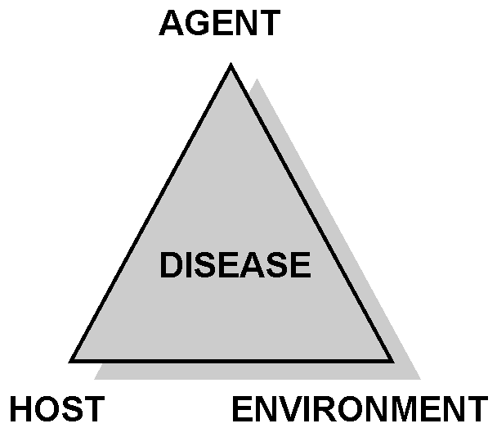

Epidemiologic Triad
Disease is the result of forces within a dynamic system consisting of:
agent of infection
host
environment

Slide 5
Classic Epidemiologic Theory
Agents
  Living organisms
  Exogenous chemicals
  Genetic traits
  Psychological factors and stress
  Nutritive elements
  Endogenous chemicals
  Physical forces
Agents have characteristics such as infectivity, pathogenicity and virulence (ability to cause serious disease)
  They may be transmitted to hosts via vectors
Notes:
Source: Smith, Theobald (1934) Parasitism and Disease. Princeton, NJ: Princeton University Press.

Slide 6
Classic Epidemiologic Theory (cont.)
Host factors:
  Immunity and immunologic response
  Host behavior
Environmental factors:
  Physical environment (heat, cold, moisture)
  Biologic environment (flora, fauna)
  Social environment (economic, political, culture)

Slide 7
Hill’s Postulates
Strength of Association – the stronger the association, the less likely the relationship is due to chance or a confounding variable
Consistency of the Observed Association – has the association been observed by different persons, in different places, circumstances, and times? (similar to the replication of laboratory experiments)
Specificity – if an association is limited to specific persons, sites and types of disease, and if there is no association between the exposure and other modes of dying, then the relationship supports causation
Temporality – the exposure of interest must precede the outcome by a period of time consistent with any proposed biologic mechanism
Biologic Gradient – there is a gradient of risk associated with the degree of exposure (dose-response relationship)
Notes:
Source: Hill, Sir Austin Bradford (1965)

Slide 8
Hill’s Postulates (cont)
Biologic Plausibility – there is a known or postulated mechanism by which the exposure might reasonably alter the risk of developing the disease
Coherence – the observed data should not conflict with known facts about the natural history and biology of the disease
Experiment – the strongest support for causation may be obtained through controlled experiments (clinical trials, intervention studies, animal experiments)
Analogy – in some cases, it is fair to judge cause-effect relationships by analogy – “With the effects of thalidomide and rubella before us, it is fair to accept slighter but similar evidence with another drug or another viral disease in pregnancy”

Slide 9
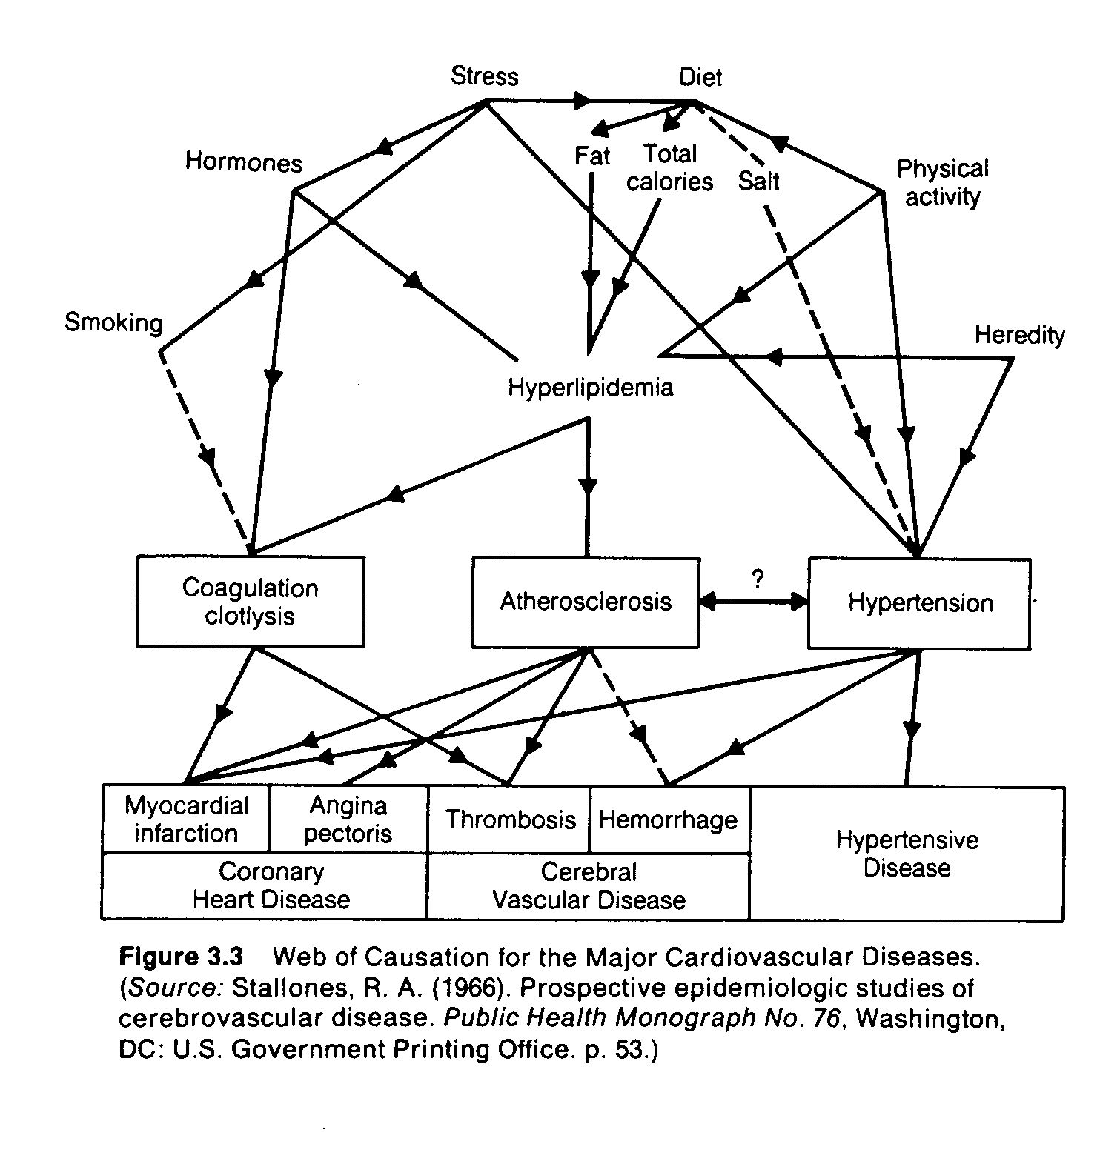
Web of Causation for the Major Cardiovascular Diseases
Notes:
Web of Causation for the Major Cardiovascular Diseases. (Source: Stallones, R.A. (1966). Prospective epidemiologic studies of cerebrovascular disease. Public Health Monograph No. 76, Washington, DC: U.S. Government Printing Office. p. 53.)

Slide 10
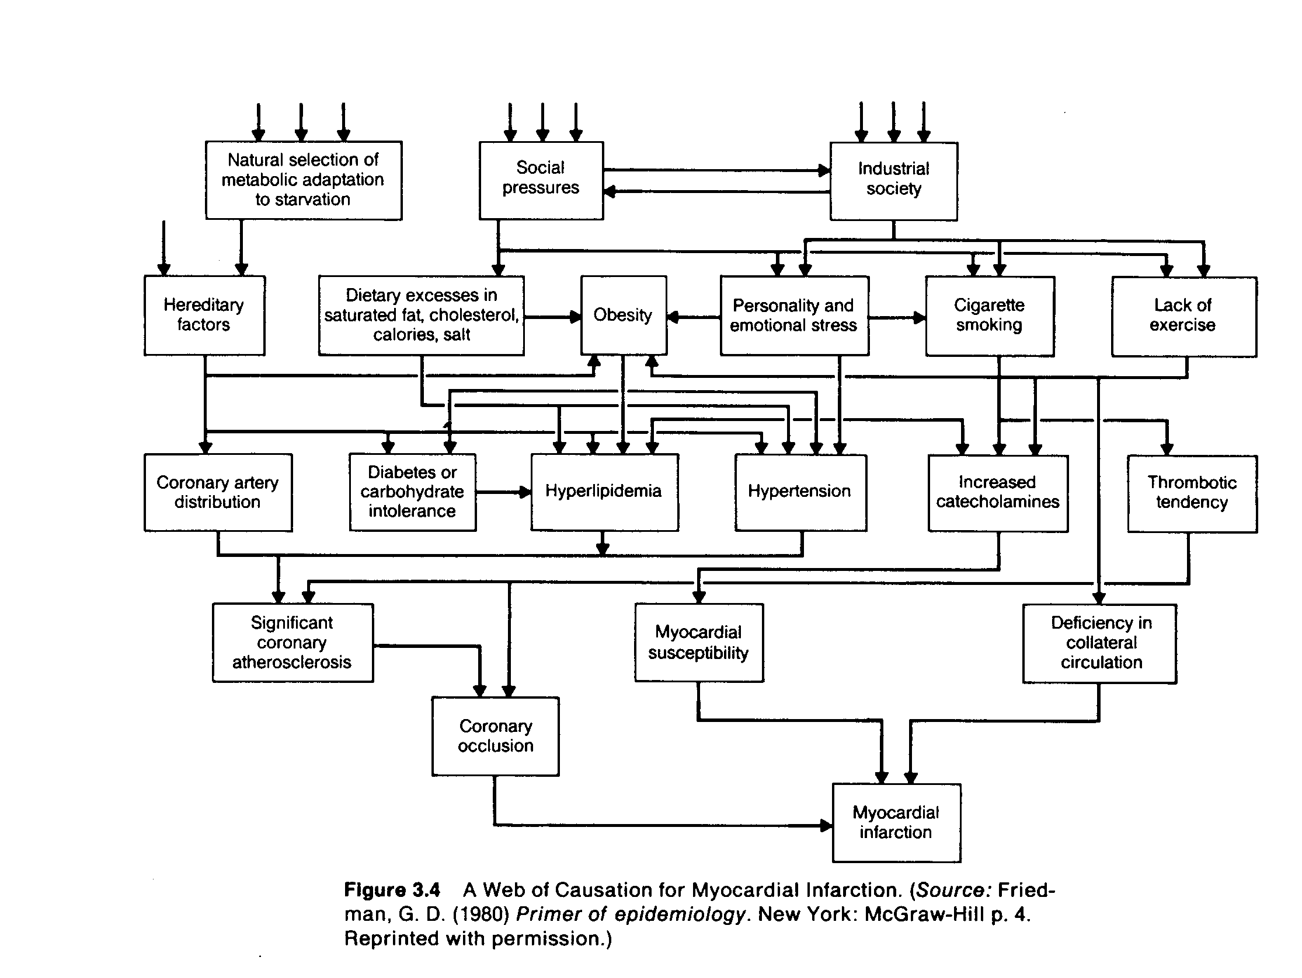

Slide 11
Causal Relationships
A causal pathway may be direct or indirect
In direct causation, A causes B without intermediate effects
In indirect causation, A causes B, but with intermediate effects
In human biology, intermediate steps are virtually always present in any causal process

Slide 12
Types of Causal Relationships
Necessary and sufficient – without the factor, disease never develops
  With the factor, disease always develops (this situation rarely occurs)
Necessary but not sufficient – the factor in and of itself is not enough to cause disease
  Multiple factors are required, usually in a specific temporal sequence (such as carcinogenesis)
Sufficient but not necessary – the factor alone can cause disease, but so can other factors in its absence
  Benzene or radiation can cause leukemia without the presence of the other
Neither sufficient nor necessary – the factor cannot cause disease on its own, nor is it the only factor that can cause that disease
  This is the probable model for chronic disease relationships

Slide 13
Factors in Causation
All may be necessary but rarely sufficient to cause a particular disease or state
  Predisposing – age, sex or previous illness may create a state of susceptibility to a disease agent
  Enabling – low income, poor nutrition, bad housing or inadequate medical care may favor the development of disease
    Conversely, circumstances that assist in recovery or in health maintenance may be enabling
  Precipitating – exposure to a disease or noxious agent
  Reinforcing – repeated exposure or undue work or stress may aggravate an established disease or state

Slide 14
Comparing Rules of Evidence
Criminal Law
Causation
Criminal present at scene of crime
Agent present in the disease
Premeditation
Causal events precede onset of disease
Accessories involved in the crime
Cofactors and/or multiple causality involved
Severity of crime related to state of victim
Susceptibility and host response determine severity
Motivation – there must be gain to the criminal
The role of the agent in the disease must make biologic and common sense
No other suspect could have committed the crime
No other agent could have caused the disease under the circumstances given
Proof of guilt must be established beyond a reasonable doubt
Proof of causation must be established beyond reasonable doubt or role of chance

Slide 15
Study Designs
Means to assess possible causes by gathering and analyzing evidence

Slide 16
Types of Study Designs
Descriptive studies (to generate hypotheses)
  Case-reports
  Cross-sectional studies (prevalence studies) measure exposure and disease at the same time
  Ecological studies (correlational studies) use group data rather than data on individuals
    These data cannot be used to assess individual risk
    To do this is to commit ecological fallacy

Slide 17
Types of Study Designs (cont.)
Analytic studies (to test hypotheses)
  Experimental studies
    Clinical trials
    Field trials
    Intervention studies
  Observational studies
    Case-control studies
    Cohort studies

Slide 18
The Key to Study Design
The key to any epidemiologic study is in the definition of what constitutes a case and what constitutes exposure
Definitions must be exclusive, categorical
Failure to effectively define a case may lead to misclassification bias

Slide 19
Sources or Error in
Epidemiologic Studies
Misclassification – wrongful classification of status for either disease or exposure
Random variation - chance

Slide 20
Sources or Error in Epidemiologic Studies
Bias – systematic preferences built into the study design
Confounding – occurs when a variable is included in the study design that is related to both the outcome of interest and the exposure, leading to false conclusions
  Example: gambling and lung cancer
Effect modification – occurs when the magnitude of the association between the outcome of interest and the exposure differ according to the level of a third variable
  The effect may be to nullify or heighten the association
  Example: gender and hip fracture modified by age

Slide 21
Contingency Tables
The findings for most epidemiologic studies can be presented in the 2x2 table
 | Disease
 | Yes | No | Total
Exposure
Yes | a | b | a+b
No | c | d | c+d
Total | a+c | b+d | a+b+c+d

Slide 22
Measures of Association from the 2x2 Table
Cohort Study: the outcome measure is the relative risk (or risk ratio or rate ratio)
  In cohort studies you begin with the exposure of interest and then determine the rate of developing disease
  RR measures the likelihood of getting the disease if you are exposed relative to those who are unexposed
    RR = incidence in the exposed/incidence in the unexposed
      RR = a/(a+b)
      c/(c+d)

Slide 23
Measures of Association from the 2X2 Table
Case-control study: the outcome measure is an estimate of the relative risk or the odds ratio (relative odds)
  In a case-control study, you begin with disease status and then estimate exposure
    RR is estimated because patients are selected on disease status and we cannot calculate incidence based on exposure
    The estimate is the odds ratio (OR) or the likelihood of having the exposure if you have the disease relative to those who do not have the disease
      ~RR = OR = a/c = ad
      b/d bc

Slide 24
Attributable Risk or Risk Difference
In a cohort study, we may want to know the risk of disease attributable to the exposure in the exposed group, that is, the difference between the incidence of disease in the exposed and unexposed groups (excess risk)
AR = a/(a+b) – c/(c+d)
AR = 0: No association between exposure and disease
AR > 0: Excess risk attributable to the exposure
AR < 0: The exposure carries a protective effect

Slide 25
Attributable Risk Percent
In a cohort study, we may want to know the proportion of the disease that could be prevented by eliminating the exposure in the exposed group (attributable fraction or etiologic fraction)
AR% = AR/[a/(a+b)] x 100
If the exposure is preventive, calculate the preventive fraction

Slide 26
Population Attributable Risk
In a cohort study, we may want to know the risk of disease attributable to exposure in the total study population or the difference between the incidence of disease in the total study population and that of the unexposed group
PAR = (a+c)/(a+b+c+d) – c/(c+d)
To estimate the PAR for a population beyond the study group you must know the prevalence of disease in the total population

Slide 27
Population Attributable Risk Percent
In a cohort study, we may want to know the proportion of the disease that could be prevented by eliminating the exposure in the entire study population
PAR% = PAR/[(a+c)/(a+b+c+d)] x 100

Slide 28
Summary of Attributable Risk Calculations
 | In exposed group |  | In total population
Incidence attributable to exposure | I_{e} – I_{n} AR |  | I_{p} – I_{n} PAR
Proportion of incidence attributable to exposure | I_{e} – I_{n} | X 100 | I_{p} – I_{n} | X 100
 | I_{e} |  | I_{p}
 | AR% |  | PAR%

Slide 29
Comparing Relative Risks
Age-Adjusted Death Rates per 100,000 for Male British Physicians
 | Smokers | Non-smokers
Lung cancer | 140 | 10
CHD | 669 | 413
Source: Doll and Peto. Mortality in relation to smoking: Twenty years’ observations on male British doctors. BMJ 1976;2:1525-36
Relative risk (relative risk, risk ratio) I_{e}/I_{n}: LC = 14.0; CHD = 1.6
Smokers are 14 times as likely as non-smokers to develop LC
Smokers are 1.6 times as likely as non-smokers to develop CHD
Smoking is a stronger risk factor for lung cancer than for CHD

Slide 30
Comparing Attributable Risks
Age-Adjusted Death Rates per 100,000 for Male British Physicians
 | Smokers | Non-smokers
Lung cancer | 140 | 10
CHD | 669 | 413
Source: Doll and Peto. Mortality in relation to smoking: Twenty years’ observations on male British doctors. BMJ 1976;2:1525-36
Attributable risk (risk difference, etiologic fraction) I_{e}- I_{n}: LC = 130; CHD = 256
The excess of lung cancer attributable to smoking is 130 per 100,000 The excess of CHD attributable to smoking is 256 per 100,000
If smoking is causal, eliminating cigarettes would save more smokers from CHD than from LC

Slide 31
Comparing Attributable Risk Percents
Age-Adjusted Death Rates per 100,000 for Male British Physicians
 | Smokers | Non-smokers
Lung cancer | 140 | 10
CHD | 669 | 413
Source: Doll and Peto. Mortality in relation to smoking: Twenty years’ observations on male British doctors. BMJ 1976;2:1525-36
Attributable Risk % = [(I_{e}-I_{n})/I_{e}] x 100: LC = 92%; CHD = 38%
About 92% of LC could be eliminated if the smokers in this study did not smoke
About 38% of CHD could be eliminated if the smokers in this study did not smoke
If smoking is causal, eliminating cigarettes would save double the proportion of smokers from LC than CHD

