Slide 1
Active/Active and Active/Passive Configurations in AWS Direct Connect
A broad exploration of hybrid connectivity options can be found here: Hybrid Connectivity.
Service Level Agreement (SLA)
AWS offers customers the ability to achieve highly-resilient network connections between Amazon Virtual Private Cloud (Amazon VPC) and their on-premises infrastructure. The Amazon Web Services (AWS) Direct Connect Resiliency Toolkit provides a connection wizard with multiple resiliency models. These models help you to determine, and then place an order for the number of dedicated connections to achieve your SLA objective.
This reference architecture focuses on the Maximum Resiliency model, which provides you with a way to order dedicated connections to achieve an SLA of 99.99%. You can find the requirements in the AWS Direct Connect Service Level Agreement.
AWS Direct Connect – Max resiliency - Active/Active with Private/Transit VIF
AWS Direct Connect – Max resiliency - Active/Passive with Private/Transit VIF
AWS Direct Connect – Max resiliency - Active/Active with Public VIF
AWS Direct Connect – Max resiliency - Active/Passive with Public VIF
Link aggregation groups (LAGs) and Equal Cost Multi Path (ECMP)
For Active/Active mode, you can leverage LAGs for dedicated Direct Connect connections, terminating on the same AWS Direct Connect endpoint. This will load balance traffic across all connections in the LAG on layer 2. This will not protect against failure on the Direct Connect endpoint or the whole Direct Connect location.
With ECMP, you can load balance traffic across multiple connections and Direct Connect locations on layer 3. You can influence path behaviour by longest prefix match and Border Gateway Protocol (BGP) attributes. This allows for setting up Active/Active or Active/Passive configurations.

Slide 2



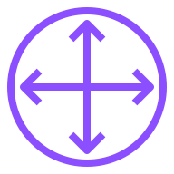


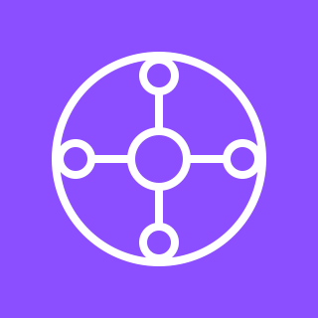


Active/Active with Private/Transit VIF
For the diagram description, refer to the full diagram.
AWS Cloud
Direct Connect location 1
Corporate data center 1
9
Region
10.0.0.0/16
2
3
4
5
6
Transit
VIF
Direct Connect endpoint
Customer or
partner router
Customer
router
VPC
Transit
VIF
Servers
7224:7200
Direct Connect endpoint
Customer or
partner router
Customer
router
10
7
8
Transit Gateway (TGW)
attachment
Direct Connect location 2
Corporate data center 2
1
11
13
Direct Connect
gateway
association
65001
Transit
VIF
AWS Transit
Gateway
Direct
Connect
gateway
12
Direct Connect endpoint
Customer or
partner router
Customer
router
MED: 50
Servers
Transit
VIF
Direct Connect endpoint
Customer or
partner router
Customer
router
All CIDR ranges, BGP communities, ASN numbers and MED values are examples only.
© 2023, Amazon Web Services, Inc. or its affiliates. All rights reserved.

Slide 3
Active/Passive with Private/Transit VIF
For the diagram description, refer to the full diagram.
AWS Cloud
Direct Connect location 1
Corporate data center 1
8
Region
10.0.0.0/16
2
3
4
5
Transit
VIF
Direct Connect endpoint
Customer or
partner router
Customer
router
VPC
Transit
VIF
Servers
7224:7300
Direct Connect endpoint
Customer or
partner router
Customer
router
9
6
7
TGW
attachment
Direct Connect location 2
Corporate data center 2
1
10
Direct Connect
gateway
association
65001
Transit
VIF
AWS Transit
Gateway
Direct
Connect
Gateway
Direct Connect endpoint
Customer or
partner router
Customer
router
11
MED: 50
Servers
Transit
VIF
Direct Connect endpoint
Customer or
partner router
Customer
router
All CIDR ranges, BGP communities, ASN numbers and MED values are examples only.
© 2023, Amazon Web Services, Inc. or its affiliates. All rights reserved.

Slide 4
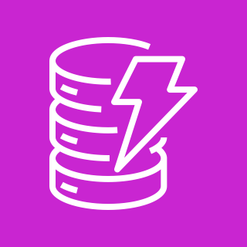


Active/Active with Public VIF
For the diagram description, refer to the full diagram.
AWS Cloud
Direct Connect location 1
Corporate data center 1
8
Region
10.0.0.0/16
1
2
3
4
5
Public
VIF
Direct Connect endpoint
Customer or
partner router
Customer
router
Public
VIF
Servers
Direct Connect endpoint
Customer or
partner router
Customer
router
6
7
AWS public resources
Direct Connect location 2
Corporate data center 2
9
Amazon DynamoDB
Amazon S3
Public ASN
Public
VIF
…
Direct Connect endpoint
Customer or
partner router
Customer
router
Amazon CloudWatch
More AWS endpoints
Public
VIF
Servers
Direct Connect endpoint
Customer or
partner router
Customer
router
All CIDR ranges, BGP communities, ASN numbers and MED values are examples only.
© 2023, Amazon Web Services, Inc. or its affiliates. All rights reserved.

Slide 5
Active/Passive with Public VIF
For the diagram description, refer to the full diagram.
AWS Cloud
Direct Connect location 1
Corporate data center 1
7
Region
10.0.0.0/16
1
2
3
4
Public
VIF
Direct Connect endpoint
Customer or
partner router
Customer
router
Public
VIF
Servers
Direct Connect endpoint
Customer or
partner router
Customer
router
5
6
AWS public resources
Direct Connect location 2
Corporate data center 2
8
Amazon DynamoDB
Amazon S3
Public ASN
Public
VIF
…
Direct Connect endpoint
Customer or
partner router
Customer
router
Amazon CloudWatch
More AWS endpoints
Public
VIF
Servers
Direct Connect endpoint
Customer or
partner router
Customer
router
All CIDR ranges, BGP communities, ASN numbers and MED values are examples only.
© 2023, Amazon Web Services, Inc. or its affiliates. All rights reserved.

Slide 6
Resources
To get started with customizing your architecture diagram, refer to the following resources.
For all service icons, refer to AWS Architecture Icons.
For more architecture diagrams, refer to AWS Architecture Center.
For more AWS best practices, refer to AWS Well-Architected.
If you have suggestions about making this experience better, provide feedback.

