Slide 1








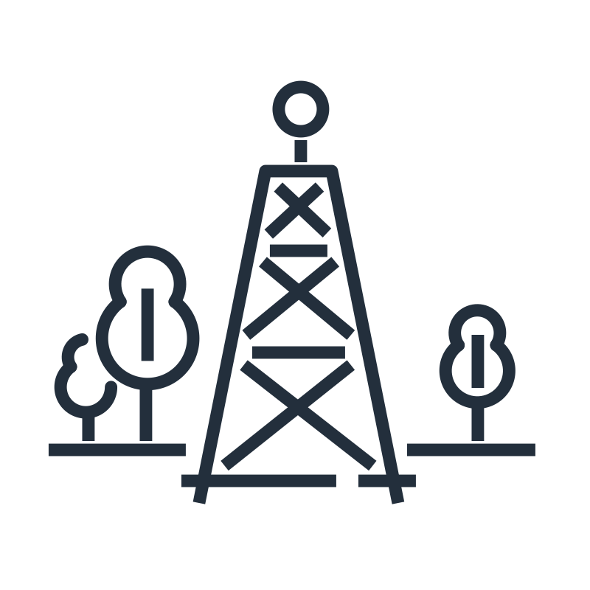
































Connected Mobility Platform
For the architecture description, refer to the full diagram.
control plane
data plane
ML use cases
personalization and prediction
remote operations
personalization/Rekognition
smart traffic light
charging station
6
shadow
command
vehicle onboarding and management
2
Amazon Kinesis
Video Streams
Amazon Rekognition
Amazon SageMaker
inference
C-V2X
governance
AWS IoT Device Management
just-in-time registration
AWS IoT FleetWise
data lake
anonymized
telco
curated
vehicle attribute and subscription management
Amazon Kinesis
Data Firehose
Amazon S3
raw
AWS Lake Formation
in-vehicle
summary
trip info, driver score
4
telemetry
service, data APIs
Amazon Neptune
integration
Amazon EventBridge
connectivity
3
X509
network gateway
SIM
Amazon Kinesis
Data Streams
aggregate
Amazon Timestream
AWS Data Exchange
Amazon API Gateway
DynamoDB
1
AWS IoT Core
rules
action
AWS IoT SDK
applications
notification
7
fleet management
assistance and call center integration
third party
5
8
AWS IoT FleetWise
Amazon Kinesis
Data Analytics
DynamoDB
Amazon Comprehend
telco provider
parking provider
Amazon QuickSight
AWS IoT Greengrass
OEM systems
fleet info
Amazon API Gateway
after sales
alert/insight
agent event
container
ML inference
portal
parts inventory
dealer
management
IVI | TCU | battery
Amazon Simple Notification Service
Amazon Location Service
bucket
Amazon Chime
Amazon Connect
© 2022, Amazon Web Services, Inc. or its affiliates. All rights reserved.
Notes:
A developer initiates an activity in AWS CI/CD pipeline such as push code changes. These activities create Amazon CloudWatch events.
An Amazon EventBridge event rule detects the CloudWatch events and sends the event data to an Amazon Kinesis Firehose Delivery Stream. One event rule per event source.
An event rule is also created to capture event data from Amazon CloudWatch Synthetics Canary if customer has set up the canary – only needed for MTTR.
The Firehose uses a Lambda function for data transformation. It extracts relevant data and sends it to an Amazon S3 bucket.
An Amazon Athena database queries the S3 data and returns the query result to an Amazon QuickSight.
An Amazon QuickSight obtains the query result and builds dashboard displays for the management team.

Slide 2
Resources
To get started with customizing your architecture diagram, refer to the following resources.
For all service icons, refer to AWS Architecture Icons.
For more architecture diagrams, refer to AWS Architecture Center.
For more AWS best practices, refer to AWS Well-Architected.
If you have suggestions about making this experience better, provide feedback.

