Slide 1


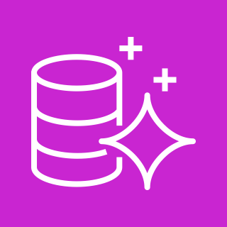
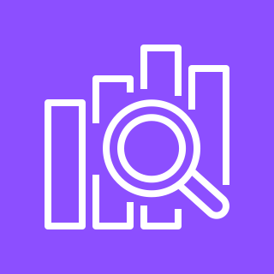
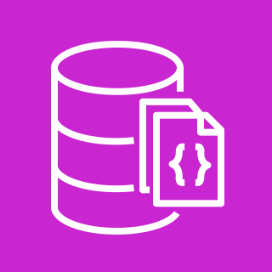
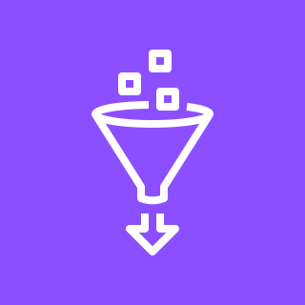
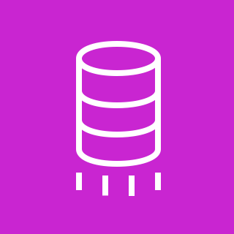

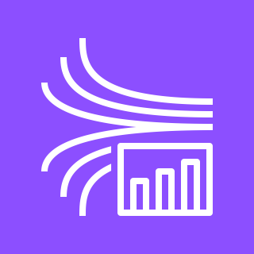

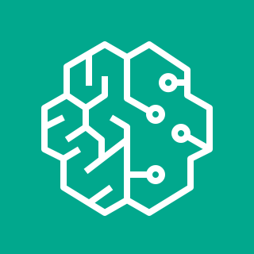
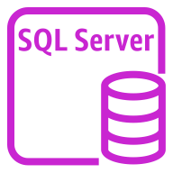
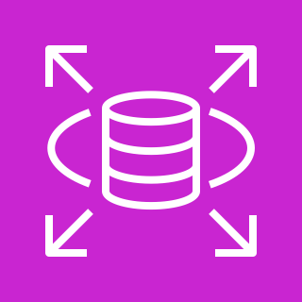
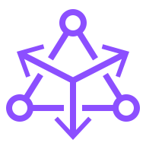
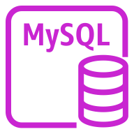
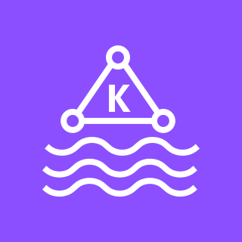

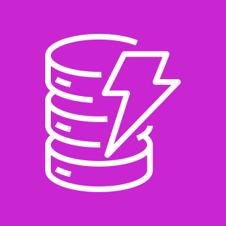
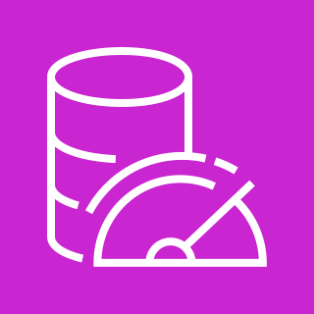
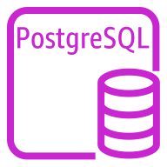

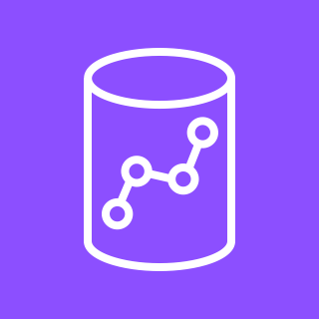

Exploring Real-Time Streaming for Retrieval Augmented Generation in GenerativeAI
For the architecture description, refer to the full diagram.
Data
Center
AWS Cloud
Data Transfer and Processing
Vector embeddings or ML search
4
6
2
Change Data Capture
1
Data Sources
Amazon Aurora
Amazon OpenSearch
Amazon DocumentDB
AWS Glue
3
AWS Database Migration Service
Generative AI model (LLM)
Amazon Aurora
Managed Service for Apache Flink
7
Amazon Kinesis Data Streams
Amazon SageMaker
Amazon Bedrock
10
5
Generative AI application
Amazon RDS
Amazon MSK Connect Debezium Connector
User Profile / History
8
Amazon MSK
AWS Lambda
Amazon DocumentDB
Amazon DynamoDB
Amazon MemoryDB
Amazon DocumentDB
Amazon Kinesis Data Firehose
Managed Service for Apache Flink
9
Amazon MSK Connect
Amazon Redshift
© 2023, Amazon Web Services, Inc. or its affiliates. All rights reserved.
Notes:
https://amazon.awsapps.com/workdocs-preview/index.html#/folder/003438dc33fd8d7406d0cf225fc47a7c84442dc5bcf0de1fd5580fa17e192089
https://aws.amazon.com/blogs/big-data/build-near-real-time-logistics-dashboards-using-amazon-redshift-and-amazon-managed-grafana-for-better-operational-intelligence/

Slide 2
Steps
This architecture demonstrates the integration of streaming data services on AWS with Retrieval Augmented Generation(RAG) in Generative AI applications.
1. Data sources for change data capture(CDC) includes on-premise or AWS databases such as Oracle, SQL Server, MySQL, PostgreSQL,
Amazon Aurora, and Amazon RDS, all funneling data into your Retrieval Augmented Generation(RAG) model.
2. AWS Database Migration Service and Amazon MSK Connect with Debezium connector help with one-time data migration of databases
and continuous data replication. AWS Database Migration Service and Amazon MSK Connect with Debezium connector captures and
stream changes from source databases and applies them in same order they are captured to the target.
3. Utilizing AWS Database Migration Service and Amazon MSK Connect with Debezium connector enables the streaming of data to Amazon
Kinesis Data Streams or Amazon Managed Streaming for Apache Kafka (Amazon MSK), facilitating the collection and processing of large
streams.
4. By utilizing AWS Glue Spark Streaming and Amazon Managed Service for Apache Flink, you can construct specialized data processing
pipelines to cater to your data consumption requirements.
5. AWS Lambda, Amazon Kinesis Data Firehose and Amazon MSK Connect, which serve as data sink services, enable the direct transfer of
source data into destinations like Data Lake , Amazon Redshift, among others.
6. Leveraging Amazon Aurora PostgreSQL with pgvector, Amazon Opensearch and Amazon DocumentDB allows the generation of vector
embeddings for streamlined data retrieval , vector representation management, scalability, and real-time inference capabilities.
7. Amazon SageMaker and Amazon Bedrock offers the means to discover pertinent information within a corpus, conduct similarity search
on vectorized domain specific datasets, and use this data as input for generation models
8. To preserve user profiles and conversation history , Amazon DocumentDB, Amazon DynamoDB and Amazon MemoryDB provide
suitable options.
9. Leverage Amazon Redshift service to ensure data persistence, thereby augmenting the data inputs for the Generative AI RAG model.
10. For details on the workings of RAG applications, refer to Retrieval-Augmented Generation(RAG)

Slide 3
Resources
Please refer to the below additional resources for details
For exploring real-time streaming for generative AI applications, refer to the blog
For more on Generative AI with AWS, refer to Generative AI.
For more on Large language models, refer to Large Language Models.
For more on Retrieval-Augmented Generation, refer to Retrieval-Augmented Generation.
If you have suggestions about making this experience better, provide feedback.

