Slide 1














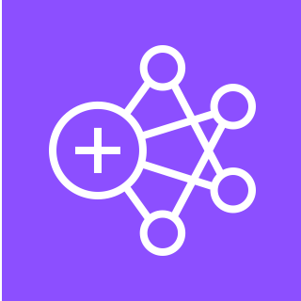



LUMINAI Refinery Advisor on AWS
For the architecture description, refer to the full diagram.
AWS Cloud
6
Virtual Private Cloud (VPC)
Availability Zones A,B,C
users
Public subnet
Private subnet
Refinery sites
Security group
Security group
1
Web/UI/API
4
LUMINAI business services
processes
assets
ALB web
Amazon ECS
UI
Amazon ECS
API/middleware
2
Amazon ECS
orchestrator
Amazon ECS
reasoner
3
Sensor processing pipeline
Amazon MQ
data historians
data streams
7
Amazon ECS
data ingress
Amazon MSK
sensor data streams
Amazon EMR
sensor processing pipeline
Amazon ECS
reporting APIs
ALB data
Raw data backup/processed data
5
authorized clients
ALB reporting data
Amazon Aurora PostgreSQL
Amazon S3
© 2024, Amazon Web Services, Inc. or its affiliates. All rights reserved.
Notes:
A developer initiates an activity in AWS CI/CD pipeline such as push code changes. These activities create Amazon CloudWatch events.
An Amazon EventBridge event rule detects the CloudWatch events and sends the event data to an Amazon Kinesis Firehose Delivery Stream. One event rule per event source.
An event rule is also created to capture event data from Amazon CloudWatch Synthetics Canary if customer has set up the canary – only needed for MTTR.
The Firehose uses a Lambda function for data transformation. It extracts relevant data and sends it to an Amazon S3 bucket.
An Amazon Athena database queries the S3 data and returns the query result to an Amazon QuickSight.
An Amazon QuickSight obtains the query result and builds dashboard displays for the management team.

Slide 2
Resources
To get started with customizing your architecture diagram, refer to the following resources.
For all service icons, refer to AWS Architecture Icons.
For more architecture diagrams, refer to AWS Architecture Center.
For more AWS best practices, refer to AWS Well-Architected.
If you have suggestions about making this experience better, provide feedback.

