Slide 1




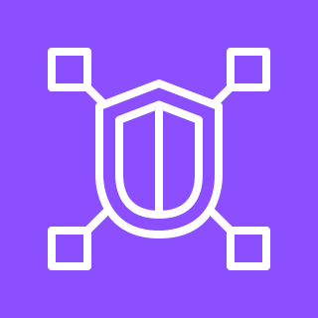
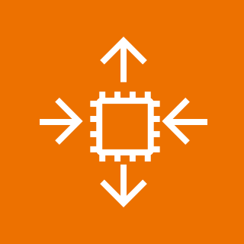




Amazon VPC Lattice - Components
For the architecture description, refer to the full diagram.
AWS Region
AWS account 4
AWS account 1
AWS account 3
4
Service VPC A
4
service policy
consumer VPC A
service network policy
Security group
VPC association
1
service
association
default
Amazon VPC Lattice
service 1
Amazon EC2
Auto Scaling
Amazon Elastic Compute Cloud (Amazon EC2)
Amazon VPC Lattice
service network
AWS account 5
AWS account 2
service
association
Service VPC B
service
association
service policy
consumer VPC B
AWS account 6
default
Security group
VPC association
Amazon VPC Lattice
service 2
Amazon Elastic
Kubernetes Service
2
3
Amazon Elastic Compute Cloud (Amazon EC2)
service
policy
default
Amazon VPC Lattice
service 3
AWS Lambda
© 2023, Amazon Web Services, Inc. or its affiliates. All rights reserved.

Slide 2
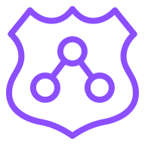




Amazon VPC Lattice - Traffic Flow
For the architecture description, refer to the full diagram.
AWS Region
AWS Account
VPC
VPC
Availability Zone
Availability Zone
1
Resolver
Private subnet
Private subnet
service network policy
Availability Zone
Security group
service policy
VPC association
service
association
default
Private subnet
2
3
4
Application Load Balancer
Amazon VPC Lattice
service network
Amazon VPC Lattice
service 1
Private subnet
Private subnet
Amazon EC2
Auto Scaling group
instances
instances
© 2023, Amazon Web Services, Inc. or its affiliates. All rights reserved.

Slide 3


Amazon VPC Lattice - Custom Domain Name for a VPC Lattice Service
For the architecture description, refer to the full diagram.
AWS Region
AWS Account
1
Records | Owner
Record name | Type | Value
service1.example.com | ALIAS | service1-{service_id}.{partition_id}.vpc-lattice-svcs.region.on.aws
private hosted zone
VPC
3
VPC
resolver
Availability Zone
service network policy
Security group
VPC association
service policy
Availability Zone
Availability Zone
service
association
default
Private subnet
4
5
6
Private subnet
Private subnet
Amazon VPC Lattice
service network
Amazon VPC Lattice
service 1
service1.example.com
Amazon EC2
Auto Scaling group
2
instances
instances
public
certificate
AWS Certificate
Manager (ACM)
© 2023, Amazon Web Services, Inc. or its affiliates. All rights reserved.

Slide 4
Amazon VPC Lattice - Multi-Account Centralized Single Service Network
For the architecture description, refer to the full diagram.
AWS Region
Provider account A
service
association
service policy
Consumer account
default
Service network account
AWS Lambda
VPC
Amazon VPC Lattice
service 1
1
4
resolver
Availability Zone
service network policy
Provider account B
Private subnet
VPC association
VPC
2
service policy
Availability Zone
Availability Zone
Amazon EC2
5
Amazon VPC Lattice
service network
default
service
association
3
Private subnet
Private subnet
Amazon VPC Lattice
service 2
1st request: successful
Auto Scaling group
instances
instances
2nd request: dropped
© 2023, Amazon Web Services, Inc. or its affiliates. All rights reserved.

Slide 5

Amazon VPC Lattice - Multi-Account Centralized Multiple Service Networks
For the architecture description, refer to the full diagram.
AWS Region
1st request:
successful
Service network account
Provider account A
Consumer account A
VPC
2nd request: dropped
resolver
service
association
service policy
Availability Zone
service network policy
default
Private subnet
VPC association
service
association
4
Amazon VPC Lattice
service 1
AWS Lambda
5
Amazon VPC Lattice
service network 1
Amazon EC2
Provider account B
VPC
Consumer account B
service policy
Availability Zone
Availability Zone
VPC
default
resolver
VPC association
service network policy
3
Private subnet
Private subnet
Availability Zone
Amazon VPC Lattice
service 2
Private subnet
Auto Scaling group
2
Amazon VPC Lattice
service network 2
service
association
1
instances
instances
AWS Lambda
ENI
© 2023, Amazon Web Services, Inc. or its affiliates. All rights reserved.

Slide 6
Amazon VPC Lattice - Multi-Account Distributed Service Networks
For the architecture description, refer to the full diagram.
AWS Region
Provider account A
1st request:
service network 1
Consumer account A
VPC
1
2nd request: service network 2
resolver
service
association
service policy
Availability Zone
service
network policy
default
Private subnet
VPC association
Amazon VPC Lattice
service 1
3
AWS Lambda
Amazon EC2
2
Amazon VPC Lattice
service network 1
service
association
Provider account B
VPC
Consumer account B
service policy
Availability Zone
Availability Zone
VPC
4
default
resolver
service
network policy
Availability Zone
6
Private subnet
Private subnet
VPC association
Amazon VPC Lattice
service 2
Private subnet
5
service
association
Auto Scaling group
Amazon VPC Lattice
service network 2
instances
instances
AWS Lambda
ENI
© 2023, Amazon Web Services, Inc. or its affiliates. All rights reserved.

Slide 7
Resources
To get started with customizing your architecture diagram, refer to the following resources.
For all service icons, refer to AWS Architecture Icons.
For more architecture diagrams, refer to AWS Architecture Center.
For more AWS best practices, refer to AWS Well-Architected.
If you have suggestions about making this experience better, provide feedback.

