Slide 1


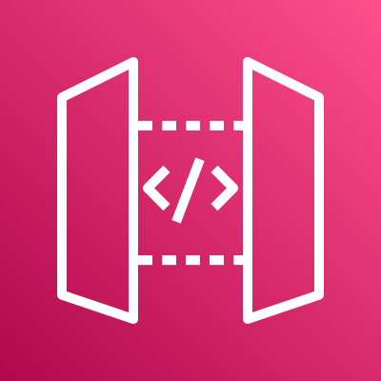
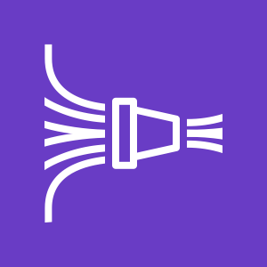
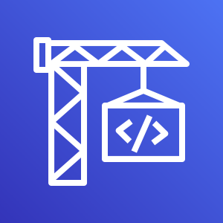


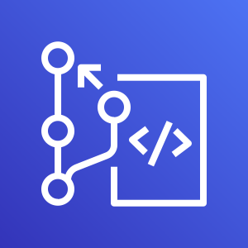





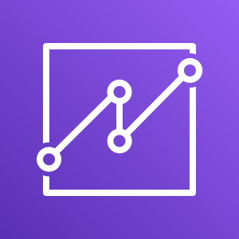

AWS DevOps Monitoring Dashboard
For the architecture description, refer to the full diagram.
Lambda function
data transformation
Git push
Git webhook
1
2
4
GitHub Repository
Amazon API Gateway
Amazon Kinesis
Data Firehose
Customer AWS CI/CD Pipeline
Lambda function
data transformation
Metric Stream
4
1
1
2
AWS CodeBuild
Amazon CloudWatch
Amazon Kinesis
Data Firehose
Events
1
3
Amazon CloudWatch
synthetics canary
Development
Team
AWS CodeCommit
Lambda function
data transformation
Events
Events Rule
4
1
1
2
AWS CodeDeploy
Amazon EventBridge
Amazon Kinesis
Data Firehose
Amazon CloudWatch
AWS CodePipeline
Event Sources
5
5
6
Management Team
Amazon S3
Amazon Athena
Amazon QuickSight
© 2022, Amazon Web Services, Inc. or its affiliates. All rights reserved.
Notes:
A developer initiates an activity in AWS CI/CD pipeline such as push code changes. These activities create Amazon CloudWatch events.
An Amazon EventBridge event rule detects the CloudWatch events and sends the event data to an Amazon Kinesis Firehose Delivery Stream. One event rule per event source.
An event rule is also created to capture event data from Amazon CloudWatch Synthetics Canary if customer has set up the canary – only needed for MTTR.
The Firehose uses a Lambda function for data transformation. It extracts relevant data and sends it to an Amazon S3 bucket.
An Amazon Athena database queries the S3 data and returns the query result to an Amazon QuickSight.
An Amazon QuickSight obtains the query result and builds dashboard displays for the management team.

Slide 2
Resources
To get started with customizing your architecture diagram, refer to the following resources.
For all service icons, refer to AWS Architecture Icons.
For more architecture diagrams, refer to AWS Architecture Center.
For more AWS best practices, refer to AWS Well-Architected.
If you have suggestions about making this experience better, provide feedback.

