Slide 1







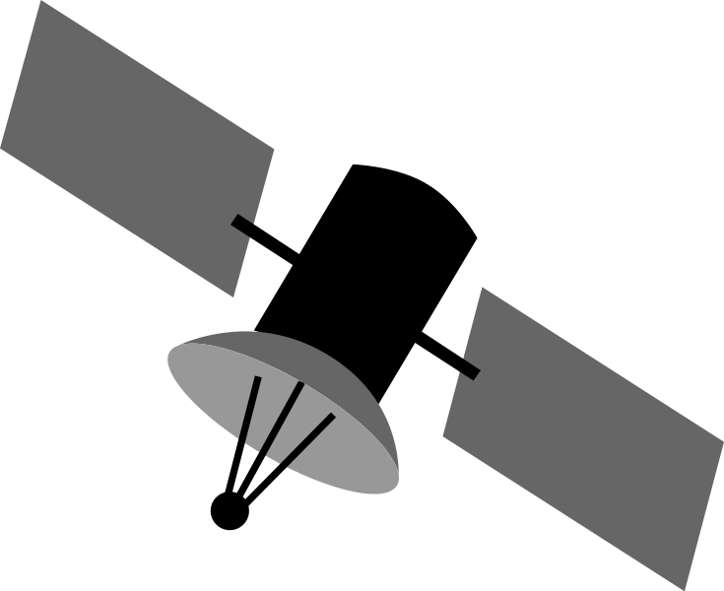














Connected Aircraft Solution
For the architecture description, refer to the full diagram.
third-party
subscribers
AWS Cloud
aircraft
7
5
data exchange
AWS Marketplace
FreeRTOS
sensors
Amazon S3
ML models
Amazon SageMaker
train predictive models
4
avionics
systems
real-time events
Athena
Amazon S3
staged flight data
ARINC 429/717
AWS IoT Core
message broker
AWS Glue
anonymization and queries
AWS IoT Greengrass
local gateway
AWS Lambda
anonymize sensitive flight data
2
AWS Lambda
business logic
engine flight data
3
Amazon S3
processed flight data
1
Amazon S3
raw engine flight data
Kinesis Data Analytics
flight processing
flight data
Flight Operations Quality Assurance (FOQA)
Amazon S3
raw flight data
Amazon API Gateway
Amazon Simple Notification Service
fault notifications
QuickSight
fleet-wide analytics
8
6
Engine Health Management team
app developers/ consumers
flight ops
© 2022, Amazon Web Services, Inc. or its affiliates. All rights reserved.
Notes:
A developer initiates an activity in AWS CI/CD pipeline such as push code changes. These activities create Amazon CloudWatch events.
An Amazon EventBridge event rule detects the CloudWatch events and sends the event data to an Amazon Kinesis Firehose Delivery Stream. One event rule per event source.
An event rule is also created to capture event data from Amazon CloudWatch Synthetics Canary if customer has set up the canary – only needed for MTTR.
The Firehose uses a Lambda function for data transformation. It extracts relevant data and sends it to an Amazon S3 bucket.
An Amazon Athena database queries the S3 data and returns the query result to an Amazon QuickSight.
An Amazon QuickSight obtains the query result and builds dashboard displays for the management team.

Slide 2
Resources
To get started with customizing your architecture diagram, refer to the following resources.
For all service icons, refer to AWS Architecture Icons.
For more architecture diagrams, refer to AWS Architecture Center.
For more AWS best practices, refer to AWS Well-Architected.
If you have suggestions about making this experience better, provide feedback.

