Slide 1

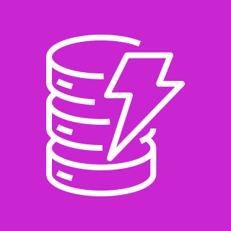













Electric Vehicle Charging Station Management System (Option 1)
For the architecture description, refer to the full diagram.
EVSE registry
1
3
OCPP connection handler
AWS Fargate
Amazon DynamoDB
AWS Certificate Manager
Elastic Load Balancing
EVSE management
AWS Fargate
4
charging station (EVSE)
Amazon DynamoDB
AWS Lambda
7
AWS Fargate
Amazon DynamoDB
Amazon CloudWatch
Amazon S3
fleet management
Web application
2
Elastic Load Balancing
Smart charging
5
Amazon CloudFront
Amazon API Gateway
AWS Fargate
Amazon DynamoDB
smart meters
charge point operators
Transaction management and audit
Amazon Cognito
Amazon S3
6
AWS Fargate
Amazon QLDB
roaming networks
© 2024, Amazon Web Services, Inc. or its affiliates. All rights reserved.
Notes:
A developer initiates an activity in AWS CI/CD pipeline such as push code changes. These activities create Amazon CloudWatch events.
An Amazon EventBridge event rule detects the CloudWatch events and sends the event data to an Amazon Kinesis Firehose Delivery Stream. One event rule per event source.
An event rule is also created to capture event data from Amazon CloudWatch Synthetics Canary if customer has set up the canary – only needed for MTTR.
The Firehose uses a Lambda function for data transformation. It extracts relevant data and sends it to an Amazon S3 bucket.
An Amazon Athena database queries the S3 data and returns the query result to an Amazon QuickSight.
An Amazon QuickSight obtains the query result and builds dashboard displays for the management team.

Slide 2



Electric Vehicle Charging Station Management System (Option 2)
For the architecture description, refer to the full diagram.
OCPP connection handler
EVSE registry
1
3
Elastic Load Balancing
AWS Fargate
7
AWS Lambda
Amazon DynamoDB
AWS Certificate Manager
EVSE management
Amazon SNS
FIFO
4
charging station (EVSE)
Amazon SQS
FIFO
Amazon DynamoDB
AWS Lambda
Amazon SQS
FIFO
AWS Lambda
Amazon DynamoDB
Amazon CloudWatch
Amazon S3
fleet management
Web application
Smart charging
2
5
Amazon CloudFront
Amazon API Gateway
Amazon SQS
FIFO
AWS Lambda
Amazon DynamoDB
smart meters
charge point operators
Elastic Load Balancing
Transaction management and audit
Amazon Cognito
Amazon S3
6
Amazon SQS
FIFO
AWS Step Functions
AWS Lambda
Amazon QLDB
roaming networks
© 2024, Amazon Web Services, Inc. or its affiliates. All rights reserved.
Notes:
A developer initiates an activity in AWS CI/CD pipeline such as push code changes. These activities create Amazon CloudWatch events.
An Amazon EventBridge event rule detects the CloudWatch events and sends the event data to an Amazon Kinesis Firehose Delivery Stream. One event rule per event source.
An event rule is also created to capture event data from Amazon CloudWatch Synthetics Canary if customer has set up the canary – only needed for MTTR.
The Firehose uses a Lambda function for data transformation. It extracts relevant data and sends it to an Amazon S3 bucket.
An Amazon Athena database queries the S3 data and returns the query result to an Amazon QuickSight.
An Amazon QuickSight obtains the query result and builds dashboard displays for the management team.

Slide 3





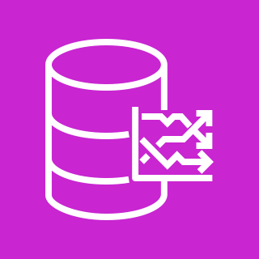













Electric Vehicle Charging Station Management System with AWS IoT
For the architecture description, refer to the full diagram.
AWS Cloud
Connectivity
Operations
Application
Provisioning and registration
Data telemetry
Charge points fleet management
2
5
1
AWS Lambda
JITP
AWS
Private CA
IoT thing, policy,
certificate
Amazon Timestream
Amazon S3
Amazon
CloudFront
Amazon
Cognito
Amazon
QuickSight
charge point operators
Charge point
3
Messaging
Remote commands and registry
Payment and billing
MQTT client
mTLS
6
IoT device shadow
AWS
Lambda
Amazon
DynamoDB
AWS
Lambda
Amazon
DynamoDB
Amazon API
Gateway
AWS IoT
Core
IoT rule
9
OTA update
Reservations and transactions
mobility solution provider
HTTP client
7
mTLS
AWS IoT Device
Management
Reserved IoT topic
IoT job
Amazon S3
Amazon SQS
AWS
Lambda
Amazon
DynamoDB
x509 certificate
Certificate rotation
Monitoring and logging
EV routing, energy demand forecasting
4
8
Amazon
SNS
AWS
Lambda
AWS IoT
Device Defender
AWS IoT
Device Defender
Amazon
CloudWatch
Amazon
SageMaker
AWS
Lambda
Amazon API
Gateway
utilities and vehicles OEMs
© 2024, Amazon Web Services, Inc. or its affiliates. All rights reserved.
Notes:
A developer initiates an activity in AWS CI/CD pipeline such as push code changes. These activities create Amazon CloudWatch events.
An Amazon EventBridge event rule detects the CloudWatch events and sends the event data to an Amazon Kinesis Firehose Delivery Stream. One event rule per event source.
An event rule is also created to capture event data from Amazon CloudWatch Synthetics Canary if customer has set up the canary – only needed for MTTR.
The Firehose uses a Lambda function for data transformation. It extracts relevant data and sends it to an Amazon S3 bucket.
An Amazon Athena database queries the S3 data and returns the query result to an Amazon QuickSight.
An Amazon QuickSight obtains the query result and builds dashboard displays for the management team.

Slide 4
Resources
To get started with customizing your architecture diagram, refer to the following resources.
For all service icons, refer to AWS Architecture Icons.
For more architecture diagrams, refer to AWS Architecture Center.
For more AWS best practices, refer to AWS Well-Architected.
If you have suggestions about making this experience better, provide feedback.

