Slide 1


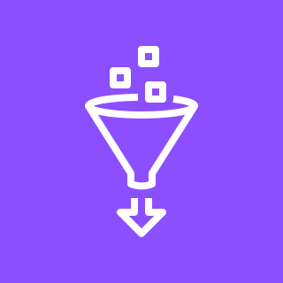

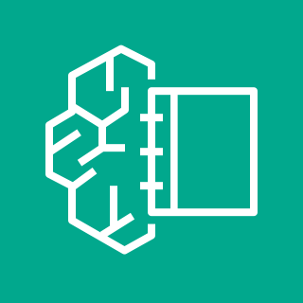
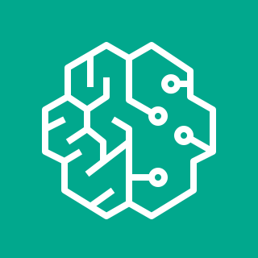
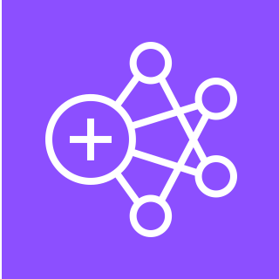
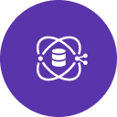


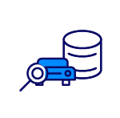



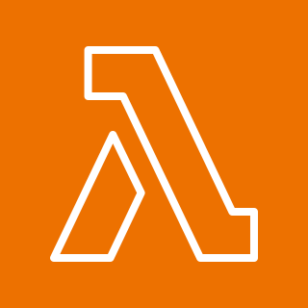
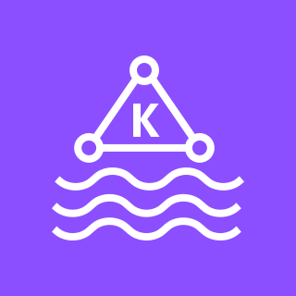
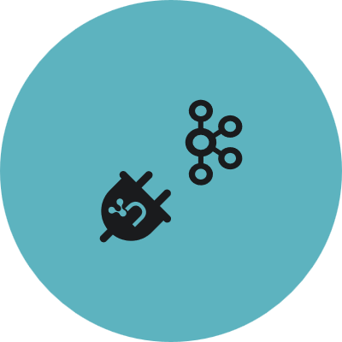


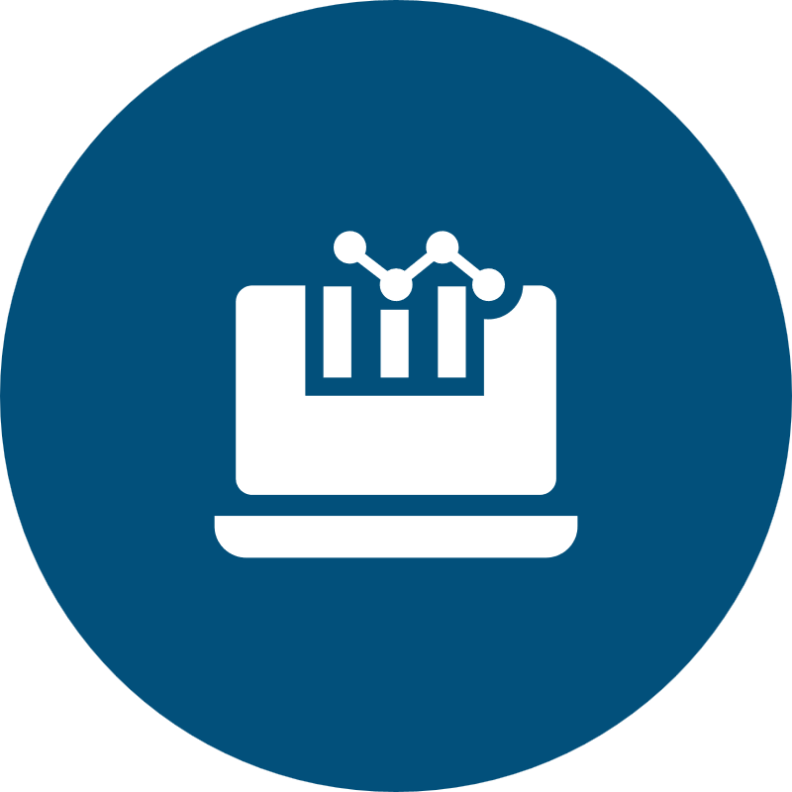

Fraud Ring Detection using Neo4j and Graphs
For the architecture description, refer to the full diagram.
AWS Cloud
1
2
Training and model data
Data sources
Ingest
Amazon S3
6
Graph embeddings data
Fraud detection predictive engine
Customer
transactions
AWS Glue
5
Neo4j Aura
Graph Data Science
3
Customer accounts
Neo4j Connectors
Amazon SageMaker
Studio
Amazon SageMaker
Amazon EMR
Batch data
7
SQL DB
Fraud detection application service
Geo data
4
Amazon Kinesis
Neo4j
Driver
Neo4j GraphQL
Library
NoSQL DB
AWS
Lambda
Neo4j Aura
Graph Database
Banking app transactions
Amazon MSK
8
Analyst tools
Data streams
Neo4j Bloom
Customer apps
© 2023, Amazon Web Services, Inc. or its affiliates. All rights reserved.
Notes:
A developer initiates an activity in AWS CI/CD pipeline such as push code changes. These activities create Amazon CloudWatch events.
An Amazon EventBridge event rule detects the CloudWatch events and sends the event data to an Amazon Kinesis Firehose Delivery Stream. One event rule per event source.
An event rule is also created to capture event data from Amazon CloudWatch Synthetics Canary if customer has set up the canary – only needed for MTTR.
The Firehose uses a Lambda function for data transformation. It extracts relevant data and sends it to an Amazon S3 bucket.
An Amazon Athena database queries the S3 data and returns the query result to an Amazon QuickSight.
An Amazon QuickSight obtains the query result and builds dashboard displays for the management team.

Slide 2
Steps
This reference architecture enables the detection of fraud rings using graphs.
Fraud Detection, graph embeddings, and other graph algorithms can improve ML model performance beyond what’s possible with more traditional approaches.
Banking transactions, customer accounts, and banking apps clickstream data flow from input data sources.
AWS Glue and Amazon EMR ingest, transform, and enrich batch data. Amazon Kinesis and Amazon MSK read real-time data.
Connectors for Spark Datawarehouse and Java Database Connectivity (JDBC) load bulk and batch data to Neo4j. You can also use database APIs.
Neo4j Kafka Connector or Neo4j Spark Connector streaming APIs ingest clickstream and near real-time transaction and application data from Amazon Kinesis or Amazon MSK to the Neo4j database.
The Neo4j Aura Graph Database (GDB) and Neo4j Aura Graph Data Science (GDS) allow you to store, query, analyze, and manage highly-connected data. Neo4j Aura is deployed as a SaaS on AWS.
Data scientists create novel graph features using embedding algorithms in GDS via Amazon SageMaker Studio notebooks. Embeddings are exported to Amazon SageMaker for improved accuracy. Data scientists can leverage additional graph algorithms, including community detection and similarity in GDS. Data scientists can write graph features back to GDB or relational systems where they can be easily visualized and analyzed.
Scientists can further enhance predictive results by matching patterns and additional information with the graph data. Developers can use Neo4j GraphQL library and drivers to access Neo4j with Java, Node, JavaScript, C#, Python, Go, Ruby, PHP, Erlang, and Perl from AWS Lambda or any application.
Neo4j Bloom visualization and customer dashboard tools allow analysts to explore data and present findings.
Links to related content:
Neo4j on AWS Marketplace
Neo4j and Amazon
Neo4j and Fraud Detection

Slide 3
Resources
To get started with customizing your architecture diagram, refer to the following resources.
For all service icons, refer to AWS Architecture Icons.
For more architecture diagrams, refer to AWS Architecture Center.
For more AWS best practices, refer to AWS Well-Architected.
If you have suggestions about making this experience better, provide feedback.

