Slide 1








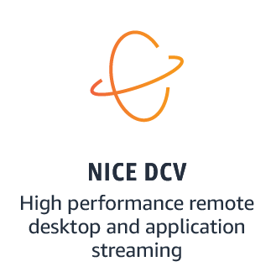




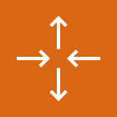









Game Production in the Cloud – Workstations
Stream Game Development from anywhere with NICE DCV
For the architecture description, refer to the full diagram.
1
AWS Workstations account
remote or work
from home
Region
Availability Zone
Availability Zone
VPC
public subnet
public subnet
remote desktop client
connection using QUIC UDP
3
Internet
gateway
Amazon Route 53
NAT gateway
NAT gateway
4
private – Workstations subnet
6
Private – Workstations subnet
AWS Directory Service for
Microsoft Active Directory
Stream Fleets
Auto-Scaling
Group
7
or streamed TCP
connection using browser
EC2 G4 instances
virtual workstations
EC2 G4 Instances
virtual workstations
NICE DCV
session manager
broker
Client VPN
network interfaces
2
work from home
developer
AWS Client
VPN
Amazon EC2 Image Builder
local game
project repos
8
5
+
NICE DCV
server
engine software, drivers, registry changes
Amazon
Machine Image
Amazon FSx for
Windows File Server
Multi-AZ Config
Amazon S3
AppData
software preferences
© 2023, Amazon Web Services, Inc. or its affiliates. All rights reserved.
Notes:
A developer initiates an activity in AWS CI/CD pipeline such as push code changes. These activities create Amazon CloudWatch events.
An Amazon EventBridge event rule detects the CloudWatch events and sends the event data to an Amazon Kinesis Firehose Delivery Stream. One event rule per event source.
An event rule is also created to capture event data from Amazon CloudWatch Synthetics Canary if customer has set up the canary – only needed for MTTR.
The Firehose uses a Lambda function for data transformation. It extracts relevant data and sends it to an Amazon S3 bucket.
An Amazon Athena database queries the S3 data and returns the query result to an Amazon QuickSight.
An Amazon QuickSight obtains the query result and builds dashboard displays for the management team.

Slide 2
Resources
To get started with customizing your architecture diagram, refer to the following resources.
For all service icons, refer to AWS Architecture Icons.
For more architecture diagrams, refer to AWS Architecture Center.
For more AWS best practices, refer to AWS Well-Architected.
If you have suggestions about making this experience better, provide feedback.

