Slide 1

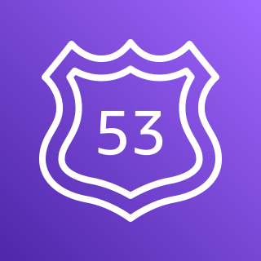

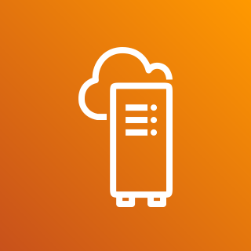
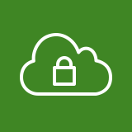







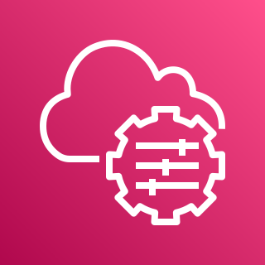
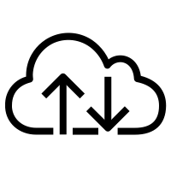


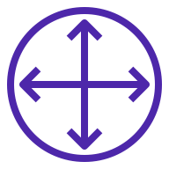

Local Clusters for Amazon EKS on AWS Outposts
For the architecture description, refer to the full diagram.
AWS Region
Customer on-premises network
Amazon
Route 53
subnet routing table
destination | target
192.168.0.0/16 | local
pl-1a2b3c4d | vpce-11bb22cc (s3)
172.16.0.0/24 | LGW
Avaliability Zone 1
2
AWS Outposts
VPC CIDR 192.168.0.0/16
private subnet
Outpost subnet 1
Outpost subnet 2
Logs
service endpoint interfaces
Kubernetes control plane
3
192.168.2.0/24
STS
Amazon EC2 instances
security group
source | protocol
192.168.1.0/24 | https
192.168.2.0/24 | https
1
SSM
AWS Outposts service link
4
EC2
VPC extended
from Region
to Outpost
Kubernetes data plane
Secrets
Manager
self-managed node group
192.168.10.0/24
ECR.API
subnet routing table
destination | target
192.168.0.0/16 | local
192.168.1.0/24
Amazon
S3
local gateway
ECR.DKR
5
EKS
S3
internet egress
client (Kubernetes)
customer edge router
172.16.0.5/24
© 2023, Amazon Web Services, Inc. or its affiliates. All rights reserved.
Notes:
A developer initiates an activity in AWS CI/CD pipeline such as push code changes. These activities create Amazon CloudWatch events.
An Amazon EventBridge event rule detects the CloudWatch events and sends the event data to an Amazon Kinesis Firehose Delivery Stream. One event rule per event source.
An event rule is also created to capture event data from Amazon CloudWatch Synthetics Canary if customer has set up the canary – only needed for MTTR.
The Firehose uses a Lambda function for data transformation. It extracts relevant data and sends it to an Amazon S3 bucket.
An Amazon Athena database queries the S3 data and returns the query result to an Amazon QuickSight.
An Amazon QuickSight obtains the query result and builds dashboard displays for the management team.

Slide 2
Resources
To get started with customizing your architecture diagram, refer to the following resources.
For all service icons, refer to AWS Architecture Icons.
For more architecture diagrams, refer to AWS Architecture Center.
For more AWS best practices, refer to AWS Well-Architected.
If you have suggestions about making this experience better, provide feedback.

