Slide 1


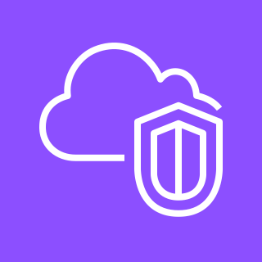
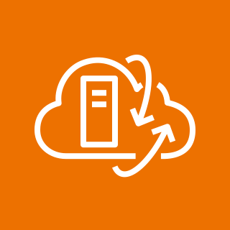





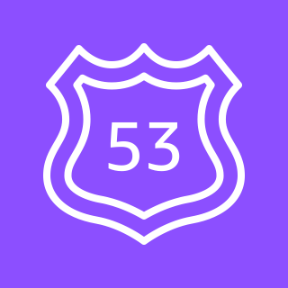
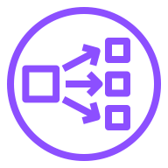



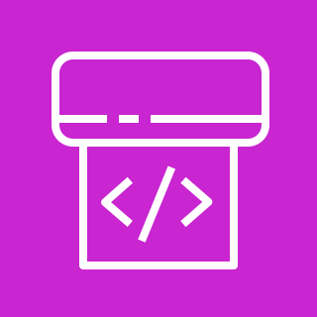

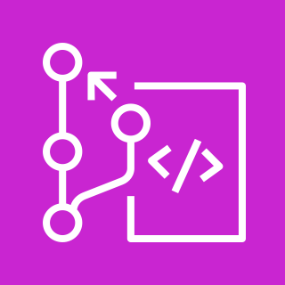
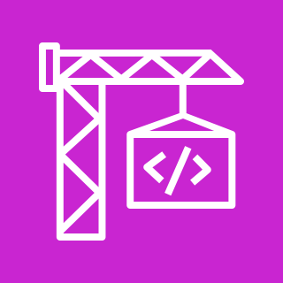


Modernize Applications with Microservices Using Amazon EKS
For the architecture description, refer to the full diagram.
AWS Region
users
Amazon VPC
customer account
VMware Cloud on AWS SDDC
Private subnet
compute network (NSX-T overlay)
2
Managed Amazon EKS Cluster
deployment-ui
deployment-app
compute
gateway
6
5
1
vm
vm
3
service-ui
service-app
database workloads
Network Load Balancer
Kubernetes
Ingress
Elastic
network
interface
NSX-T Tier-0
Router
4
Amazon Route 53
pods-ui
pods-app
SDDC ESXi clusters
10
10
11
AWS CodePipeline
8
9
7
Amazon EC2
bare metal instances
dev team
AWS CodeCommit
AWS CodeBuild
Amazon ECR
© 2023, Amazon Web Services, Inc. or its affiliates. All rights reserved.
Notes:
A developer initiates an activity in AWS CI/CD pipeline such as push code changes. These activities create Amazon CloudWatch events.
An Amazon EventBridge event rule detects the CloudWatch events and sends the event data to an Amazon Kinesis Firehose Delivery Stream. One event rule per event source.
An event rule is also created to capture event data from Amazon CloudWatch Synthetics Canary if customer has set up the canary – only needed for MTTR.
The Firehose uses a Lambda function for data transformation. It extracts relevant data and sends it to an Amazon S3 bucket.
An Amazon Athena database queries the S3 data and returns the query result to an Amazon QuickSight.
An Amazon QuickSight obtains the query result and builds dashboard displays for the management team.

Slide 2
Resources
To get started with customizing your architecture diagram, refer to the following resources.
For all service icons, refer to AWS Architecture Icons.
For more architecture diagrams, refer to AWS Architecture Center.
For more AWS best practices, refer to AWS Well-Architected.
If you have suggestions about making this experience better, provide feedback.

