Slide 1










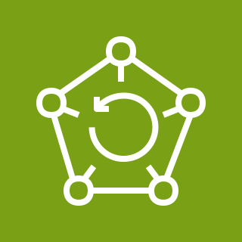






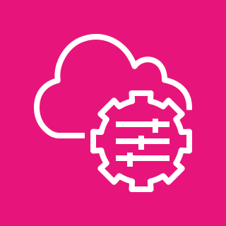


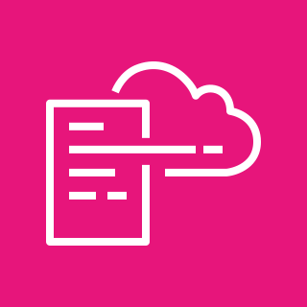

Oracle E-Business Suite on AWS
For the architecture description, refer to the full diagram.
4
5
internet
AWS Cloud
1
2
AWS WAF
Amazon Route 53
Region
Availability Zone 1
Availability Zone 2
VPC
Public subnet
internet gateway
Public subnet
3
AWS
Directory Service
NAT gateway
NAT gateway
10
Public subnet
Public subnet
AWS Backup
EC2 DMZ APPL_TOP
EC2 DMZ APPL_TOP
external
load balancer
EC2 DMZ APPL_TOP
EC2 DMZ APPL_TOP
7
6
Amazon Simple Storage Service
Private subnet
Private subnet
9
users
Amazon
WorkSpaces
client
AWS
Systems Manager
EC2 APPL_TOP
EC2 APPL_TOP
internal
load balancer
EC2 APPL_TOP
EC2 APPL_TOP
8
Amazon CloudWatch
Private subnet
Private subnet
EC2 Oracle
Oracle Data Guard synchronous replication
EC2 Oracle
AWS CloudFormation
© 2023, Amazon Web Services, Inc. or its affiliates. All rights reserved.
Notes:
A developer initiates an activity in AWS CI/CD pipeline such as push code changes. These activities create Amazon CloudWatch events.
An Amazon EventBridge event rule detects the CloudWatch events and sends the event data to an Amazon Kinesis Firehose Delivery Stream. One event rule per event source.
An event rule is also created to capture event data from Amazon CloudWatch Synthetics Canary if customer has set up the canary – only needed for MTTR.
The Firehose uses a Lambda function for data transformation. It extracts relevant data and sends it to an Amazon S3 bucket.
An Amazon Athena database queries the S3 data and returns the query result to an Amazon QuickSight.
An Amazon QuickSight obtains the query result and builds dashboard displays for the management team.

Slide 2
Resources
To get started with customizing your architecture diagram, refer to the following resources.
For all service icons, refer to AWS Architecture Icons.
For more architecture diagrams, refer to AWS Architecture Center.
For more AWS best practices, refer to AWS Well-Architected.
If you have suggestions about making this experience better, provide feedback.

