Slide 1















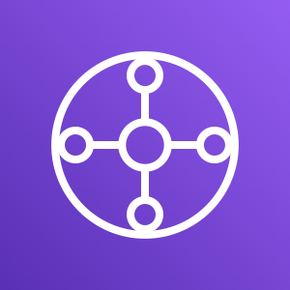
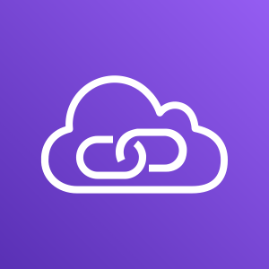
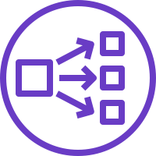










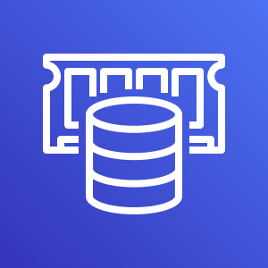
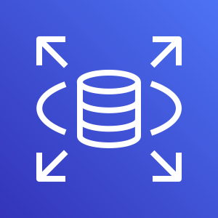

Payment System Interface Modernization on AWS:
Modern Cloud-Native Payment Systems
For the architecture description, refer to the full diagram.
bank data center
1
banks
users
payment authority
2
HSM
analytic systems
request gateway
core banking system
VPC
5
3
13
endpoint
AWS WAF
AWS Direct
Connect
AWS Transit
Gateway
AWS IAM
AWS KMS
Amazon API Gateway
4
serverless
NLB
14
authorization
AWS Lambda
VPC
8
6
Amazon ECR
Amazon EKS
ALB
7
11
ingress
Availability Zone
Availability Zone
Amazon Elastic Compute Cloud (EC2) Auto Scaling
15
egress
Amazon MSK
payment
Account
payment
balance
balance
Account
SMS
volume
short message service (SMS)
onboarding
merchant
SMS
onboarding
merchant
12
OpenSearch Service
CloudWatch
10
9
ElastiCache
RDS
Amazon RDS
RDS
standby
primary
replica
© 2023, Amazon Web Services, Inc. or its affiliates. All rights reserved.
RDS
Notes:
A developer initiates an activity in AWS CI/CD pipeline such as push code changes. These activities create Amazon CloudWatch events.
An Amazon EventBridge event rule detects the CloudWatch events and sends the event data to an Amazon Kinesis Firehose Delivery Stream. One event rule per event source.
An event rule is also created to capture event data from Amazon CloudWatch Synthetics Canary if customer has set up the canary – only needed for MTTR.
The Firehose uses a Lambda function for data transformation. It extracts relevant data and sends it to an Amazon S3 bucket.
An Amazon Athena database queries the S3 data and returns the query result to an Amazon QuickSight.
An Amazon QuickSight obtains the query result and builds dashboard displays for the management team.

Slide 2
Resources
To get started with customizing your architecture diagram, refer to the following resources.
For all service icons, refer to AWS Architecture Icons.
For more architecture diagrams, refer to AWS Architecture Center.
For more AWS best practices, refer to AWS Well-Architected.
If you have suggestions about making this experience better, provide feedback.

