Slide 1





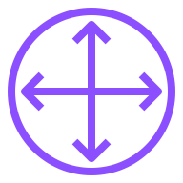
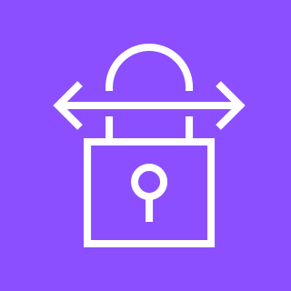















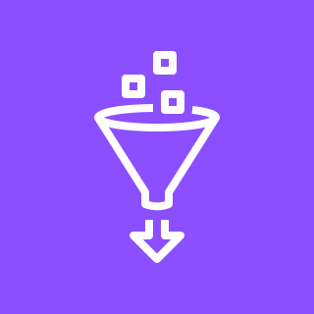





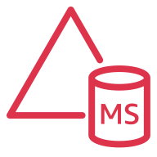

Power Grid Simulation with High Performance Computing on AWS
For the architecture description, refer to the full diagram.
corporate data center
SMB or NFS
protocol
6
AWS Direct Connect
engineering laptop
file server
Amazon S3
File Gateway
customer gateway
AWS Site-to-Site VPN
AWS Cloud
VPN gateway
https
Amazon Route 53
Region
1
5
VPC
Availability Zone 1
Availability Zone 2
AWS Storage Gateway
Public subnet 1
Public subnet 2
post-HPC analytics/BI reporting
3
HPC Pack head node
Elastic
Load Balancer
HPC Pack
head node (optional)
Amazon SageMaker
Private subnet 1
Private subnet 2
read/write
Amazon S3
raw layer bucket
HPC Pack
compute nodes
Auto Scaling Group
HPC Pack
compute nodes
intermediate results
output
AWS Glue
ETL
Amazon
Athena
Amazon QuickSight
FSx for Windows
Amazon S3
analytics layer bucket
2
domain and access control
4
licensing host
TCP/IP-based licensing
AWS Managed
Microsoft AD
AWS
Secrets Manager
AWS
Directory Service
© 2023, Amazon Web Services, Inc. or its affiliates. All rights reserved.
Notes:
A developer initiates an activity in AWS CI/CD pipeline such as push code changes. These activities create Amazon CloudWatch events.
An Amazon EventBridge event rule detects the CloudWatch events and sends the event data to an Amazon Kinesis Firehose Delivery Stream. One event rule per event source.
An event rule is also created to capture event data from Amazon CloudWatch Synthetics Canary if customer has set up the canary – only needed for MTTR.
The Firehose uses a Lambda function for data transformation. It extracts relevant data and sends it to an Amazon S3 bucket.
An Amazon Athena database queries the S3 data and returns the query result to an Amazon QuickSight.
An Amazon QuickSight obtains the query result and builds dashboard displays for the management team.

Slide 2
Resources
To get started with customizing your architecture diagram, refer to the following resources.
For all service icons, refer to AWS Architecture Icons.
For more architecture diagrams, refer to AWS Architecture Center.
For more AWS best practices, refer to AWS Well-Architected.
If you have suggestions about making this experience better, provide feedback.

