Slide 1



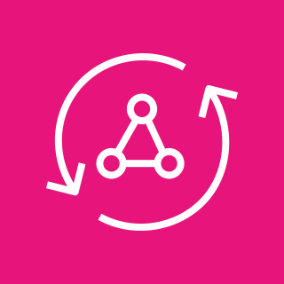
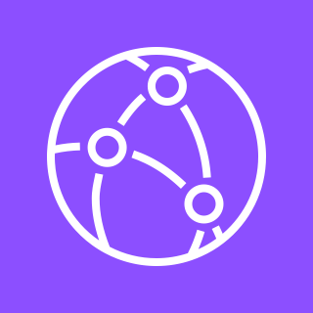

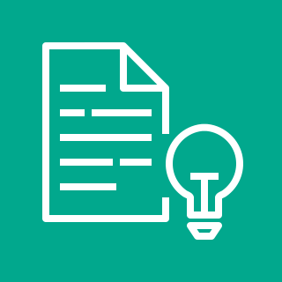
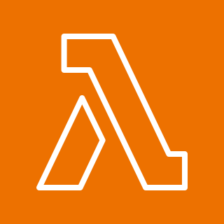
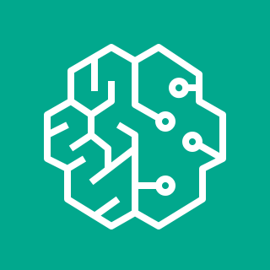
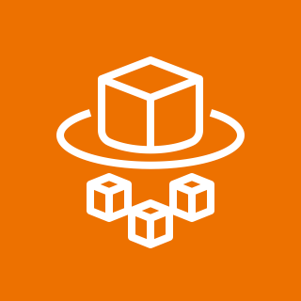
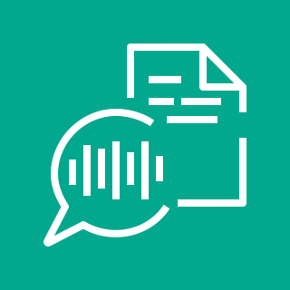
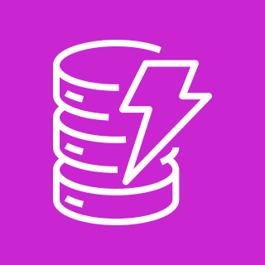
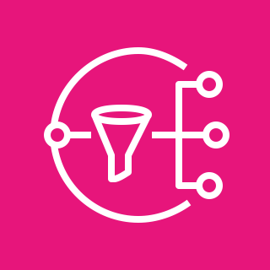
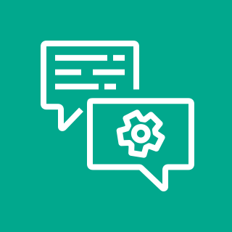


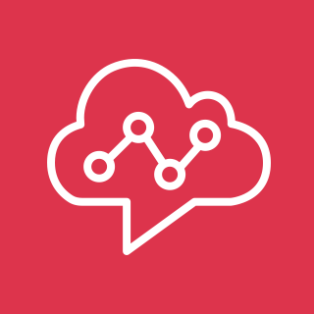



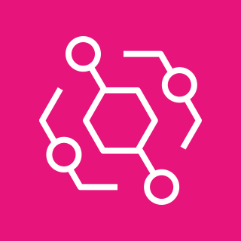

Powering Multiple Contact Centers with GenAI Using Amazon Bedrock
For the architecture description, refer to the full diagram.
Genesys Cloud contact center
AI/ML Stack
Call ingestion
1
Call processing
API
Web app
Integration
Enrichment
5
Summarization
GenAI
8
10
7
AudioHook
Amazon S3
call recordings
AWS Secrets Manager
Amazon Kinesis Data Streams
AWS AppSync
Amazon CloudFront
LCA web application
Amazon Comprehend
sentiment
AWS Lambda
AWS Lambda
custom transcript
AWS Lambda
transcript summary
Amazon Bedrock LLM
4
AWS Fargate
websocket server
Amazon Transcribe
streaming
9
CRM systems
Salesforce
Knowledge sources
Amazon DynamoDB
Amazon CloudFront
Amazon Simple
Notification Service
Amazon S3
webpage bucket
Amazon Connect contact center
Agent assist
6
Amazon CloudFront
customer website FAQ
Call processing
2
Call ingestion
Amazon Kinesis Data Streams
stream/export to search, datalakes
AWS Lambda
QnA bot
Amazon Kendra
Amazon Cognito
authorization
Amazon CloudFront
QnA bot designer
Amazon Lex
Amazon Kendra
other data donnections
Amazon Connect
Amazon Connect
contact lens
Other contact centers
3
Call processing
11
Call ingestion
AWS Lambda
call initialization
Amazon Kinesis
Video Streams
AWS Lambda
call transcriber
Amazon DynamoDB
event recording
agents
Amazon Chime
voice connector
Amazon EventBridge
call signaling events
Amazon S3
call recordings
Amazon Transcribe
© 2023, Amazon Web Services, Inc. or its affiliates. All rights reserved.
© 2023, Amazon Web Services, Inc. or its affiliates. All rights reserved.

Slide 2
Resources
To get started with customizing your architecture diagram, refer to the following resources.
For all service icons, refer to AWS Architecture Icons.
For more architecture diagrams, refer to AWS Architecture Center.
For more AWS best practices, refer to AWS Well-Architected.
If you have suggestions about making this experience better, provide feedback.

