Slide 1









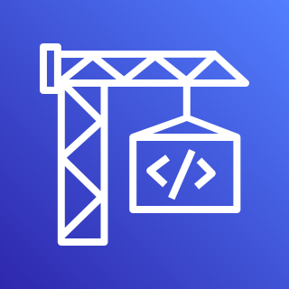






Serverless Web Hosting on AWS App Runner
For the architecture description, refer to the full diagram.
AWS Cloud
AWS App Runner-owned account
AWS App Runner-
owned VPC
1a
1b
1c
1d
3
GitHub
source repo
AWS
CodeStar connection
language
runtime
AWS
CodeBuild
Amazon ECR
secure
service
URL
Customer-owned account
AWS Fargate
tasks
4
2a
Amazon ECR
container
image
2b
Amazon ECR
AWS IAM role
© 2022, Amazon Web Services, Inc. or its affiliates. All rights reserved.
Notes:
A developer initiates an activity in AWS CI/CD pipeline such as push code changes. These activities create Amazon CloudWatch events.
An Amazon EventBridge event rule detects the CloudWatch events and sends the event data to an Amazon Kinesis Firehose Delivery Stream. One event rule per event source.
An event rule is also created to capture event data from Amazon CloudWatch Synthetics Canary if customer has set up the canary – only needed for MTTR.
The Firehose uses a Lambda function for data transformation. It extracts relevant data and sends it to an Amazon S3 bucket.
An Amazon Athena database queries the S3 data and returns the query result to an Amazon QuickSight.
An Amazon QuickSight obtains the query result and builds dashboard displays for the management team.

Slide 2





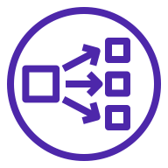






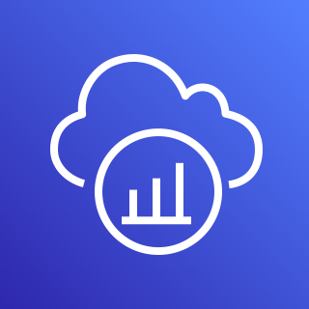
Serverless Web Hosting on AWS App Runner
For the architecture description, refer to the full diagram.
AWS Cloud
Customer-owned VPC
AWS App Runner-owned account
AWS App Runner-owned VPC
2
AWS IAM
Amazon
Route 53
1
AWS Secrets Manager
3
4
internet
service URL
maps to NLB
L7 Request Router
5a
AWS Fargate
tasks
AWS KMS
7
internet
internet
gateway
NAT
gateway
AWS Systems Manager
5b
Customer-owned account
Customer-owned VPC
Amazon CloudWatch
6
private in-VPC dependencies
internet
internet
gateway
NAT Gateway
AWS X-Ray
© 2022, Amazon Web Services, Inc. or its affiliates. All rights reserved.
Notes:
A developer initiates an activity in AWS CI/CD pipeline such as push code changes. These activities create Amazon CloudWatch events.
An Amazon EventBridge event rule detects the CloudWatch events and sends the event data to an Amazon Kinesis Firehose Delivery Stream. One event rule per event source.
An event rule is also created to capture event data from Amazon CloudWatch Synthetics Canary if customer has set up the canary – only needed for MTTR.
The Firehose uses a Lambda function for data transformation. It extracts relevant data and sends it to an Amazon S3 bucket.
An Amazon Athena database queries the S3 data and returns the query result to an Amazon QuickSight.
An Amazon QuickSight obtains the query result and builds dashboard displays for the management team.

Slide 3
Resources
To get started with customizing your architecture diagram, refer to the following resources.
For all service icons, refer to AWS Architecture Icons.
For more architecture diagrams, refer to AWS Architecture Center.
For more AWS best practices, refer to AWS Well-Architected.
If you have suggestions about making this experience better, provide feedback.

