Slide 1
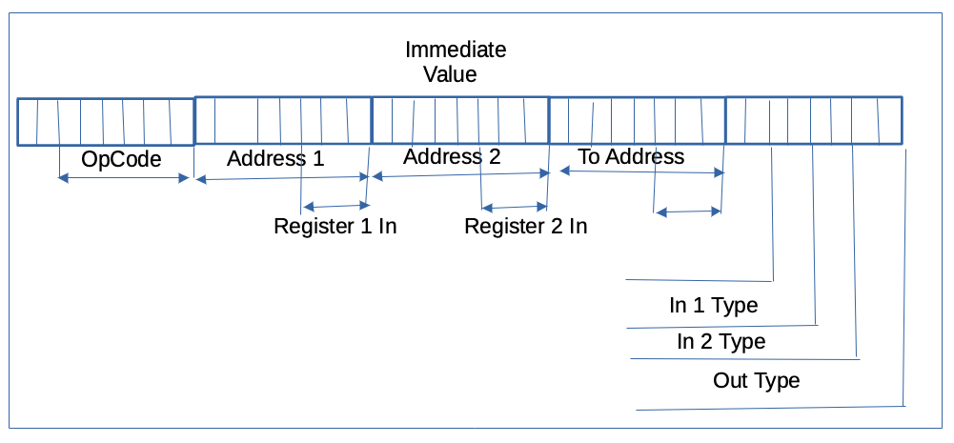
Viewer
Switches
LEDs
Program
Memory
Choice
Clock
Button
ALU
ALU
Parser
CPU
Source1Value | OpCode
Source2Value | +-/...
ImmediateValue
ALUResult
Address1
Register1
Choice1
Address2
Register2
Choice2
AddressOut
RegisterOut
ChoiceOut
ImmediateValue
Clock | Address1 | opCode
Reset | Register1 | aluResult
isReset | Choice1 | realAddress1
resetCode | Address2 | realAddress2
pc | Register2 | realAddressOut
 | Choice2
 | AddressOut
 | RegisterOut
 | ChoiceOut
 | InstructionValue
Alu Recognizer
OpCode
isALU
Memory
Address1
Data1
Address2
Data2
Write Address
Write Data
Write Enable
Stack
PC
Return
Call
Reset
Reg
Call
JUMP
IF0JUMP
IF1JUMP
RESET
Registers
Address Decoder
AluResult
OutRegister
OutType
isALU
Address1Type | Address2Type | AddressOutType
Address1 | Address2 | AddressOut
RegisterAValue | RegisterBValue | RegisterOutValue
RealAddress1 | RealAddress2 | RealOutAddress

