Slide 1

Library Management System – Group Project
Course: Database – Session 14

Slide 2
Group Members
Abu Bakr E Ceesay
Farisahilmi
Rezal Fauzian
Drame Ibrahima
Fathima Saafa
⁠

Slide 3
Introduction
This project demonstrates the creation of a Library Management System using Python and SQLite. The focus was on implementing Data Definition Language (DDL) and Data Manipulation Language (DML).

Slide 4
Database Structure
The system uses five master data tables:
- Authors
- Books
- Members
- Staff
- Loans
Each table is linked using primary and foreign keys.

Slide 5
DDL – Table Creation
The CREATE TABLE command was used to define all five tables with appropriate data types and constraints. FOREIGN KEY constraints ensure referential integrity between tables.

Slide 6
DML – Data Manipulation
- INSERT: to populate each table with sample data
- UPDATE: to change existing member email
- REPLACE: to update a book’s information
- TRUNCATE (DELETE FROM): to clear the Staff table

Slide 7
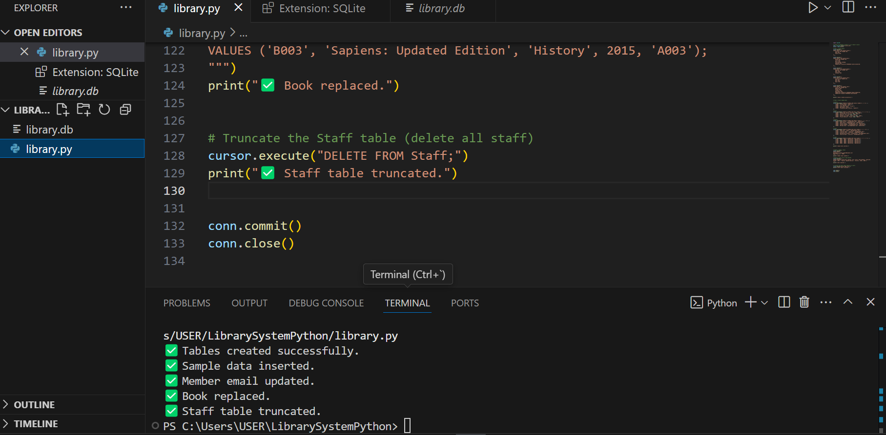
Demo: Screenshots
• Screenshot: Tables Created
• Screenshot: Data Inserted
• Screenshot: After UPDATE / REPLACE / TRUNCATE

Slide 8
Challenges & Solutions
- Had to simulate TRUNCATE in SQLite using DELETE FROM
- Managed foreign key relationships carefully
- Ensured proper data flow across all tables

Slide 9
Conclusion
This project successfully demonstrated DDL and DML in a real-world scenario using Python and SQLite.
We created a multi-table database, handled data operations, and explored key SQL commands with integrity.

Slide 10
Thank You
Questions & Answers

