Slide 1
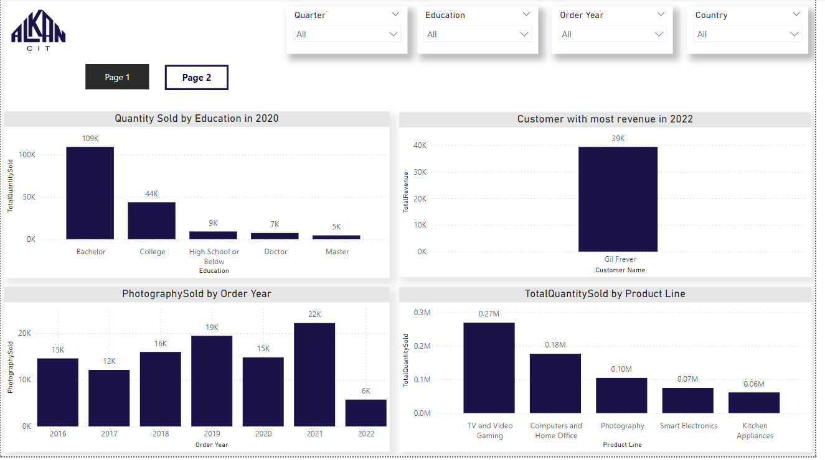
A dashboard that representing insights about order sales consists of two pages with a bookmark buttons to navigate between them and filters to apply conditions

Slide 2
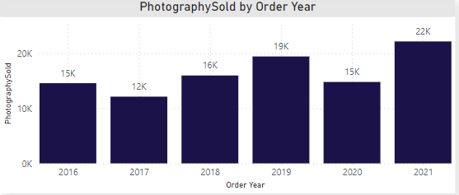
1st Question :
From 2016-2021, which ORDER_YEAR had the lowest QUANTITY_SO0LD for Photography products?
In this visual we can see the sold quantity for photography by year from 2016 to 2021 excluding 2022 and the lowest quantity sold was 12K in year 2017 .

Slide 3
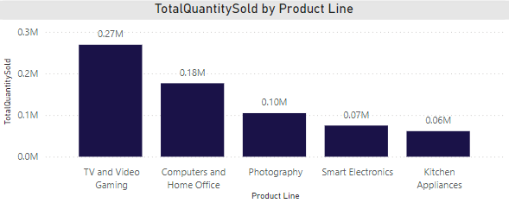
2nd Question :
Which PRODUCT_LINE has the highest QUANTITY_SOLD?
In this visual we can see the sold quantity by product line and the highest quantity sold was .27M in the line of TV and Video Gaming.

Slide 4
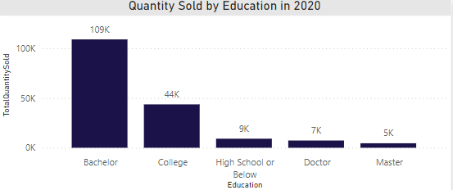
3rd Question :
Which EDUCATION of the loyalty members had the highest amount of QUANTITY_SOLD in 2020?
In this visual we can see the sold quantity by customer education level in 2020 and the highest quantity sold was 109K by Bachelor degree customers.

Slide 5
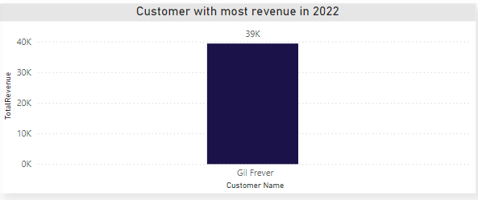
4th Question :
What is the CUSTOMER_NAME who provided the highest REVENUE in 2022?
In this visual we can see the Customer named Gil Frever made the highest revenue in 2022 equal to 39K.

Slide 6
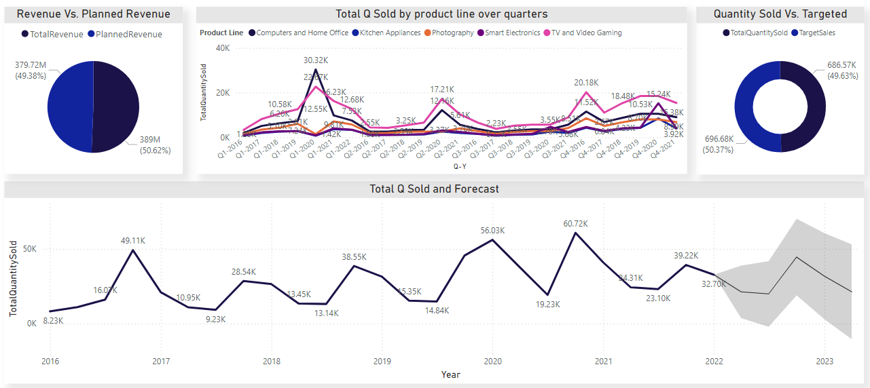
Additional Visualizations
This View Visualize the following points:
- Percentage and values of Revenue vs Planned Revenue.
- Percentage and values of Quantity Sold vs Target Sales.
- Quantity Sold by Order Year and Quarter colored by Product Line
- Forecast and predict the expected quantity sold (Range accepted) for all products in Q2 2023 with confidence level 95% based on historical data.

