Slide 1
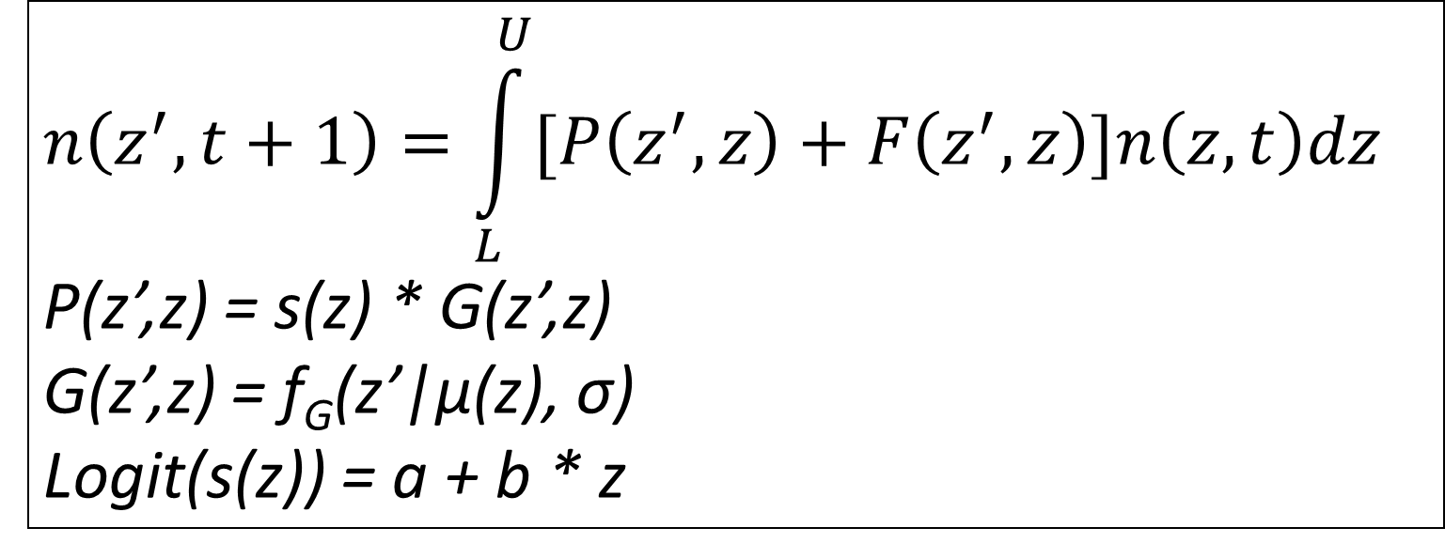
$$n\left(z^{′}, t+1\right)=\int_{L}^{U}{[P\left(z^{′},z\right)+F\left(z^{′},z\right)]n\left(z,t\right)dz}$$
P(z’,z) = s(z) * G(z’,z)
G(z’,z) = f_{G}(z’|μ(z), σ)
Logit(s(z)) = a + b * z
Paper published
Reports information associated with an IPM.
We digitize this into PADRINO.
P = s* G
G = Norm(mu_g, sigma_g)
s = 1 / (1 + exp(-(a_s + b_s * z_1)))
PADRINO
Stores IPM metadata, implementation details, and functional forms.
Available for download using the RPadrino package.
pdbDigitUtils
Tests models after entry by digitization team to verify IPM behavior.
define_kernel(
“P”,
P = s * G
G = dnorm(z_2, mu_g, sigma_g)
S = 1 / (1 + exp(-(a_s + b_s * z_1))),
data_list = parameter_list)
RPadrino
Downloads, saves, loads, and subsets IPMs in PADRINO.
Translates PADRINO syntax into ipmr syntax (pdb_make_proto_ipm()).
Provides ipmr-like analysis functionality for PADRINO objects (pdb_make_ipm()).
lambda(), right_ev(), left_ev(), make_iter_kernel(), mean_kernel(), other packages
ipmr
General engine for implementing IPMs with R.
Is not specific to PADRINO or RPadrino.

