Slide 1
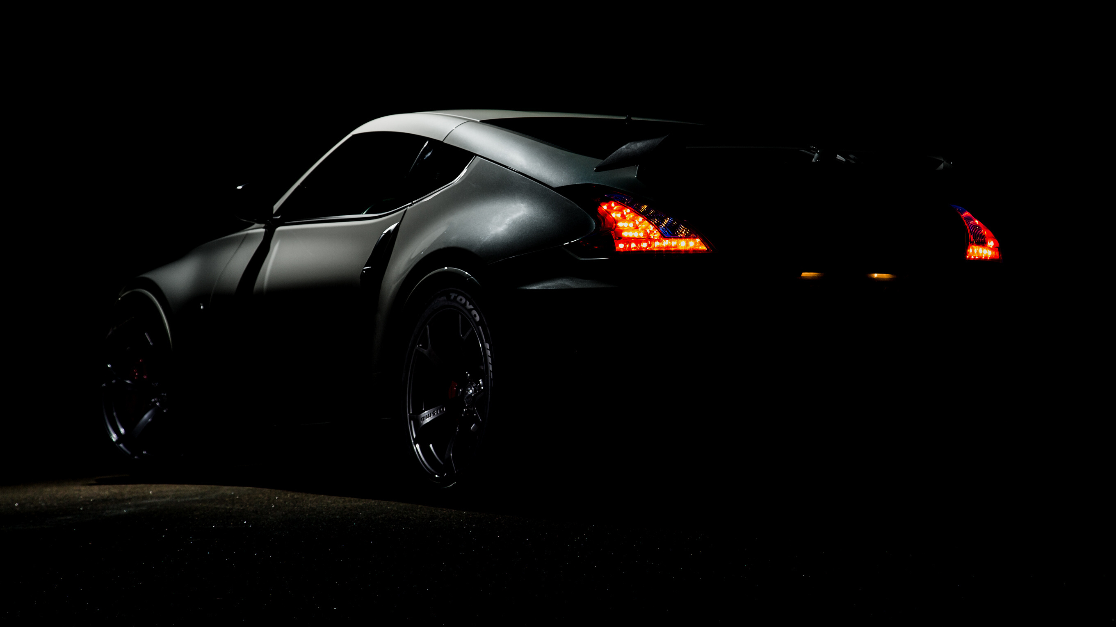
Driver Drowsiness Detection

Slide 2
Goal
Labelled two classes (open&closed) , based on the eyelid-closure
Sleepy (eyes closed consistently)
Active (eyes open consistently)
Signs of Drowsiness:
Difficulty keeping eyes open
Yawning
Frequent blinking
Difficulty concentrating
Swerving out of the lane and delayed reaction to traffic
Nodding

Slide 3


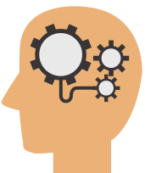
Mind Map
Modelling
Transfer Learning
(Binary Classification)
Webcam
Haarcascade algorithm
Load the images

Slide 4
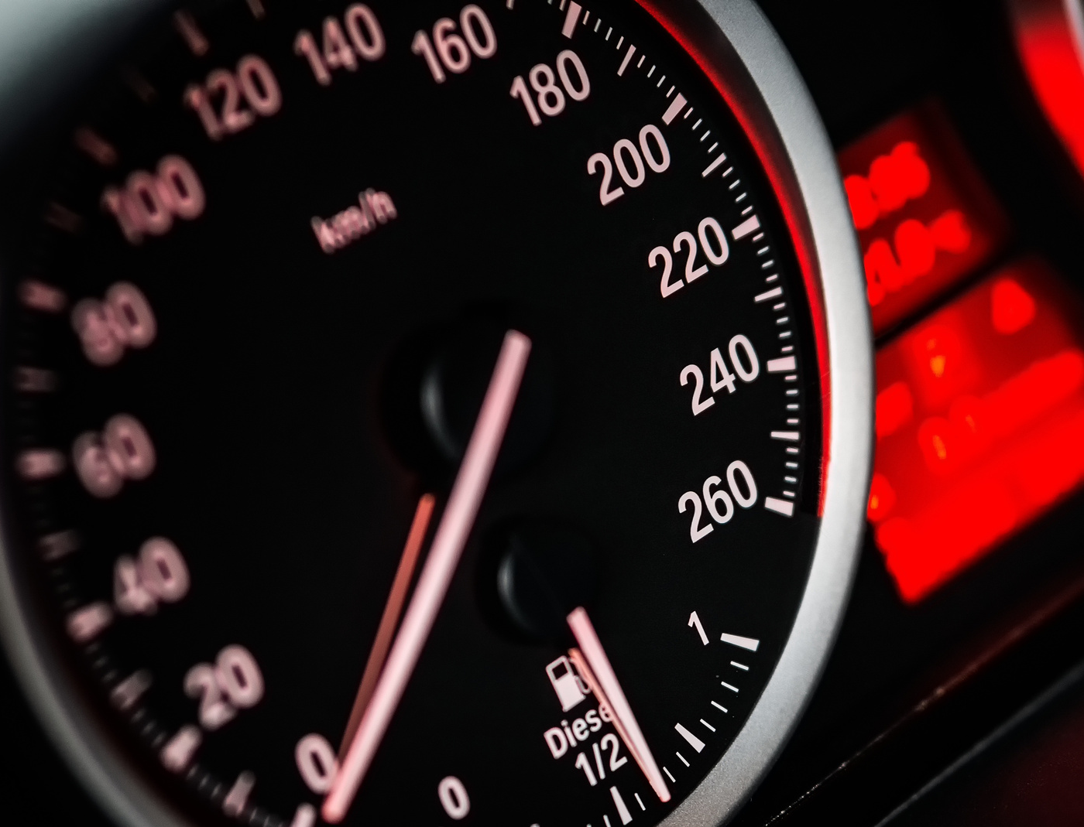
Tools
Anaconda
Package of multiple libraries
IDEs
Jupyter notebook
VSCode
Libraries
Tensorflow
Opencv
Numpy
Pygame

Slide 5
Transfer Learning
Takes weights and architecture of pre-trained network
Learns from previous training images
Nature of the problem should be the same
Use last fully connected (FC) layer

Slide 6
Flowchart
Facial Image
input
webcam
Open
Active
video
Face/Eye
Detection
Pre-Processing
split eyes into left and right
Deep Learning
Model
webcam
Eye Status
Closed
Drowsy
Alarm

Slide 7



DRIVE SAFELY
SLEEP WITH YOUR
LOVED ONES
THANK YOU VERY MUCH
FOR YOUR ATTENTION

